Slide 1

Project Iowa
Data-driven recommendations to improve SAT participation rates
by Albin Wan

Slide 2

Which state can we generate the highest gain in participation rates?

Slide 3
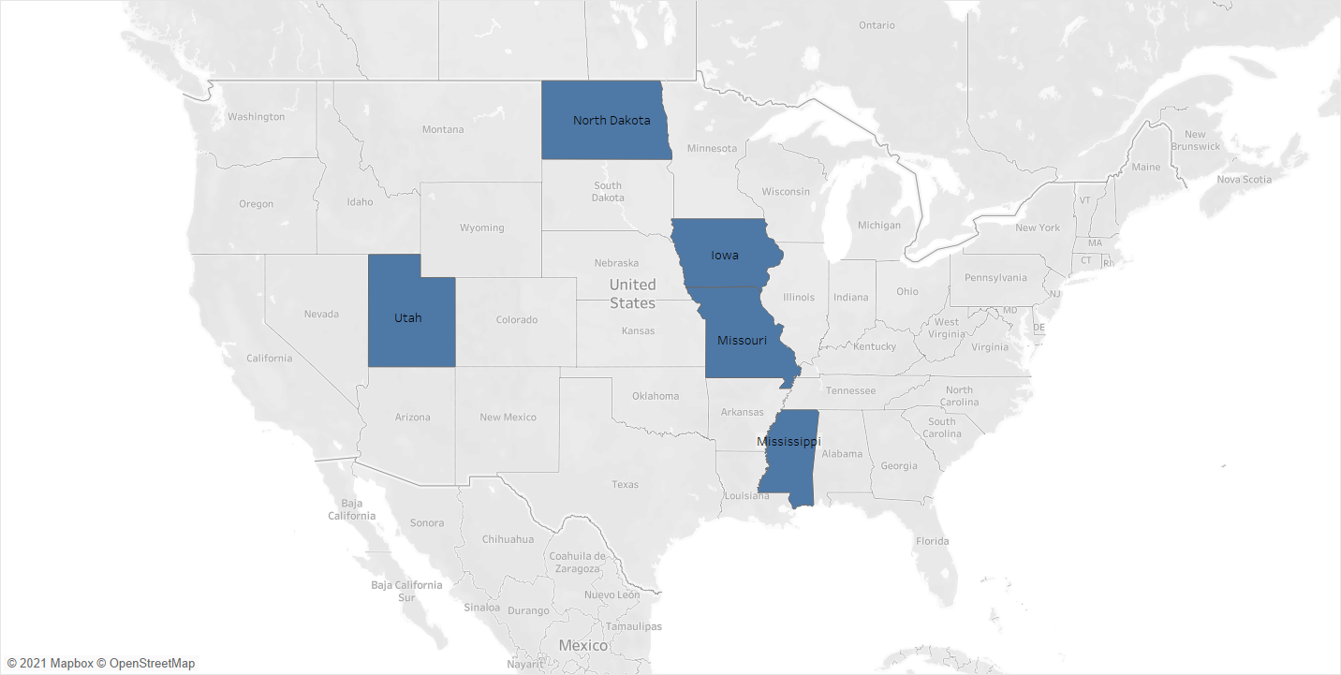
These 5 states have lesser than 3% participation rate for SAT

Slide 4

North Dakota, Mississippi, Missouri, and Utah enforces ACT for students
Iowa is the only state from the five that does not enforce SAT or ACT

Slide 5

Two recommendations to improve participation rate in Iowa

Slide 6

Strike similar contracts with Iowa to require SAT testing for admissions

Slide 7

Recommendation 1: SAT requirement for Iowa
Colorado
Connecticut
Delaware
District of Columbia
Illinois
Maine
Michigan
New Hampshire
States that require SAT have at least 92% participation rate
Source for list of states: College Board’s 2017 Form 990

Slide 8

Recommendation 1: SAT requirement for Iowa
Case study: Colorado & Illinois
Colorado and Illinois enforced SAT test from ACT test from 2018
Sources: Collegeboard.Org and Washingtonpost.com

Slide 9
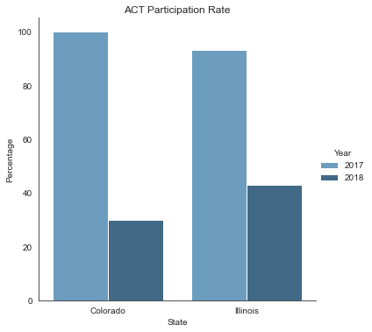
Recommendation 1: SAT requirement for Iowa
ACT participation rate dropped more than 50%
This is across both Colorado and Illinois from 2017 to 2018

Slide 10
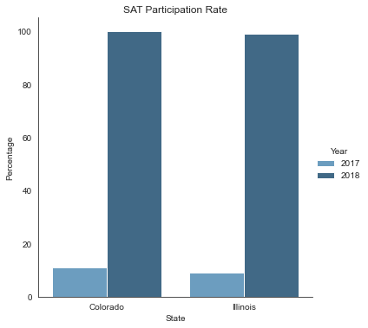
Recommendation 1: SAT requirement for Iowa
SAT participation rate increased to almost 100%
This is across both Colorado and Illinois from 2017 to 2018

Slide 11

Waive fees for students (at least for those in public schools)

Slide 12

Recommendation 2: Waive fees
College Board is a non-profit organization and filed $139,917,497 profits in 2017
Source: College Board’s 2017 Form 990

Slide 13


