Slide 1

BackEnd Course
Many to Many Relationships
December 2022

Slide 2

Overview
A many-to-many relationship occurs between entities when a one-to-many relationship between them works both ways. A book can appear in many categories and a category can contain many books. This type of relationship is represented in a database by a join table (also known among other things as a bridging, junction or linking table).
Typically, the join table contains just the entity key values of each side of the relationship. In the books and categories example, this would result in a field for the BookId and one for the CategoryId.
A many-to-many relationship is defined in code by the inclusion of collection properties in each of the entities - The Categories property in the Book class, and the Books property in the Category class as shown in the next slide.

Slide 3
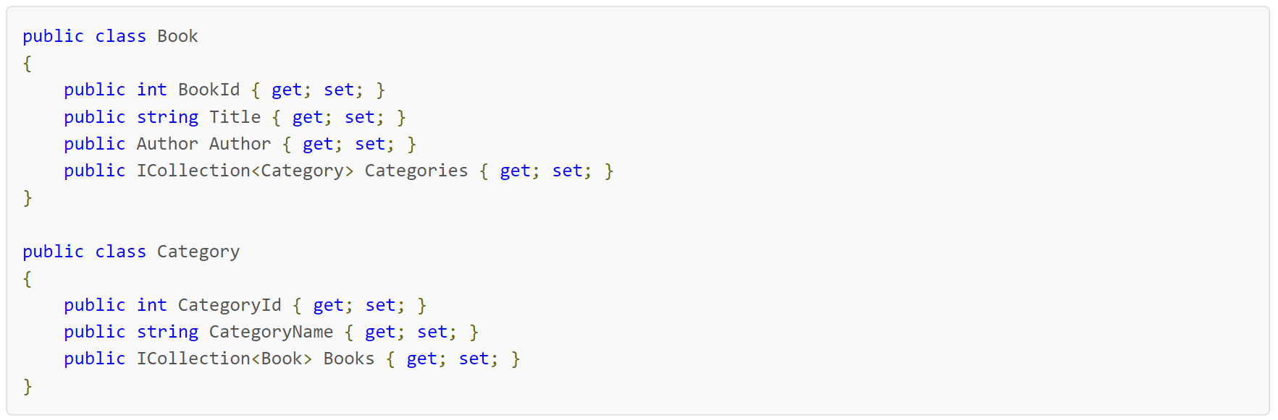
Entities configuration
Notes:
public class Book
{
public int BookId { get; set; }
public string Title { get; set; }
public Author Author { get; set; }
public ICollection<Category> Categories { get; set; }
}
public class Category
{
public int CategoryId { get; set; }
public string CategoryName { get; set; }
public ICollection<Book> Books { get; set; }
}

Slide 4
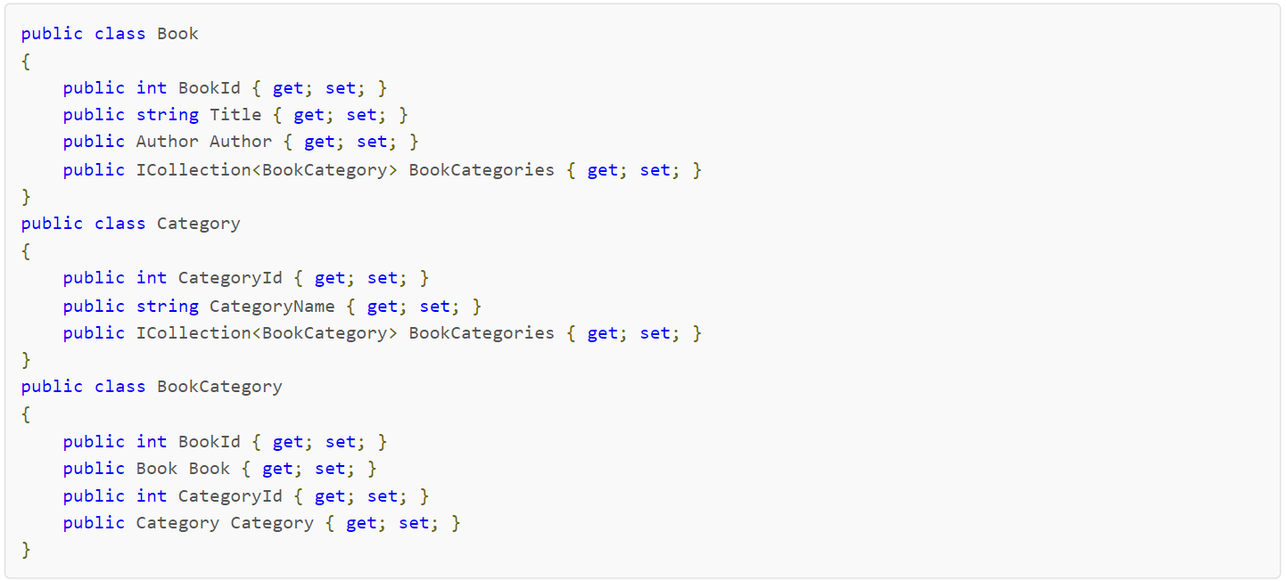
New way
In previous versions of Entity Framework, this model definition was sufficient for EF to imply the correct type of relationship and to generate the join table for it. In EF Core up to and including 3.x, it is necessary to include an entity in the model to represent the join table, and then add navigation properties to either side of the many-to-many relations that point to the join entity instead:
Notes:
public class Book
{
public int BookId { get; set; }
public string Title { get; set; }
public Author Author { get; set; }
public ICollection<BookCategory> BookCategories { get; set; }
}
public class Category
{
public int CategoryId { get; set; }
public string CategoryName { get; set; }
public ICollection<BookCategory> BookCategories { get; set; }
}
public class BookCategory
{
public int BookId { get; set; }
public Book Book { get; set; }
public int CategoryId { get; set; }
public Category Category { get; set; }
}

Slide 5
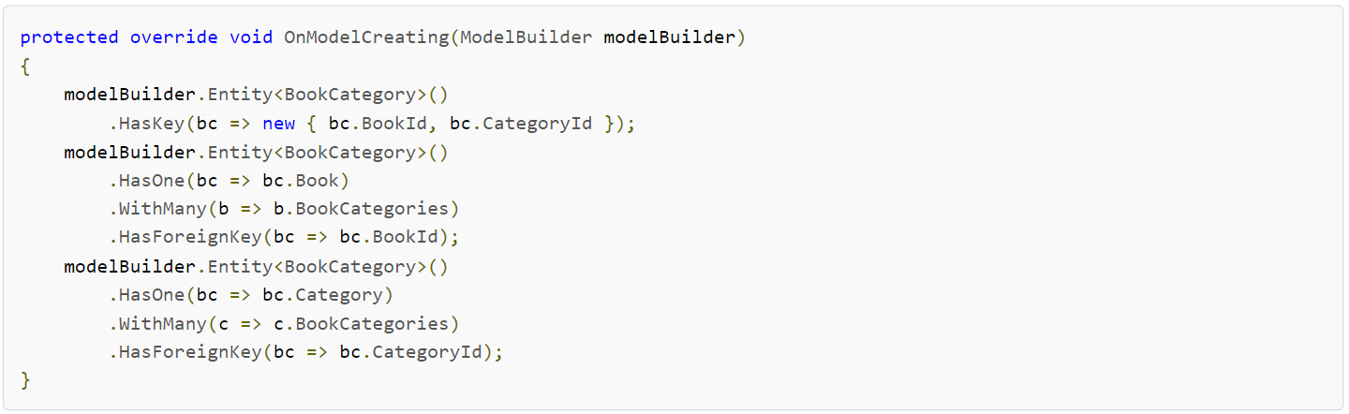
Fluent API
The join table will be named after the join entity (BookCategory in this case) by convention. The relationship also needs to be configured via the Fluent API for EF Core to be able to map it successfully:
Notes:
protected override void OnModelCreating(ModelBuilder modelBuilder)
{
modelBuilder.Entity<BookCategory>()
.HasKey(bc => new { bc.BookId, bc.CategoryId });
modelBuilder.Entity<BookCategory>()
.HasOne(bc => bc.Book)
.WithMany(b => b.BookCategories)
.HasForeignKey(bc => bc.BookId);
modelBuilder.Entity<BookCategory>()
.HasOne(bc => bc.Category)
.WithMany(c => c.BookCategories)
.HasForeignKey(bc => bc.CategoryId);
}

Slide 6
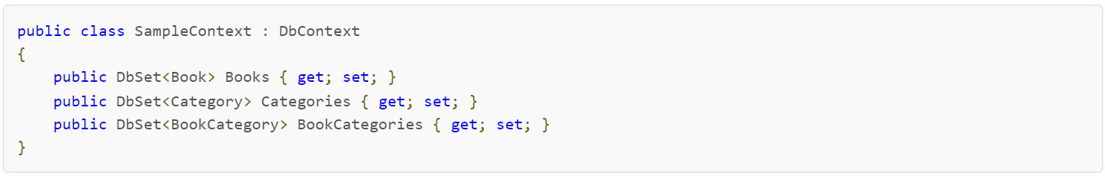
Accessing data
The primary key for the join table is a composite key comprising both of the foreign key values. In addition, both sides of the many-to-many relationship are configured using the HasOne, WithMany and HasForeignKey Fluent API methods.
This is sufficient if you want to access book category data via the Book or Category entities. If you want to query BookCategory data directly, you should also add a DbSet for the join table to the context:
Notes:
public class SampleContext : DbContext
{
public DbSet<Book> Books { get; set; }
public DbSet<Category> Categories { get; set; }
public DbSet<BookCategory> BookCategories { get; set; }
}

Slide 7
Thank You!

