Slide 1
SENSORS AND ACTUATORS
INTRODUCTION:
Presented by: Mohammad Mohid & Muhammad Asad
Subject: ICT
Program: Bs Data Science
Semester: I

Slide 2
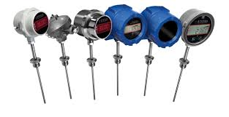
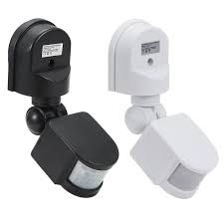
SENSORS:
DEFINITION:
Devices that detect and measures physical changes or
environmental changes.
PURPOSE:
Sensors allow machines and systems to interact with the physical
changes
EXAMPLE:
Temperature sensors, motion detectors, etc.

Slide 3
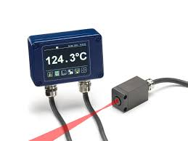
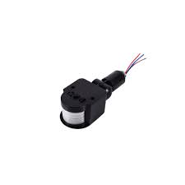
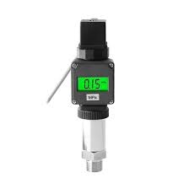
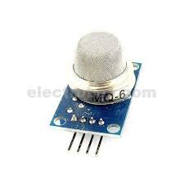
TYPES OF SENSORS:
Temperature Sensors:
Measure temperature; e.g., thermocouples, thermistors.
Motion Sensors:
Detect movement; e.g., PIR (Passive Infrared), radar.
Pressure Sensors:
Measure the force exerted by a fluid or gas; e.g., piezoelectric sensors.
Gas Sensors:
Detect specific gases; e.g., carbon dioxide (CO₂), methane (CH₄), or oxygen (O₂) sensors.
Etc.

Slide 4
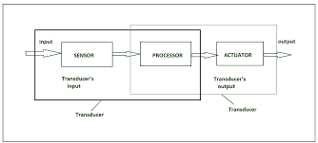
WORKING OF SENSORS:
BASIC PRINCIPLE:
Detect changes in the environment (e.g., light, heat, motion, pressure).
Changes are converted into an electrical signal or data.
Data is then processed or transmitted.

Slide 5
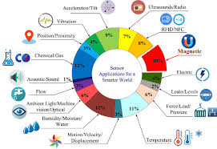
APPLICATION OF SENSORS:
Automotive:
Sensors in cars for ABS, parking assistance
Healthcare:
Wearable sensors for heart rate, blood pressure monitoring
Home Automation:
Smart homes use sensors for lighting, climate control, and security systems.
Environmental Monitoring:
Sensors for detecting pollution levels, weather, and natural disasters.

Slide 6
What is an Actuator?
Definition:
Actuator is a device which takes energy and converts it into
motion. This energy can be electrical, hydraulic or pneumatic.
Purpose:
Actuators are the crux of automation, robotics, and industrial processes. They move or manage the operation of devices based on signals received from sensors or controllers.

Slide 7
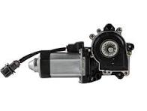
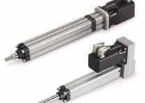
Types of Actuators:
There are different types of Actuators:
Electrical Actuator:
Application:
It is used in Robotics, automobile applications,
manufacturing equipment.
Examples:
Electric motors, Stepper motors, Jackscrews, Electric muscular stimulators in robots.

Slide 8
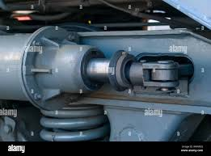
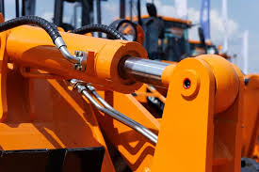
Hydraulic Actuator:
Application:
It is used in Heavy machinery, For instance Cranes and Excavators.
Examples:
Balers, cranes, excavators, loaders, and presses.

Slide 9
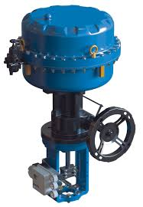
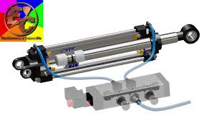
Pneumatic Actuator:
Application:
It is used in Conveyor systems, automated doors, packaging machinery.
Examples:
Pneumatic Cylinder, Diaphragm Actuator, Rotary Actuator

Slide 10
Advantages
Disadvantages
High precision
High power density
Smooth motion
Lightweight components
Limited force and speed
Leakage potential
Complex maintenance
Compressibility of air

Slide 11
Working of Actuator:
Electric Actuator:
Signal Input
Power Supply
Motor Activation
Energy Conversion
Movement Transmission

Slide 12


Slide 13
Thank You

