Slide 1
Channel Archive Library
Kay-Uwe Kasemir, LANL

Slide 2
Channel Archiver
Directory File + Data Files
Fast disk-based Hash-table lookup
All files interlinked (bi-dir.)
It’s a Database!
API: fopen/fseek/fread/fwrite …

Slide 3
Database-Type API
Alternatives:
  Implement API for Archiver’s files
  Use existing DB after converting
Affordable DBs the Archiver could rely on:
  MS Access?
    Standard supplement to most PCs
  MySQL (www.tcx.se)?
    Free for non-commercial use on e.g. Linux,
    starting $200 for MS Win & commercial use

Slide 4
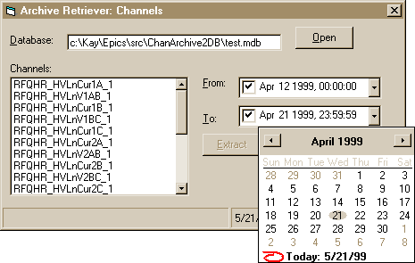
Advantage of MS Access/Vis. Basic

Slide 5
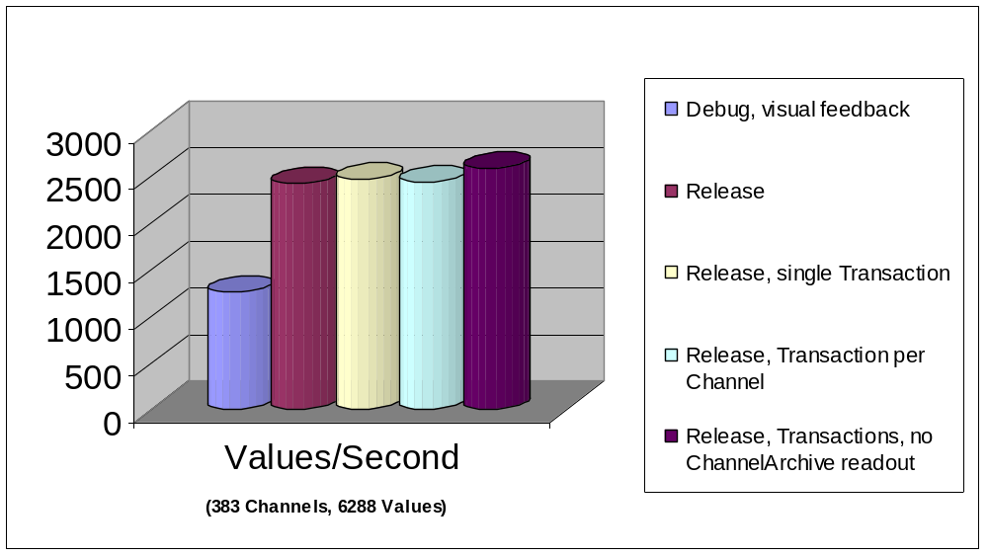
Test: Convert into MS Access Database
DAO from Visual Basic

Slide 6
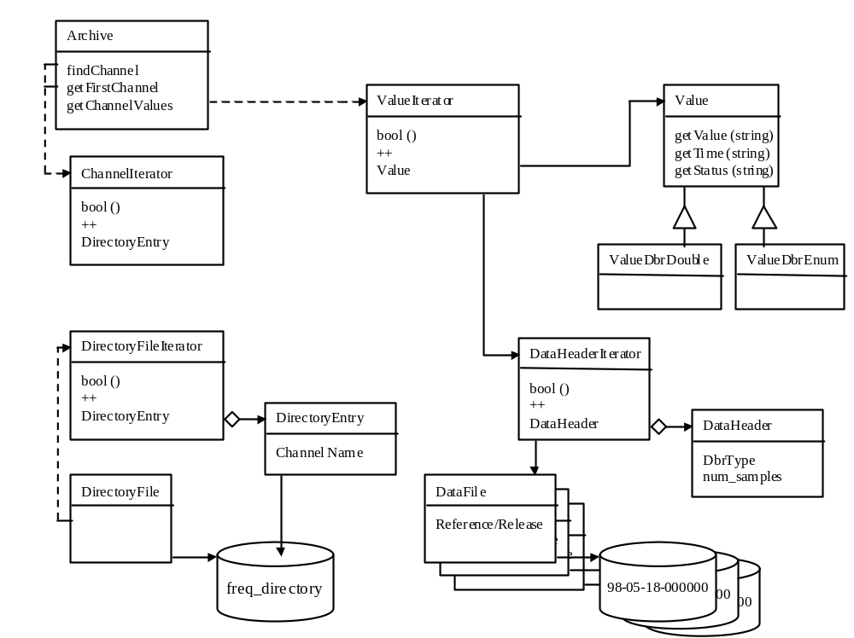
ChannelArchive Library

Slide 7
ChannelArchive Library…
Portable C++ code,
uses Standard C++/STL Library
  except for FILE * instead of iostream (→ factor 2)
Handles “Byte Swapping”
Allows Read/Write Access via
  Channel Iterator
  Value Iterator
First Tests:
  Debug: 9000 values/sec
  Release: 14000 values/sec (390 channels, 308800 values)
Knuth: “Early optimization is the root of all evil”

