Slide 1

Interactive Data Visualization Tools in R
C. Ashton Drew, PhD
PyData Carolina, September 2016

Slide 2
Next Two Hours…
OUTLINE
High level overview of interactivity
Specific examples of code and output
ASSUMPTIONS
Familiar with R syntax
RStudio software and the Shiny R package
OBJECTIVES
Ability to build simple interactive plot, table, map, and app with R
Resources and tips to keep learning on your own

Slide 3
Instruction Method
R, R Studio, and packages ggplot2, shiny, plotly, leaflet, and DT
use built-in data to demo widgets alone and embedded in Shiny
we will build code as we go – starting simple and then adding some options to give a flavor of the code
workshop materials will be available online at github soon

Slide 4




Interactivity in R
R & R Studio
js, HTML, CSS

Slide 5
Interactivity in R
htmlwidgets
R & R Studio
js, HTML, CSS
leaflet - maps
plotly - graphics
DT - tables
Desktop, web documents (Markdown), apps (Shiny)

Slide 6
Interactive Data Applications
Basic data exploration within an organized framework
Deliver large volumes of data where each individual user interested in a different subset
Scenario analysis to test assumptions or compare alternatives

Slide 7
Fiji Earthquake Data (quake)
locations of 1000 seismic events (magnitude > 4.0) since 1964 off the coast of Fiji
Data frame with 5 numeric variables:
[,1] lat - Latitude of event
[,2] long - Longitude
[,3] depth - Depth (km)
[,4] mag - Richter Magnitude
[,5] stations - Number of stations reporting
https://stat.ethz.ch/R-manual/R-devel/library/datasets/html/quakes.html
Sourced from: Harvard PRIM-H project data sets, Dr. John Woodhouse, Dept. of Geophysics, Harvard University.

Slide 8
Stand-Alone Interactive Tools

Slide 9
library(DT) http://rstudio.github.io/DT/
interactive web-based tables via the JavaScript library DataTables
matrix or data frame objects transbribed to HTML tables
support filtering, pagination, and sorting
lots of ways to customize appearance via CSS styling options

Slide 10
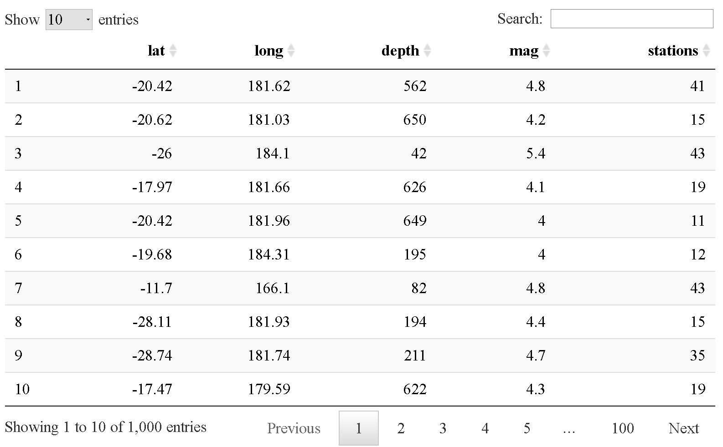
Basic Interactive Table
library(DT)
datatable(quakes)

Slide 11
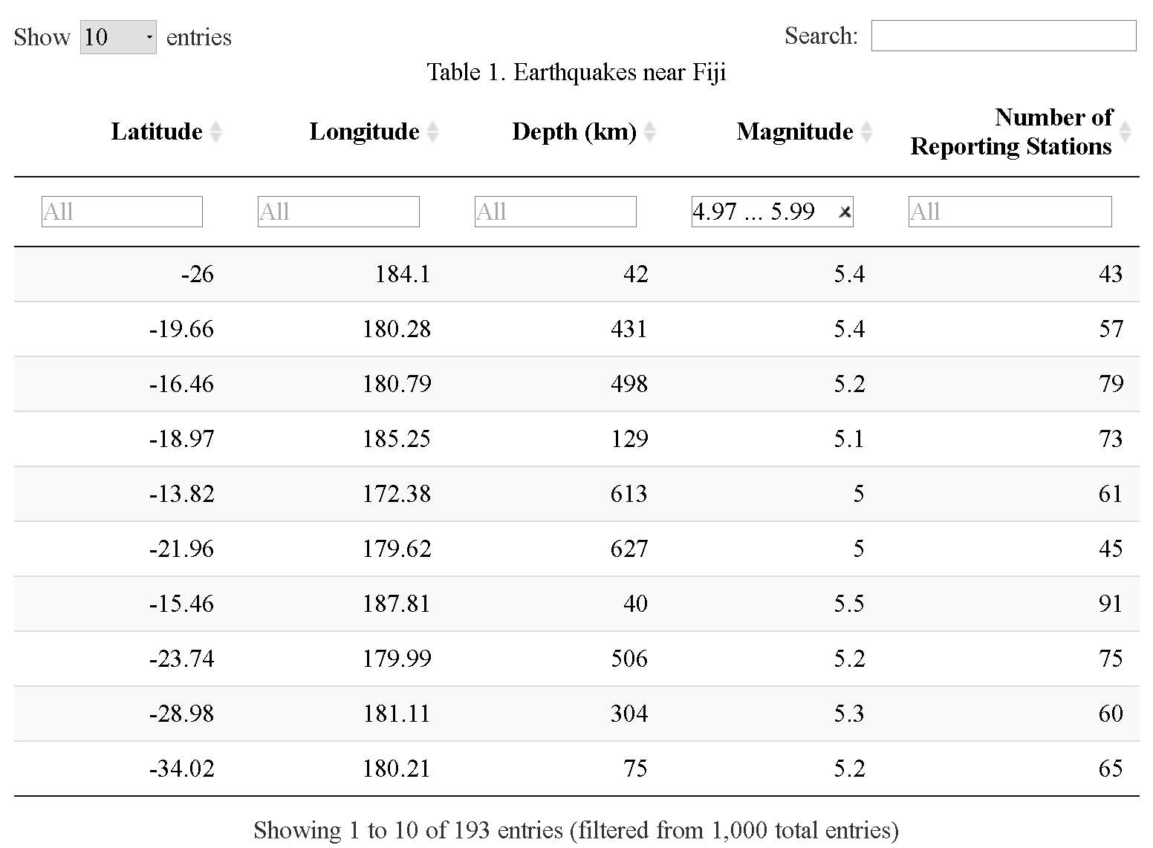
Prettier Interactive Table
datatable(data=quakes,
rownames=FALSE,
colnames=c("Latitude", "Longitude",
"Depth (km)", "Magnitude",
"Number of Reporting Stations"),
filter="top",
caption="Table 1. Earthquakes near Fiji"
)

Slide 12
library(plotly) https://plot.ly/r/
interactive web-based 2D and 3D graphs with open source plotly.js
clickable legend, pan, zoom, hover popup text, etc.
easy to combine data manipulation and visualization functions with pipe commands
flexible, and especially easy if using ggplot (ggplotly)
view within R Studio or web browser, or embed in Markdown or Shiny
to publish, create free plotly account where you can share, with options for privacy settings

Slide 13
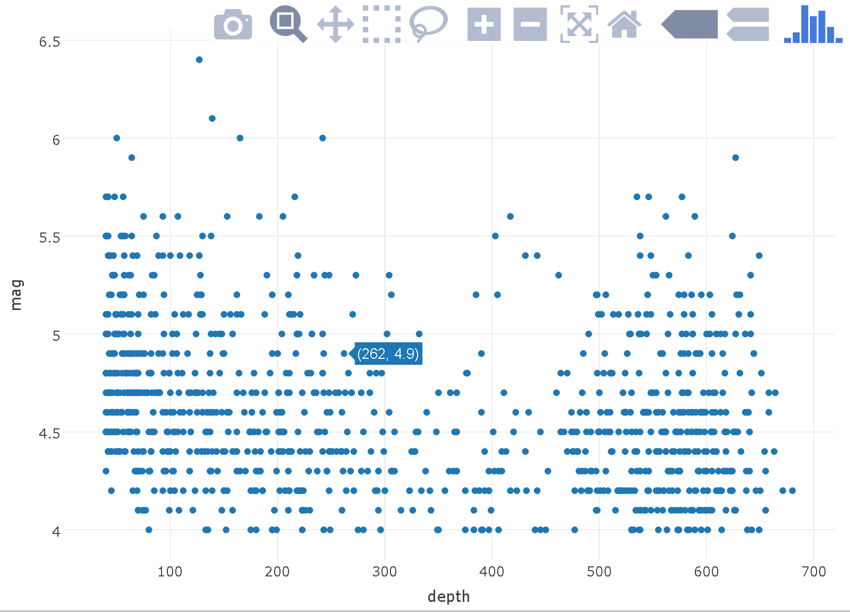
Basic Interactive Graph
library(plotly)
plot_ly(quakes,
x=depth,
y=mag,
mode="markers")

Slide 14
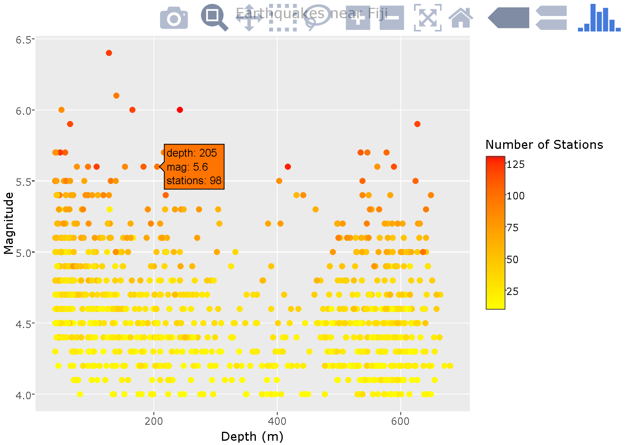
Prettier Interactive Graph
library(ggplot2)
qGraph <-
ggplot(data=quakes, aes(x=depth, y=mag,
size=stations, color=-stations)+
geom_point()+
scale_color_gradient(low=“yellow”, high=“red”, name="Number of
Stations")+
xlab("Depth (m)")+
ylab("Magnitude")+
ggtitle("Earthquakes near Fiji")
ggplotly(qGraph, tooltip=c("x", "y", "colour"))

Slide 15
library(leaflet) http://rstudio.github.io/leaflet/
based on popular open-source js library for creating interactive maps
render spatial objects or data frames with lat/long columns
compose maps using combinations of:
Background map tiles
Layers of vector points, lines, polygon data
familiar interface with panning/zooming, etc.
embed maps in Markdown docs and Shiny apps
use map bounds, mouse events to drive Shiny logic

Slide 16
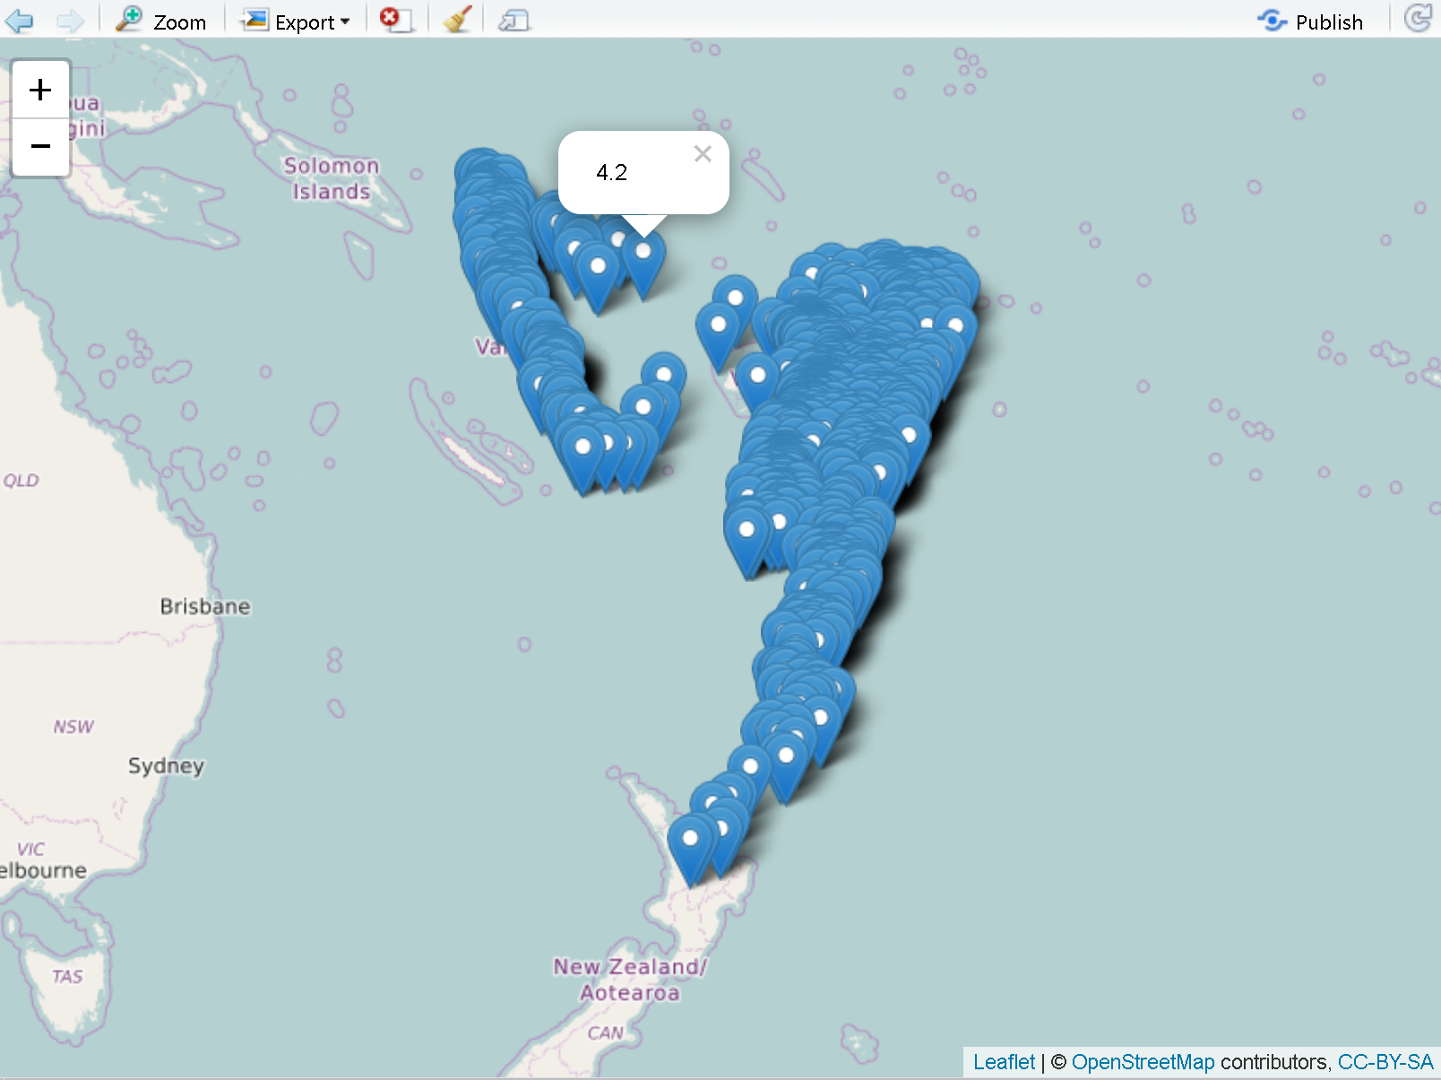
Basic Interactive Map
library (leaflet)
qMap <-
leaflet(data = quakes) %>%
addTiles() %>%
addMarkers(~long, ~lat,
popup = ~as.character(mag))
qMap

Slide 17
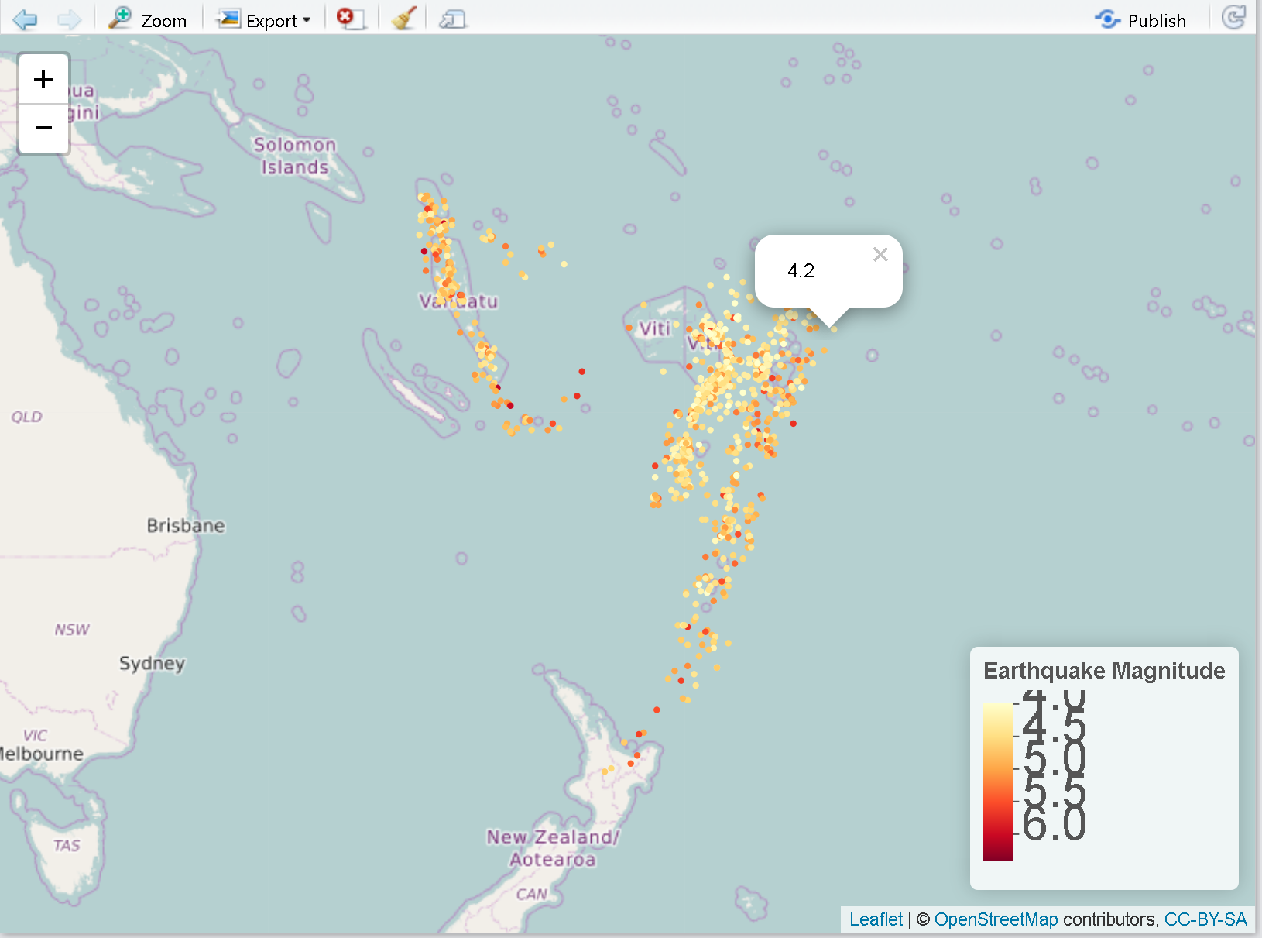
Prettier Interactive Map
pal <- colorNumeric("YlOrRd",
domain=c(min(quakes$mag),
max(quakes$mag)))
qMap <- leaflet(quakes) %>%
addTiles() %>%
addCircleMarkers(radius = 2,
color = ~pal(mag),
stroke = FALSE, fillOpacity = 1,
popup=~as.character(mag)) %>%
addLegend("bottomright", pal = pal,
values = ~mag, opacity = 1,
title = "Earthquake Magnitude")
qMap

Slide 18
Other Stand Alone Tools
Prepackged tools
ggvis, rCharts, googleVis, leaflet, network3D, etc.
library(htmlwidgets)
create an R binding for your favorite JavaScript library and enable use of it in the R console, Markdown docs, and in Shiny web apps
create HTML widgets to display R data objects interactively via JavaScript libraries or use one of existing html widget libraries
http://gallery.htmlwidgets.org/

Slide 19
Shiny Web Apps

Slide 20
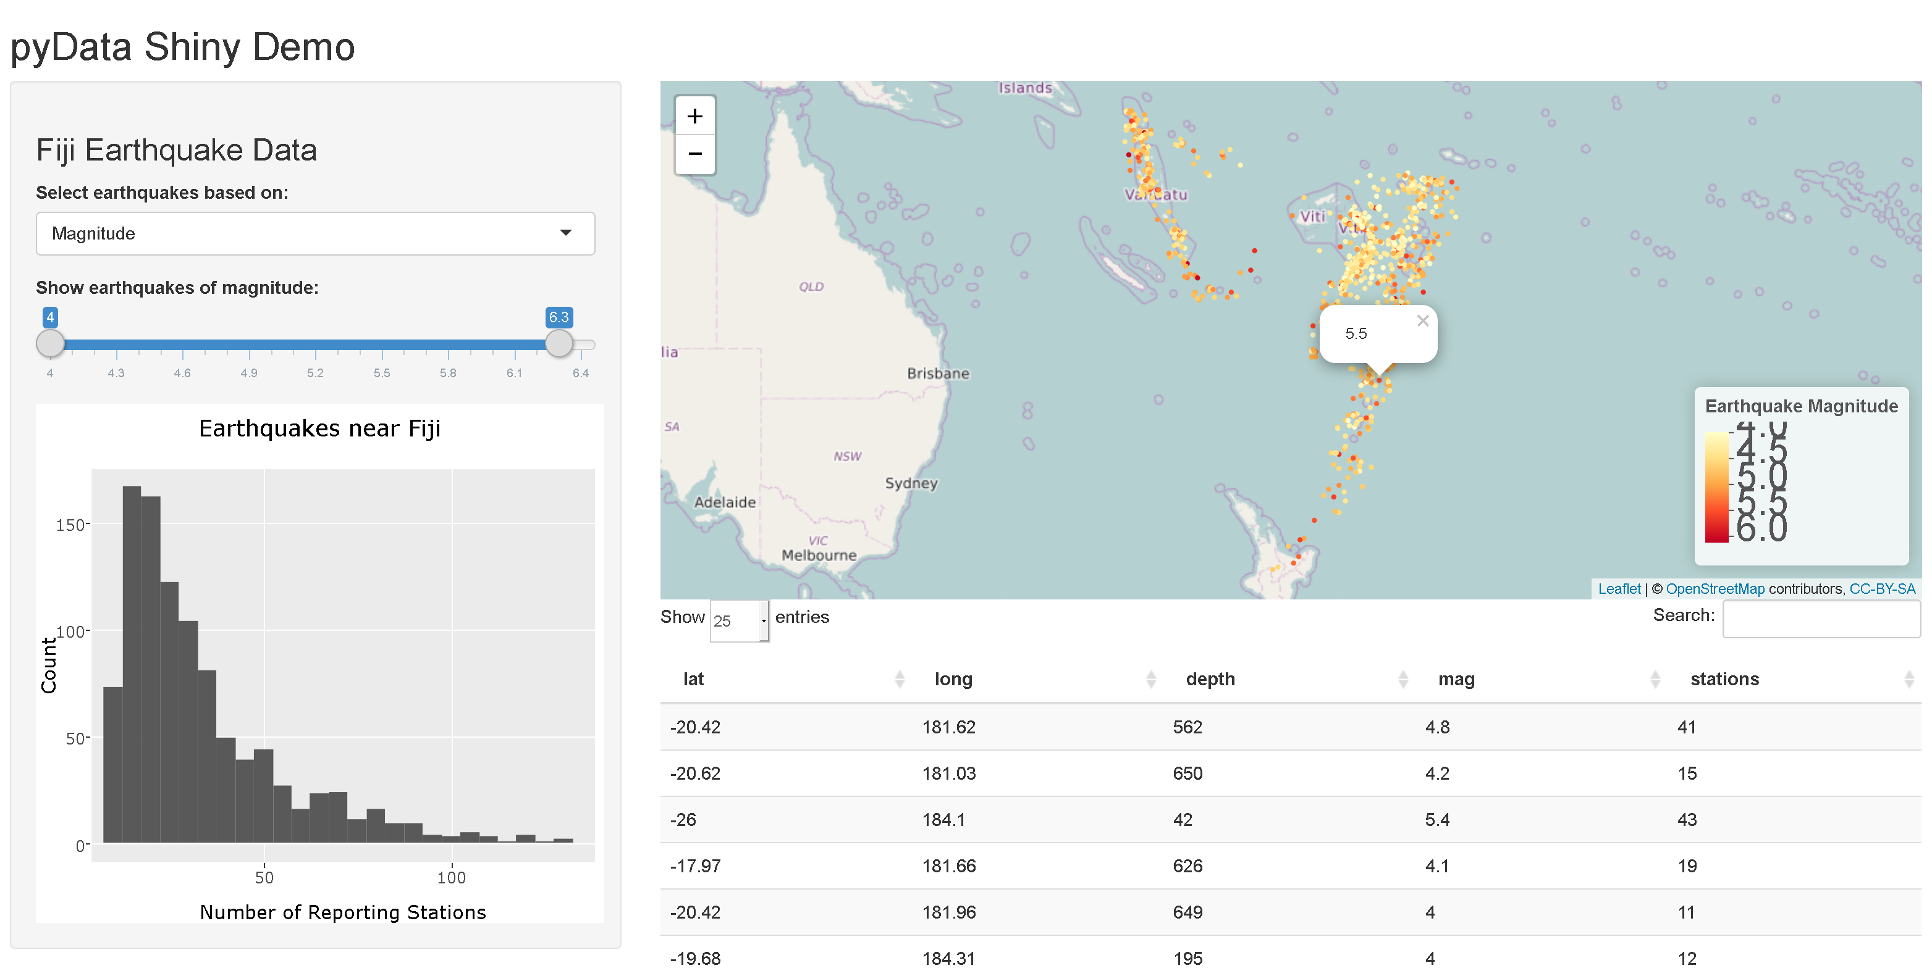
Basic Shiny Demo: Goal

Slide 21
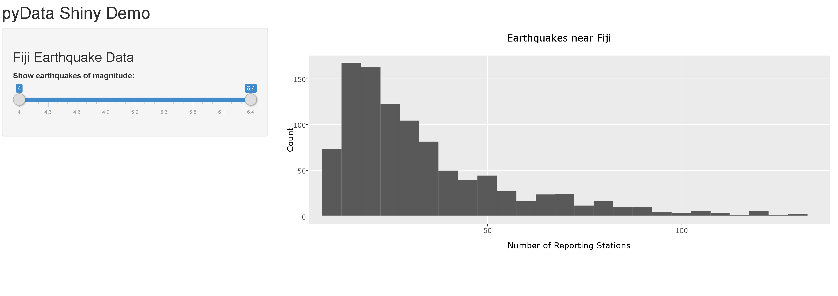
Basic Shiny Demo: Start

Slide 22
Shiny App Structure: R Script
library(shiny)
ui <- fluidPage()
server <- function(input, output){}
shinyApp(ui = ui, server = server)
Start with in-line construction (single R script, app.R)
Requires library(shiny), a ui object or script, a server object or script, and a command to run the app
ui: nested R functions that instruct Shiny to build an HTML user interface filled with R objects
server: function with instructions on how to build (and rebuild as user selects different inputs) the R objects requested by the ui

Slide 23
Shiny App Structure: Files and Folders
MyFavApp
app.R
global.R
DESCRIPTION
README
www
<other files>
MyOtherApp
ui.R
server.R
etc., same as above
One folder per app
folder name is the app name
text, dots, underscores, dashes preferred
app.R (or ui.R with server.R) required, but rest are optional
global.R: script defines objects available to both ui.R and server.R
DESCRIPTION and README: text files
www: folder with files to share with web browser (e.g., images, CSS, .js)
<other files>: data files, function script files, etc

Slide 24
fluidPage with Title, Sidebar, and Main Panel
Title Panel
Sidebar Panel
Main Panel

Slide 25
ui and server components
# load data, libraries, etc.
ui <- fluidPage(
titlePanel(“PyData Shiny Demo”),
sidebarLayout(
sidebarPanel(
# Code for some text
# Code for sliderbar input
),
mainPanel(
# Code to position plot output
)
)
)
server <- shinyServer(function(input, output) {
# Code to create and render the plot
})
shinyApp(ui = ui, server = server)
Notes:
Two components: the user interface layout script and the server script that contains your R code within reactive wrapping.
Both scripts must have these names (but this may change soon), must be in the same folder along with any data files or other material that your script will call (e.g., images, website design scripts, R functions, etc.)
All Shiny scripts will have a “page” designation (fluid, fixed, or fill)
Both scripts start by calling the shiny library
Note indenting, commas: two elements within page, separated by comma and sharig same indentation; and two elements within sidebarLayout follow this same structural pattern)

Slide 26
ui sidebarPanel contents
library(shiny)
library(ggplot2)
qDat <- quakes
ui <- fluidPage(
titlePanel(“PyData Shiny Demo”),
sidebarLayout(
sidebarPanel(
# Code for some text
# Code for sliderbar input
),
mainPanel(
# Code to position plot output
)
)
)
sidebarPanel(
h3("Fiji Earthquake Data"),
sliderInput(
inputID="sld01_Mag",
label="Show
earthquakes of magnitude:",
min=min(qDat$mag),
max=max(qDat$mag),
value=c(min(qDat$mag),
max(qDat$mag)),
step=0.1)
),
Notes:
Two components: the user interface layout script and the server script that contains your R code within reactive wrapping.
Both scripts must have these names (but this may change soon), must be in the same folder along with any data files or other material that your script will call (e.g., images, website design scripts, R functions, etc.)
All Shiny scripts will have a “page” designation (fluid, fixed, or fill)
Both scripts start by calling the shiny library
Note indenting, commas: two elements within page, separated by comma and sharig same indentation; and two elements within sidebarLayout follow this same structural pattern)

Slide 27
ui mainPanel Contents
qDat <- quakes
ui <- fluidPage(
titlePanel(“My Page Title”),
sidebarLayout(
sidebarPanel(
# Code for some text
# Code for sliderbar input
),
mainPanel(
# Code to position plot output
)
)
)
mainPanel(
plotOutput(
outputID=“hist01”
)
),
Notes:
Two components: the user interface layout script and the server script that contains your R code within reactive wrapping.
Both scripts must have these names (but this may change soon), must be in the same folder along with any data files or other material that your script will call (e.g., images, website design scripts, R functions, etc.)
All Shiny scripts will have a “page” designation (fluid, fixed, or fill)
Both scripts start by calling the shiny library
Note indenting, commas: two elements within page, separated by comma and sharig same indentation; and two elements within sidebarLayout follow this same structural pattern)

Slide 28
server Contents
server <- shinyServer(function(input, output) {
# Code to create and render the plot
})
shinyApp(ui = ui, server = server)
output$hist01 <-
renderPlot({
qSub <- qDat[qDat$mag>=input$sld01_Mag[1] &
qDat$mag<=input$sld01_Mag[2],]
ggplot(data=qSub, aes(x=mag))+
geom_histogram()+
xlab(“Number of Reporting Stations")+
xlim(min(qDat$stations),
max(qDat$stations))+
ylab(“Count")+
ggtitle("Earthquakes near Fiji")
})
Notes:
Now switch to outputPlotly and renderPlotly

Slide 29
More ui Text Entry Code
Can be placed anywhere within the document
Functions indicate kind of text
h1(“biggest header”)
h2(“2nd biggest header”)
text(“plain text”)
helpText(“smallish grey text”)
p(strong(“bold text”)
p(em(“italics text”)
hr(), br()
Include static html tags with tags$ notation
tags$ul(“unordered list item”)
Include linked text with:
a(href=“linked text”, “link”)

Slide 30
Other ui User Input Types
Inputs are how the user interacts with the R script, such as:
fileInput()
checkboxInput()
dateInput()
numericInput()
selectInput()
sliderInput()
textInput()
radioButtons()
submitButton()
actionButton()
…
sidebarPanel(
h2(“Population Census”),
selectInput("select1.Gender",
label = h3(“View population data for:"),
choices = list(“Total Population" = “Total”,
“Females Only" = “Female”,
“Males Only" = “Male”),
selected = “Total”
)

Slide 31
Other ui Outputs & Render functions
UI:
…
mainPanel(
plotOutput=“myplot”
)
…
SERVER:
…
output$myplot <- renderPlot({
# any sort of plot object
})
Reactive outputs are generated by pairing render*() and *Output() functions:
renderPlot() with plotOutput()
renderTable() with tableOutput()
renderText() with textOutput()
renderUI() with uiOutput()
The *Output() function is in the ui function/script
The render*() function is in the server function/script

Slide 32
Add a Table to the mainPanel
ui <-
….
mainPanel(
plotOutput(
outputID=“sct01_MagDpth”
),
tableOutput(
outputID=“table01”
)
)
server <-
shinyServer(function(input, output) {
output$hist01 <- renderPlot({ …
})
output$table01 <- renderTable({
qSub2 <-
qDat[qDat$mag>=input$sld01_Mag[1] &
qDat$mag<=input$sld01_Mag[2],]
})
})
Notes:
Two components: the user interface layout script and the server script that contains your R code within reactive wrapping.
Both scripts must have these names (but this may change soon), must be in the same folder along with any data files or other material that your script will call (e.g., images, website design scripts, R functions, etc.)
All Shiny scripts will have a “page” designation (fluid, fixed, or fill)
Both scripts start by calling the shiny library
Note indenting, commas: two elements within page, separated by comma and sharig same indentation; and two elements within sidebarLayout follow this same structural pattern)

Slide 33
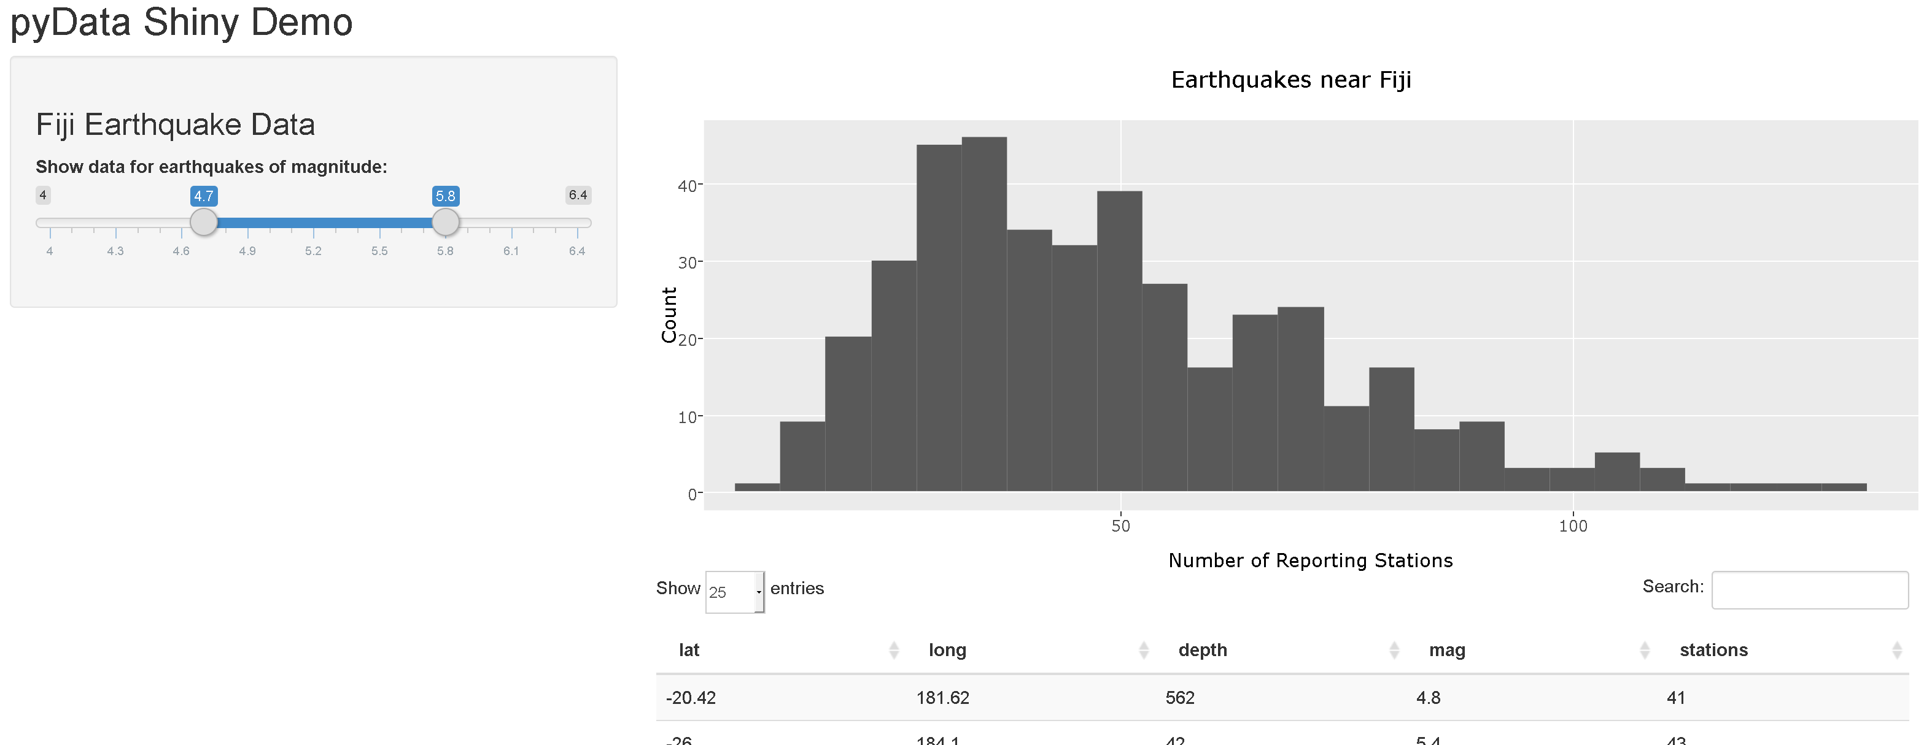

Slide 34
Change from Static to Interactive Objects
DT comes with Shiny
change from tableOutput & renderTable
to dataTableOutput & renderDataTable
Plotly requires library(plotly)
change from plotOutput & renderPlot
to plotlyOutput & renderPlotly

Slide 35
Organize Code In and Around server Function
library(ggplot2)
data <- read.csv(“somedata.csv”)
server <- shinyServer(function(input, output) {
myValue <- input$uservalue
myData <- data[data$values>myValue,]
output$myPlot <- renderPlot({
ggplot(myData, aes(X, Y))+
geom_point()
})
})
RUN ONCE
libraries, data, and scripts
outside server function
RUN ONCE PER USER
run on page open and browser refresh
in server function, but outside render* functions
RUN OFTEN
run whenever user modifies input
inside render*, reactive, and observe functions

Slide 36
reactive() function
OLD CODE:
output$hist01 <- renderPlotly({
qSub <- qDat[qDat$mag>=input$sld01_Mag[1] &
qDat$mag<=input$sld01_Mag[2],]
ggplot(data=qSub, aes ….
})
NEW CODE:
qSub <- reactive({
qDat[qDat$mag>=input$sld01_Mag[1] &
qDat$mag<=input$sld01_Mag[2],]
})
output$hist01 <- renderPlotly({
ggplot(data=qSub(), aes …
})
output$table01 <- renderDataTable({
qSub()
})
previous examples used render*() functions to manage interactivity
runs code whenever any input value changes
saves results to output$<outputname>
reactive() has similar function, but different application
caches values to reduce computation, only updates when relevant input changes
can be called by other code
calls last object in code
Notes:
good for when one value likely used by many others – e.g. reactive() to generate data subset based on selectInput, then render*() for graphs and table that update but use that same data

Slide 37
Move the plotOutput and add a leafletOutput
library(leaflet)
ui <- ….
sidebarPanel(
h3("Fiji Earthquake Data"),
sliderInput(…),
plotlyOutput(
outputID=“hist01”
),
),
mainPanel(
leafletOutput(
outputID=“map01”
),
dataTableOutput(“table01”)
)
server <- …
output$map01 <- renderLeaflet({
pal <- colorNumeric("YlOrRd", domain=c(min(quakes$mag), max(quakes$mag)))
qMap <- leaflet(data = qSub()) %>%
addTiles() %>%
addCircleMarkers(radius = 2, color = ~pal(mag),
stroke = FALSE, fillOpacity = 1, popup=~as.character(mag)) %>%
addLegend("bottomright", pal = pal, values = ~mag,
title = "Earthquake Magnitude",
opacity = 1)
qMap
})
Notes:
Two components: the user interface layout script and the server script that contains your R code within reactive wrapping.
Both scripts must have these names (but this may change soon), must be in the same folder along with any data files or other material that your script will call (e.g., images, website design scripts, R functions, etc.)
All Shiny scripts will have a “page” designation (fluid, fixed, or fill)
Both scripts start by calling the shiny library
Note indenting, commas: two elements within page, separated by comma and sharig same indentation; and two elements within sidebarLayout follow this same structural pattern)

Slide 38
conditionalPanel() function
ui <- fluidPage(sidebarPanel(
selectInput("plotType", "Plot Type",
c(Scatter = "scatter", Histogram = "hist")
),
conditionalPanel(condition = "input.plotType == 'hist'",
selectInput("breaks", "Breaks",
c("Sturges", "Scott", "Freedman-Diaconis“)
)
),
conditionalPanel(condition = "input.breaks == ‘Scott'",
sliderInput("breakCount", "Break Count", min=1, max=1000, value=10)
)
)
)
Creates a panel that is visible or not, depending on the value of a condition
Notes:
good for when one value likely used by many others – e.g. reactive() to generate data subset based on selectInput, then render*() for graphs and table that update but use that same data

Slide 39
Add selectInput & conditionalPanel to ui
selectInput("select01", label: "Select earthquakes based on:", choices=c("Magnitude"="mag", "Depth"="depth"),
selected="mag“
),
conditionalPanel(condition="input.select01=='mag'",
sliderInput("sld01_mag", label="Show earthquakes of magnitude:",
min=min(qDat$mag), max=max(qDat$mag),
value=c(min(qDat$mag),max(qDat$mag)), step=0.1)
),
conditionalPanel(condition="input.select01=='depth'",
sliderInput("sld02_depth",
label="Show earthquakes of depth:",
min=min(qDat$depth), max=max(qDat$depth),
value=c(min(qDat$depth),max(qDat$depth)), step=5)
),

Slide 40
Update server to process conditional data subsets
qSub <- reactive({
if (input$select01=="mag"){
subset <- qDat[qDat$mag>=input$sld01_mag[1] & qDat$mag<=input$sld01_mag[2],]
} else {
subset <- qDat[qDat$depth>=input$sld02_depth[1] & qDat$depth<=input$sld02_depth[2],]
}
subset
})

Slide 41
For much longer leaflet demo with the same data: https://rstudio.github.io/leaflet/shiny.html

Slide 42
More Resources:
R Studio resources:
Shiny cheatsheets
Shiny gallery, htmlwidgets gallery
Plotly R examples and tutorials
Shiny tutorials
Google searches *with year*
Tutoring and workshops
Ashton Drew
KDV Decision Analysis LLC
ashton@kdv-decisions.com
www.kdv-decisions.com
919-886-2811

