Slide 1





Keeping Things Stable
How Controllers Tackle Complexity in Modern Physics
EXERCISE

Slide 2
Overview
Introduction
Exercises
1: PID
2: LQR
Competition
Discussion

Slide 3
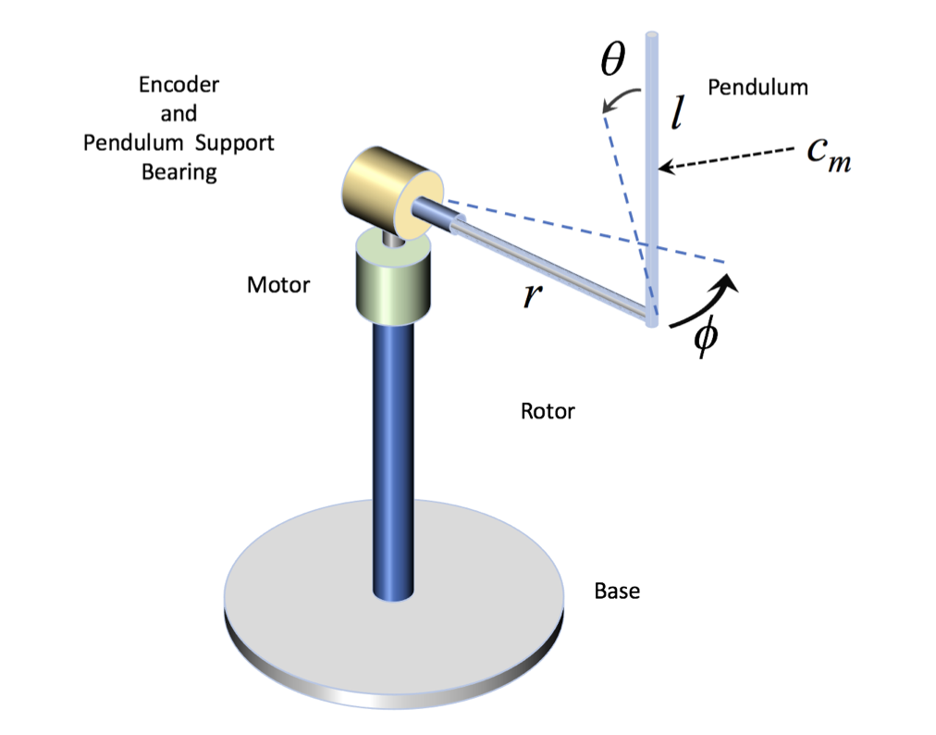


Inverted pendulum
Sensor ($θ$)
Actor ($φ$)
Source: STMicroelectronics, STSW-EDUKIT01 (graphic on product page); accessed 16 Feb 2026.

Slide 4
Exercise procedure
Work in teams of 2 (max 3) people
Ideally: One is good in python, other one good in math.
Python notebook with a simulation of the inverted pendulum
It contains 2 examples to click through and 2 exercises (PID and LQR)
Just change code where #TODO is written
Write down your best parameters for the competition!
GIT: https://github.com/alboeh/iCSC-2026-exercise.git

Slide 5
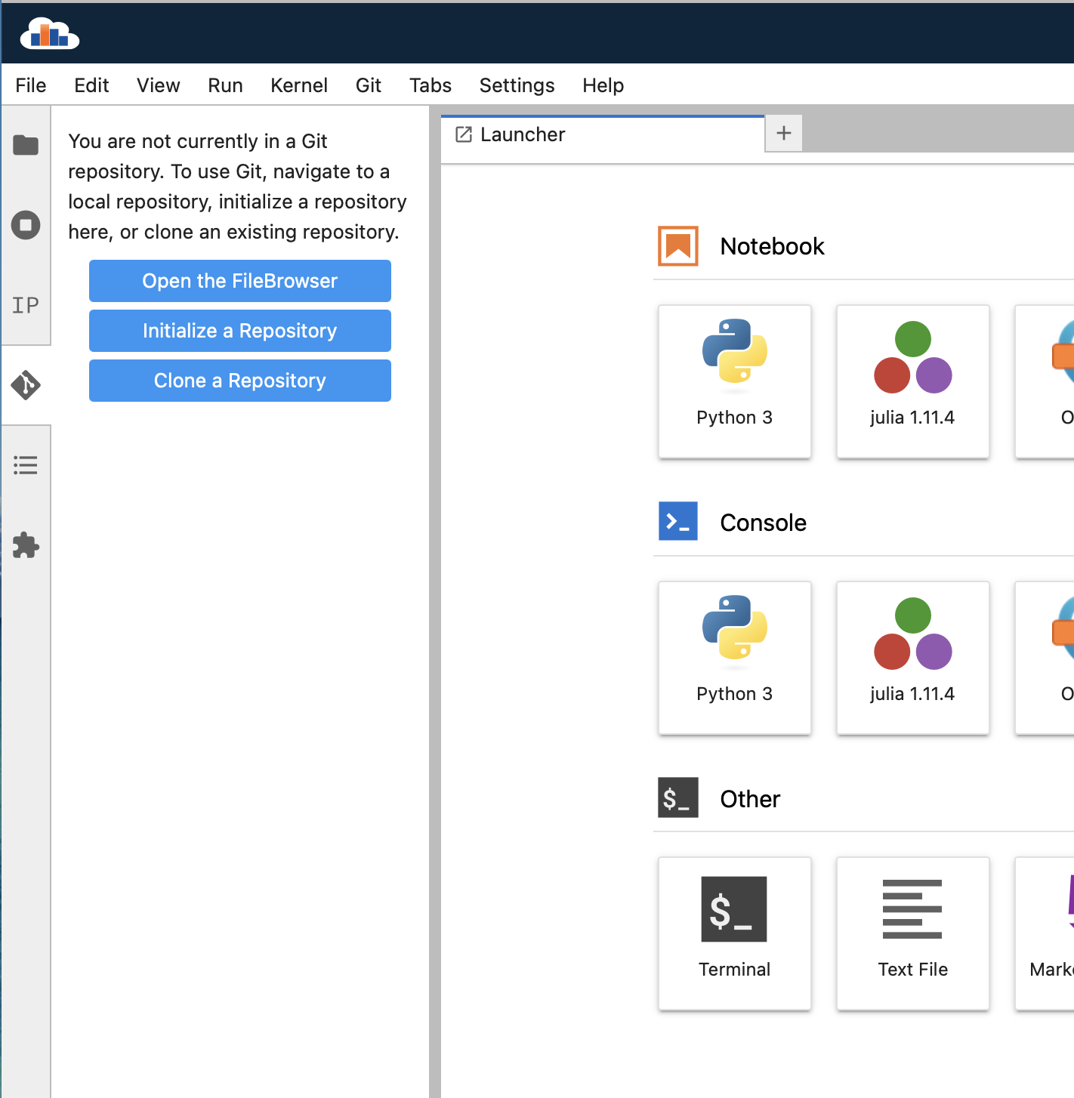

Run the notebook
Login to SWAN: https://swan.cern.ch
Non-cern users can get licenses from the CSC team
Start session
New JupyterLab interface
LCG curated stack, General purpose Software stack (108)
Check “Use python packages installed on CERNBox”
Use 4 CPU and 16 GB RAM
Click left on Git and clone exercise rep, include submodules and download rep, ignore error msg
Open exercises/InvPendulum.ipynb (not solution!)
Use “show_animation” function wisely, its time consuming
Alternatively: Clone on your local machine, may be faster!

Slide 6
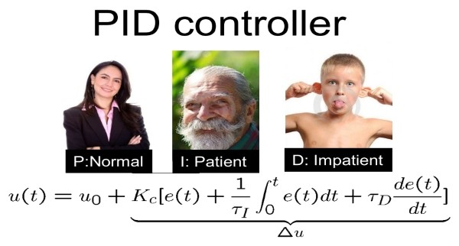
Exercise 1: PID control

Slide 7
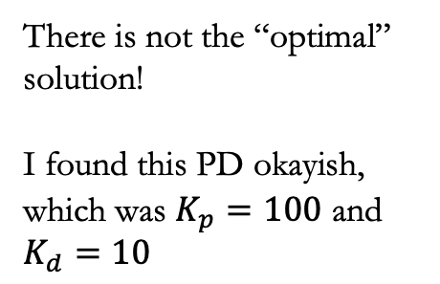
Solutions Exercise 1 (PID)
This is the reason we want a State-space controller!
There is not the “optimal” solution!
I found this PD okayish, which was $K_{p}=100$ and $K_{d}=10$

Slide 8

Exercise 2: State-Space control

Slide 9
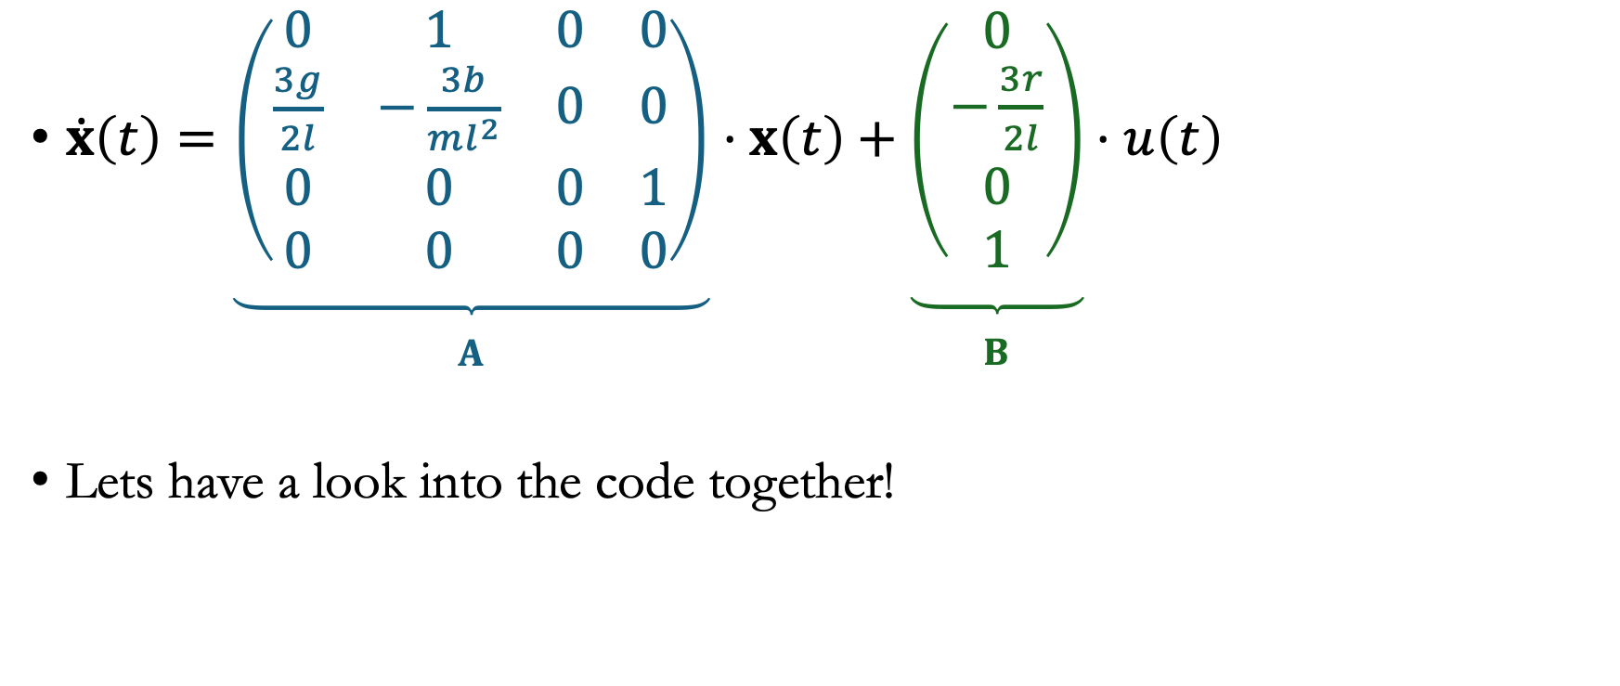
Solutions Exercise 2 (LQR)
$\dot{x}\left(t\right)=\underset{\begin{aligned} \\ A\end{aligned}}{\underbrace{\left(\begin{matrix}0 & 1 & 0 & 0 \\ \frac{3g}{2l} & −\frac{3b}{ml^{2}} & 0 & 0 \\ 0 & 0 & 0 & 1 \\ 0 & 0 & 0 & 0\end{matrix}\right)}}⋅x\left(t\right)+\underset{\begin{aligned} \\ B\end{aligned}}{\underbrace{\left(\begin{matrix}0 \\ −\frac{3r}{2l} \\ 0 \\ 1\end{matrix}\right)}}⋅u\left(t\right)$
Lets have a look into the code together!

Slide 10
Solutions Exercise 2 (LQR)
Everything smooth and stable now :)
I used
Q=(100, 1, 1000, 1)
And R=100

Slide 11
Solutions Exercise 3 (step)
We just want to change phi. Nevertheless, the controller did something „wrong“ here on purpose by counteracting the motion!
A PID would never do that, because it is „stupid“. A LQR instead knows the system and is smarter!

Slide 12
Solutions BONUS Exercise (LQI)
I used
Q=(100, 1, 1000, 1, 50000)
And R=100

Slide 13
Competition

Slide 14
The rules
Taking your LQR / LQI values!
Sequence of positions (0° → 30° → -30° → 0°, each for 5s)
Score = RMS(theta) + 1/10 * RMS(phi)
RMS only from 5 seconds on, so you have initially time to stabilize!
1x try per group during the exercise, 1 final shot!
Lowest score is the winner! ☺

Slide 15
The rules
Example
Lowest score is the winner! ☺

Slide 16
Discussions

Slide 17
Some questions…
Is a PID or LQR better for the inverted pendulum?
Which PID parameters and method you used? Which LQR weights?
How much of a difference you noticed between the simulated and the real pendulum?
Has the winning team got the “best” controller? Or were they lucky?

Slide 18
… and some answers
Is a PID or LQR better for the inverted pendulum?
It depends in general! But here the LQR was better, it counteracted the motion
Which PID parameters and method you used? Which LQR weights?
ZN is hard if system is intrinsically non-linear. PD worked best for me. I weighted theta and phi the strongest, the velocities not that much.
How much of a difference you noticed between the simulated and the real pendulum?
Even though the simulation ran on non-linearized equations, it is nearly impossible to simulate it perfectly. Many things were not fully described, like the stepper dynamics, friction models, and much more!
Has the winning team got the “best” controller? Or were they just lucky?
There is not something like a “best” controller. Maybe they build the “best” in keeping the pole vertically, but this is always a trade-off. E. g. maybe other groups had better results in terms of robustness (so more stable for big disturbances)

Slide 19
Take-aways
PID
No description of system necessary, fast solution
Only one output can be controlled (without further ado)
SISSO systems
State-Space
Modelling necessary
Therefore full state controllable
YES: Most of the life of a control engineer is to understand the system and find a good linearization, not the control itself ☺

Slide 20
Thank you!
https://www.youtube.com/watch?v=Rh7JuL3PRSY
Full git project (with all plots, examples, etc) https://github.com/alboeh/iCSC-2026-full.git

