Slide 1
Java Module aka JigSaw

Slide 2
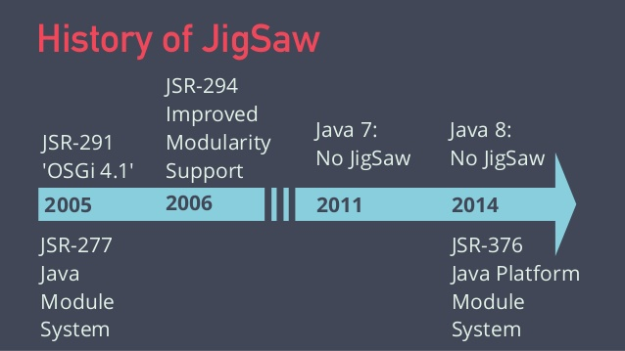

Slide 3
Java Modules
History
It started with the intention to design and implement a module system focused and narrowly for the JDK itself and NOT to be a part of the Java SE Platform.
But the growing demand of a standard module system for the Java Platform motivated expanding the scope of the project. And so it became a part of the Java SE.
JSR 277 Java Module System was originally proposed for Java 7 2005. Than superseded by JSR 376 Java Platform Module System target for Java 8 and finally released in Java 9 after it has been delayed to September 2017.
Some of the features had been out scoped such as the versioning of the modules, and the possibility to run 2 different versions of the same module in one application.

Slide 4
Java Modules
Goals
Reliable configuration - Modules must explicitly declare their dependencies to other modules.
Strong encapsulation - The packages in the module are only accessible if the module exports them. Even then, another module cannot use those packages unless it imports them. Also with reflection not exported packages, classes cannot be accessed.
Scalable Java Platform - Previously the Java Platform was a monolith with a massive number of classes and packages. Challenging to develop, maintain and evolve. Now Java consists of 95 (growing) modules. You can create custom runtimes consisting of only those modules you need.
Greater platform integrity - Before Java 9 it was possible to use any public class and method in the JDK, even when it was in the internal (com.sun….) package. This is now no longer possible.

Slide 5
Java Modules
Theory

Slide 6
Java Modules
Theory
Java 9 Modules uses the module path instead of the classpath. It derive the module path from the file module-info.java in your module.
Location of the file:
moduleName/src/module-info.java

Slide 7
Java Modules
Naming
It is recommended to use the reverse-domain pattern for module names, just like we name packages,
=> ch.zuehlke.myfirstmodule

Slide 8
Java Modules
Directory Structure
The name of the directory containing a module’s source should be equal to the name of the module => for ch.zuehlke.myfirstmodule
src +-main +- ch.zuehlke.myfirstmodule : our source root +- module-info.java : the module declaration +- ch : first package directory +- zuehlke +- myfirstmodule +- HelloModuleWorld.java

Slide 9
Java Modules
module-info.java
The file module-info.java is the module declarator. It contains the information of which package it exports, which module it imports and for which interfaces it provides an implementation.
The most simple declaration looks like
The name of the module
module ch.zuehlke.myfirstmodule {
}

Slide 10
Java Modules
module-info.java keywords
exports | Exports the named package (not the class!)
requires | Requires the named module
provides | Provides an implementation of an exported interface of an other module
uses | Uses an interface of an other module
Recognise!
Different level of granularity

Slide 11
Java Modules
module-info export / requires example
module ch.zuehlke.myfirstmodule {
exports ch.zuehlke.myfirstmodule.service; exports ch.zuehlke.myfirstmodule.serviceTwo;
}
Requires the module by its name
Imports all exported packages of the module
module ch.zuehlke.mysecondmodule {
requires ch.zuehlke.myfirstmodule;
}

Slide 12
Java Modules
module-info provides example
module ch.zuehlke.myfirstmodule {
exports ch.zuehlke.myfirstmodule.service;
}
The name of the interface
module ch.zuehlke.mysecondmodule {
requires ch.zuehlke.myfirstmodule; provides ch.zuehlke.myfirstmodule.service.DoIt with ch.zuehlke.mysecondmodule.DoItImpl
}

Slide 13
Java Modules
module-info uses example
module ch.zuehlke.mysecondmodule {
requires ch.zuehlke.myfirstmodule; provides ch.zuehlke.myfirstmodule.service.DoIt with ch.zuehlke.mysecondmodule.DoItImpl
}
module ch.zuehlke.mythirdmodule {
requires ch.zuehlke.myfirstmodule; requires ch.zuehlke.mysecondmodule; uses ch.zuehlke.myfirstmodule.service.DoIt
}

Slide 14
Java Modules
Lagacy non modularised jars
Ok so far we know how to write a module and declare its dependencies. But how can we use the libraries which have not yet been a module i.e. Junit?
In this case we just provide the name of the jar without the possible version information in the module-info.java as requires
For Junit junit-4.12.jar it would be
module ch.zuehlke.mythirdmodule {
requires junit; }
In this case the compiler creates an automatic module and exports all packages.
This means all public classes are visible.

Slide 15
Java Modules
Fine we can create new modules and use the old libraries. Cool so everything is fine?
Unfortunately
NO

Slide 16
Java Modules
They forgot the
TESTING

Slide 17
Java Modules
Testing
Since the module-info.java is in the main/java folder can we have a second module-info.java in the test/java folder?
NO

Slide 18
Java Modules
Only one module-info.java
To have only one module-info.java for a module has a nasty consequence.
Jar files only needed for testing must be declared in the module-info.java of the main folder.
This has the consequence that i.e. junit is now part of your module!
Do we like that? No
Do we want that? No
So what shall we do? A nasty trick: using module path extension at start up

Slide 19
Java Modules
Module Path extention
It is possible to add modules as arguments with
--add-modules
But we have to add all dependencies separately
J—add-modules unit,hamcrest.core

Slide 20
Java Modules
History

Slide 21
Java Modules
History

Slide 22
Java Modules
History

Slide 23
Java Modules
History

Slide 24
Java Modules
History

Slide 25
Java Modules
module-info.java

