Slide 1
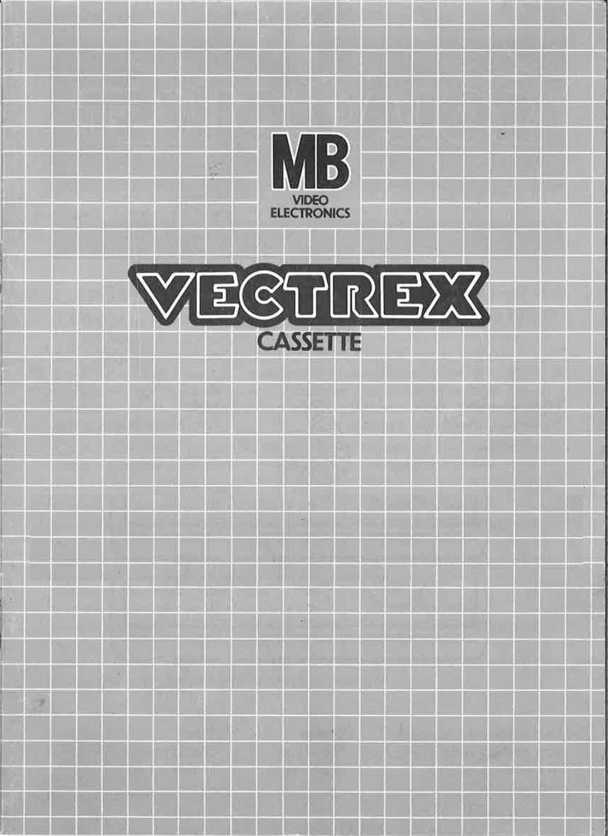
CROC & DOC

Slide 2
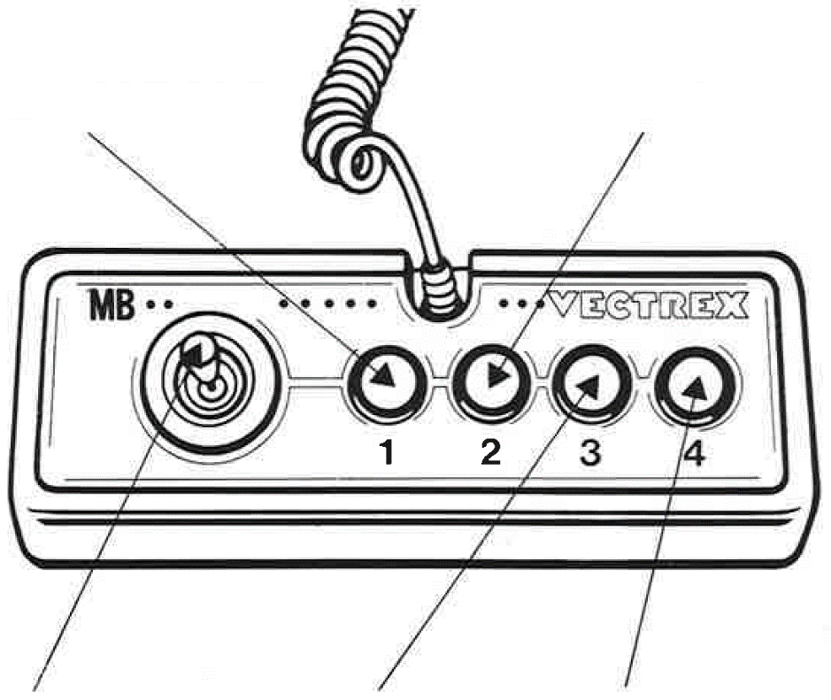
CROC & DOC
GAME CONTROLS
CROC & DOC is designed to be played with the built-in control panel only. The functions of the controls are:
Button 1
Jump
Button 2
Hit or grab.
Joystick
Moves character to the left or right.
Button 3
Swaps out the character.
Button 4
No function.

Slide 3
HOW TO PLAY
PLAYER SELECTION
This game can be played by only one player.
OPTION SELECTION
Description of the available game options and of how these options are selected in the game menu.
GAME PLAY
CROC & DOC is a Platformer which takes us on a Journey with the Crocodile Croc and the duck Doc with the objective to stop the villainous Prae Ying mantis from trying to largely dry up the earth with his space laser to bring the age of bugs as the new supreme leaders.
Croc and Doc excel at different tasks. Croc is strong, can dash forward and bite his way through the enemy forces. Doc on the other is small but can fly over large areas void of any safe place to stand on. Well, to the untrained eye it might seem more like gliding. Both characters can be swapped while on ground and if the other character is alive. At the start of each level, only Croc is alive. Beat the levels and you’ve won the game.
WHATEVER ELSE IS IMPORTANT
In the game your character is the center of the screen and can be moved through the stage. Jumping on villains makes them so dizzy that they will question their actions and leave the screen. But beware! Don’t get hit from the front or back. This will banish your current character from the screen, and he can’t be played until you find a crate that can be thrown and broken to bring him back. When both Doc and Croc are banished is the world doomed, and you will lose the game.
Can you stop them?

Slide 4
SCORING
Points are awarded for achieving the following:
Jump on enemies and persuade them with your buttocks to earn points.
HIGH SCORE MEMORY
As long as your machine is on, with the game cartridge in place, the highest score is retained. To see this score, press the Reset button. When the machine is turned off and the cartridge removed, the score is lost.
RESTARTING THE GAME
To restart a completed game with the same number of players and the same game option, press any of the four buttons once the game is over. If you wish to restart the game before it is completed, or change the number of players or the game option, press the Reset button.

Slide 5
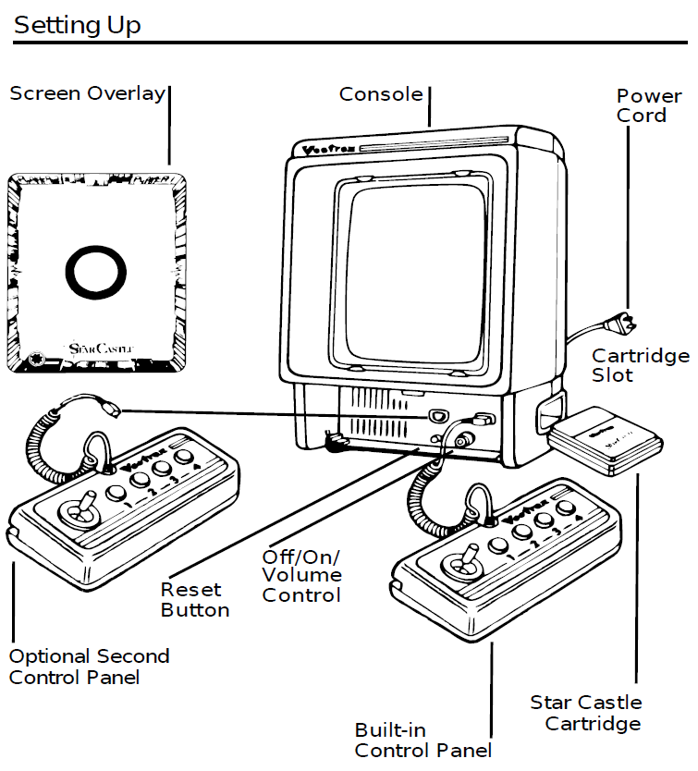
SETTING UP
CREDITS
This game was developed by Julian Albrecht and programmed in C and MC6809 assembly language. It is the outcome of a student project which was part of the elective course “Advanced hardware-oriented C and Assembly Language Programming” at Pforzheim University, Germany, in spring term 2025, supervised and tutored by Prof. Dr. rer. nat. Peer Johannsen.

Slide 6


