Slide 1

ANT 157L: Advanced Human Genetics Lab / Population Genetics
TA: Alaina Brenner
Dept. of Anthropology
Week 1: UNIX/BASH Lab

Slide 2
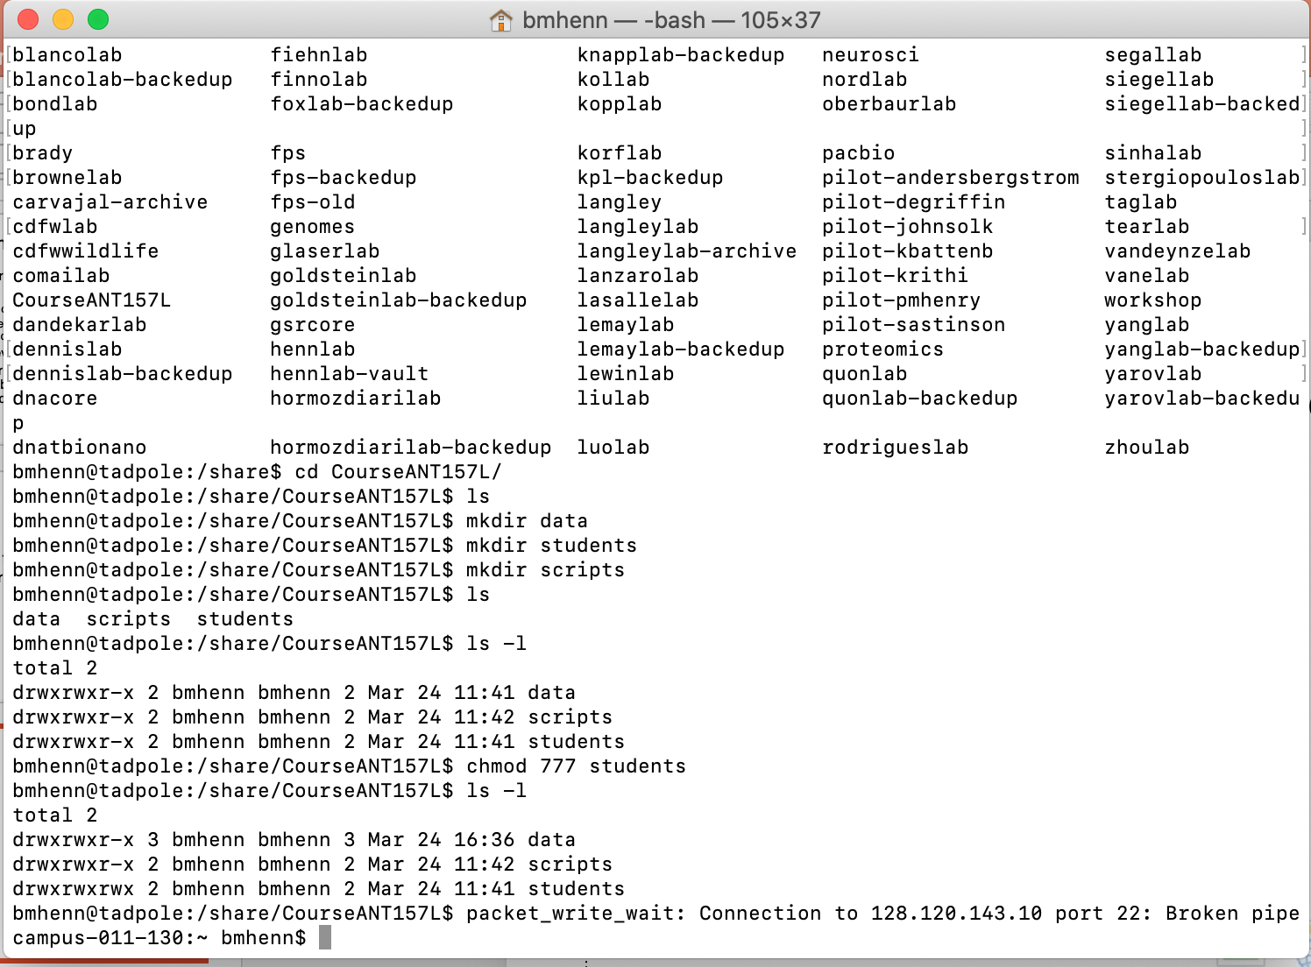
On a Mac: Open your Terminal
Click on the application to open →

Slide 3
print working directory
When you are not sure what directory you are in you can use the command pwd
$ pwd
prints working directory

Slide 4
change directories
$ cd /path/to/directory
$ cd data #cd to ‘data’ directory
$ cd ~ #home directory
$ cd .. #up one level
$ cd ../.. #up two levels
$ cd - #previous directory
. ← current directory
.. ← directory one level up

Slide 5
Let’s try that…
$ cd Desktop/
$ pwd
$ cd –
$ pwd

Slide 6
make a directory
$ mkdir foldername
$ cd Desktop/
$ mkdir week1

Slide 7
Filename Conventions
no spaces
as description and brief as possible
lower case is better
camelCase or no_camel_case
sometimes you cannot name files with a complete description of the file, so create a README.txt file

Slide 8
list directory contents
$ ls
lists files & directories
Switches
$ command [options]
$ ls –l #long form
$ ls –lt #long form sorted by time
$ ls –ltr #long form, sorted by time, reverse order
$ ls –lh #long form, human readable
Notes:
options are always in [ … ]

Slide 9
creating & deleting files
$ nano file.txt #creates text file to edit (file.txt)
$ rm file.txt #removes file.txt (cannot undo)
$ rm * #removes all files in directory
$ rm output.*
#removes anything starting with output, followed by any file extension

Slide 10
Using Nano
Edit text in a file
$ cd Desktop/
$ nano test_file.txt
Write something in this text file

Slide 11
copy a file
$ cp path/to/file/I/Want local/folder
For example, we made a directory called “week1”, move into that directory
$ cd week1
And you wanted to copy files from a different location
$ cp /Desktop/test_file.txt .
What does “.” mean?
How do I check if this has worked?
Don’t forget the space

Slide 12
Assignment 0: UNIX / BASH
http://swcarpentry.github.io/shell-novice/
Not graded
We will breakout into smaller groups
Start in your directory, for example
$ cd Desktop/week1
Begin working!

Slide 13
Notes
Working with Files and Directories
Skip the exercises with using the GUI file explorer

Slide 14
displaying files
$ cat file.txt #prints file to terminal
$ less file.txt #shows preview of file.txt
$ head file.txt #prints first 10 lines to terminal
$ head –n 100 file.txt #prints first 100 lines to terminal
$ tail file.txt #prints last 10 lines to terminal

Slide 15
command redirection
$ ls | less #output of ls piped over to less
$ ls | grep .txt | less
# output of ls piped to grep (which searches for searches for .txt)
the matches from grep are piped to less

Slide 16
command redirection
$ ls –l > DirectoryList.txt
# output from ls is redirected to a file called DirectoryList.txt
$ ls –l | grep chr22 > matches.txt
# output from ls is piped to grep, results are sent to file called matches.txt
> #creates new file (removes existing file)
>> #appends to existing file

Slide 17
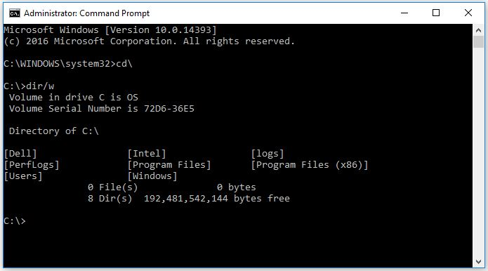
On a Microsoft Windows: Open Command Prompt
Search for application to open →

