Slide 1
Assessment 2 - Portfolio
COIT11241: Cyber Security Technologies
Name: Albrent Pangan
ID: 12185449
09/2024

Slide 2
Week 6
Search the Information System for Vulnerabilities

Slide 3
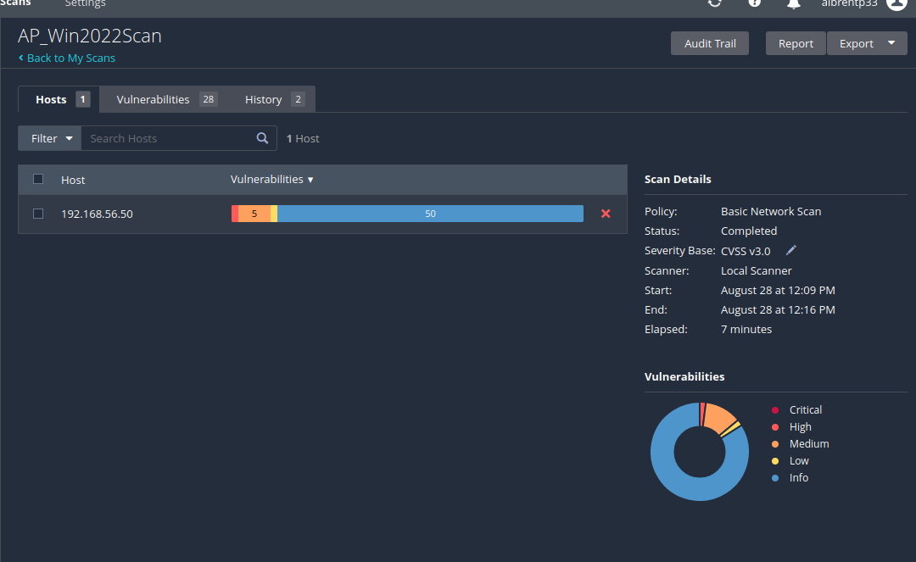
Win2022 VM Vulnerability scan

Slide 4
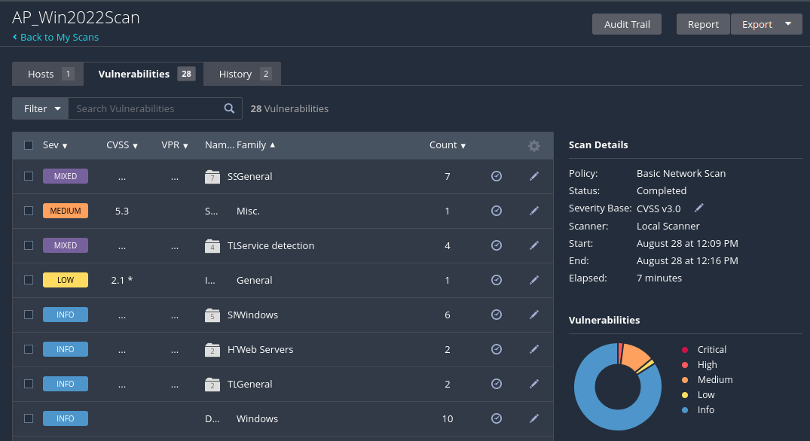
Vulnerabilities
Critical: N/A
High: 2%
Medium: 12%
Low: 2%
Info: 84%

Slide 5
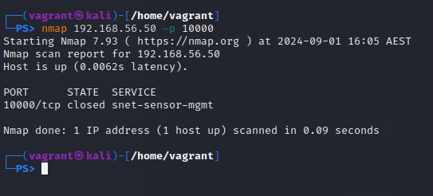
Win2022 VM Nmap
Command: nmap 192.168.56.50 –p 10000

Slide 6
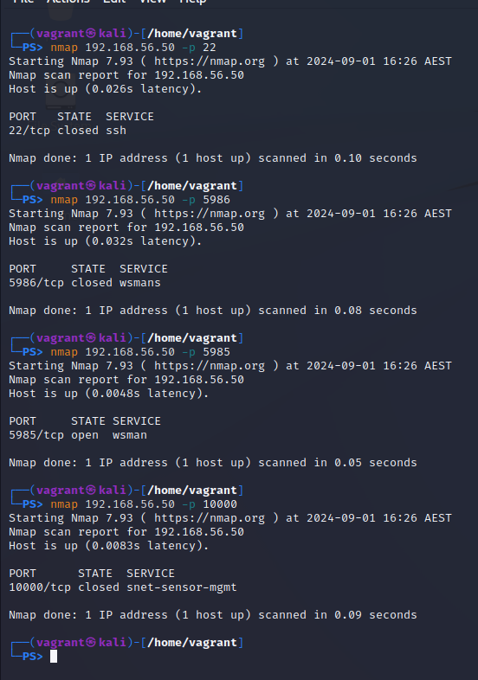
More nmap ports

Slide 7
WafW00f

Slide 8
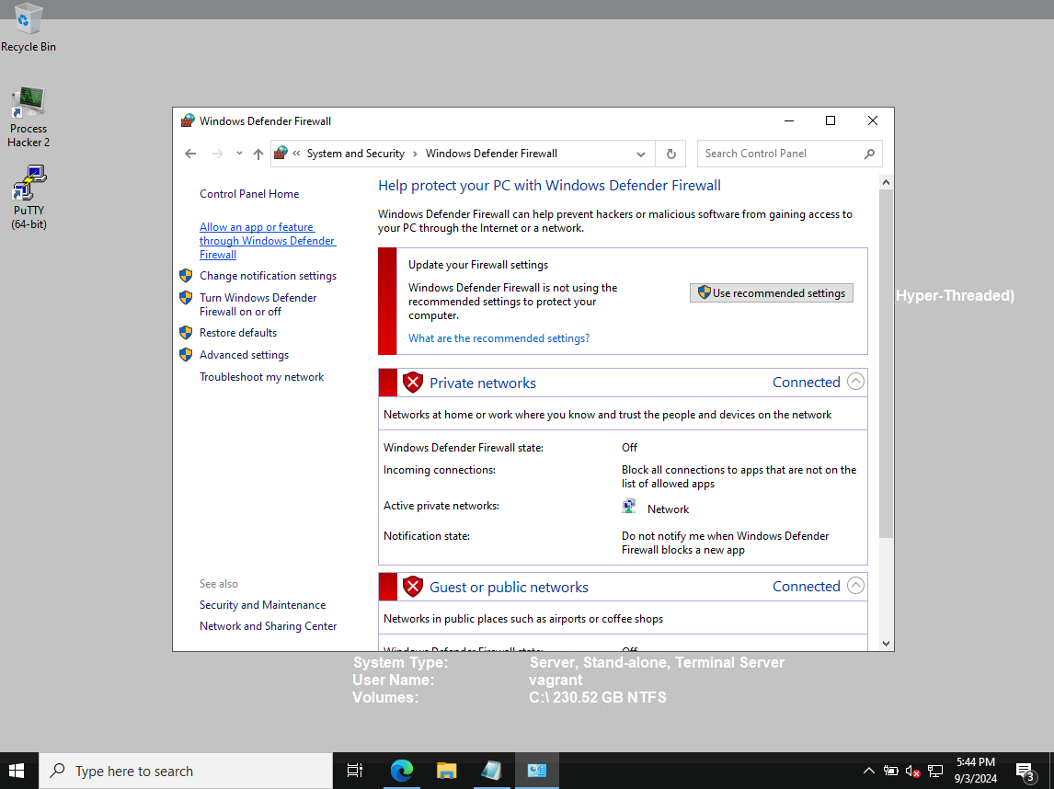
Windows Firewall appears to be Off

Slide 9
Week 7
ATT&CK Threat intelligence Report

Slide 10
Threat Intelligence Report
Group Name: Lace Tempest (Ransomware actors exploiting MoveIt Transfer vulnerability | TechTarget)
Associated Groups: Clop Ransomware (Ransomware actors exploiting MoveIt Transfer vulnerability | TechTarget)
Description: Lace Tempest, also known as DEV-0950, is a threat actor group that has exploited zero-day vulnerabilities in software such as Progress Software’s MoveIt Transfer. This group is recognized for deploying the Clop ransomware to exfiltrate data from compromised networks and conduct extortion attacks. (DEV-0950 (Threat Actor) (fraunhofer.de))
Techniques:
Exploitation of Zero-Day Vulnerability: CVE-2023-34362 (T1190) – Lace Tempest exploited a critical SQL injection flaw in MoveIt Transfer to gain unauthorized access and deploy a custom web shell. (Exploit Public-Facing Application, Technique T1190 - Enterprise | MITRE ATT&CK®), (Ransomware actors exploiting MoveIt Transfer vulnerability | TechTarget)
Web Shell Deployment: Custom web shell “Lemurloot” (T1071.001) – Used for data exfiltration, disguised with the filename "human.aspx." (Application Layer Protocol: Web Protocols, Sub-technique T1071.001 - Enterprise | MITRE ATT&CK®), (Ransomware actors exploiting MoveIt Transfer vulnerability | TechTarget)
Software Name: Clop Ransomware (Ransomware actors exploiting MoveIt Transfer vulnerability | TechTarget),
Group Association: Clop Ransomware is the primary tool used by Lace Tempest for data theft and extortion. (Ransomware gang behind MOVEit attacks is targeting new zero-day, Microsoft says (therecord.media))
Description: Clop ransomware is employed by Lace Tempest to encrypt files and demand ransoms. The ransomware is used in conjunction with other tools to achieve persistence and data extraction. (Ransomware gang behind MOVEit attacks is targeting new zero-day, Microsoft says (therecord.media)), (Ransomware actors exploiting MoveIt Transfer vulnerability | TechTarget)
Platform: Windows, Powershell
Techniques:
Boot or Logon Autostart Execution: Registry Run Keys / Startup Folder (T1547.001) – Clop ransomware has been observed using Registry Run keys to establish persistence. (Boot or Logon Autostart Execution: Registry Run Keys / Startup Folder, Sub-technique T1547.001 - Enterprise | MITRE ATT&CK®), (Ransomware actors exploiting MoveIt Transfer vulnerability | TechTarget)
File and Directory Discovery: Custom methods – Clop ransomware has used malicious techniques to discover and exfiltrate sensitive data from compromised systems. (Ransomware actors exploiting MoveIt Transfer vulnerability | TechTarget)

Slide 12
Week 8
Prioritise Vulnerabilities

Slide 13
CVE-2023-34362
CWE | CAPEC | ATT&CK | Used By Threat Actor

Slide 14
CVE-2023-0669
CWE | CAPEC | ATT&CK | Used By Threat Actor

Slide 15
CVE-2023-47246
CWE | CAPEC | ATT&CK | Used By Threat Actor
CWE-22

