Slide 1
Assessment 2 - Portfolio
COIT11241 – Cyber Security Technologies
Albrent Pangan - 12185449, Joshua Kerley - 12257521, Matthew Hunt - 12260484

Slide 2
Week 6
Search the Information System for Vulnerabilities

Slide 3
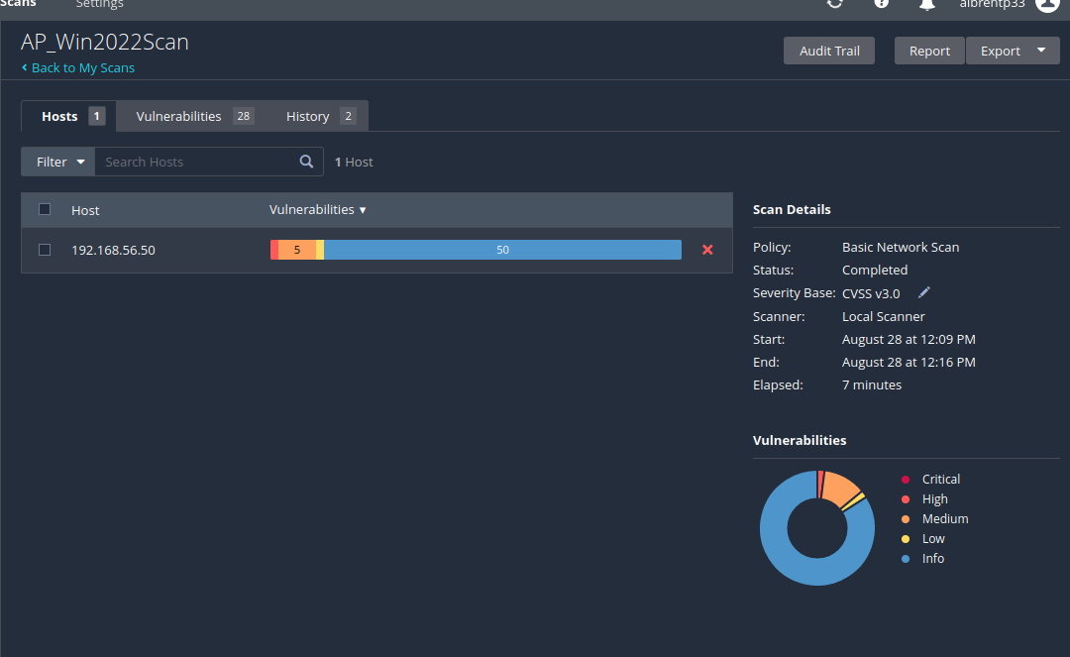
Win2022 VM Nessus Vulnerability scan

Slide 4
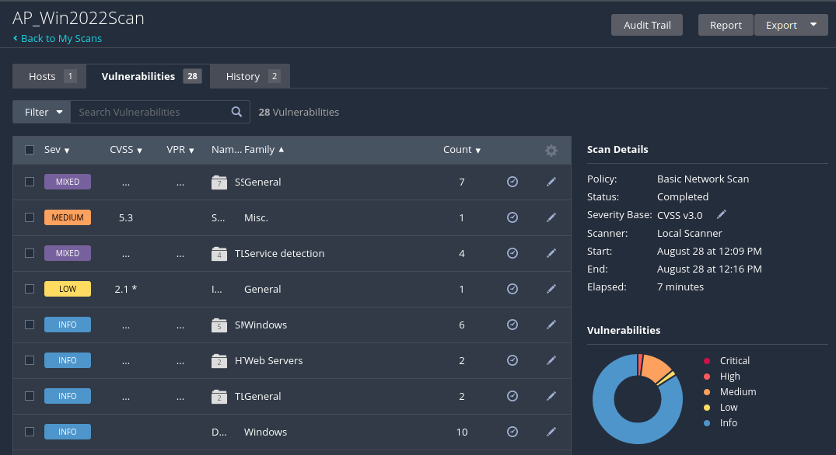
Vulnerabilities
Critical: N/A
High: 2%
Medium: 12%
Low: 2%
Info: 84%

Slide 5
Nmap
Nmap offers several benefits, including quickly identifying devices and networks, discovering running services and DNS servers, and determining the operating systems on networked devices. Its GUI, Zenmap, helps visualise network mappings for reporting and enhanced use. Additionally, Nmap can detect unauthorised services and find devices with open ports, aiding in improving network security.
Source: Top 8 Nmap Commands you should know in 2024 (mygreatlearning.com)

Slide 6
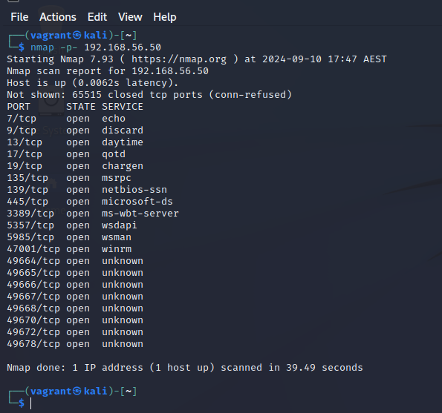
Nmap scan all ports from Win2022
The command
“nmap -p- 192.168.56.50” scans a total of 65,535 TCP ports in the Win2022 vm. The scan shows that the host is active with a 0.0062-second latency. Out of all of these ports, 20 are open and 65,515 are closed. The open ports included 7, 9, 13, 17, 19, 135, 139, 445, 3389, 5357, 5985, 4700 aswell as several other high-numbered ports. Services running on these ports included echo, discard, daytime, qotd, chargen, msrpc, netbios-ssn, microsoft-ds, ms-wbt-server, wsdapi, wsman, winrm, and some other unknown services. This information is useful for network security assessments and open ports need to revised by MediSecure.
Notes:
- Fix up

Slide 7
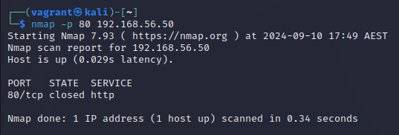
Win2022 VM Nmap port 80
Port 80 is the default network port for web servers using HTTP.
The command nmap -p 80 192.168.56.50 scans port 80 on the IP address 192.168.56.50. The host is up with a latency of 0.029 seconds, but port 80 is closed, indicating no HTTP service is running on that port. The scan completed in 0.34 seconds.

Slide 8
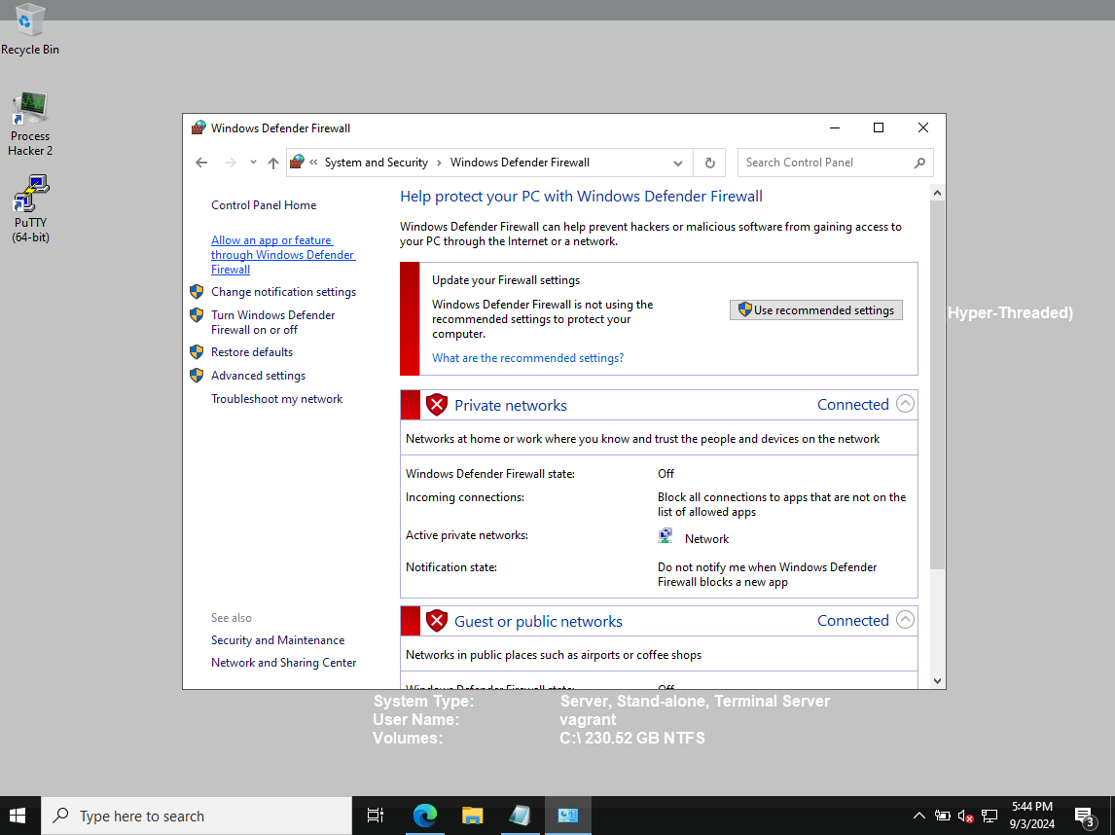
Observation
Windows Firewall appears to be Off

Slide 9
Week 7
ATT&CK Threat intelligence Report

Slide 10
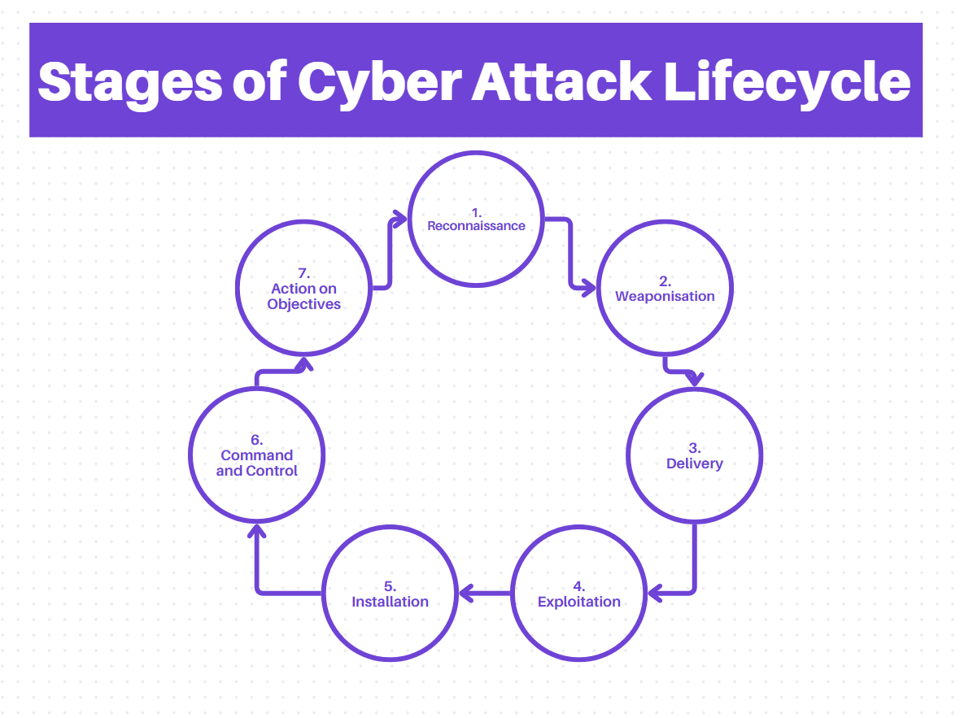

Slide 11
Stages of Cyber Attack Lifecycle
Reconnaissance – scan the environment for information​, this information could be found by scouring social media.
Weaponisation – creation of malware​ is done through combining malicious code with an exploit.
Delivery – Delivering the weapon to target​, this can be done via email, usb or could also be done through clicking a website link.
Exploitation – the malware is triggered, exploiting the vulnerability.​

Slide 12
Stages of Cyber Attack Lifecycle continued…
5. Installation – malware is installed on the system​ via the previously created weapon in step 2.
6. Command and Control – a channel used to gain control over the target​. This is done to be able to manipulate the target.
7. Action on Objections – threat actor can achieve their goal given they now have access​ into the desired location of attack.

Slide 13
Threat Intelligence Report
Group Name: Lace Tempest (Ransomware actors exploiting MoveIt Transfer vulnerability | TechTarget)
Associated Groups: Clop Ransomware (Ransomware actors exploiting MoveIt Transfer vulnerability | TechTarget)
Description: Lace Tempest, also known as DEV-0950, is a threat actor group that has exploited zero-day vulnerabilities in software such as Progress Software’s MoveIt Transfer. This group is recognized for deploying the Clop ransomware to exfiltrate data from compromised networks and conduct extortion attacks. (DEV-0950 (Threat Actor) (fraunhofer.de))
Techniques:
Exploitation of Zero-Day Vulnerability: CVE-2023-34362 (T1190) – Lace Tempest exploited a critical SQL injection flaw in MoveIt Transfer to gain unauthorized access and deploy a custom web shell. (Exploit Public-Facing Application, Technique T1190 - Enterprise | MITRE ATT&CK®), (Ransomware actors exploiting MoveIt Transfer vulnerability | TechTarget)
Web Shell Deployment: Custom web shell “Lemurloot” (T1071.001) – Used for data exfiltration, disguised with the filename "human.aspx." (Application Layer Protocol: Web Protocols, Sub-technique T1071.001 - Enterprise | MITRE ATT&CK®), (Ransomware actors exploiting MoveIt Transfer vulnerability | TechTarget)
Software Name: Clop Ransomware (Ransomware actors exploiting MoveIt Transfer vulnerability | TechTarget),
Group Association: Clop Ransomware is the primary tool used by Lace Tempest for data theft and extortion. (Ransomware gang behind MOVEit attacks is targeting new zero-day, Microsoft says (therecord.media))
Description: Clop ransomware is employed by Lace Tempest to encrypt files and demand ransoms. The ransomware is used in conjunction with other tools to achieve persistence and data extraction. (Ransomware gang behind MOVEit attacks is targeting new zero-day, Microsoft says (therecord.media)), (Ransomware actors exploiting MoveIt Transfer vulnerability | TechTarget)
Platform: Windows, Powershell
Techniques:
Boot or Logon Autostart Execution: Registry Run Keys / Startup Folder (T1547.001) – Clop ransomware has been observed using Registry Run keys to establish persistence. (Boot or Logon Autostart Execution: Registry Run Keys / Startup Folder, Sub-technique T1547.001 - Enterprise | MITRE ATT&CK®), (Ransomware actors exploiting MoveIt Transfer vulnerability | TechTarget)
File and Directory Discovery: Custom methods – Clop ransomware has used malicious techniques to discover and exfiltrate sensitive data from compromised systems. (Ransomware actors exploiting MoveIt Transfer vulnerability | TechTarget)

Slide 14
Techniques & Sub-techniques Process Injection
Main Technique: Process Injection | ID: T1055
Sub-technique(s): | T1055.001, T1055.002, T1055.003, T1055.004, T1055.005, T1055.008, T1055.009, T1055.011, T1055.012, T1055.013, T1055.014, T1055.015
Tactics: | Defence Evasion, Privilege Escalation
Platforms: | Linux, Windows, macOS
Defense Bypassed: | Anti-virus, Application control
Adversaries use process injection to execute code within another process's address space, allowing them to bypass defenses, access memory, and potentially elevate privileges. This method often evades detection by masking malicious activity within legitimate processes. Various code injection techniques exist, each tailored to specific operating systems, and some advanced methods involve multiple injections and IPC mechanisms to further avoid detection.
Source: Process Injection, Technique T1055 - Enterprise | MITRE ATT&CK®

Slide 15
Techniques & Sub-Techniques Server Software Component
Main Technique: Server Software Component | ID: T1505
Sub-technique(s): | T1505.001, T1505.002, T1505.003, T1505.004, T1505.005
Tactics: | Persistence
Platforms: | Linux, Network, Windows, macOS
Defense Bypassed: | N/A
Adversaries might exploit legitimate extensibility features in server applications to gain persistent access. These features often allow developers to add custom software or scripts to enhance the application's functionality. Attackers can leverage these capabilities to install malicious components and misuse the server applications.
Source: Server Software Component, Technique T1505 - Enterprise | MITRE ATT&CK®

Slide 16
Techniques & Sub-Techniques Exfiltration Over Alternative Protocol
Main Technique: Exfiltration Over Alternative Protocol | ID: T1048
Sub-technique(s): | T1048.001, T1048.002, T1048.003
Tactics: | Exfiltration
Platforms: | Google Workspace, IaaS, Linux, Network, Office 365, SaaS, Windows, macOS
Defense Bypassed: | N/A
Adversaries may exfiltrate data using different protocols or network locations than the main command and control channel. Common alternative protocols include FTP, SMTP, HTTP/S, DNS, and SMB, which can be encrypted or obfuscated. Tools like Net/SMB, FTP, and curl on macOS or Linux facilitate this. Additionally, IaaS and SaaS platforms like Microsoft Exchange and AWS S3 enable direct data downloads via web consoles or APIs.
Source: Exfiltration Over Alternative Protocol, Technique T1048 - Enterprise | MITRE ATT&CK®

Slide 17
Techniques & Sub-Techniques Credential Dumping
Main Technique: OS Credential Dumping | ID: T1003
Sub-technique(s): | T1003.001, T1003.002, T1003.003, T1003.004, T1003.005, T1003.006, T1003.007, T1003.008
Tactics: | Credential Access
Platforms: | Linux, Windows, macOS
Defense Bypassed: | N/A
Adversaries may dump credentials to acquire login information and passwords, typically in hash or plaintext form. They can extract these credentials from OS caches, memory, or system structures. Once obtained, credentials facilitate lateral movement and access to restricted data.
Both attackers and security professionals may use the tools associated with these techniques, along with additional custom tools.
Source: OS Credential Dumping, Technique T1003 - Enterprise | MITRE ATT&CK®

Slide 18
Techniques & Sub-Techniques Exploitation For Client Execution
Main Technique: Exploitation For Client Execution | ID: T1203
Sub-technique(s): | No Sub-Techniques
Tactics: | Execution
Platforms: | Linux, Windows, MacOS
Defense Bypassed: | N/A
Adversaries may exploit vulnerabilities in client applications to execute arbitrary code. These vulnerabilities, often due to insecure coding practices, can lead to unexpected behavior. Exploiting these vulnerabilities, especially those allowing remote code execution, is highly valuable for gaining access to systems. Targeting common applications is effective because they are frequently used and thus offer high utility for exploitation.
Source: Exploitation for Client Execution, Technique T1203 - Enterprise | MITRE ATT&CK®

Slide 19
Rationale For Techniques Identified (1&2)
1. SQL Injection (T1055) Exploiting SQL injection vulnerabilities, like CVE-2023-34362, allows the threat actor to access and manipulate databases, bypass security, and control systems. This technique has proven effective in high-impact attacks and is crucial for accessing sensitive data. (Process Injection, Technique T1055 - Enterprise | MITRE ATT&CK®), (Ransomware actors exploiting MoveIt Transfer vulnerability | TechTarget)
2. Web Shell Deployment (T1505) Deploying web shells such as "Lemurloot" enables tenacious control and data extraction from compromised systems. These shells blend with legitimate components, reducing detection risks and ensuring continuous access. (Server Software Component, Technique T1505 - Enterprise | MITRE ATT&CK®), (Ransomware actors exploiting MoveIt Transfer vulnerability | TechTarget)

Slide 20
Rationale For Techniques Identifies (3&4)
3. Data Exfiltration (T1048) Efficient data exfiltration is key to the threat actor’s operations. Techniques that allow them to extract large volumes of sensitive files, including those from cloud storage, maximize our leverage over victims and enhance extortion potential. (Exfiltration Over Alternative Protocol, Technique T1048 - Enterprise | MITRE ATT&CK®), (Ransomware actors exploiting MoveIt Transfer vulnerability | TechTarget).
4. Credential Dumping (T1003) Credential dumping expands our reach within networks by extracting and using credentials for privilege escalation and lateral movement. This broadens our impact and allows deeper system compromise. (), (Ransomware actors exploiting MoveIt Transfer vulnerability | TechTarget).

Slide 21
Rationale For Techniques Identified (5)
5. Exploitation of Zero-Day Vulnerabilities (T1203) Zero-day vulnerabilities provide a significant advantage by allowing the threat actor to exploit weaknesses before they are patched. This ensures their attacks remain effective and impactful, keeping them ahead of defensive measures. (Exploitation for Client Execution, Technique T1203 - Enterprise | MITRE ATT&CK®), (Ransomware actors exploiting MoveIt Transfer vulnerability | TechTarget)
Conclusion: The threat actors will implement these techniques to enhance their capability to execute successful attacks, take control over compromised systems, and extract valuable data. This strategic focus ensures that they remain at the front of cybercriminal operations, leveraging both vulnerabilities and advanced exploitation methods to achieve their objectives.

Slide 22
Week 8
Prioritise Vulnerabilities

Slide 23
CVE-2023-34362
Severity: 9.8 Critical
CWE | CAPEC | ATT&CK | Used By Threat Actor
CWE-89 | 66 – SQL Injection | T1190 - Exploit Public-Facing Application | Yes LaceTempest Uses T1203 to Exploit Moveit’s database
 | 108 - Command Line Execution through SQL Injection | T1059 - Command and Scripting Interpreter | Yes Used by LaceTempest, similar to T1083
 |  | T1041 - | Not used
CVE-2023-34262 and the threat actor LaceTempest, action should be taken. T1203 (Exploitation for Client Execution) is relevant as it involves exploiting client-side vulnerabilities, a method used by LaceTempest. T1190 (Exploit Public-Facing Application) is directly related to SQL Injection vulnerabilities like CVE-2023-34262. T1068 (Exploitation for Elevation) is less directly related but may be part of a broader attack chain. Since these techniques are pertinent to LaceTempest's methods, CVE-2023-34262 is likely to be exploited by them.

Slide 24
CVE-2023-47246
Severity: 9.8 Critical
CWE | CAPEC | ATT&CK | Used By Threat Actor
CWE-22 | 126 - Path Traversal | T1083 – File and Directory Discovery | T1083 Used by LaceTempest
 | 76 - Manipulating Web Input to File System Calls | T1565 - Data Manipulation | T1565 Used by LaceTempest
The vulnerability CVE-2023-47246 and the threat actor LaceTempest, action is warranted. T1083 (File and Directory Discovery) is relevant as it helps attackers identify exploitable files, T1565 (Data from Information Repositories) aligns with the directory traversal vulnerability that could expose sensitive data. Both techniques are pertinent to how LaceTempest operates. Given their relevance, CVE-2023-47246 is likely to be exploited by LaceTempest.

Slide 25
CVE-2023-0669
Severity: 7.2 High
CWE | CAPEC | ATT&CK | Used By Threat Actor
CWE-502 - Deserialisation of Untrusted Data | 586 - Object Injection | T1203 – Exploitation of data | Yes, LaceTempest Uses T1203 to Exploit Moveit’s database
-- | -- | T1486
-- | -- | T1068 - Exploitation for Privilege Escalation
LaceTempest has been exploiting vulnerabilities similar to CVE-2023-0669. CWE-502 (Deserialisation of Untrusted Data) is a critical vulnerability that can lead to severe security issues. Relevant Mitre ATT&CK techniques, particularly T1203 (Exploitation for Client Execution) and T1068 (Exploitation for Elevation of Privilege), support the likelihood of exploitation by showing how such vulnerabilities could be used in attacks. Given the high-risk nature of this vulnerability and its exploitation by a known threat actor, immediate action should be taken to mitigate the risks associated with CVE-2023-0669.

Slide 26
Week 9
Emulate An Attack
T1083
T1115

Slide 27

Attack 1 - T1083
The attack that has been emulated is T1083.
This attack allows attackers to identify exploitable files as gives all the files found in a directory
This attack was chosen as it is used by Lace Tempest in there Clop ransomware therefore its essential to recognise attacks by this group to ensure security in our information system for MediSecure.

Slide 28
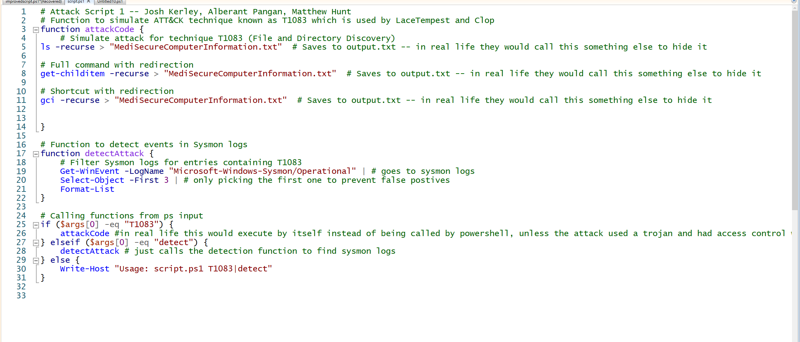
Basic Script for T1083 Attack and Detect
Attack based of Atomic Red Test T1083 test 2, functions and detection based of what was shown in class, ChatGPT4 creating the appending data code and writing a file for output in temp.

Slide 29
Information
As seen in the previously slide the attack script is similar to what would be used in real life, however the script would likely change slightly to improve the attack. This would be done by the output file name being changed to hide the attack. This wasn’t done for demonstration purposes. Also, the file would likely be deleted afterwards as well to further hide the attack. Again, this wasn’t done for demo purposes. Before the file would be deleted it would be uploaded to a secured private server where the attackers could access the file and read the private information which then would be used to further attack the company.

Slide 30
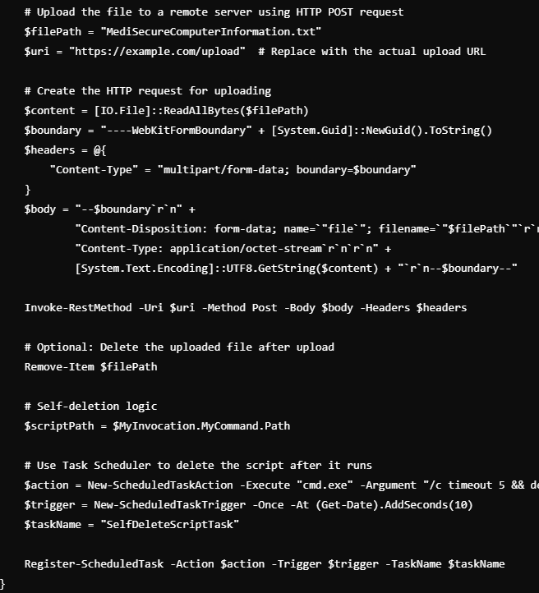
Example improvement of script through ChatGpt4
This would just add uploading the file to a server in the attack function
of the script.

Slide 31
Commands to Emulate the attack / detect.
& "C:\Users\vagrant\Documents\Powershell Scripts\script.ps1" T1083
& "C:\Users\vagrant\Documents\Powershell Scripts\script.ps1" detect
These are the commands for demo purposes, in real life the detection script would have to be made by itself as obviously attackers wouldn’t include the detection for the attack in the attack script.
The attack script could also be activated in many different ways but that is up to the attacker, LaceTempest would likely try many attempts to ensure success, possibly execution through the ransomware which may be brought onto the systems by phishing emails with virus links.

Slide 32
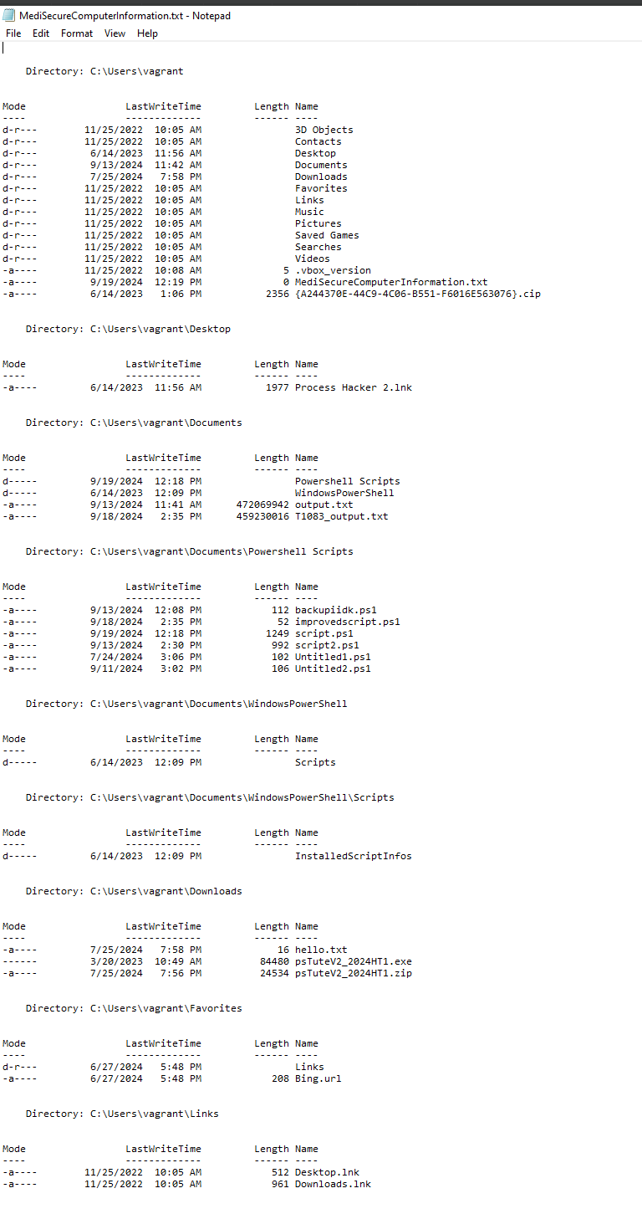
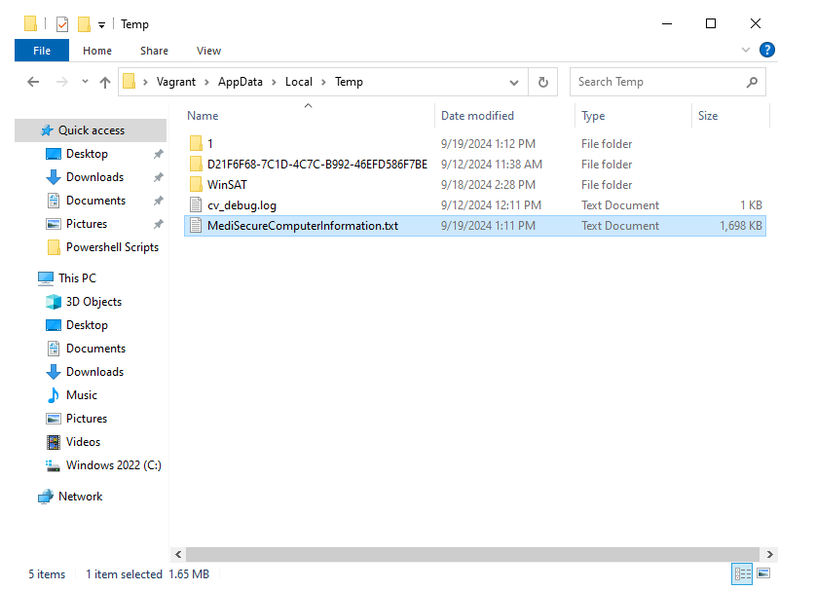
T1083 attack in action
Although it's hard to see here, this documents list all the files under the victim's computer in their C: drive. This is what the attackers get after executing the attack. The script uses powershell to list the files and then save it to a document which they can view later.
← There is heaps more computer information data regarding files and directories but its way to long to show all it.

Slide 33
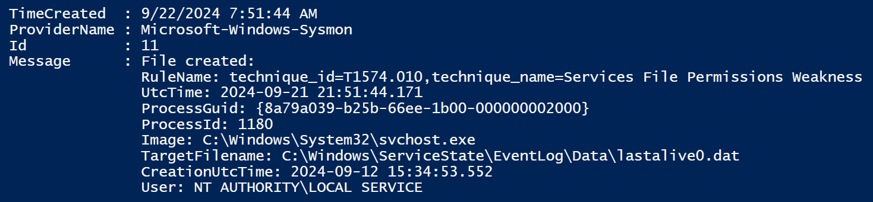
Detecting the Attack

Slide 34
Test Explained
Although the code executes a T1083 technique, Sysmon does not detect the exact attack.
It does however recognise that there is an attack and shows a detection of T1574

Slide 35
Attack 2 - T1115
This attack scripts targets a victim's clipboard to try and obtain information about pipe processes.
This is relevant at this an attack technique used by LaceTempest as mentioned on Mitre attack.

Slide 36
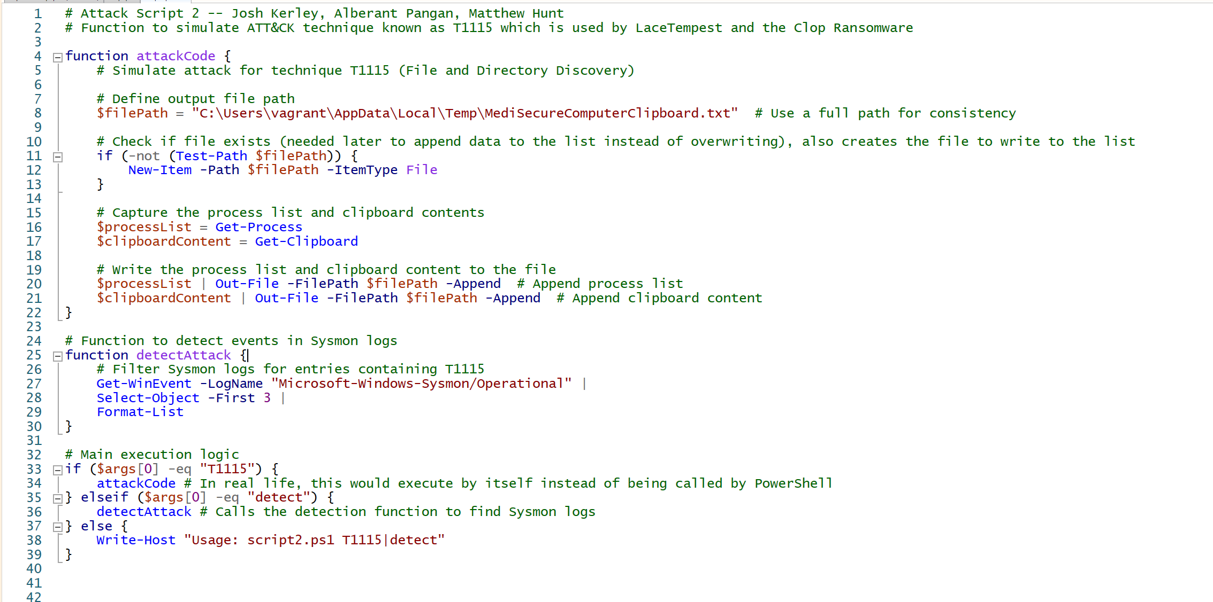
Attack Script + Detection Script
Script based of first script (functions and calling, appending to list, temp file location etc.) Script based of Atomic Red Test T1115 #2 - Execute Commands from Clipboard using PowerShell. Script improved to be realistic using ChatGPT4.

Slide 37
Script Improvement
Similar to last time obviously the previous improvements mentioned would be made here aswell as that script would be a realistic example of a proper attack. Again wasn’t done for demo purposes.

Slide 38
Script Commands
& "C:\Users\vagrant\Documents\Powershell Scripts\script2.ps1" T1115
& "C:\Users\vagrant\Documents\Powershell Scripts\script2.ps1" detect
Wouldn’t be used likely in real life other as the script would most likely execute by itself. Similar to the script commands mentioned in attack 1.

Slide 39
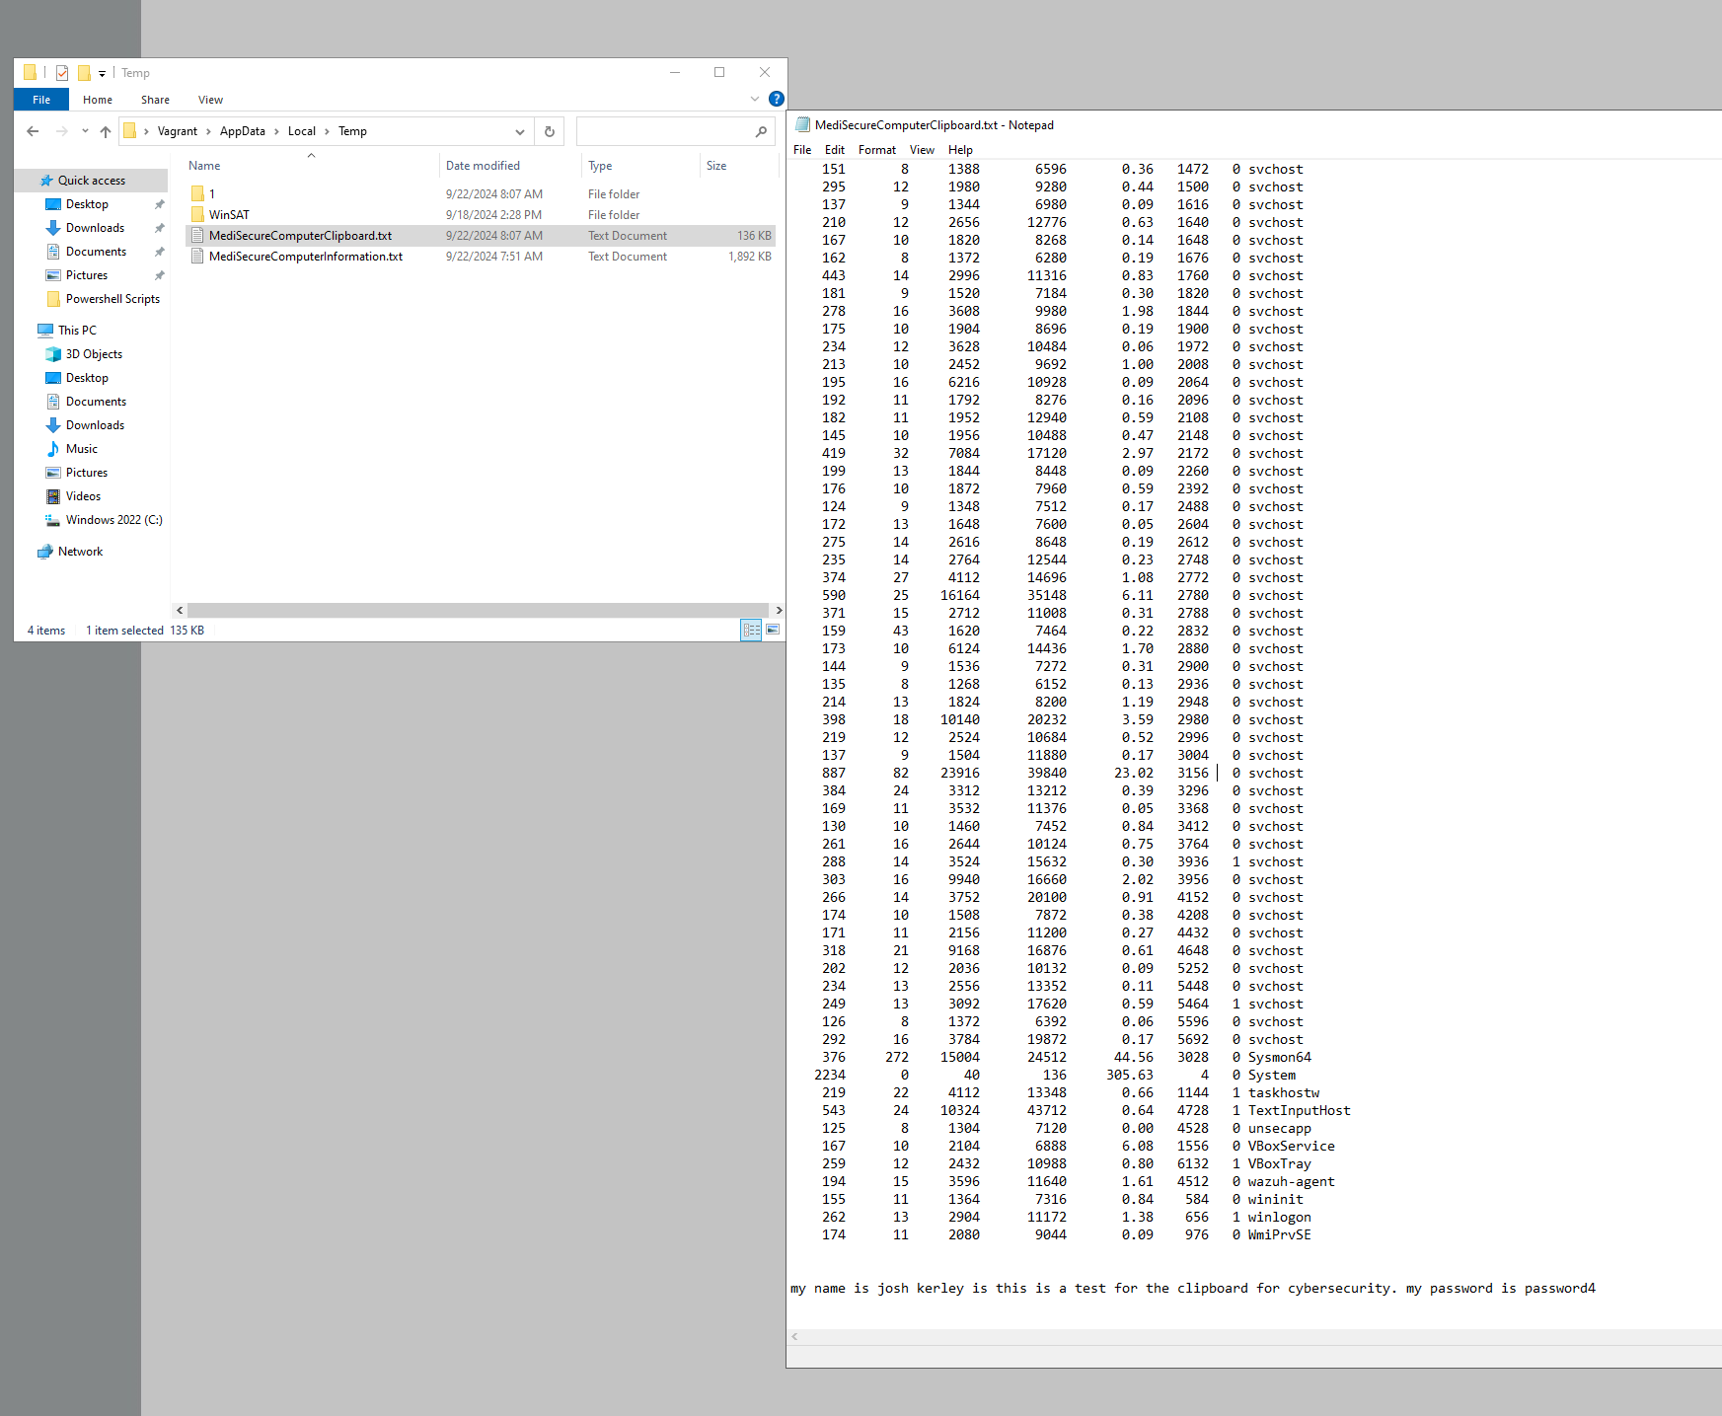
Attack Demo
As seen the script captures sensitive information, this is dangerous considering users sometimes copy and paste passwords across sites. As seen in the example file a possible password leak can occur as the attackers have access to anything that is copy and pasted.

Slide 40
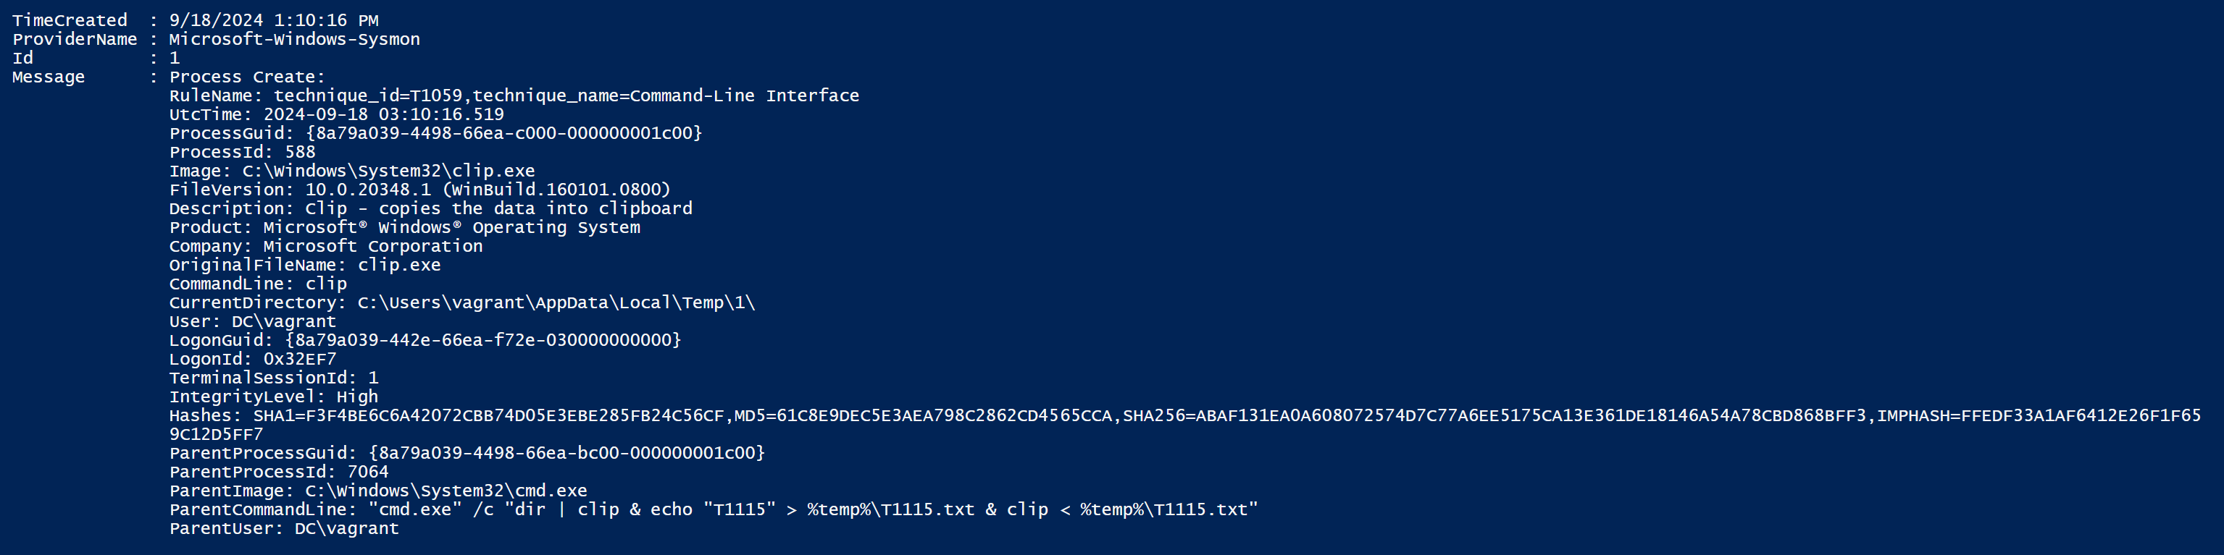
Detection
For some reason the script does not get detected even though it has clearly taken clipboard date and pipeline information. Here’s an example of a detection when an atomic test is done. Even still is it not an exact match of technique which goes to show how dangerous an attack like this can be.

Slide 41
Attack Explained
In summary the attack obtains pipeline information which is dangerous as its sensitive information. The info can give malicious attackers the ability to finder usernames, passwords and help attackers find vulnerable software to further attack. The clipboard is obviously dangerous and a very clear breach of privacy as people often copy and paste passwords especially if they use a password manager.

Slide 42
Git Repository
https://github.com/albrent05/ePortfolio.git

