Slide 1
Assessment 2 - Portfolio
COIT11241: Cyber Security Technologies
Name: Albrent Pangan
ID: 12185449
09/2024

Slide 2
Week 6
Vulnerabilities Scan

Slide 3
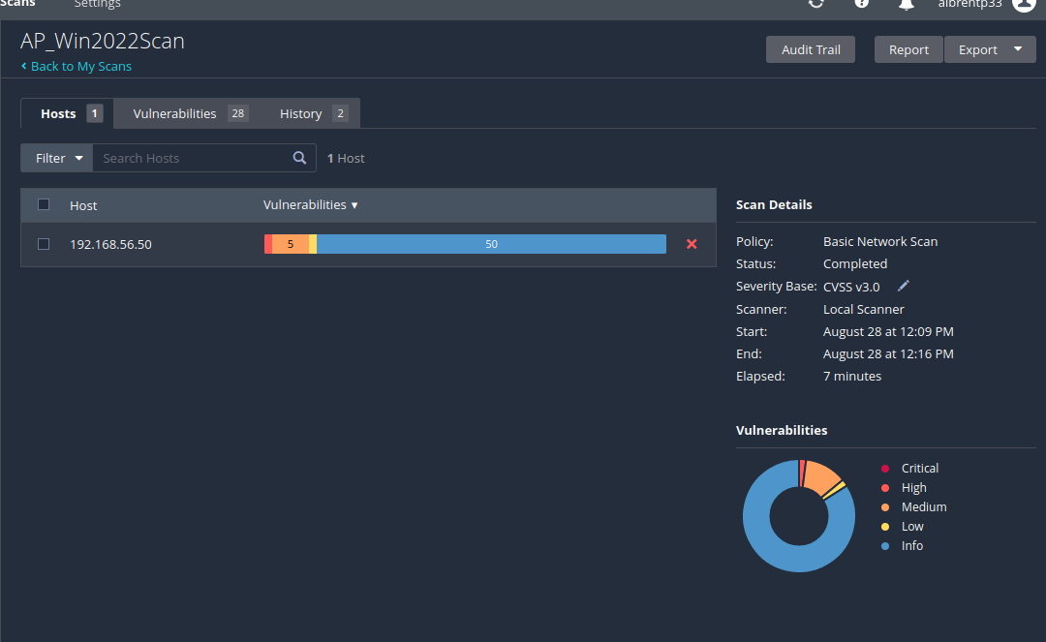
Win2022 VM Vulnerability scan

Slide 4
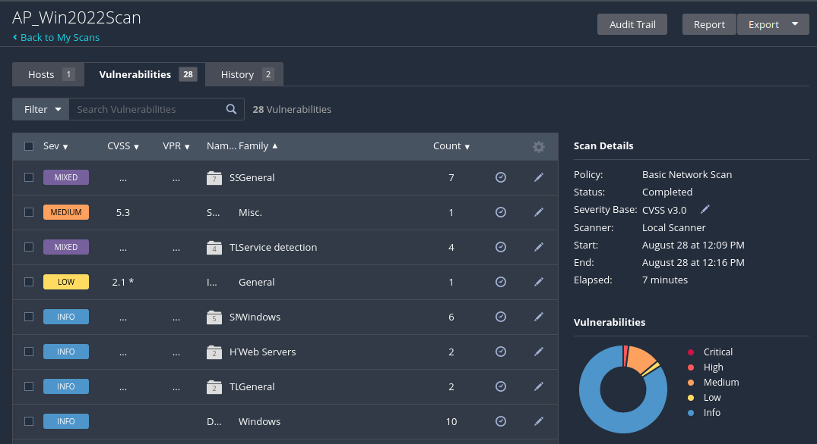
Vulnerabilities
Critical: N/A
High: 2%
Medium: 12%
Low: 2%
Info: 84%

Slide 5
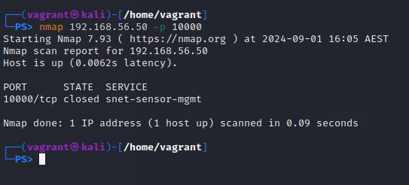
Win2022 VM Nmap
Command: nmap 192.168.56.50 –p 10000

Slide 6
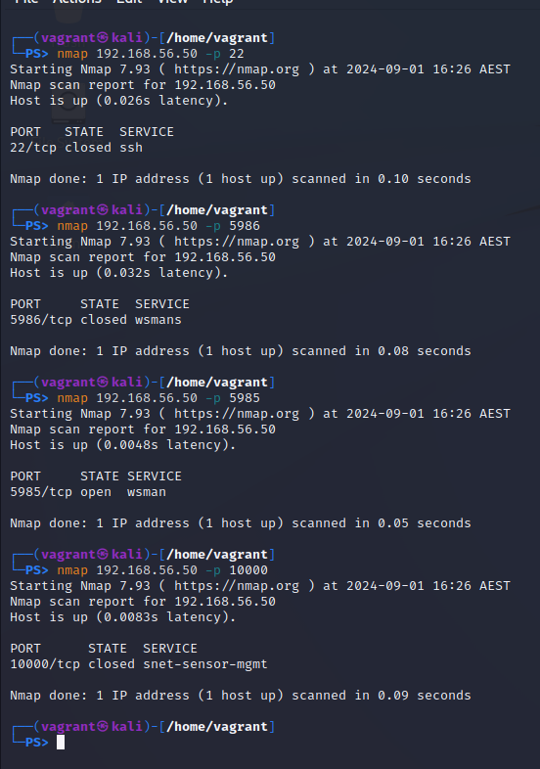
More nmap ports

Slide 7
WafW00f

