Slide 1
Multi-Objective Path Planning in GPS Denied Environments under Localization Constraints
Shaunak Bopardikar, Brendan Englot and Alberto Speranzon
United Technologies Research Center
American Control Conference, 2014 – Portland, OR
06.04. 2014

Slide 2
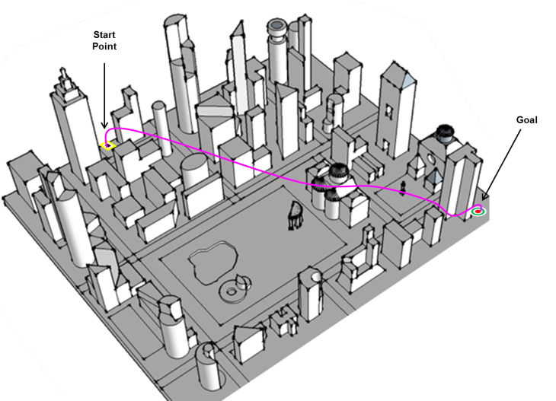
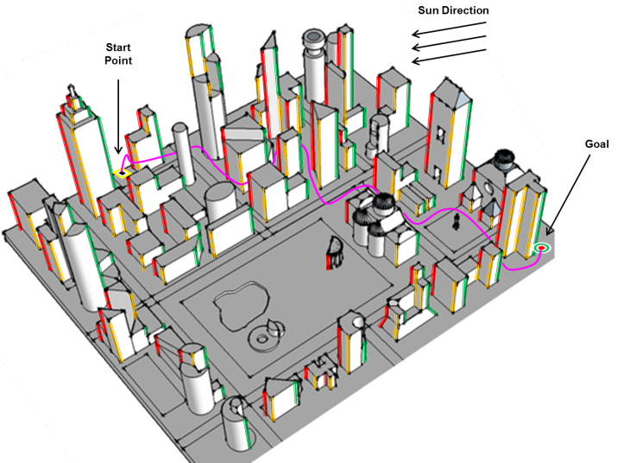
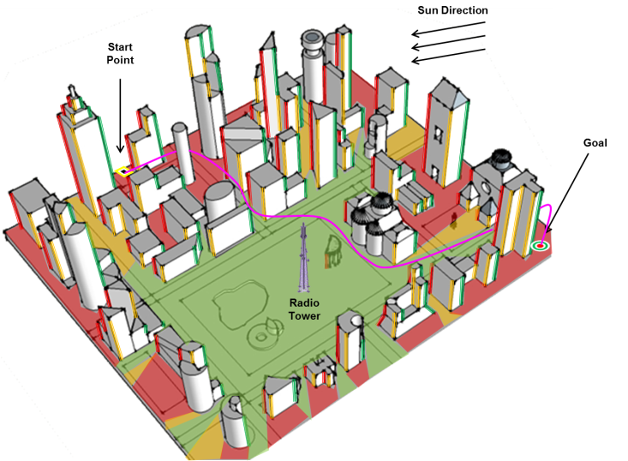
Problem Statement
Design a path for a vehicle (e.g. helicopter) in a complex environment (e.g. urban environment) that optimizes multiple costs
In particular, optimize the path so that localization errors are minimized given a prior map and sensor models under GPS denied or degraded
Detection of features, landmarks, RF signals, etc. can, not only be noisy, but also intermittent. We will not consider this in this talk, however it is possible to extend the methods discussed here in this context as well – See paper: “Robust Belief Roadmap: Planning Under Intermittent Sensing“, S. Bopardikar, B. Englot and A. Speranzon, ICRA 2014.

Slide 3
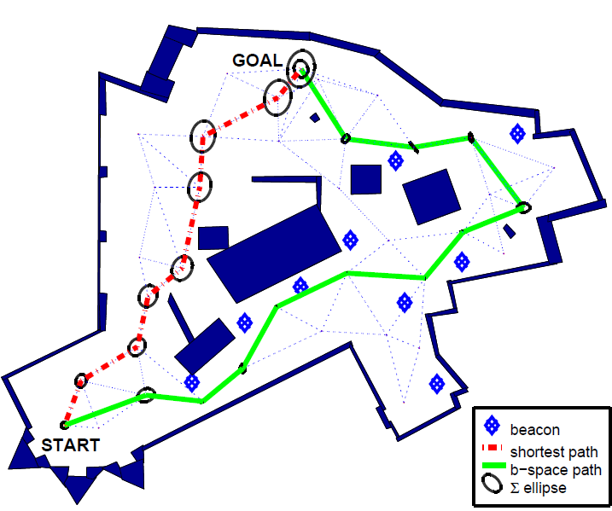


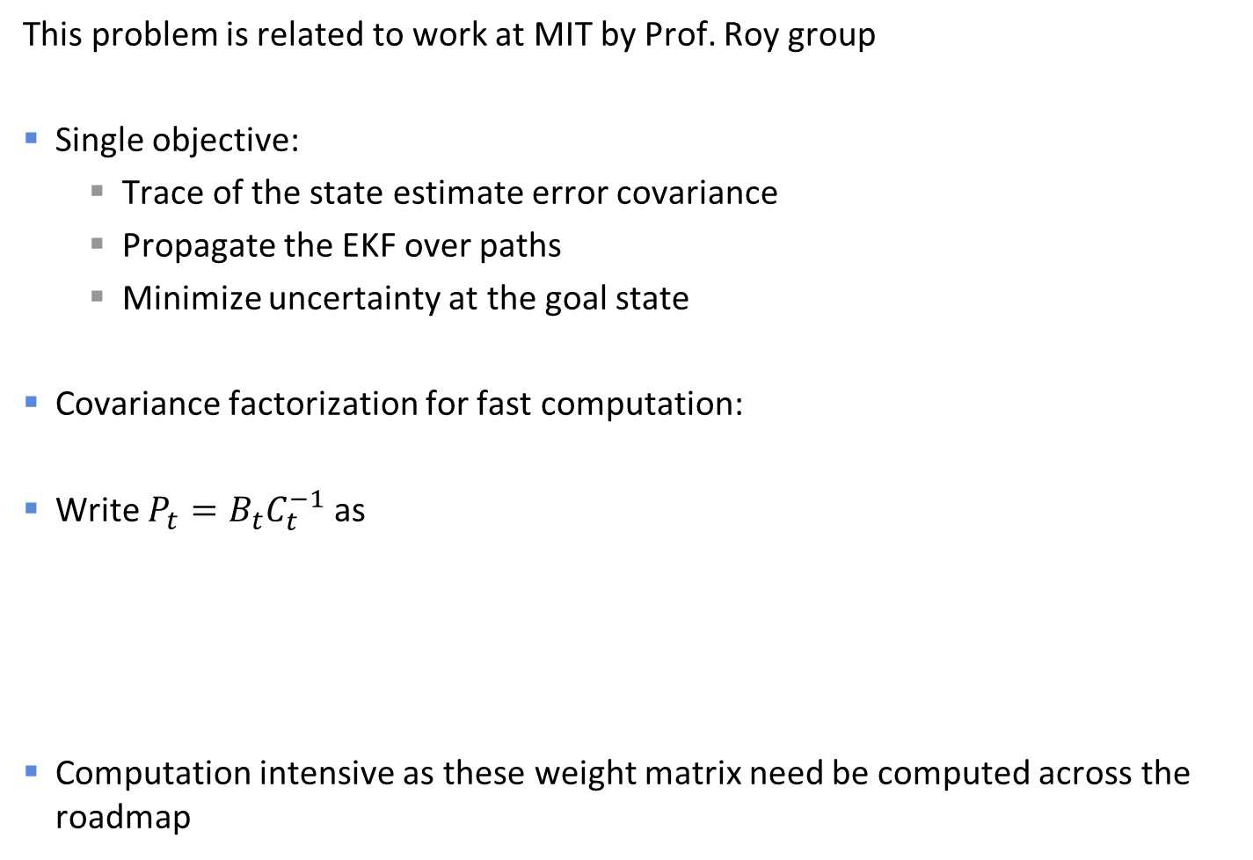
Related Work: Planning in Belief Space
This problem is related to work at MIT by Prof. Roy group
Single objective:
Trace of the state estimate error covariance
Propagate the EKF over paths
Minimize uncertainty at the goal state
Covariance factorization for fast computation:
Write $P_{t}=B_{t}C_{t}^{−1}$ as
Computation intensive as these weight matrix need be computed across the roadmap

Slide 4
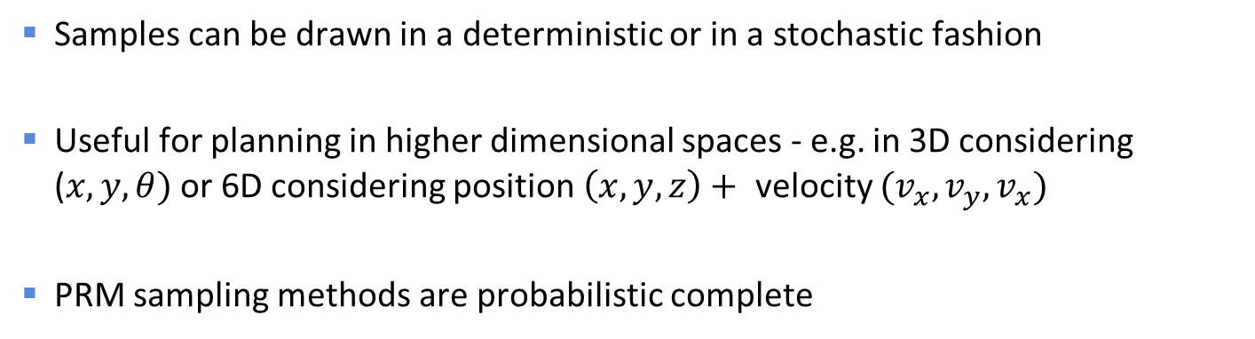
Probabilistic Roadmaps
Randomly sample the configuration space
Remove samples that are not collision free
Determine path compatible with vehicle dynamics that connects the nodes
Connect Start and Goal to closest nodes
Samples can be drawn in a deterministic or in a stochastic fashion
Useful for planning in higher dimensional spaces - e.g. in 3D considering ($x, y, θ)$ or 6D considering position $\left(x,y,z\right)+$ velocity $(v_{x},v_{y},v_{x})$
PRM sampling methods are probabilistic complete

Slide 5
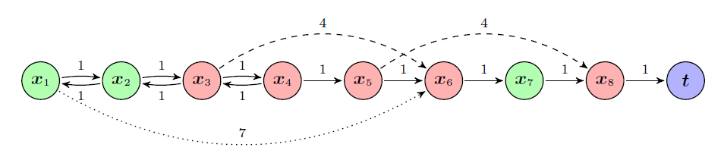
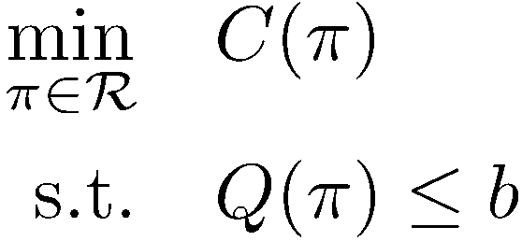
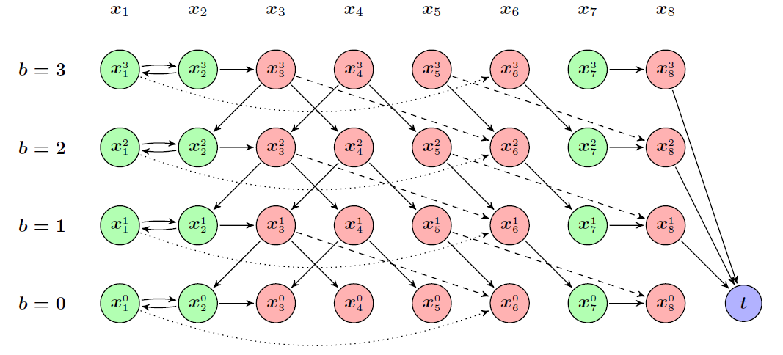

Multi-objective Path Planning
Let us consider the problem of minimizing two costs functions $C\left(.\right)$ and $Q\left(.\right)$
To pose this problem we consider the cost function $C(.)$ as primary cost and $Q\left(.\right)$ as a secondary cost (constrains) and pose the following problem where now $b$ is considered a free variable
One obtains the full Pareto curve
For monotonic non-decreasing costs this graph can be search very efficiently
Quantization of the secondary cost
D. Ding, B. Englot, A. Pinto, A. Speranzon, A. Surana, “Hierarchical Multi-objective Planning: From Mission Specifications to Contingency Management”, ICRA 2014
R. Takei, W. Chen, Z. Clawson, S. Kirov, and A. Vladimirsky, “Optimal control with budget constraints and resets”, SIAM Journal on Control and Optimization, to Appear.

Slide 6
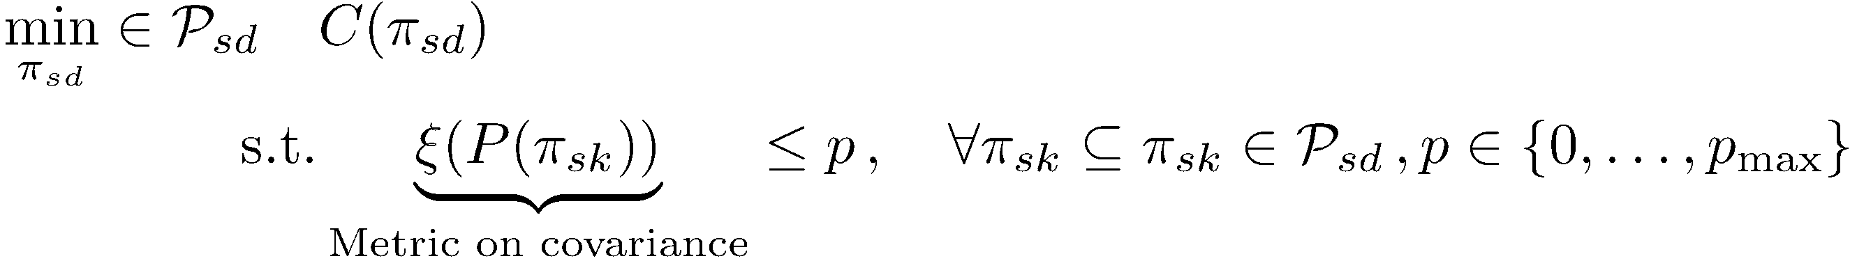
Multi-Objective Planning Under Localization Constraints
We are interested in a multi-objective problem where the secondary cost is a state and initial condition dependent function
In particular, taking into account strong priors, determine a path that minimizes length and position accuracy (never exceeding a maximum)
The problem, setting the secondary cost to be a localization metric, is then

Slide 7
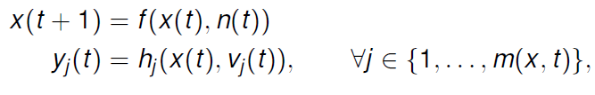
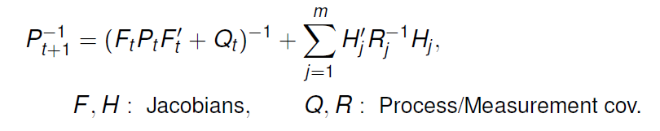
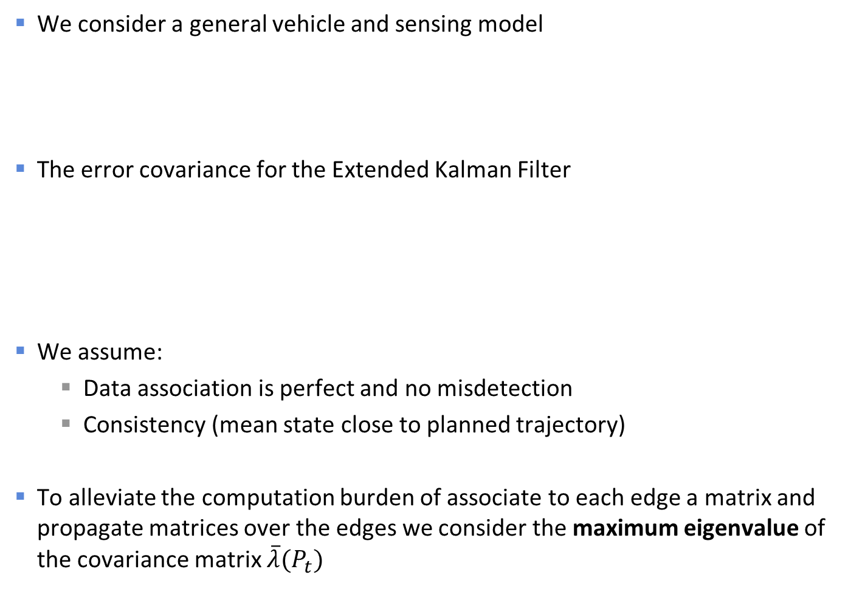
Problem Setup
We consider a general vehicle and sensing model
The error covariance for the Extended Kalman Filter
We assume:
Data association is perfect and no misdetection
Consistency (mean state close to planned trajectory)
To alleviate the computation burden of associate to each edge a matrix and propagate matrices over the edges we consider the maximum eigenvalue of the covariance matrix $\overline{λ}(P_{t})$

Slide 8
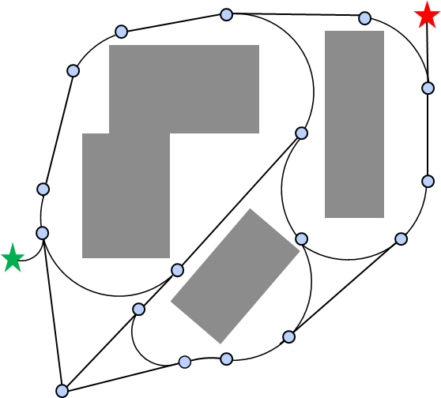
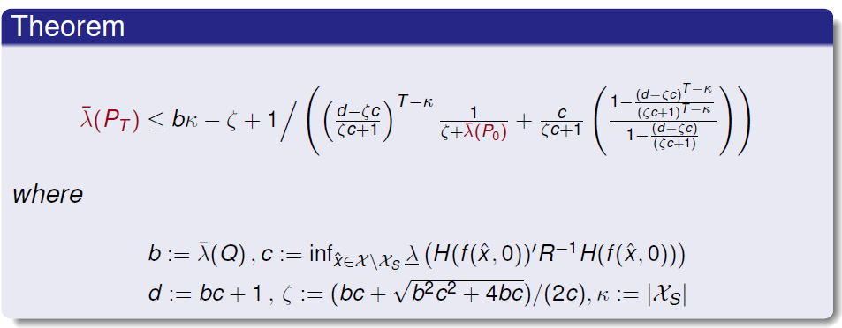
Maximum Eigenvalue Bound
Given a set of vertices in the roadmap
Given a prior about the environment
Worst case approximation
Open loop
Closed loop

Slide 9
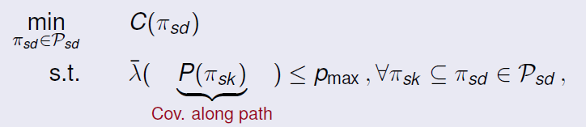
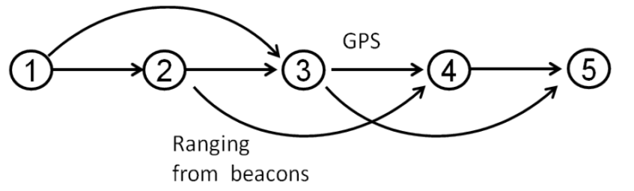
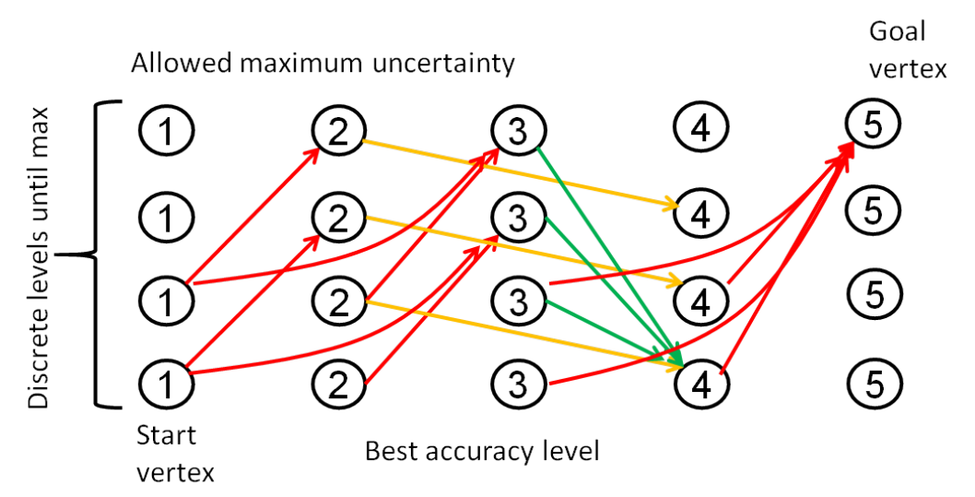
Multi-Objective Planning with Localization Constraints
The problem we are interested is then the following:
We can build an extended graph as mentioned before and solve use Dijkstra:

Slide 10
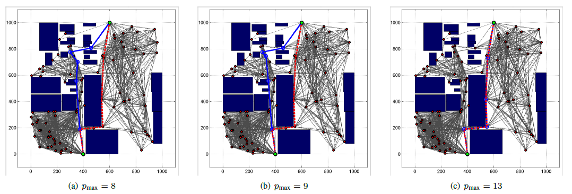
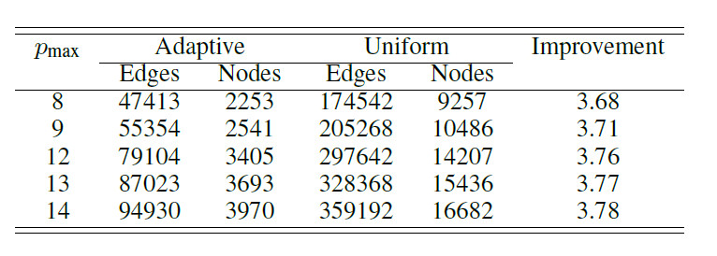
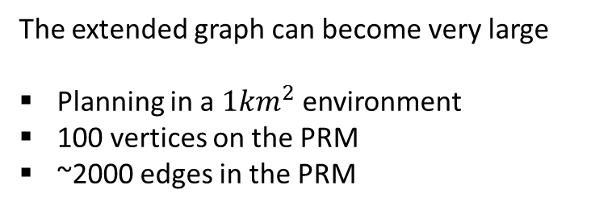
Simulations Results
Sensor modalities: IMU + LIDAR to range to building corners
The extended graph can become very large
Planning in a $1km^{2}$ environment
100 vertices on the PRM
~2000 edges in the PRM
How does one choose the quantization level for the secondary cost?

Slide 11
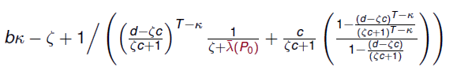
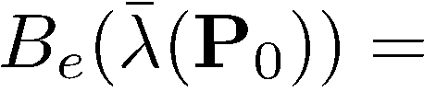

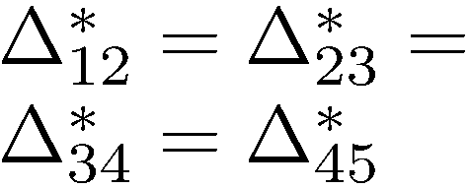



Sparse Extended Graph
Consider the change of $\overline{λ}\left(P_{0}\right)$ over an edge $e∈ℛ$
This function is concave in $\overline{λ}(P_{0})$ so that for every $e∈ℛ$ there is a worst-case difference $Δ_{e}^{∗}$
A closed form expression for $Δ_{e}^{∗}$ can be computed
1
2
3
4
Ranging Beacons

Slide 12

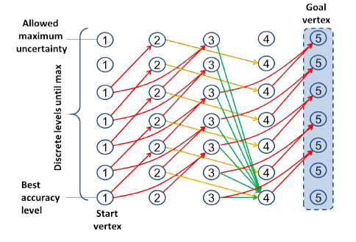

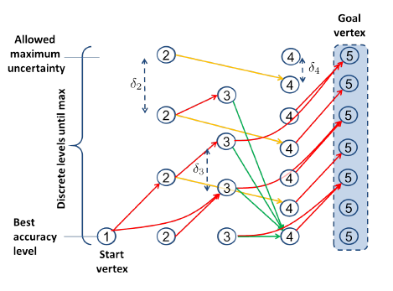
Two Schemes
Uniform
Adaptive

Slide 13
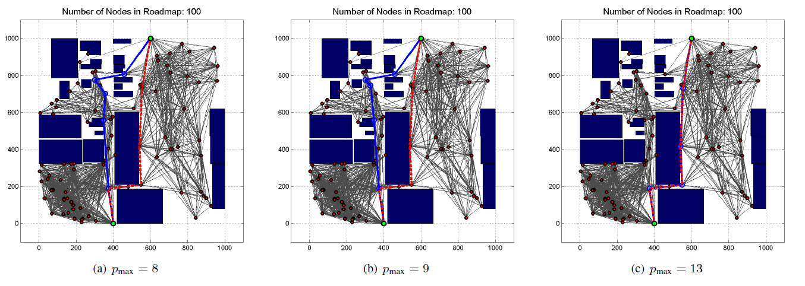
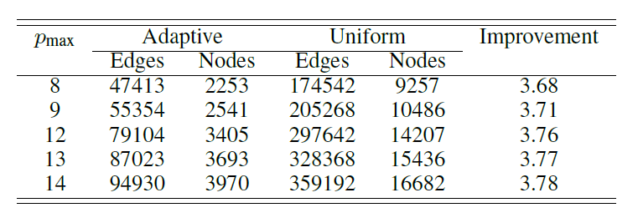
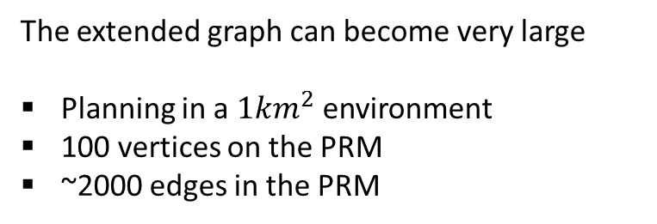
Results for Adaptive Scheme
Sensor modalities: IMU + LIDAR to range to building corners
The extended graph can become very large
Planning in a $1km^{2}$ environment
100 vertices on the PRM
~2000 edges in the PRM

Slide 14
Conclusions
Developed a new algorithm that extends sample based planning methods to consider multiple costs that are state, initial condition and history dependent
Developed various approximation methods to:
Enable fast propagation of relevant state estimation error information: maximum eigenvalue metric
Reduces the size of the expanded graph so that computation is more amenable for real-time planning/re-planning
Currently we have extended the algorithm to consider the problem where we have a third cost capturing collision probability

Slide 15
For more information contact:
Alberto Speranzon
Research Scientist
Control Systems Group
United Technologies Research Center
sperana@utrc.utc.com

Slide 16
BACKUP

Slide 17
CMDP Formulation with Mission Constraint
Probability of tasks success constraints
Other total cost constraints
Other constraints
e.g. critical resource constraints over paths

Slide 18
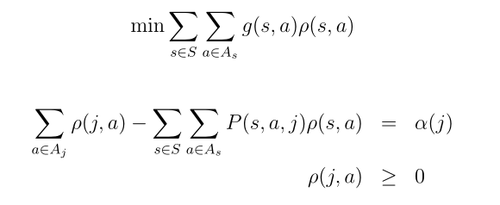




Dual formulation – LP on the Product
Cost Function
Constraints:
Probability of mission success constraint
Other total cost constraints
Other constraints (e.g. critical resource constraints over paths)
Plan Obtained:
Randomized policy on the product MDP

Slide 19
Belief based planning using a geometric model and a coarse representation of what an image based feature extraction algorithm would produce, based on predicted lighting conditions

