Slide 1
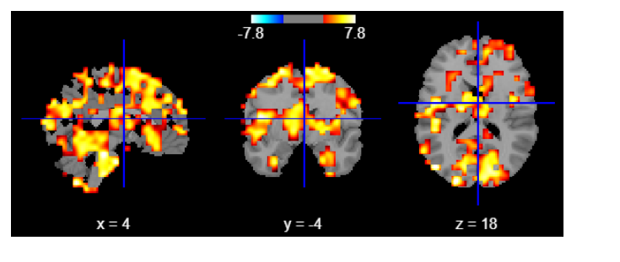
Data = autism_data.csv

Slide 2
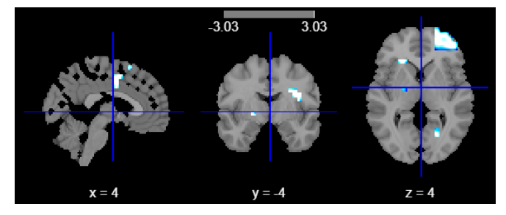
Data = test_data2.csv

