Slide 1
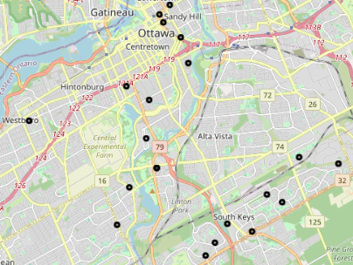
Canada Post
Head Office

Slide 2
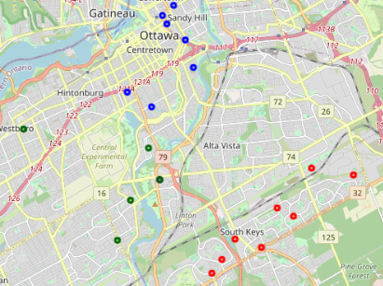
Canada Post
Head Office

Slide 3
Canada Post
Head Office

Slide 4
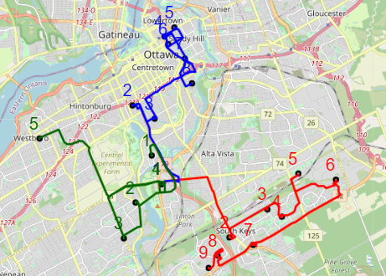
Canada Post
Head Office

Slide 5
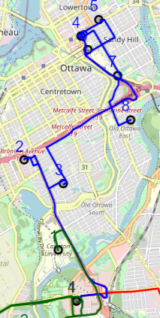

Slide 6
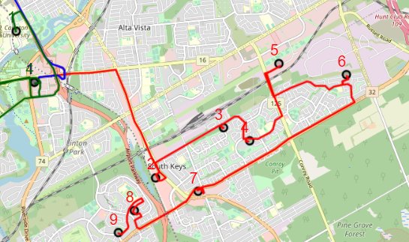

Slide 7
