Slide 1
rsocsim
Tom Theile – Software Developer
Max-Planck Institute for demographic research
Notes:
I am tom Theile from the MPIDR, Departement of digital and computational demography
As a software developer I

Slide 2
Are we living in a simulation?
Notes:
Are we living in a Simulation?
Well, probably not in a socsim simulation, because socsim simulates a very reduced version of reality. It simulates a universe that only consists of a number of persons, which can only experience a few events over their whole life.
picture from diss: input: rates --> socsim-->output: kinship network ... artificial population
We provide rates as input and get a simulated population as output.
We can then use R to analyze this kinship network in ways that is not possible with real world data – because we do not have this data
We can also simulate counterfactual populations and circumstances

Slide 3
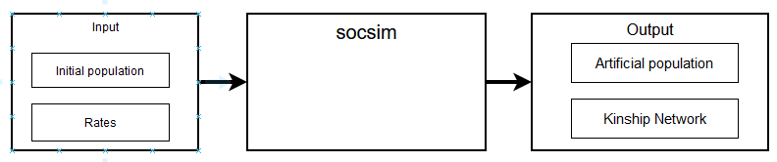
Are we living in a simulation?
Notes:
Are we living in a Simulation?
Well, probably not in a socsim simulation, because socsim simulates a very reduced version of reality. It simulates a universe that only consists of a number of persons, which can only experience a few events over their whole life.
picture from diss: input: rates --> socsim-->output: kinship network ... artificial population
We provide rates as input and get a simulated population as output.
We can then use R to analyze this kinship network in ways that is not possible with real world data – because we do not have this data
We can also simulate counterfactual populations and circumstances

Slide 4
Agenda
History
How does socsim work internally?
Why is socsim now an R-package?
Notes:
Zweigeteilt: Erst stelle ich unser Institut, unser Lab vor, und gehe dabei auch einmal auf meine Position als unbefristeter Research Software Developer ein (relevant hier)
Anschließend kommt der eigentliche Inhalt über das Migrationsverhalten von Wissenschaftlern und insbesondere wie wir im Team diese Daten aus Bibliometrischen Daten herausfiltern und wie wir überhaupt an diese herankommen.

Slide 5
History
* first developed in the 70ies by Kenneth Wachter (?) and colleagues at the UC Berkeley
* written in FORTRAN
* rewritten in C in the 80ies
* Used throughout the years
Similar and derived software emerged:

Slide 6
Why Socsim
It is established and well tested
It is complex enough to support all the things that are interesting to us, While still simple enough to not introduce too much moving parts and unforeseeable inner interactions
The basic simulation mechanic is still the same as it was 50 years ago.
Notes:
Why socsim, if there are many alternatives?

Slide 7
Overview
How does Socsim work?
Every person is an individual object
The population is a long list of persons
When a birth happens, a new person is created and appended to that list
At the start of the simulation (or after an event), every person gets a “next event”
Events can be marriage, divorce, childbirth, death, etc.
Time increments in discrete timesteps
In every time step, all events scheduled for this time “happen”
A simulation can consist of 1 or more “segments”, every segment can have different rates
At the end of the simulation, socsim writes the population into output files
Notes:
Why socsim, if there are many alternatives?
Every person is an individual object
The population is a long list of persons
When a birth happens, a new person is created and appended to that list → closed simulation. No other way to enter this world
At the start of the simulation (or after an event), every person gets a “next event”
Events can be marriage, divorce, childbirth, death, etc.
Time increments in discrete timesteps
In every time step, all events scheduled for this time “happen” → the code for this event is executed, which can change parameters of a person or introduce new persons
A simulation can consist of 1 or more “segments”, every segment can have different rates
At the end of the simulation, socsim writes the population into output files

Slide 8
Person
How does Socsim work?
Every person has some parameters:
dead/alive
Sex
female or male, nothing in between
marital status
single, married, divorced, cohabiting, widowed
parity
total number of children born to a woman
Group Number
between 0 and 63. Can be used to simulate different groups/countries/towns.... with transition rates between groups
Age
In months, changes with time steps, starts at 0. Max age is 200 years
Next event
Notes:
The age has influence on the rates and marriage behaviour

Slide 9
Events
How does Socsim work?
birth
creation of a new person with age 0 and parameters that are random (sex) or derived (marital status=single at birth, …)
death
according to mortality rates. These are specific to parameters of the individual persons (age, gender, groups, parity, marital status)
marriage
Just like in real live, Marriage is the most complicated event, because it involves 2 persons.
Socsim comes with 3 Marriage market systems
1 - Marriage rates for both males and females
2 - Marriage rates only for females - males just get picked
3 - No marriage rates; Marriage just before a childbirth to an unmarried mother
Divorce
Childbirth
Notes:
divorce
much easier than marriage
Childbirth
happens to potential mothers

Slide 10
Event Scheduling
How does Socsim work?
Every person has 1 next event scheduled for the future
Every timestep, all events scheduled for this timestep are executed in random order
After an event, new events are scheduled for affected persons
For every possible event, a waiting time is calculated based on rates and random numbers
The event with the shortest waiting time is picked as the next event

Slide 11
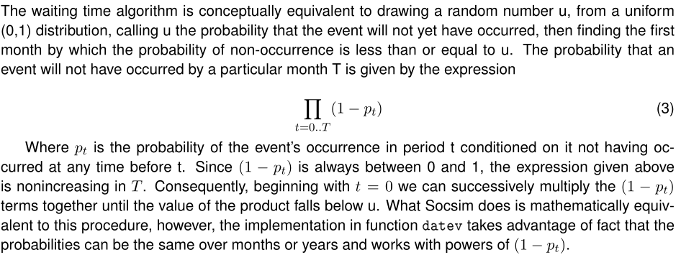
Event Scheduling
How does Socsim work?
Every person has 1 next event scheduled for the future
Every timestep, all events scheduled for this timestep are executed in random order
After an event, new events are scheduled for affected persons
For every possible event, a waiting time is calculated based on rates and random numbers
The event with the shortest waiting time is picked as the next event

Slide 12
Segments
How does Socsim work?
One Simulation can consist of many segments
A new segment can introduce new rates

Slide 13
At the End of a Simulation
How does Socsim work?
The virtual population will be written to output files
opop
contains every person that has lived during the whole simulation.
Month of birth, month of dead, etc.
omar
Contains information of every marriage
These output files can then be read in with R to analyze the virtual kinship network, retrieve rates etc.
Notes:
insert table here!

Slide 14
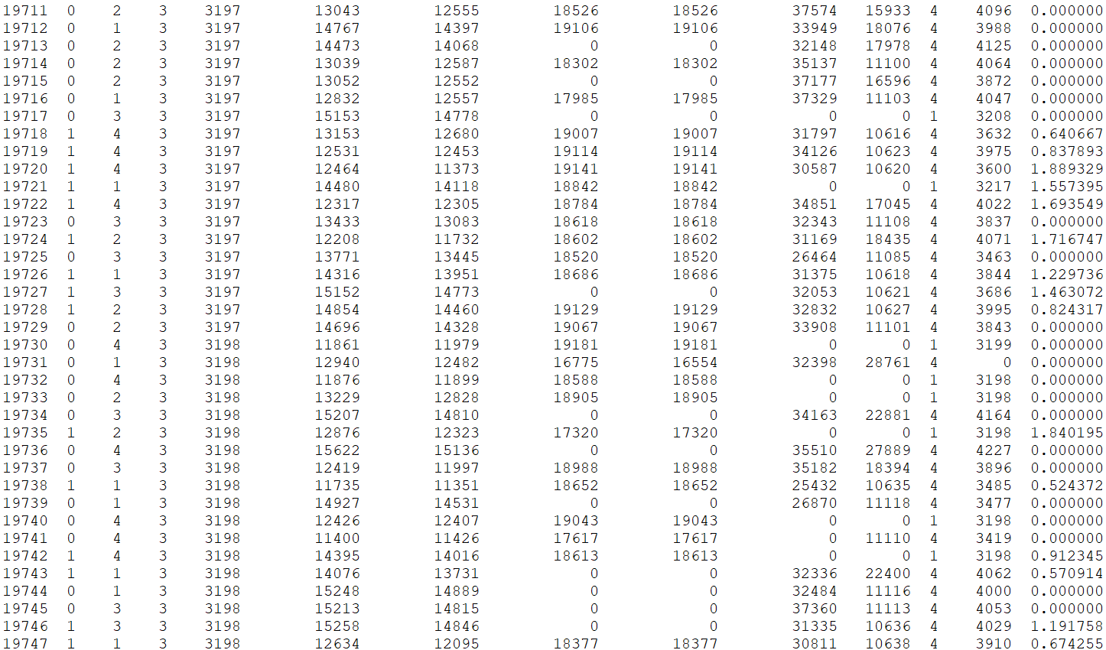
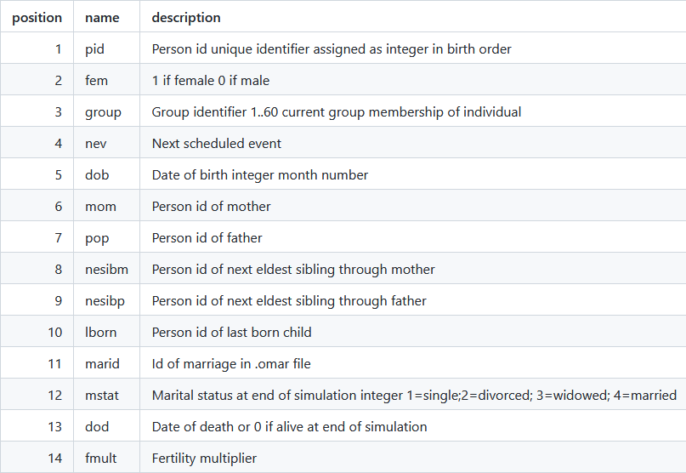
At the End of a Simulation
How does Socsim work?
.opop-file
1 row = 1 person
.opop
Notes:
insert table here!

Slide 15
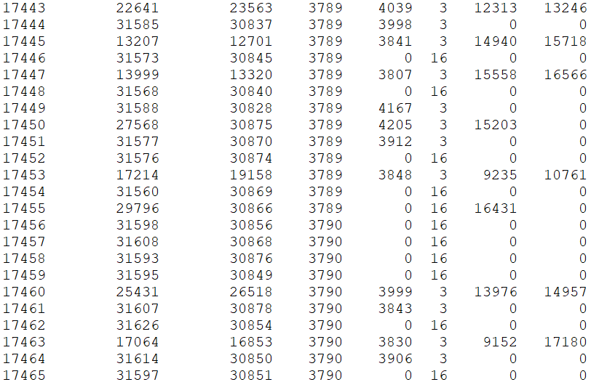
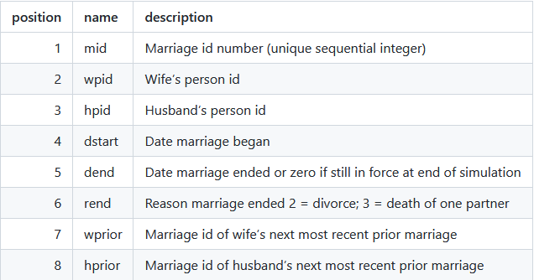
At the End of a Simulation
How does Socsim work?
.opop
Marriage file
1 row = 1 marriage
Notes:
insert table here!

Slide 16
What is different now? Why R?
Rsocsim
Most of the code is still the old C code (mostly from Carl Mason)
Windows-support
R-package instead of command-line program
R-package includes useful functions:
create_simulation_folder(),Retrieve_rates(), retrieve_kin(),
Notes:
Old version didn't run on Windows - which is basically the only option at the Max-Planck-Institute for demographic research.
Carl Mason, the last maintainer of Socsim retired 2020, so we took over the project before he left and
I rewrote some of the old code so that it compiles with newer compilers.
Then we decided to use RCPP, which is a R-package with which you can compile C++ code and make it interoperable with R. That is convenient, because 1) users used R to start SOCSIM simulations and read and process the output of SOCSIM anyways. 2) It makes the distribution to users on different operating systems easy and convenient. I think the installation is much easier now... I hope the feedback today does not show something else...
Behind the curtains, SOCSIM did not change by a lot. When we start a simulation from the R-Package, we provide the input just like we would when using the command-line version by writing input-files. The output will also be written to files in a specific output folder.
We added some R-functions that were not part of Socsim before, but which are very usefull when working with socsim output files.
You will learn to use them in the exercises that Liliana Calderon and Mallika Schneider prepared for today.

Slide 17
Future work
Rsocsim
Making it more robust on all platforms, better tested
Improving the documentation
More R-functions to analyze the simulation output
Parallelization
Integrating user feedback

Slide 18

Thank you for your attention
Tom Theile Research Software Developer
DCoDe Departement MPIDR
theile@demogr.mpg.de

