Slide 1

AI-driven Path Finder for Autonomous Vehicles
Team Members:
Alby Jacob Martin – 2023BCSE07AED001
Yeshwanth R – 2023BCSE07AED060
Ritam Jana – 2023BCSE07AED191
Mentor: Anupama K Ingale
6CS1991 – Design Project II

Slide 2

Agenda
Introduction
Literature Review
Observation from Literature Review
Limitation from Literature Review
Problem Definition
Implemented Approach
Methodology
Hardware Requirement
Software Requirement
Diagram
Module Description
Results and Discussion
Conclusion and Future Works
References

Slide 3
Introduction
In controlled environments such as campus, warehouse, factories, and airports, vehicles are manually operated. This leads to problems such as inefficient navigation, delays, and increased changes of human error. Autonomous vehicles can solve these issues, but completely replacing existing vehicles is expensive and not feasible. So, there is a need for cost-effective and scalable solution that can improve existing vehicles with autonomous capabilities. Our project proposes a simulation-based autonomous navigation system designed for controlled environments. The system focuses on path planning using A* algorithm along with dynamic replanning and real-time monitoring through a dashboard interface. The goal of our project is to demonstrate a proof-of-concept framework that can be extended to real-world hardware implementation in future.

Slide 4
Literature Review
1. Trustworthy Internet of Vehicles
This work by Jing Yang et al focuses on safe, secure, and collaborative autonomous driving. It shows the potential of the Internet of Vehicle to reduce on-board system costs in autonomous vehicles through shared intelligence is considerable. However, it still faces significant challenges, including concerns over data breaches and privacy, inefficiencies and limited fault tolerance in centralized management, and the challenge of ensuring data accuracy. [1]
2. Driving information logger with in-vehicle communication for autonomous vehicle research
This work by Sung et al focuses on information logger with in-vehicle communication for autonomous vehicle research. The authors describe in detail the driving information logging used in developing an autonomous vehicle. The recorded vehicle information is used to identify the cause of problems in the system or undesired operations. Driving information logger can be used in many areas, such as analysis of problems in the study of autonomous driving systems and analysis of accident risk. [2]
3. Intelligent Vehicle Path Planning Based on Optimized A* Algorithm
This work by Liang Chu et al explains the rapid development of intelligent driving technology. Achieving accurate path planning for autonomous vehicles has become increasingly crucial. However, path planning algorithms face challenges when dealing with complex and ever-changing road conditions. In this paper, aiming at improving the accuracy and robustness of the generated path, a global programming algorithm based on optimizing is proposed, while maintaining the efficiency of the traditional A* algorithm. [3]

Slide 5
Literature Review
4. Research on Autonomous Vehicle Path Planning Algorithm Based on Improved RRT* Algorithm and Artificial Potential Field Method
This work by Xiang Li et al focuses on research on AV path planning algorithms based on improved version of RRT* algorithm and Artificial field method. For the RRT* algorithm, there are problems such as great randomness, longer time consumption, more redundant nodes and inability to perform local obstacle avoidance when encountering unknown obstacles in the path planning process of autonomous vehicles, and the artificial potential field method (APF) applied to autonomous vehicles is prone to problems such as local optimality, unreachable targets and inapplicability to global scenarios. [4]
5. Design of an autonomous surface vehicle (ASV) for swarming application
This work by Majid et al focuses on designing ASV for swarming applications. It shows Autonomous surface vehicle is a versatile marine vehicle developed to fulfill complexity requirement of wide range offshore activities. Currently, ASV’s are primarily developed based on the conventional surface vessel design in term of body structure and manoeuvrability capability. [5]
6. Real-Time Dynamic Trajectory Planning for Autonomous Driving Vehicles
This work by Wang et al presents real time dynamic trajectory planning algorithm that provides an optimal trajectory along with appropriate acceleration and speed for autonomous driving vehicles. To this end, a center line is first constructed based on a group of predesigned center waypoints that are generally used as a reference line. [6]

Slide 6
Literature Review
7. Path planning algorithms in the autonomous driving system
This work by Reda et al focuses on the Autonomous driving system, which aims to reduce human errors, that are the reasons for about 95% of car accidents. The ADS consists of six stages: sensors, perception, localization, assessment, path planning, and control. We explain the main state-of-the-art techniques used in each stage, analyzing 275 papers with 162 specifically on path planning due to its complexity NP-Hard optimization nature, and pivotal role in ADS. [7]
8. Research Status of Autonomous Vehicle Path Planning
This work by Shi et al focuses on latest research and applications of path planning algorithms and related hardware for autonomous vehicles. The introduced algorithms include improvement to traditional algorithms, intelligent optimization algorithms, reinforcement learning algorithms and hybrid algorithms such as improving algorithm running speed, path planning ability, and environment learning speed. [8]
9. Vehicle Testing Based on Digital Twins Theory for Autonomous Vehicles
This work by Meng et al focuses on vehicle testing based on digital twin theory for autonomous vehicles. Digital twins' theory can provide an effective solution for the complex whole vehicle testing, which includes the dynamics and scenarios. The parallel system is the most advanced method for implementing parallel control theory. In this paper, it introduced virtual systems established by digital modelling the autonomous driving vehicle and scenario, it introduces a connection between virtual system and the real system. [9]

Slide 7
Observations from the Literature Review
This work focuses on building an autonomous vehicle system for controlled environments rather than complex real-world scenarios. Since real-world autonomy is highly challenging, a simpler, modular approach is adopted using predefined paths. The A* algorithm is chosen for path planning due to its deterministic nature, efficiency, and suitability for grid-based environments, unlike more complex and non-deterministic methods such as RRT. The system also supports dynamic re-planning, making A* ideal for handling frequent path updates efficiently. In contrast to existing research that relies on expensive sensors and high computational resources, this design emphasizes low-cost deployment and retrofitting of existing vehicles through a scalable and modular architecture. Additionally, simulation-based validation, including dashboard simulations and A* testing, is used to ensure safety, cost-effectiveness, and reliable system performance before real-world implementation.

Slide 8
Limitations from the Literature Review
This work addresses key limitations identified in existing autonomous systems. Many current approaches rely on complex technologies such as LiDAR, multi-sensor fusion, and advanced AI, which increase computational demands and hardware complexity, making them impractical for small-scale or retrofit applications. Additionally, high deployment costs limit accessibility for smaller organizations. Most research also targets urban and unstructured environments, whereas this project focuses on controlled settings like factories and airports. Another issue is the lack of real-time adaptability, as many systems depend on static path planning; this is addressed through dynamic re-planning using the A* algorithm. Finally, existing studies often lack practical validation. To overcome this, the project incorporates dashboard-based simulation and circuit design using TinkerCAD, providing a cost-effective, scalable, and demonstrable proof-of-concept.

Slide 9
Problem Definition
Autonomous navigation technologies have the potential to improve efficiency, safety, and coordination of vehicles operating in controlled environments such as factories, campuses, airports and shipyards. However, converting existing manually operated vehicles into fully autonomous systems is costly and requires complex hardware integration. Although significant improvements and innovations are being made in the field of autonomous driving systems, the adoption of these systems is still in its infancy due to the high costs of the hardware components required for the system’s implementation. Most of the existing systems are designed and implemented with the assumption of a completely autonomous platform and are thus difficult to implement in industries and organizations with existing manually driven vehicles.

Slide 10
Implemented Approach
This project addresses navigation in controlled environment by using A* algorithm for path planning and dynamic replanning of route in unexpected situations or obstacle detection. The system is designed to work in controlled environment with low cost retrofitted vehicles. This will solve the problem of converting all vehicles to autonomous retrofitting the existing vehicles which can have autonomous feature such as path planning, perception for obstacle detection, dynamic replanning and such. The implemented system focuses on path planning in graph based controlled environment using A* algorithm, this is part of our proof-of-concept framework where we have also decided on circuit design for prototype version which can be scaled for real sized vehicles which can be retrofitted

Slide 11
Methodology
1. Identify the needs of customers and users through design thinking methods
Autonomous driving systems have become essential in industries and institutions where efficiency and safety are top priorities. However, most of the existing vehicles are still manually operated, leading to higher manpower costs, operational inefficiency and safety risks. Through different stages of design thinking we identified that the main customer and user needs include:
Reducing human involvement in repetitive vehicle operations
Minimizing conversion costs of replacing existing vehicles with autonomous vehicles.
Enabling safe, reliable and efficient navigation in controlled environments like factories, shipyards, colleges and so on.
Providing retrofit solution that can be integrated into existing electric vehicles without major hardware redesign.
By analysing stakeholders such as industrial users, vehicle operators and administrators we concluded that an AI based path finding system capable of autonomous navigation within limited environments would effectively meet these user’s requirements.
2. Translate the needs of customer into product / process / project
In response to these needs, the proposed project was conceptualized. Our goals as part of this project as in product, process and project are:
Product Goal: To develop an AI module that can guide a vehicle autonomously along a defined route
Process Goal: To design and simulate algorithms, circuits and control logic required for autonomous movement.
Project Goal: To demonstrate a prototype that can later be implemented on a real vehicle user in many industries.
The solution integrates AI pathfinding with hardware control and monitoring systems, forming a hybrid system that demonstrates autonomy though simulation. In the next phase this system will be physically implemented into a life-sized vehicle to validate its effectiveness in a real-world environment.

Slide 12
Methodology
3. Specification of the product / process / project
These specifications define how the proposed system will function and what components will be required to realize it.
Functional Specifications:
The system must detect obstacles and plan an optimal route to the destination using the A* algorithm. It must generate control commands for vehicle movement through a real-time dashboard. The system should be upgraded for integration with any vehicle.
Non-Functional Specifications:
The system should operate safely within a fixed, controlled environment, It should minimize computational cost and maintain real-time response. Must provide an emergency stop feature and manual override in real prototype.
4. Designing the solution for required customed needs
The methodology adopted for the project presents the steps for a systematic approach in designing, simulating, and implementing an AI-based pathfinding system that could be integrated into a non-autonomous electric vehicle. The approach merges hardware design, algorithm development, and simulation testing into one comprehensive package that is scalable and cost-effective for autonomous navigation within a controlled environment, such as a college campus or an industrial site.

Slide 13
Hardware Requirements
Arduino Uno R3
Ultrasonic sensor HCSR04
DC Motor L293D
Motor Driver
Power Supply
Resistors and Capacitors
Servo Motor
Buzzer

Slide 14
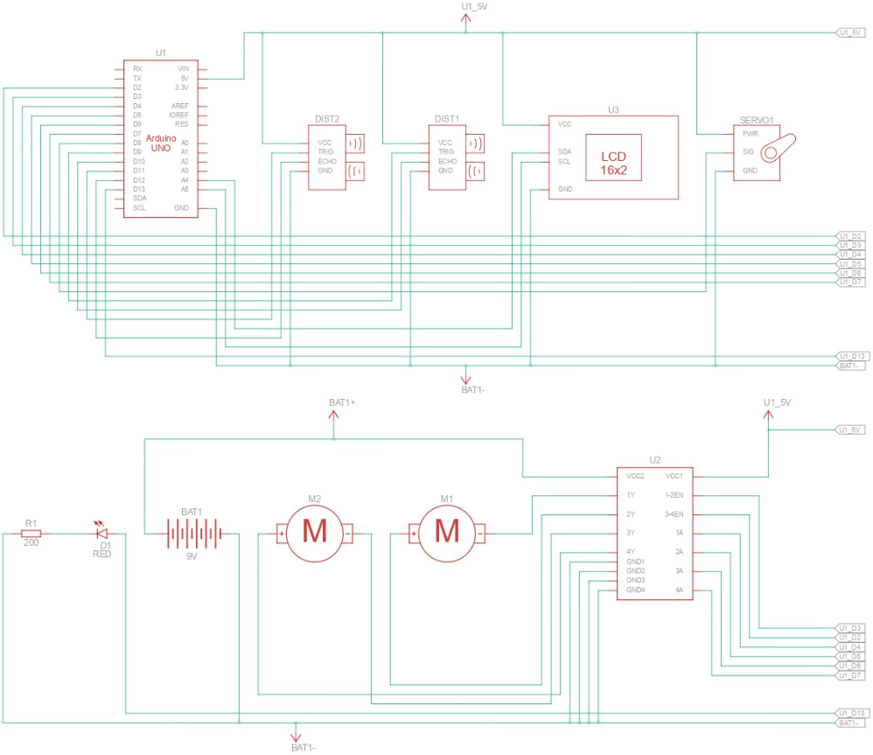
Hardware Requirements

Slide 15
Software Requirements
Python for A* path planning algorithm
HTML and JavaScript for dashboard
Arduino C for hardware logic
TinkerCAD for circuit simulation

Slide 16
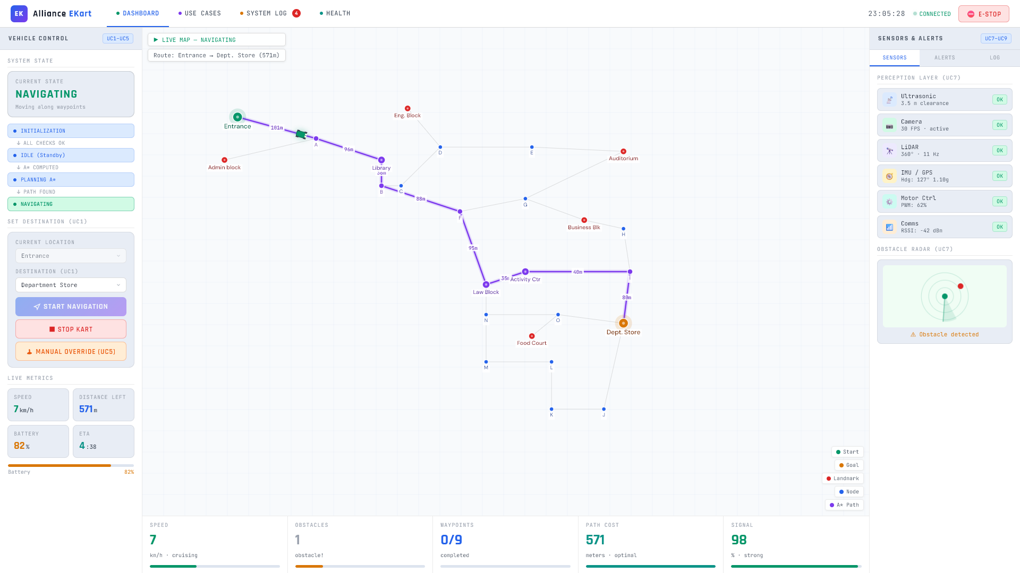
Software Requirements

Slide 17
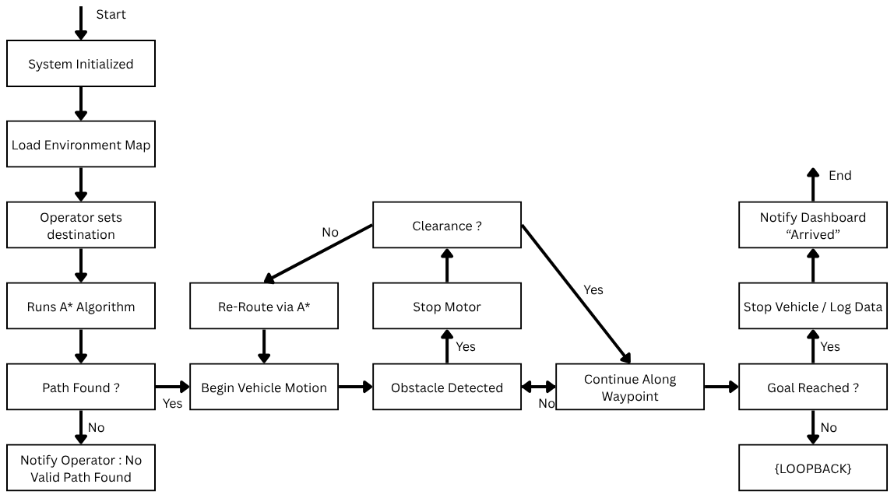
Diagrams

Slide 18
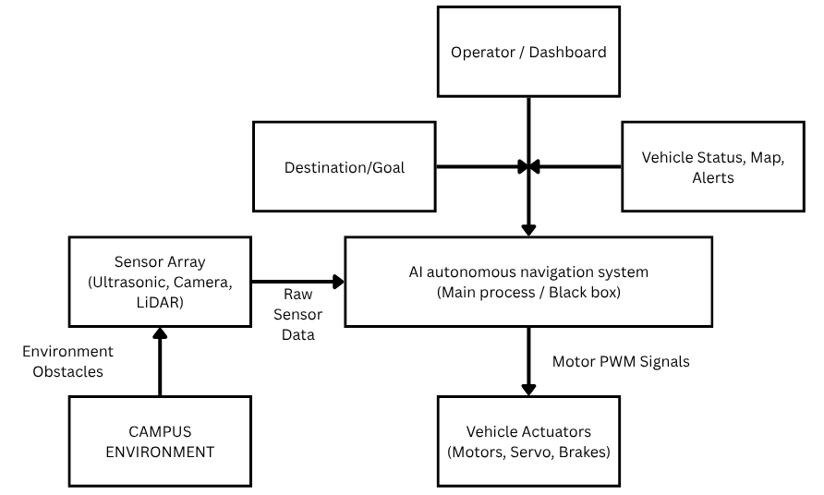
Diagrams

Slide 19
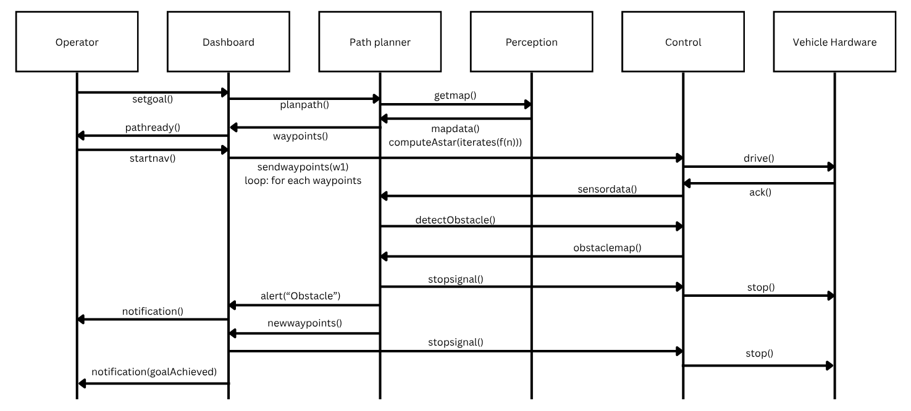
Diagrams

Slide 20
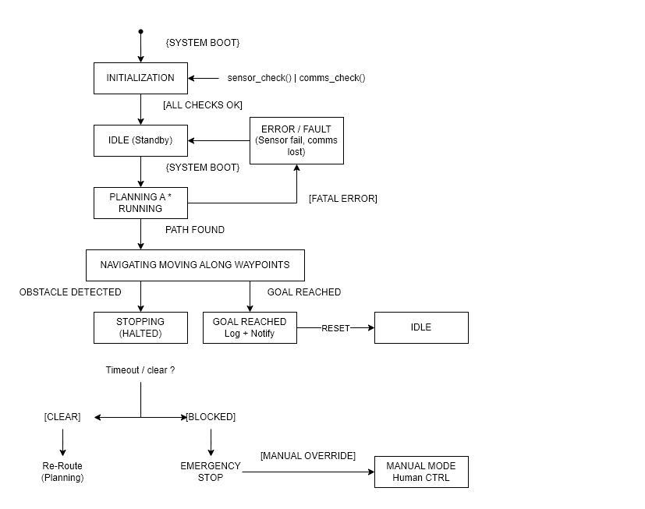
Diagrams

Slide 21
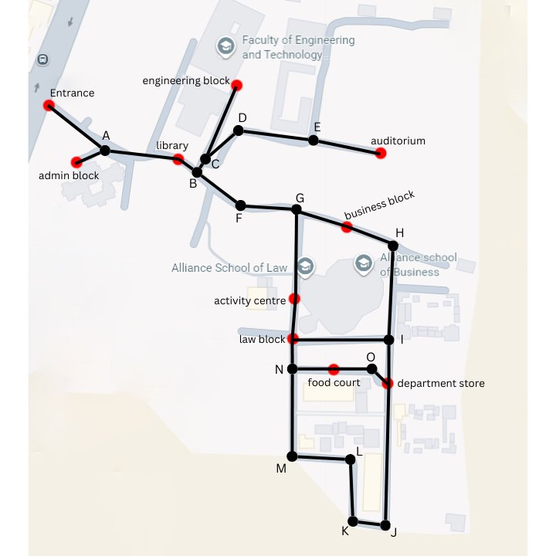
Diagrams

Slide 22
Module Description
1. Input and Goal Management Module
This module takes destination from user as input, it is then converted into coordinates, it will pass the information to other modules after it is validated. This is the starting point of system.
2. Perception Module
This module is one of the most important parts of the project, it uses simulated sensor data. It contains Ultrasonic sensor which senses distance between vehicle and object in the range. This module detects obstacles and provides environment data. Simulated sensor inputs are used for validation.
3. Path Planning Module
This module is also one of the most important parts of the project, it uses A* algorithm to calculate the path from the current position to the destination. It calculates the shortest path for the destination using A* path planning algorithm. It is also responsible for dynamic replanning which recalculates path after stop/obstacle.

Slide 23
Module Description
4. Navigation and Control Module
This module is responsible for converting path into movement, it generates waypoints and control signals.
5. Dashboard/Monitoring Module
This module is responsible for visual interface of dashboard, it shows map, path, vehicle position in the map and vehicle status. It includes real time updates of the vehicle and replanning visualization.
6. Hardware Interface Module
This module connects software with hardware, this includes controller board, motor driver, sensors and hardware component. This is designed and validated using TinkerCAD.

Slide 24
Result and Discussion
In our testing, we observed that A* algorithm always found valid path, optimality is also maintained. The trend in the testing results showed that:
- More nodes require more computation time.
- More obstacles/replans result in longer path.
- Dynamic obstacles result in higher replanning.
Based on our evaluation across multiple iterations:

Slide 25
Result and Discussion
Path length | Average Distance (meter) | Average path planning time (ms) | Average journey time (sec)
Very small | 110m | 12ms | 244
Small | 174m | 15ms | 386
Medium | 212m | 19ms | 471
Large | 273m | 23ms | 606
Very large | 335m | 27ms | 744

Slide 26
Conclusion and Future Works
This work shows a proof of concept of a simulated system of autonomous navigation in a controlled environment. This system combines the concepts of grid-based environment modelling, perception abstraction, and the A* algorithm of path planning to create efficient paths of navigation. Contrary to existing methods of path planning and navigation that heavily depend on hardware and a large environment of deployment, this study proposes a lightweight and software-based approach to the problem of path planning and navigation in a structured environment. Simulation results of the study prove the effectiveness of classical methods of path planning in the creation of adaptive paths of navigation with minimal computations required. This proposed system provides a strong platform on which further research can be conducted on the implementation of the system in the real world.

Slide 27
Conclusion and Future Works
As mentioned earlier, we are demonstrating the proof of concept of the proposed framework. Currently we are making this project Open Source for research, academia and industry. In the future we are expecting to build a new version which includes Real world integration with real sized vehicle, Multi Agent Navigation and Machine Learning Integration.

Slide 28
References
[1] Jing Yang, Qinghua Ni, Guiyang Luo, Qi Cheng Nov 2023 “A Trustworthy Internet of Vehicles: The DAO to Safe, Secure, and Collaborative Autonomous Driving” IEEE Explore doc 10334017
Available: www.ieeexplore.ieee.org/document/10334017
[2] Kyungbok Sung, Kyougwook Min, Jeongdan Choi, Feb 2018 “Driving information logger with invehicle communication for autonomous vehicle research”, IEEE Explore doc 8323732
Available: www.ieeexplore.ieee.org/document/8323732
[3] Lianf Chu, Yilin Wang, Shibo Li, Zhiqi Guo, Weiming Du, Jinwei Li, Zewei Jiang, April 2024 “Intelligent Vehicle Path Planning Based on Optimized A* Algorithm”, MDPI 1424-8220/24/10/3149 Available: www.mdpi.com/1424-8220/24/10/3149
[4] Li, X., Li, G., & Bian, Z, June 2024 “Research on Autonomous Vehicle Path Planning Algorithm Based on Improved RRT* Algorithm and Artificial Potential Field Method”, Sensors, 24(12), 3899 Available: https://doi.org/10.3390/s24123899
[5] M H A Majid, M R Arshad, Dec 2016 “Design of an autonomous surface vehicle (ASV) for swarming application”, IEEE Explore doc 7778676
Available: www.ieeexplore.ieee.org/document/7778676

Slide 29
References
[6] Mingqiang Wang, Lei Zhang, Zhenpo Wang, Yinghui Sai, Yafeng Chu, Sept 2019 “A Real-Time Dynamic Trajectory Planning for Autonomous Driving Vehicles”, IEEE Explore doc 8951735
Available: www.ieeexplore.ieee.org/document/8951735
[7] Mohamed Reda, Ahmed Onsy, Amira Y. Haikal, Ali Ghanbari, April 2024 “Path planning algorithms in the autonomous driving system: A comprehensive review”, ISSN 0921-8890
Available: https://doi.org/10.1016/j.robot.2024.104630.
[8] Shangzhe Shi, August 2022 “Research Status of Autonomous Vehicle Path Planning”, DOI:10.1051/shsconf/202214402019
Available: www.researchgate.net/publication/362948954
[9] Zhangjie Meng, Shulian Zhao, Hua Chen, Mengxia Hu, Yichao Tang, Oct 2022 “The Vehicle Testing Based on Digital Twins Theory for Autonomous Vehicles”, IEE Explore doc 9910602
Available: https://ieeexplore.ieee.org/document/9910602
[10] Zhu, Zhaomin, Zhu, Jingxi, Wei, Jinzhan, August 2025 “Autonomous Vehicle System Based on A* Pathfinding and improved YOLOv11”, ISBN 9798400715006
Available: https://dl.acm.org/doi/10.1145/3744439.3744446

