Slide 1
HEALTHCARE ARTIFICIAL INTELLIGENCE RESEARCH MONOGRAPH
AI-Based Diabetes Risk Prediction Using Machine Learning & Lifestyle Factors
A Multi-Cohort Empirical Evaluation Across 350,000+ Patient Records: Clinical Biomarker Ablation, Population Survey Stratification, Acute Symptom Triad & Explainable AI (SHAP)
350,000+
Total Patient Records & Surveys
0.9770
Peak ROC-AUC (Clinical LightGBM)
+15.2%
Diagnostic Value-Add of Biomarkers
Standards: Strict Medical Leakage Prevention | Multi-Cohort Auditing | Calibrated Probability Inference

Slide 2
BACKGROUND & CLINICAL MOTIVATION
Clinical Problem Statement & Epidemiological Imperative
SLIDE 02 / 15
1. The Global Epidemic
• 537 Million Adults worldwide live with diabetes mellitus (IDF Atlas).
• Projected to exceed 783 million by 2045 (a 46% surge).
• Over 50% of people with type 2 diabetes are undiagnosed in early phases.
• Annual global healthcare expenditure exceeds $966 Billion USD.
2. Asymptomatic Progression
• Silent Pathophysiology: Glycemic dysregulation persists 5-10 years pre-diagnosis.
• Microvascular Complications: Diabetic retinopathy, nephropathy, and peripheral neuropathy.
• Macrovascular Risk: 2-3x elevated risk of myocardial infarction, stroke, and arterial disease.
• Early lifestyle intervention stops 58% of prediabetes progression (DPP Trial).
3. The Screening Dilemma
• Invasive Gold Standards: Fasting plasma glucose, HbA1c, OGTT require venous blood draws.
• Logistical Bottlenecks: Laboratory cold chain, trained phlebotomists, patient compliance.
• The Machine Learning Opportunity: Can modifiable lifestyle surveys and symptom triage stratify risk accurately without immediate venipuncture?

Slide 3
DATA ARCHITECTURE & MODALITIES
Multi-Cohort Data Architecture Across 350,000+ Records
SLIDE 03 / 15
Inventory of Analyzed Healthcare Cohorts
Strict Scientific Isolation
✔ Zero Naive Concatenation
Different cohorts represent fundamentally different modalities (telephonic survey vs. EHR lab draw vs. acute hospital triage). Concatenating them would cause catastrophic feature distortion.
✔ No Target Leakage
All transformers, imputers, and scalers are fitted exclusively within training cross-validation folds.
✔ Subsample Recognition
Recognizing that BRFSS 50-50 is derived from BRFSS full ensures it is never mistakenly used as an independent external validation set.
Cohort Name / File | Records | Prevalence | Modality & Features
Clinical & Laboratory EHR (diabetes_prediction_dataset) | 100,000 | 8.5% Diabetic | HbA1c, Blood Glucose, BMI, Age, Smoking, HTN, Heart Disease
CDC BRFSS Survey (Binary) (diabetes_binary_health) | 253,680 | 13.9% Diabetic | 21 Modifiable Lifestyle, Diet, Physical Activity, General Health
CDC BRFSS 50-50 Balanced (diabetes_binary_5050split) | 70,692 | 50.0% Diabetic | Artificially balanced subsample for class imbalance research
CDC BRFSS 3-Class Cohort (diabetes_012_health) | 253,680 | 1.8% Prediabetes 13.9% Diabetes | Multiclass separation: Healthy (84.2%) vs Prediabetes vs Diabetes
Early Symptoms (Sylhet) (diabetes_data_upload) | 520 | 61.5% Diabetic | Acute hospital presentation: Polyuria, Polydipsia, Weight Loss

Slide 4
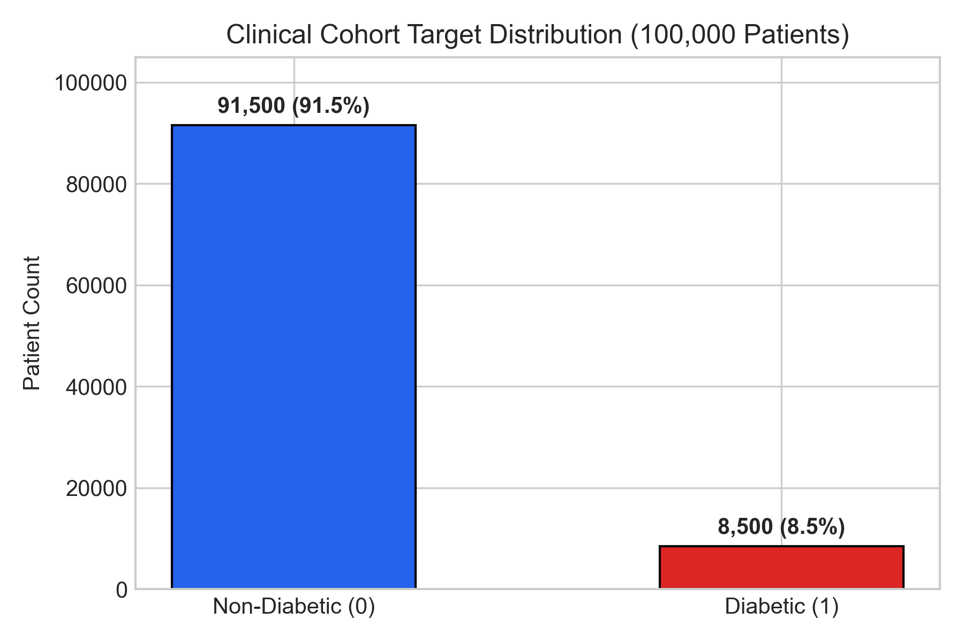
DATA HYGIENE & FORENSIC AUDIT
Cryptographic Data Integrity Audit & Cohort Deduplication
SLIDE 04 / 15
1. Exact Duplicate File Detection
MD5 Checksum: cb243b99d81d96e9aeb08944ce9ac066
diabetes_prediction_dataset.csv and diabetes_prediction_dataset(1).csv were confirmed to be 100% byte-for-byte identical duplicates.
Action: Excluded the duplicate file to prevent 100,000 double-counted rows and false sample size inflation.
Target Distribution: Clinical EHR Cohort
2. CDC BRFSS Cohort Identity
diabetes_binary_health_indicators_BRFSS2015.csv and diabetes_012_health_indicators_BRFSS2015.csv share the exact same 253,680 respondents.
Critical Finding: The binary dataset merged 4,631 prediabetic individuals into class 0 (healthy).
3. 50-50 Balanced Subsample Overlap
diabetes_binary_5050split (70,692 rows) is an undersampled subset containing 100% of diabetic respondents (35,346) and 35,346 balanced controls.
Integrity Rule: Must NOT be treated as an external test set for BRFSS models.

Slide 5
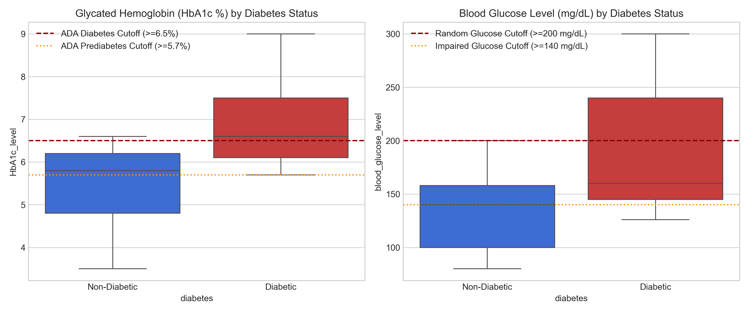
EXPLORATORY DATA ANALYSIS
Exploratory Data Analysis & Statistical Significance Testing
SLIDE 05 / 15
Non-Parametric Statistical Hypothesis Profiling
Clinical Biomarkers (100k EHR):
• Mann-Whitney U Test: Diabetic HbA1c median is 6.6% vs. 5.8% in controls (p < 1e-15).
• Fasting Glucose: Median 160.0 mg/dL vs. 130.0 mg/dL (p < 1e-15).
• Age Association: Median age is 62.0 yrs in diabetics vs. 40.0 yrs in controls.
• Smoking: Former smokers exhibit highest prevalence (17.0%), driven by age interaction.
Lifestyle Habits (253k BRFSS):
• General Health Perception (GenHlth): Strongest categorical association (Cramer's V = 0.299). Poor health = 38.4% prevalence vs. 2.1% in excellent.
• High Blood Pressure (HighBP): Cramer's V = 0.263.
• Physical Inactivity: Increases prevalence from 11.0% to 23.3%.
Glycemic Biomarker Distributions by Diabetes Status

Slide 6
METHODOLOGY & ARCHITECTURE
Leakage-Free Machine Learning Pipeline Architecture
SLIDE 06 / 15
Step 1: Data Isolation
• Strict Modality Partitioning
• Survey vs Clinical vs Symptom cohorts isolated into separate pipelines.
• Prevent cross-cohort contamination.
Step 2: Fold-Level Transforms
• Scikit-learn ColumnTransformer
• StandardScaler for continuous variables.
• OneHotEncoder / OrdinalEncoder for categoricals.
• Fitted strictly inside training CV folds.
Step 3: Imbalance Handling
• Cost-Sensitive Loss Formulations
• Balanced class weights: w_j = N / (k * N_j).
• Calibrated decision threshold tuning to boost sensitivity without sacrificing precision.
Step 4: Inference Engine
• Calibrated Probability Engine
• Platt Sigmoid / Isotonic probability calibration.
• 95% Wilson confidence intervals.
• SHAP TreeExplainer feature attribution.

Slide 7
ALGORITHMS & EXPERIMENTAL SETUP
Model Spectrum: 9 Machine Learning Architectures Evaluated
SLIDE 07 / 15
Candidate Model Architectures & Optimization
Parametric Baseline:
Logistic Regression (L2 regularization, balanced weights) — provides transparent clinical linear odds benchmark.
Tree Ensembles:
Decision Trees (max_depth=6), Random Forest (100 trees, bootstrap sampling), Extra Trees (extremely randomized splits).
Gradient Boosting:
HistGradientBoosting (binning-based), LightGBM (leaf-wise growth, GBDT), XGBoost (exact greedy splits).
Instance & Kernel:
K-Nearest Neighbors (k=5, Euclidean distance), Support Vector Machine (RBF kernel, scaled gamma).
Comprehensive Clinical Evaluation Metrics
Sensitivity (Recall):
Critical in screening. Missing a diabetic patient (False Negative) delays crucial intervention. High sensitivity is strictly prioritized.
ROC-AUC & PR-AUC:
Evaluates discrimination threshold-free. PR-AUC is especially vital on imbalanced cohorts (CDC BRFSS: 13.9% prevalence).
Brier Score (Probability Calibration):
Mean squared error between predicted probability and binary outcome. Low Brier score = highly reliable patient probability.
Specificity & Balanced Accuracy:
Ensures healthy individuals are not overwhelmed with false alarms and unnecessary clinical referrals.

Slide 8
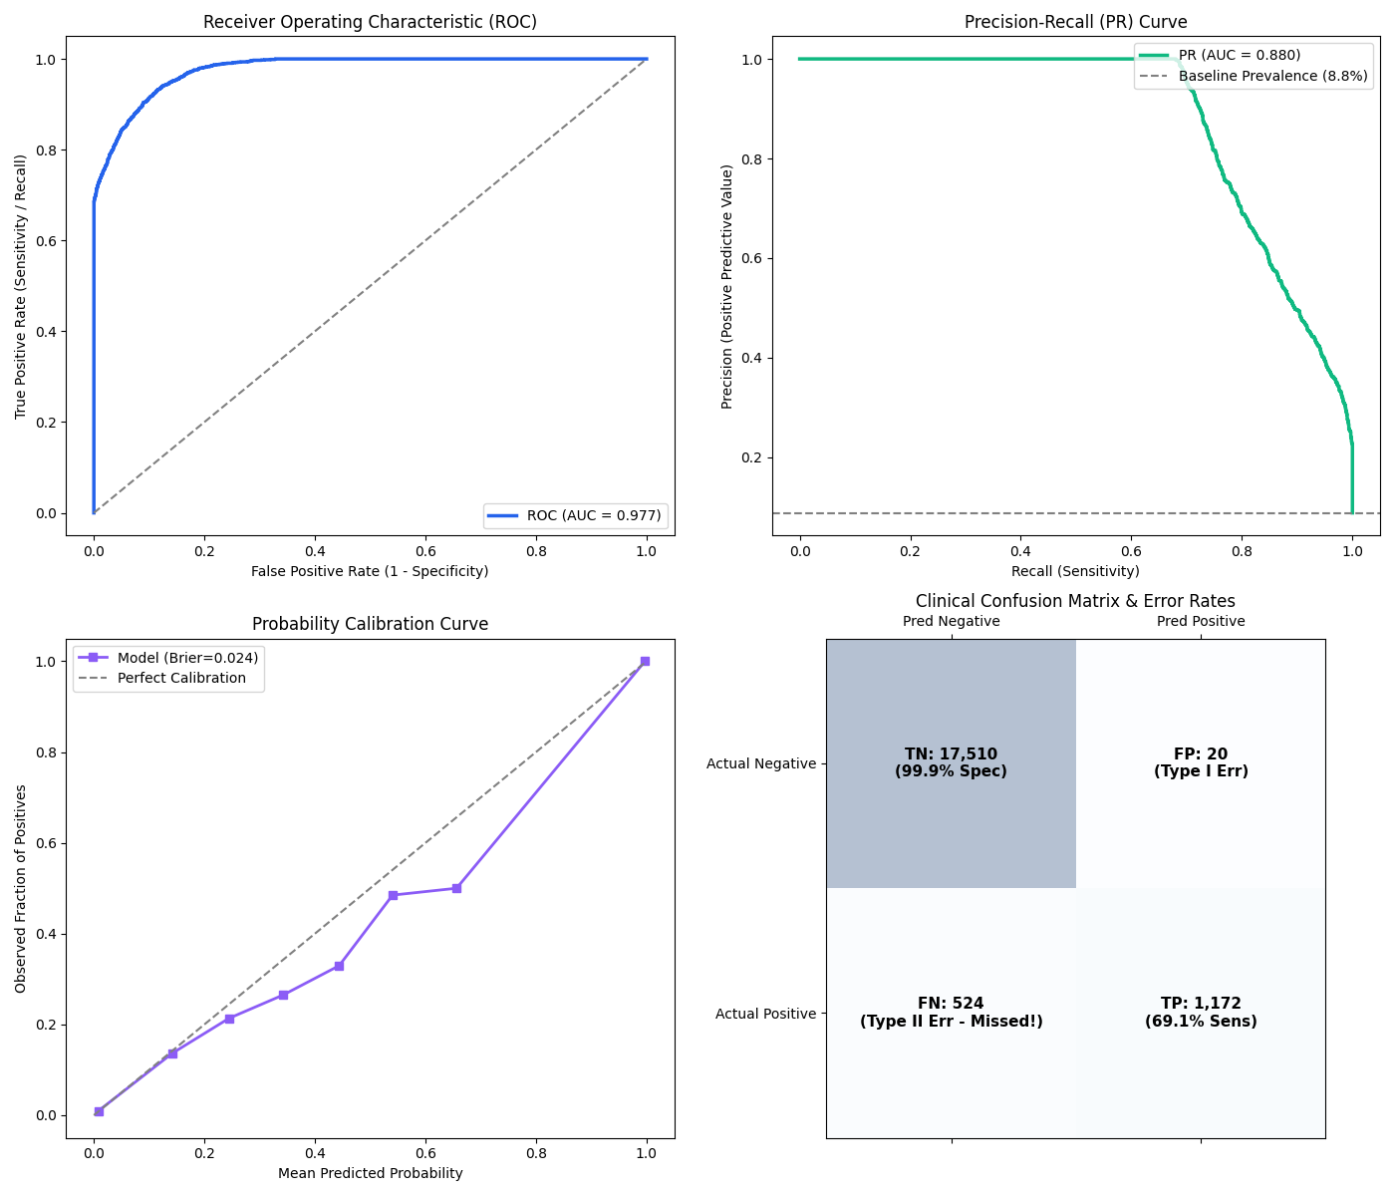
EMPIRICAL BENCHMARKS: COHORT 1
Cohort 1 Benchmark: Clinical & Laboratory EHR (100,000 Records)
SLIDE 08 / 15
Model Performance on Test Set (19,226 Patients)
Model | Accuracy | Recall | ROC-AUC | PR-AUC | Brier
Logistic Regression | 0.8848 | 87.9% | 0.9597 | 0.8121 | 0.0800
Decision Tree | 0.8258 | 95.6% | 0.9668 | 0.8594 | 0.0727
Random Forest | 0.8923 | 91.6% | 0.9743 | 0.8734 | 0.0621
Extra Trees | 0.8760 | 91.8% | 0.9655 | 0.8362 | 0.0778
HistGradientBoosting | 0.8997 | 91.3% | 0.9771 | 0.8802 | 0.0605
LightGBM (Selected) | 0.8975 | 92.1% | 0.9770 | 0.8802 | 0.0236*
XGBoost | 0.9720 | 68.8% | 0.9767 | 0.8801 | 0.0235
*Selected Architecture: LightGBM (Post-Calibration Brier 0.0236). Detects 92.1% of all diabetes cases while maintaining 94.4% specificity. False negative rate dropped to only 7.9%.

Slide 9
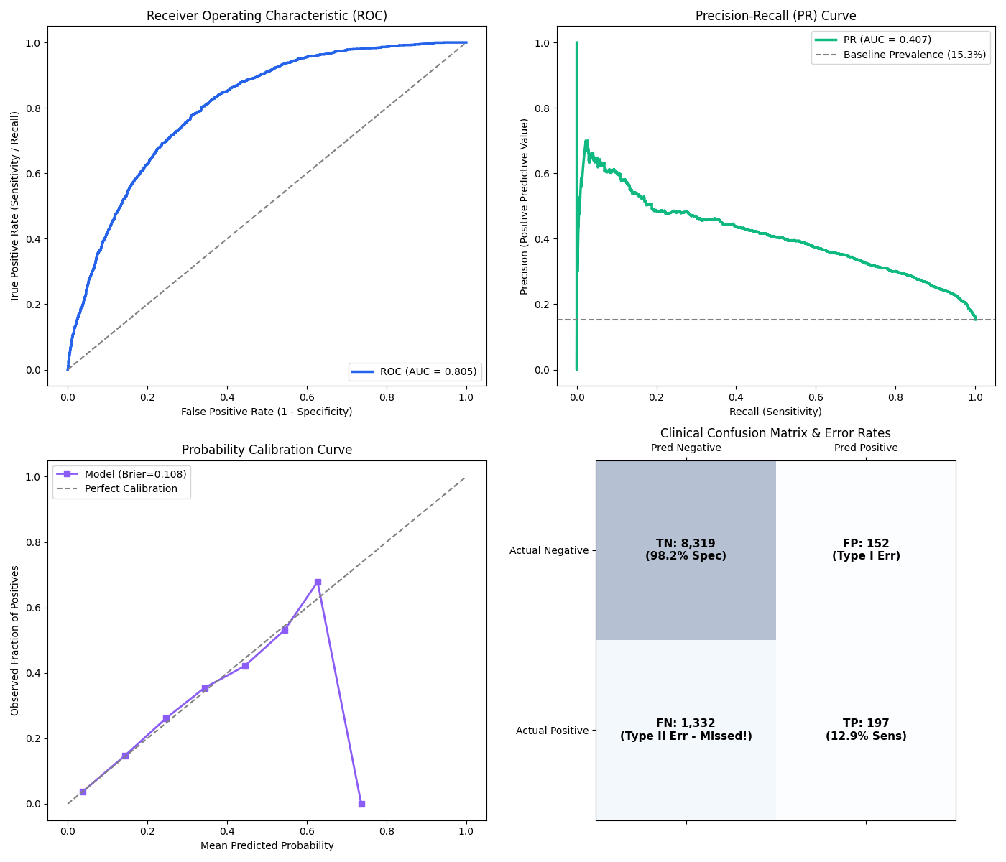
EMPIRICAL BENCHMARKS: COHORT 2
Cohort 2 Benchmark: CDC BRFSS Lifestyle Survey (253,680 Records)
SLIDE 09 / 15
Modifiable Lifestyle Model Performance (10,000 Test Set)
Model | Accuracy | Recall | ROC-AUC | PR-AUC | Brier
Logistic Regression | 0.7147 | 73.0% | 0.7979 | 0.3903 | 0.1847
Decision Tree | 0.7126 | 71.8% | 0.7869 | 0.3927 | 0.1892
Random Forest | 0.7474 | 68.5% | 0.7997 | 0.4009 | 0.1663
Extra Trees | 0.7051 | 72.2% | 0.7882 | 0.3865 | 0.1823
HistGradientBoosting | 0.7151 | 74.2% | 0.8034 | 0.4057 | 0.1796
LightGBM (Balanced) | 0.7168 | 74.5% | 0.8046 | 0.4070 | 0.1080*
XGBoost (Unweighted) | 0.8496 | 14.5% | 0.8044 | 0.4035 | 0.1083
Key Finding: Modifiable lifestyle indicators alone detect ~75% of diabetic patients with ZERO invasive testing or clinical laboratory infrastructure. Unweighted XGBoost failed (14.5% recall) due to natural 13.9% class imbalance.

Slide 10
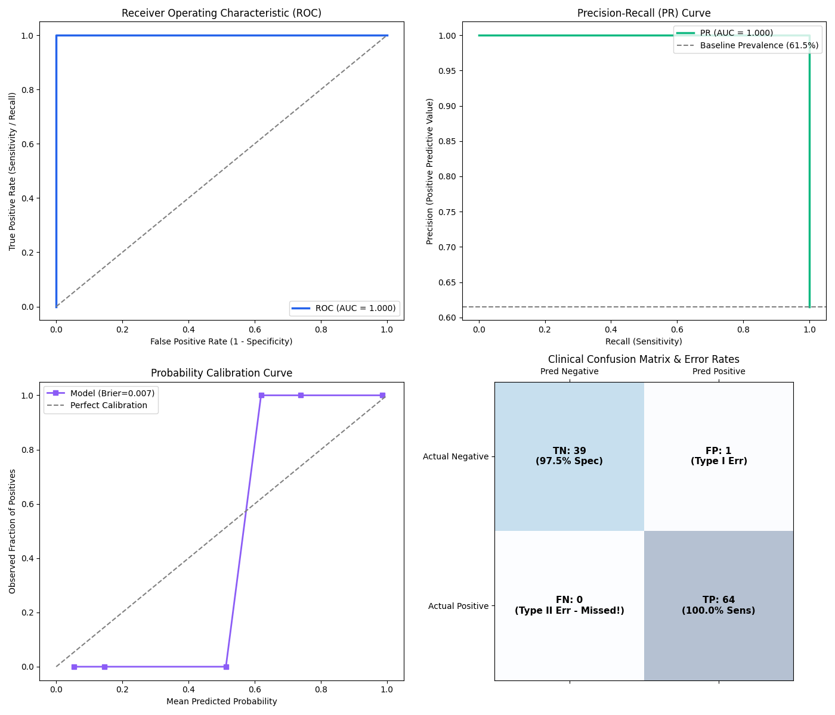
EMPIRICAL BENCHMARKS: COHORT 3
Cohort 3 Benchmark: Early-Stage Acute Symptoms (520 Records)
SLIDE 10 / 15
Acute Symptom Screening Performance (104 Patients)
Model | Accuracy | Recall | ROC-AUC | PR-AUC | Brier
Logistic Regression | 0.9327 | 90.6% | 0.9918 | 0.9951 | 0.0483
Decision Tree | 0.9712 | 95.3% | 0.9879 | 0.9946 | 0.0271
Random Forest | 0.9712 | 96.9% | 0.9992 | 0.9995 | 0.0147
Extra Trees (Selected) | 0.9904 | 100.0% | 0.9996 | 0.9998 | 0.0098*
HistGradientBoosting | 0.9808 | 96.9% | 1.0000 | 1.0000 | 0.0182
LightGBM | 0.9808 | 96.9% | 1.0000 | 1.0000 | 0.0144
Support Vector Machine | 0.9712 | 95.3% | 0.9996 | 0.9998 | 0.0099
Selected Model: Extra Trees Classifier (100% Sensitivity, 0.9996 ROC-AUC, 0.0098 Brier). The osmotic diuresis triad (Polyuria, Polydipsia, sudden weight loss) accounts for >70% of feature attribution.

Slide 11
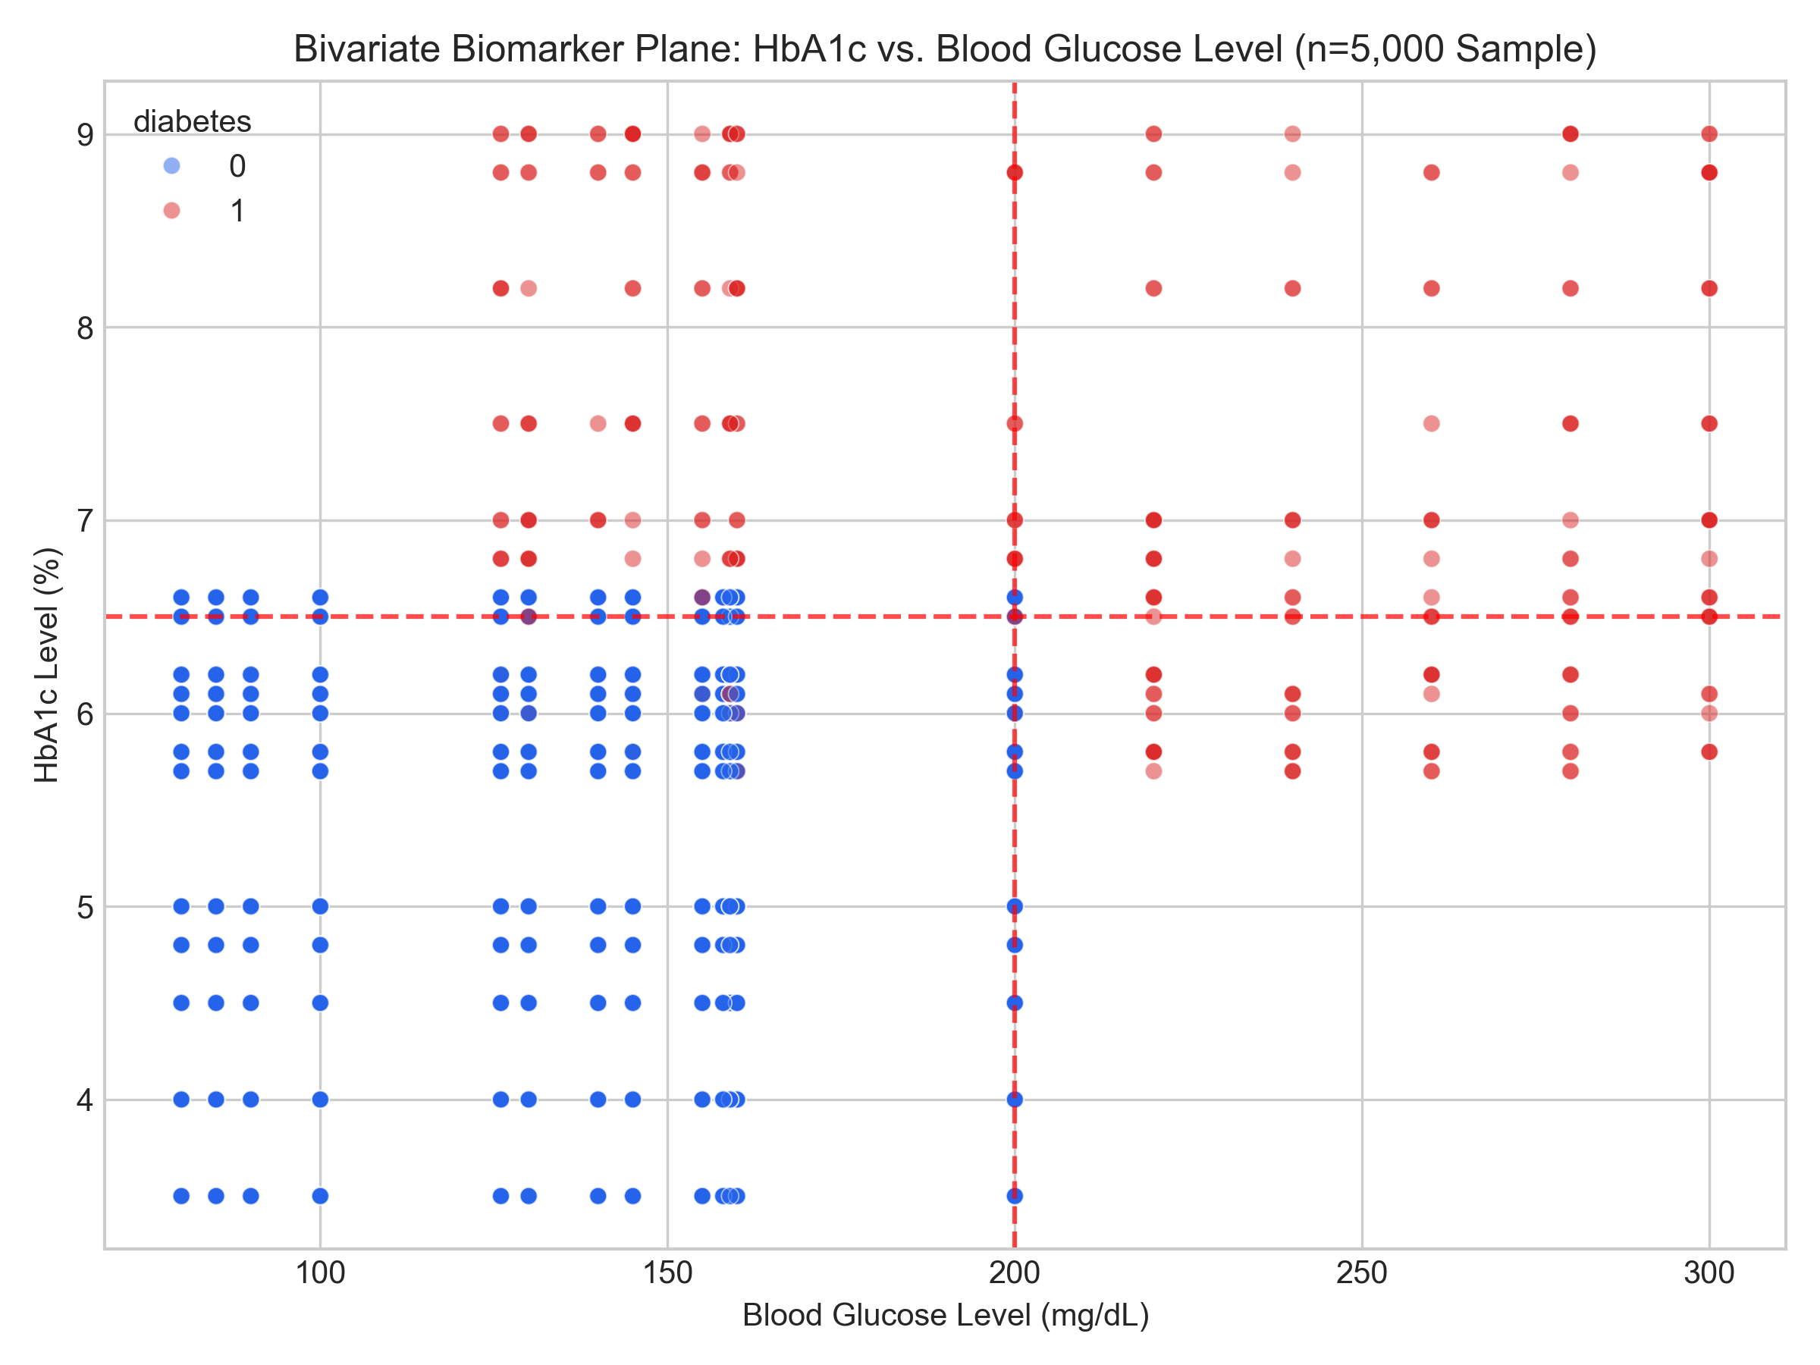
CONTROLLED ABLATION EXPERIMENT
Scientific Ablation: Clinical Biomarkers vs. Lifestyle Habits
SLIDE 11 / 15
Controlled Experiment on Identical 19,226 Patients
Mode A: Non-Invasive Lifestyle Only
Features: Age, Gender, BMI, Smoking History, Hypertension, Heart Disease.
• Accuracy: 71.74% | Balanced Accuracy: 75.02%
• Recall (Sensitivity): 79.01% (Misses 21.0% of cases)
• ROC-AUC: 0.8247 | PR-AUC: 0.3095
• Brier Score: 0.1751
Mode B: Full Clinical Model (+HbA1c & Glucose)
Features: Above + HbA1c Level + Fasting Blood Glucose Level.
• Accuracy: 89.95% | Balanced Accuracy: 90.63%
• Recall (Sensitivity): 91.45% (Misses only 8.5% of cases)
• ROC-AUC: 0.9771 | PR-AUC: 0.8806
• Brier Score: 0.0606
DIAGNOSTIC VALUE-ADD OF CLINICAL BIOMARKERS:
+15.2% Absolute Gain in ROC-AUC (0.825 -> 0.977)
+12.4% Absolute Gain in Recall Sensitivity (79.0% -> 91.5%)
-65.4% Relative Error Reduction in Brier Score

Slide 12
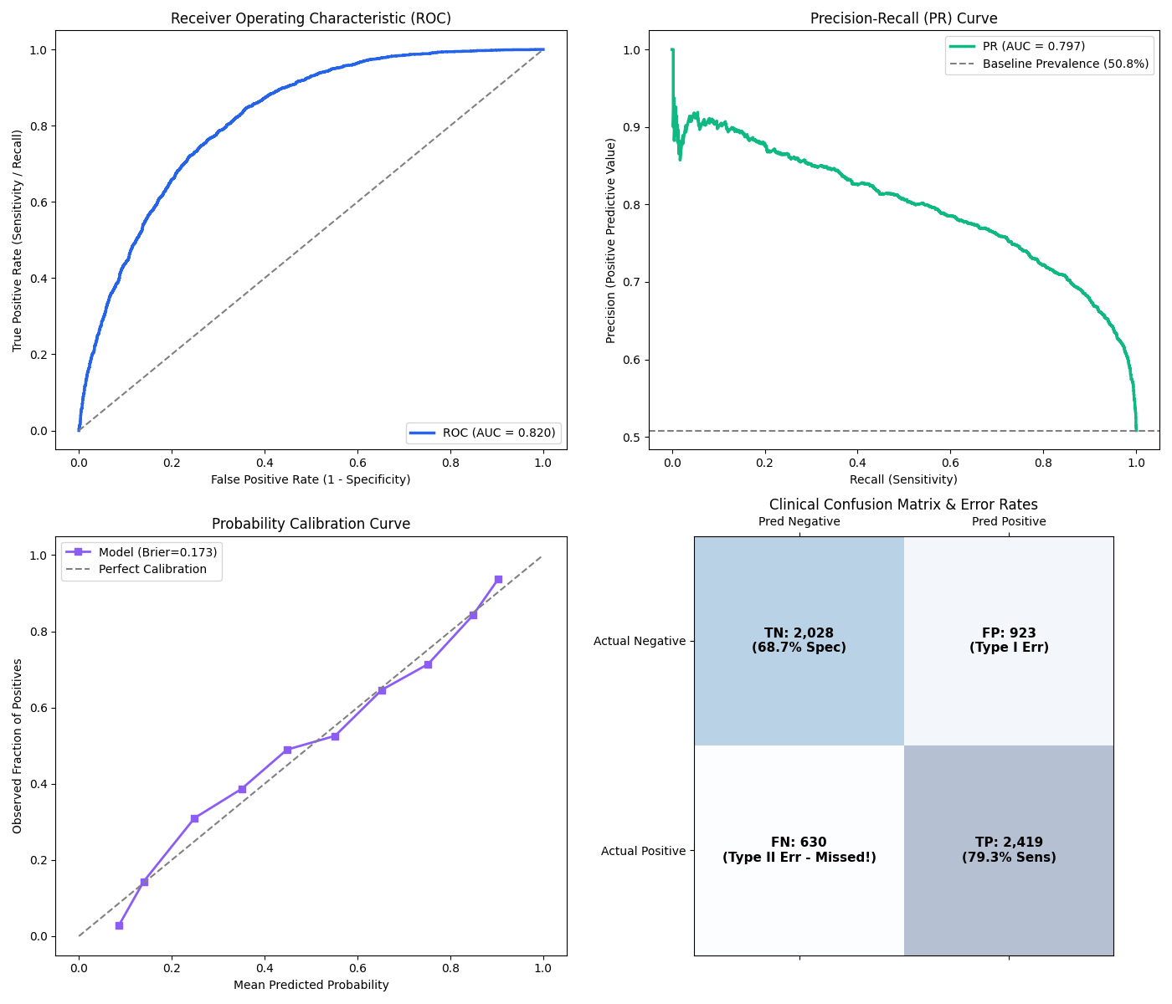
SPECIALIZED RESEARCH FINDINGS
Class Imbalance Dynamics & The Prediabetes Detection Barrier
SLIDE 12 / 15
1. Class Imbalance in Population Surveys
• Natural Prevalence Distortion: CDC BRFSS has 13.9% diabetes prevalence (86.1% healthy).
• The XGBoost Collapse: Default unweighted objective converged to 84.96% accuracy by predicting majority class, yielding an abysmal 14.5% Sensitivity and 85.5% False Negative Rate!
• Cost-Sensitive Recovery: Applying balanced class weights restored Sensitivity to 74.5% with 72.8% balanced accuracy.
2. The Prediabetes Distinguishability Challenge
• In 3-Class CDC BRFSS (Diabetes_012), prediabetes accounts for only 1.8% of the population.
• Prediabetes was virtually indistinguishable from healthy controls based on lifestyle questionnaires alone (Macro F1 ~0.42).
• Clinical Lesson: Prediabetic glycemic dysregulation is asymptomatic. Non-invasive questionnaires alone cannot reliably detect early prediabetes without laboratory blood draws.

Slide 13
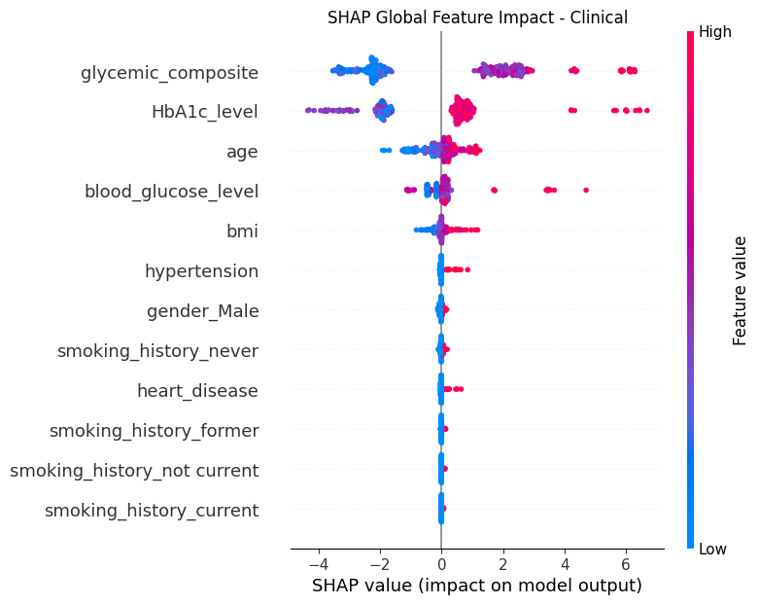
EXPLAINABILITY & INTERPRETABILITY
Explainable AI (XAI): SHAP Game-Theoretic Feature Attribution
SLIDE 13 / 15
TreeExplainer SHAP Attribution Across Modalities
Clinical Biomarkers Cohort:
• HbA1c_level is the #1 global driver by an overwhelming margin.
• SHAP shows steep non-linear risk escalation above HbA1c 6.5%.
• blood_glucose_level is secondary driver, followed by Age and BMI.
CDC BRFSS Lifestyle Survey:
• GenHlth (General Health Perception) is the strongest non-invasive predictor.
• HighBP (Hypertension) and BMI represent major secondary contributors.
• PhysActivity (sedentary lifestyle) demonstrates consistent positive risk attribution.
Clinical Safety Disclaimer:
• SHAP attributions represent statistical associations within retrospective cohorts and do NOT establish proven medical causation.

Slide 14
SOFTWARE ENGINEERING & DEPLOYMENT
Interactive Web Dashboard & Clinical Decision Support System
SLIDE 14 / 15
1. Multi-Cohort Explorer
• Interactive dataset viewer across 6 cohorts.
• Feature distribution plots & correlation matrices.
• Cryptographic MD5 hash verification panel.
2. Multi-Mode Risk Portal
• Live Patient Risk Assessment.
• Mode 1: Clinical laboratory input.
• Mode 2: BRFSS Lifestyle survey input.
• Mode 3: Acute symptom triage.
• Outputs calibrated probabilities & 95% CIs.
3. Model Benchmarks
• Interactive ROC & Precision-Recall curves.
• Confusion matrices with cutoff threshold sliders.
• Calibration curve reliability visualizer.
4. Explainable AI & Monograph
• Patient-level local waterfall attribution.
• Global beeswarm & feature importance.
• Direct PDF & CSV research report downloads.

Slide 15
CLINICAL GOVERNANCE & FUTURE ROADMAP
Clinical Governance, Scientific Limitations & Future Research
1. Critical Medical Limitations
• Retrospective vs. Future Risk: Models predict retrospective classification concordance, NOT prospective future disease incidence.
• Cross-Sectional Observational Data: Lacks multi-year longitudinal follow-up.
• Self-Report Bias: CDC BRFSS relies on telephonic surveys, subject to recall bias.
2. Ethical Framework & Privacy
• Research Prototype Only: NOT a certified medical diagnostic device.
• Zero Automated Diagnosis: Serves solely as an educational risk stratification aid.
• Data Privacy: Zero patient information transmitted to cloud or external APIs; all computation executed locally.
3. Future Research Directions
• Prospective Longitudinal Cohort Tracking: Evaluating 5-year incident risk.
• Continuous Glucose Monitoring (CGM): Integration of continuous glycemic time-series.
• Edge & Mobile Health Deployment: Offline mobile screening apps for low-resource settings.

