Slide 1
Construction of an environmental attitudinal score from Visa transactional data
Please ignore hidden slides
Might not make sense in parts

Slide 2
Note
Higher score -> Worse impact on the environment

Slide 3
Problems
Literature suggests behavior is not (or is very weakly) correlated to attitude:
Must consider actions’ opportunity-cost for each individual:
How much they earn -> Standardize results at the end
Where they live (urban or rural) -> Focus exclusively on London initially
No easy way of measuring correctness:
Look at distributions of demographics receiving high medium and low scores, do these match previous literature?
‘Eco-gender gap’: Females more likely to pursue environmental behaviors
Older audiences more likely to pursue environmental behaviors
Regional Recycling Rates
Train models with different metrics, do they agree?

Slide 4
Dataset
Start off with small subset:
Those who live in London
If time, this will be expanded to all Urban Areas, then Rural too.
Highly active cards: hitting certain spending thresholds in different categories
Recent data: possibly 2022, 6 months, or 12 months

Slide 5
Two Scoring Possibilities
Regional Scoring:
Each behavior has a ‘baseline’ of most common outcome
Change score if non-baseline outcome appears
Baseline and effects on score potentially vary by area
National Scoring:
Each behavior has a ‘baseline’ of most common outcome
Post-scoring, standardize regionally

Slide 6
Types of behavior:
Binary: You perform it or you don’t - e.g. car ownership
Sliding Scale: Happens on differing levels – e.g. clothes purchased
To account for family expenditure, taken as a proportion of total spend
Plot distributions of results and split into categorical in a reasonable way
Decide if 0 is reasonable, if not, select the new baseline group
Might be worth seeing if sliding scale values worth using raw values (would have to cap at certain impact)

Slide 7
Action Vectors:
Lets assume we only are interested in public transport usage (None, Some, Frequent) and Car Ownership (Yes, No).
We set a reference value -> What is the most common outcome:
(None, Some, Frequent) (Yes, No)
This can be expressed as a single vector:
(None, Some, Frequent, Yes, No)
For each individual, we can decompose their behaviors to a sparse vector: (0, 0, 1, 0, 1)
However, each action needs to have a different effect, so we introduce a weights vector for transportation outcomes and car ownership: (T₁, T₂, T₃, C₁, C₂)

Slide 8
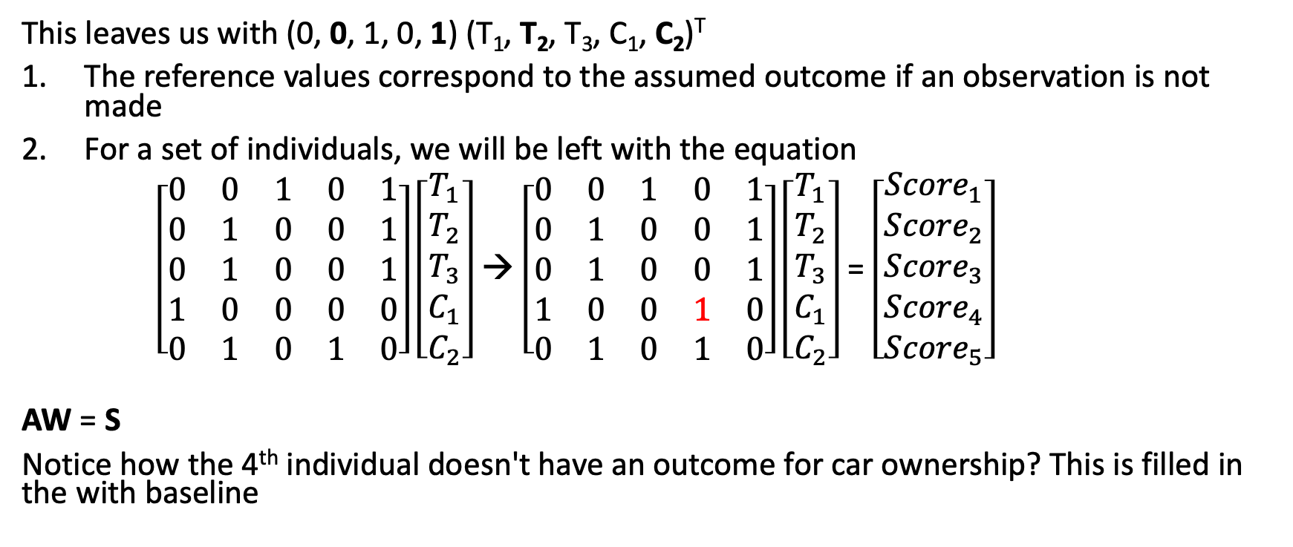
Action Vectors
This leaves us with (0, 0, 1, 0, 1) (T₁, T₂, T₃, C₁, C₂)^{T}
The reference values correspond to the assumed outcome if an observation is not made
For a set of individuals, we will be left with the equation
$\left[\begin{matrix}0 & 0 & 1 & 0 & 1 \\ 0 & 1 & 0 & 0 & 1 \\ 0 & 1 & 0 & 0 & 1 \\ 1 & 0 & 0 & 0 & 0 \\ 0 & 1 & 0 & 1 & 0\end{matrix}\right]\left[\begin{matrix}T_{1} \\ T_{2} \\ T_{3} \\ C_{1} \\ C_{2}\end{matrix}\right]$ → $\left[\begin{matrix}0 & 0 & 1 & 0 & 1 \\ 0 & 1 & 0 & 0 & 1 \\ 0 & 1 & 0 & 0 & 1 \\ 1 & 0 & 0 & 1 & 0 \\ 0 & 1 & 0 & 1 & 0\end{matrix}\right]\left[\begin{matrix}T_{1} \\ T_{2} \\ T_{3} \\ C_{1} \\ C_{2}\end{matrix}\right]$ = $\left[\begin{matrix}{Score}_{1} \\ {Score}_{2} \\ {Score}_{3} \\ {Score}_{4} \\ {Score}_{5}\end{matrix}\right]$
AW = S
Notice how the 4th individual doesn't have an outcome for car ownership? This is filled in the with baseline

Slide 9
Heart of the problem
How do we best determine our weight vector: (T₁, T₂, T₃, C₁, C₂)?
Baseline model: Via literature
Voting model: By tuning values

Slide 10
Simple baseline:
Use literature to determine how much an individuals think outcomes relate to CO2 environment

Slide 11
Spending Sectors Model
This must already exist
Internally at visa
For each individual break spending down into categories
Rate each category for environmental attitude
Sum up ratings using proportion of spend as a weighting
Greater limitations -> Only works for ‘Complete’ accounts
Raw spending would work for all accounts, but brief indicates this has been tried and doesn't show clear behaviours

Slide 12
Values must be standardised
Some sectors might have quite a large range of values while others might have tightly packed results
Work with standard deviations from the mean (or median)

Slide 13
Process
Once n repeats have been complete for each dataset, take average of outputs
Sparce Matrix Framework of actions
Randomly select p random predictor sets
Tune parameter weight vectors on batch so medians best match demographic scores
Move to next data set
For each dataset, score each demographic according to environmental attitude (literature), assuring results are scaled to importance:
For each data set and demographic (examples):
Gender eco gap (split by gender)
Age (split by age)
Recycling rates (split by region)
Repeat n time
Determine demographics of individuals
Hyperparameter tuning for p, maybe start with 2 or 3

Slide 14
An example
Sparce Matrix Framework of actions
Randomly select p random predictor sets
Assume gender eco gap chosen
With females having an impact of 1,
Males 1.15
Tune parameter weight vectors on batch so medians best match demographic scores
Move to next data set
For each dataset, score each demographic according to environmental attitude (literature), assuring results are scaled to importance:
For each data set and demographic (examples):
Gender eco gap (split by gender
Age (split by age)
Recycling rates (split by region)
Repeat n time
Determine demographics of individuals

Slide 15
An example
Sparce Matrix Framework of actions
Randomly select p random predictor sets
This should already be established
Tune parameter weight vectors on batch so medians best match demographic scores
Move to next data set
For each dataset, score each demographic according to environmental attitude (literature), assuring results are scaled to importance:
For each data set and demographic (examples):
Gender eco gap (split by gender
Age (split by age)
Recycling rates (split by region)
Repeat n time
Create a Y matrix labelling each male 1.15 and female 1
These demographics will be calculated with internal visa models (hopefully)
Determine demographics of individuals

Slide 16
An example
For the example, we will let p = 2
The predictors randomly selected are
Car ownership (Yes, No), Clothes purchased (None, Some, Lots)
Sparce Matrix Framework of actions
Randomly select p random predictor sets
Tune parameter weight vectors on batch so medians best match demographic scores
Move to next data set
For each dataset, score each demographic according to environmental attitude (literature), assuring results are scaled to importance:
For each data set and demographic (examples):
Gender eco gap (split by gender
Age (split by age)
Recycling rates (split by region)
Repeat n time
Determine demographics of individuals

Slide 17
An example
Sparce Matrix Framework of actions
Randomly select p random predictor sets
Parameters are then tuned. This will be outlined in a different slide
Tune parameter weight vectors on batch so medians best match demographic scores
Move to next data set
For each dataset, score each demographic according to environmental attitude (literature), assuring results are scaled to importance:
For each data set and demographic (examples):
Gender eco gap (split by gender
Age (split by age)
Recycling rates (split by region)
Repeat n time
Determine demographics of individuals

Slide 18
An example
Sparce Matrix Framework of actions
Randomly select p random predictor sets
Tune parameter weight vectors on batch so medians best match demographic scores
Move to next data set
For each dataset, score each demographic according to environmental attitude (literature), assuring results are scaled to importance:
For each data set and demographic (examples):
Gender eco gap (split by gender
Age (split by age)
Recycling rates (split by region)
Repeat n time
This process repeats a large number of times
You would want each predictor set to appear with each other predictor set many times n >> P
Determine demographics of individuals

Slide 19
An example
Sparce Matrix Framework of actions
Randomly select p random predictor sets
Once this is done, tune parameters again for the next data set
Tune parameter weight vectors on batch so medians best match demographic scores
Move to next data set
For each dataset, score each demographic according to environmental attitude (literature), assuring results are scaled to importance:
For each data set and demographic (examples):
Gender eco gap (split by gender
Age (split by age)
Recycling rates (split by region)
Repeat n time
Determine demographics of individuals

Slide 20
An example
Sparce Matrix Framework of actions
Randomly select p random predictor sets
Once this is done, tune parameters again for the next data set
Tune parameter weight vectors on batch so medians best match demographic scores
Move to next data set
For each dataset, score each demographic according to environmental attitude (literature), assuring results are scaled to importance:
For each data set and demographic (examples):
Gender eco gap (split by gender
Age (split by age)
Recycling rates (split by region)
Repeat n time
Determine demographics of individuals

Slide 21
Tuning
Must assure trends seen are have no other explanations (different recycling rates could be different things offered by different councils)
Tuning data sets should be independent from eachother, or must be weighted appropriately (including recycling rates and landfill rates will not be independent, so need a lower weighting if both included)
Stipulate extra conditions on sets of parameters: e.g. Public Transport: Lots <= Some <= None
Select small step size
Get equal samples from each region or use weighting for error
Possible feature selection for each tuning step -> It could be that recycling is only predicted from X Y Z, while air quality is predicted from W, X, Y.
Then when taking aggregate, weight importance by number of models contained in
(relevance1 relevance2... )^{T} %*% (Standardised coefficient)

Slide 22
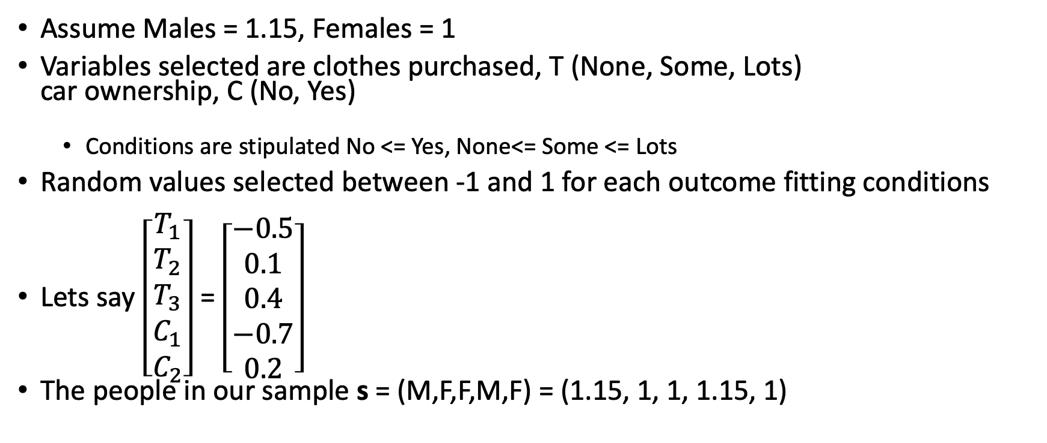
Tuning example
Assume Males = 1.15, Females = 1
Variables selected are clothes purchased, T (None, Some, Lots) car ownership, C (No, Yes)
Conditions are stipulated No <= Yes, None<= Some <= Lots
Random values selected between -1 and 1 for each outcome fitting conditions
Lets say $\left[\begin{matrix}T_{1} \\ T_{2} \\ T_{3} \\ C_{1} \\ C_{2}\end{matrix}\right]$ = $\left[\begin{matrix}−0.5 \\ 0.1 \\ 0.4 \\ −0.7 \\ 0.2\end{matrix}\right]$
The people in our sample s = (M,F,F,M,F) = (1.15, 1, 1, 1.15, 1)

Slide 23
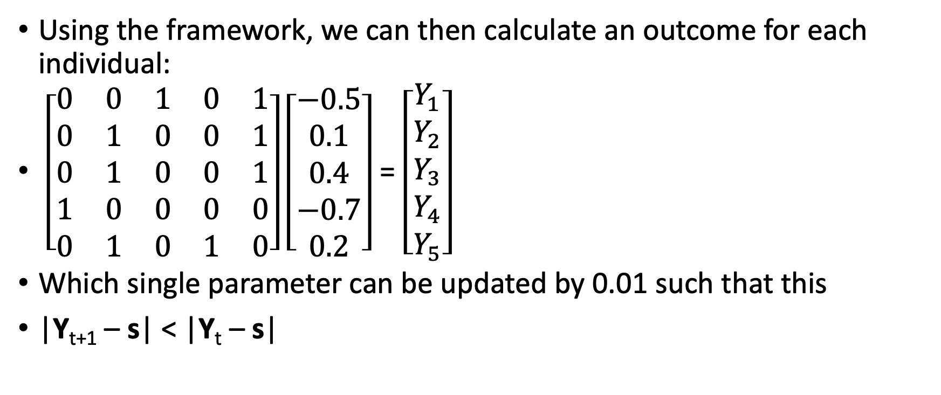
Tuning example
Using the framework, we can then calculate an outcome for each individual:
$\left[\begin{matrix}0 & 0 & 1 & 0 & 1 \\ 0 & 1 & 0 & 0 & 1 \\ 0 & 1 & 0 & 0 & 1 \\ 1 & 0 & 0 & 0 & 0 \\ 0 & 1 & 0 & 1 & 0\end{matrix}\right]\left[\begin{matrix}−0.5 \\ 0.1 \\ 0.4 \\ −0.7 \\ 0.2\end{matrix}\right]$ = $\left[\begin{matrix}Y_{1} \\ Y_{2} \\ Y_{3} \\ Y_{4} \\ Y_{5}\end{matrix}\right]$
Which single parameter can be updated by 0.01 such that this
|Y_{t+1} – s| < |Y_{t} – s|

Slide 24
Tuning problem
What if the best improvement breaks the stipulated condition
It tries to make car ownership score higher than no ownership despite (Yes <= No)
Set outcomes to the same value
If it is still the best improvement, make the second best improvement so long as it still lowers error
End tuning when no improvements can be made or after x repetitions

Slide 25
Tuning
MLE?

Slide 26
Behaviors (initial guesses - London)
To be confirmed by literature
 | Baseline | Good |  | Good |  | Bad |  | Bad
Air Travel | Some
Public Transport – Car usage ratio * | High
Clothes purchased | Some
Fast food consumption | Some
Type of vehicle | Fossil fuel
Locally purchased produce | No
Second hand market places / charity shops | No
*Can maybe be broken down further?
Notes:
Total amount an individual chooses to spend
Stratified into spending categories
Energy / Water Usage
Locally purchased produce
Holiday Locations
Diet (Vegetarian, Vegan, Carnivore etc)

Slide 27
Scoring
Baselines established as most common -> score of 0
Each difference from baseline -> upto +- 1 from the score depending on rough guess
Values are tuned predict region’s value for several datasets:
Household Renewable Energy production per capita
Landfill per capita
Recycling per capita
Water usage per capita
Air Quality
This hopefully leaves a model that can predict for environmental attitude

Slide 28
Standardize all results by income:
Medians are all equivalent
Standard deviations away from the mean are equivalent

Slide 29
Valid results
Is appropriate age and gender (and other demographic) distribution seen?
Do models show similar results?
How do they compare to ground truth? Do those with a higher score emit more CO2 in total on average?
Visa internal measurement?

Slide 30
Health based outcomes
Does health score provide any more information than age and gender alone?
Get health outcomes by area, along with age, gender and environmental score outcomes (and maybe ana’s score)
Run regression of age and gender, then one with age gender and score -> Is score significant?
health score - environmental score SRCC
Interesting but not necessarily allowed

