Slide 1
Construction of an environmental behavioural score from Visa transactional data
Msoa

Slide 2
What’s New
Transactional Data
Map Behaviours
Determine impact of behaviours
Determine impact of categories
Split spending into categories
Calculate overall impact

Slide 3
Dataset
Start off with small subset:
Those who live in London
Recent data: possibly 2022, maybe 12 months
Highly active cards:

Slide 4
Problems
Individuals have different opportunity-costs for their behaviors:
No easy way of measuring validity:
Look at distributions of demographics receiving high, medium and low scores: do these match previous literature?
Train models with different metrics: do they ?
Extrapolate to previous years, are results consistent?
Where they live: Focus exclusively on London
How much they earn: Standardize results at the end by income band

Slide 5
Types of behavior:
Binary: You perform it or you don’t - e.g. car ownership
Continuous: Happens on differing levels – e.g. clothes purchased
To account for family expenditure, taken as a proportion of total spend
Plot distributions of results and split into categorical in a reasonable way

Slide 6
Action Vectors:
Lets assume we only are interested in:
Public transport usage: (None, Some, Frequent) Car Ownership (Yes, No)
This can be expressed as a single vector: (None, Some, Frequent, Yes, No)
We set a reference value → Given what is observed, what is the most likely outcome: For each PAN, we can decompose behaviors into a sparse ‘action’ vector: A = (0, 0, 1, 0, 1)
However, each action needs to have a different effect, so we introduce a weights vector for transportation outcomes and car ownership: W = (T₁, T₂, T₃, C₁, C₂)

Slide 7
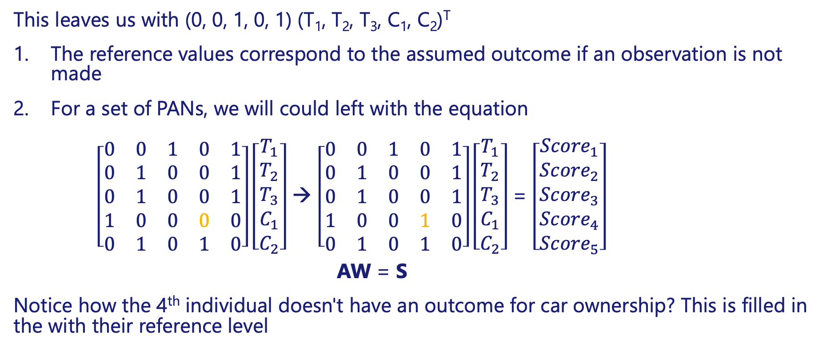
Action Vectors
This leaves us with (0, 0, 1, 0, 1) (T₁, T₂, T₃, C₁, C₂)^{T}
The reference values correspond to the assumed outcome if an observation is not made
For a set of PANs, we will could left with the equation
$\left[\begin{matrix}0 & 0 & 1 & 0 & 1 \\ 0 & 1 & 0 & 0 & 1 \\ 0 & 1 & 0 & 0 & 1 \\ 1 & 0 & 0 & 0 & 0 \\ 0 & 1 & 0 & 1 & 0\end{matrix}\right]\left[\begin{matrix}T_{1} \\ T_{2} \\ T_{3} \\ C_{1} \\ C_{2}\end{matrix}\right]$ → $\left[\begin{matrix}0 & 0 & 1 & 0 & 1 \\ 0 & 1 & 0 & 0 & 1 \\ 0 & 1 & 0 & 0 & 1 \\ 1 & 0 & 0 & 1 & 0 \\ 0 & 1 & 0 & 1 & 0\end{matrix}\right]\left[\begin{matrix}T_{1} \\ T_{2} \\ T_{3} \\ C_{1} \\ C_{2}\end{matrix}\right]$ = $\left[\begin{matrix}{Score}_{1} \\ {Score}_{2} \\ {Score}_{3} \\ {Score}_{4} \\ {Score}_{5}\end{matrix}\right]$
AW = S
Notice how the 4th individual doesn't have an outcome for car ownership? This is filled in the with their reference level

Slide 8
Heart of the problem
How do we best determine our weight vector: (T₁, T₂, T₃, C₁, C₂)?
Perform a literature search to determine impact to carbon emissions of each action

Slide 9
Spending Sectors Model (secondary – ‘normal’ approach)
Determine unique spending categories C
Weight each category for environmental impact per pound W
CW = Score
Greater limitations -> Only works for ‘highly active’ accounts
Raw spending would work for all accounts, but brief indicates this has been tried and doesn't show clear behaviors

Slide 10
Valid results
Is appropriate age and gender (and other demographic) distribution seen? Might not be accessible
Can check ecological correlations with ONS
Do models show similar results?
What do previous visa models show? Similar things?

Slide 11
Look at ecological correlations between scores and various health outcomes within LADs:
Life expectancy / Heart Disease / Cancer
Will look for outcomes that have good data accessibility
Started today → will clean data and created visualisations over the coming day

Slide 12
Plan
Collect and clean data for health outcomes
Create visualisations for health outcomes
Determine impact of behaviours on CO2 emissions
Develop strategy to map behaviours
Analyse distributions of behaviours to choose sensible categorical thresholds

Slide 13
Total fuel consumption looked and as opposed to breaking it down by vehicle type – a litre of fuel used always produces the same emissions (fuel spent / fuel price per litre)*emissions per litre

Slide 14
Behaviours
Air Travel
Public Transport
Car usage (Gas)
Car Usage (electric)
Taxi Usage
Clothes Purchased
Fast Food
Locally purchased Produce
Second hand market places
Charitable Donations
Food ‘Rescue’

Slide 15
Air Travel: Algorithm
If large quantity of money spent on holiday sites 1-2 times
Assume 'None'
By Default
Assume 'Some'
Assume 'Frequent'
Large quantities of money spent on holiday sites 3+ times
If spending abroad 2+ times a year AND no other transport arrangements observed
If large amount of money spent at common flights website
Back to behaviours
Notes:
What happens if away on work trip -> Not their behaviour?

Slide 16
Air Travel Method
Small transaction → Presumed short haul flight
Large Transaction → Presumed long haul flight
Also check for multiple transactions within small space of time, half thresholds
Can similarly be checked for boats,

Slide 17
Air Travel Estimates
101g per KM https://www.carbonindependent.org/22.html

Slide 18
Public Transport: Algorithm
If large quantity of money spent on holiday sites 1-2 times
Assume 'None'
By Default
Assume 'Some'
Assume 'Frequent'
Large quantities of money spent on holiday sites 3+ times
Back to behaviours

Slide 19
Public Transport Estimates
Tube: 44g/km pp - https://tfl.gov.uk/corporate/transparency/freedom-of-information/foi-request-detail?referenceId=FOI-0354-2021 31g/km pp - https://ourworldindata.org/travel-carbon-footprint 70g/km pp - https://www.carbonindependent.org/21.html
12b km per year -https://www.statista.com/statistics/304948/historical-passenger-kilometres-on-the-london-uk-underground/
1350m tube journeys per year - https://www.statista.com/statistics/304852/passenger-journeys-on-the-london-underground/
48g avg journey - https://content.tfl.gov.uk/london-underground-carbon-footprint-2008.pdf
Bus

Slide 20
Car Usage (Gas): Algorithm
If fuel top ups fuel 0<n<=x times per month AND no electricity top ups
Assume 'None'
By Default
Assume 'Some'
Assume 'Frequent'
If fuel top ups n > x times per month AND no electricity top ups
If fuel top ups exceed £ AND no electricity top ups
Back to behaviours

Slide 21
Car Usage (Electric / Hybrid): Algorithm
If fuel top ups fuel 0<n<=x times per month AND electricity top ups
Assume 'None'
By Default
Assume 'Some'
Assume 'Frequent'
If fuel top ups n > x times per month AND electricity top ups
If fuel top ups exceed £ AND no electricity top ups
Back to behaviours

Slide 22
Car travel: The figures
Two steps:
Calculate total of each fuel consumed (Electric, Gas)
Determine Type of vehicle (Electric, Hybrid, Fuel)
Motorbike, Car, Van/Lorry -> Don’t differentiate between vehicle category, purely based on fuel purchased (use total spend / avg. price per litre or kWh in time period)
2.2kg CO₂/litre petrol, 2.6kg CO₂/litre petrol Price petrol 131p/L, Diesel 136p/L
221g CO2/kWh 23p/kWh
Notes:
Proof of method: https://www.wltpfacts.eu/link-between-co2-emissions-fuel-consumption/
Petrol/ Diesel emissions: https://www.sciencedirect.com/science/article/pii/S0959652619340429?casa_token=dtJ1eMR7p8sAAAAA:Mj5l0kfX5_l6vePJSaC3OXzm8ULd0r02Ztm_Cu8OOBF4Vnl5Drp31_VArfWUxni5rIIDopchAA
Electricity: https://www.sciencedirect.com/science/article/pii/S0960148120310934?casa_token=UD3LAEn7w4MAAAAA:PnqYIYVwGrWeHqvw-fACJn7fd7CfuZVoUY4TtibR4pBfzyEJZGBmsoU2ZuIAsBjk__5AVnYDmQ
Price gas: https://www.racfoundation.org/data
Price Electric: https://www.edfenergy.com/electric-cars/costs

Slide 23
Taxi use: Algorithm
If observed 1 <n < x times
Assume 'None'
By Default
Assume 'Some'
Assume 'Frequent'
If observed n > x times
Back to behaviours

Slide 24
Taxi Problems
Is a journey the distance the passenger is in the vehicle, or the distance for the driver to return as well?
1.5x distance with passenger?
So many different types of uber, what figure to take for environment?
Assume all are Toyota Prius?

Slide 25
Taxi
Black cab 212g/km - https://ourworldindata.org/travel-carbon-footprint
£3.70/mile -https://tfl.gov.uk/modes/taxis-and-minicabs/taxi-fares/tariffs Can be more specific if times given Might need to account for waiting times
£3.80 base fare
Spend – base fair
(Price paid – base fair) price per mile = distance

Slide 26
Uber (and other private taxis)
104g/km https://www.sciencedirect.com/science/article/pii/S0967070X07000285?casa_token=Rv2zkqyebhAAAAAA:-Q_ghCfAlfwsvka_SXu6A71ABHAQxju6ZhMv8vzyJPHEWCQvrqIzcOIlGgJrzGBcOJS6_cxtDsQ
£2.5 base
£1.25 mile
£0.15 stationary
If time of transaction available → add surge charge estimate

Slide 27
Clothes Purchased
If 1 < n < x transactions on clothes
Assume 'None'
By Default
Assume 'Some'
Assume 'Frequent'
If n > x transactions on clothes
Back to behaviours

Slide 28
Look at number of days with transactions
Avg brit throws away 3.1kg a year https://labfresh.eu/pages/fashion-waste-index?lang=en&locale=en
1kg ~ 20kg CO2 https://climatescience.org/advanced-fashion-textiles-sustainable
Notes:
https://labfresh.eu/pages/fashion-waste-index?lang=en&locale=en

Slide 29
Fast food: Not significantly different

Slide 30
Locally purchased food
Small impact (if any) https://www.scielo.br/j/sa/a/DNPPhm8L8RD9zGQtzrjCwhf/?lang=en&stop=next&format=html
No impact (due to regional growing methods – UK often needs heaters) https://www.sciencedirect.com/science/article/pii/S0924224408000034?casa_token=dg6NqDbBj74AAAAA:jEmGJi4Cosc7TJvMYNcidMJgiKB4fQMcmEgegP3TrzUv6XXFcDGIdWc7lLw-G1-slnRX6cIOFN9X

Slide 31
Second hand market places
If observed 1 <n < x times
Assume 'None'
By Default
Assume 'Some'
Assume 'Frequent'
If observed n > x times
Includes charity shops, eBay, …
Back to behaviours

Slide 32
Ebay has such a high energy consumption, barely any impact

Slide 33
Charitable Donations
Iff observed
Assume ‘No'
By Default
Assume ‘Yes'
Back to behaviours

Slide 34
Woodland Trust: £25 → 1tonne https://www.woodlandtrust.org.uk/blog/2020/01/carbon-donation/
Others definitely help by some unknown quantity

Slide 35
Food ‘Rescue’
If 1 < n < x transactions with vendors
Assume 'None'
By Default
Assume 'Some'
Assume 'Frequent'
If n > x transactions with vendors
Back to behaviours

Slide 36
Too good to go 2.3kg https://toogoodtogo.com/en-us/movement/knowledge/the-carbon-footprint
Medium oddbox 6kg https://shop.oddbox.co.uk/register.php?step=box&viewing_step=check

