Slide 1
Customer Retention: Analysis
Presented by:
Albin Reji

Slide 2
Business Problem
Customer satisfaction has emerged as one of the most important factors that guarantee the success of online store; it has been posited as a key stimulant of purchase, repurchase intentions and customer loyalty.
A comprehensive review of the literature, theories and models have been carried out to propose the models for customer activation and customer retention.
Five major factors that contributed to the success of an e-commerce store have been identified as: service quality, system quality, information quality, trust and net benefit.
The research furthermore investigated the factors that influence the online customers repeat purchase intention. The combination of both utilitarian value and hedonistic values are needed to affect the repeat purchase intention (loyalty) positively.
The data is collected from the Indian online shoppers. Results indicate the e-retail success factors, which are very much critical for customer satisfaction.
We have to apply our Analytical skills to find the reason why any customers prefer a website and what can be done better.

Slide 3
We have 47 columns to start with and our ideal goal should be to check the values that we have in the data and how to extract meaning out of it.
We didn’t have any null values in the data and hence we can proceed directly with the visualization part as that is what is required to analyse the customer behaviour.
There are few things we have to check to get a better result of the data.

Slide 4
We are able to see here that 31.40 years are the people who does most of the shopping in almost all the cities. 51-year-olds and above shops less, The difficulty in adapting to newer technologies among the elder generations could be a reason for the phenomenon.

Slide 5
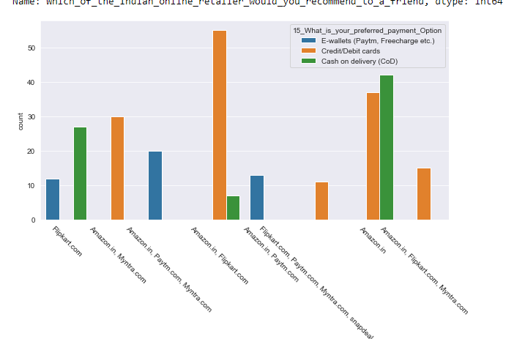
credit debit cards are the most used payment method while the solo flip kart users prefer e wallets,
credit debit cards are the msot used payment method while the solo flipkart users prefer e wallets,

Slide 6
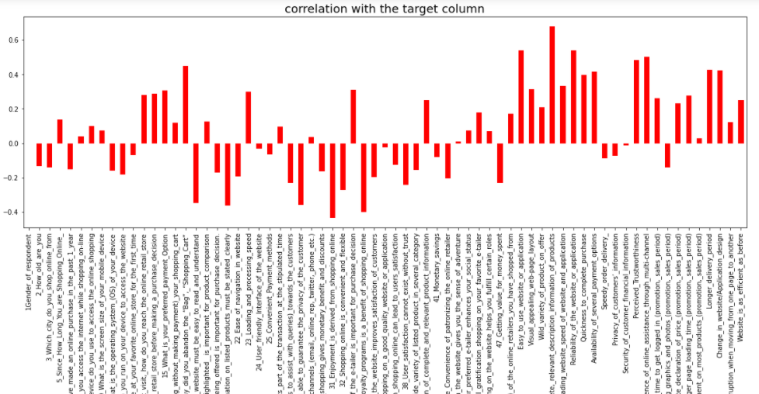
Correlation of other variables to Which_of_the_Indian_online_retailer_would_you_recommend_to_a_friend

Slide 7
Which_of_the_Indian_online_retailer_would_you_recommend_to_a_friend seems to be the closest variable which predicts the the online retailers the customer prefer
The variables which seems to be having higher correlation to the target variable are:
Complete,_relevant_description_information_of_products
Reliability_of_the_website_or_application
Easy_to_use_website_or_application
Presence_of_online_assistance_through_multi-channel
Perceived_Trustworthiness

Slide 8
The data indicates that rather than monetary benefits customers relay most on the on the trustworthiness of the website and and easiness in using the same.
Quality of the services has an important role in customers choosing the service
More details on the products more customer relays on the service
Better customer services can lure in more customers, addressing the customers issues is as important as providing the services
Trust on the service is build up over multiple instances of service

Slide 9
Conclusion
As per the data that we have seen, in almost all the feedback taken from the customers, most of
them prefers Amazon over other and Flipkart as well, but when we talk about websites like Myntra,
snapdeal and paytm, there is a very less probability that any user will visit the same website again.
But when it comes to factors like offers, discount, support and other details that we discussed above,
the two websites, that are Amazon and Filpkart are the ones which pulls the population towards
them.
The data indicates that rather than monetary benefits customers relay most on the on the
trustworthiness of the website and easiness in using the same.

Slide 10
Thank you

