Slide 1

FLIGHT PRICE PREDICTION
Submitted By:
Albin Reji

Slide 2
Problem Statement
Anyone who has booked a flight ticket knows how unexpectedly the prices vary. The cheapest available ticket on a given flight gets more and less expensive over time. This usually happens as an attempt to maximize revenue based on - 1. Time of purchase patterns (making sure last-minute purchases are expensive) 2. Keeping the flight as full as they want it (raising prices on a flight which is filling up in order to reduce sales and hold back inventory for those expensive last-minute expensive purchases)

Slide 3
Understanding
Build a model which can be used to predict in terms of a probability for each flight pricing factor, .
The motive behind this project is to create a ML model that predicts with the given conditions the price of a car resold.

Slide 4
EDA
Removing unwanted columns.
Checking the distribution.
Plotting Correlation.
Removing columns with low correlation.
Removing correlation pairs.
Checking outliers.
Checking skewness
Encoding
Scaling

Slide 5
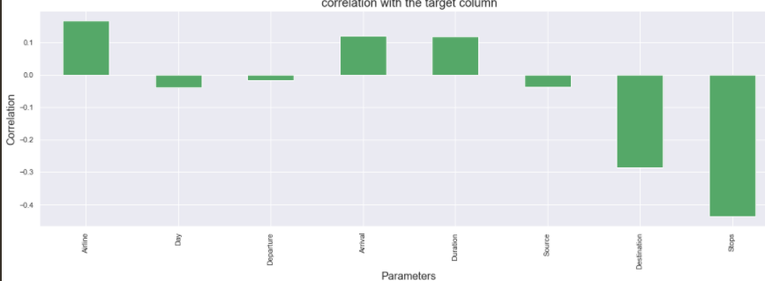
Visualizations
Correlation

Slide 6
Steps
These are the models that I’ve tested to find the best model.
Linear Regression
K-Neighbors Regressor
Decision Tree Regressor
SVR
Random Forest Regressor
Lasso
Ridge
Elastic Net

Slide 7
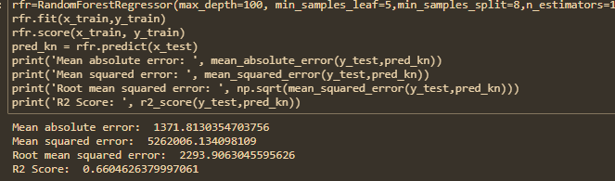
Model dashboard

Slide 8
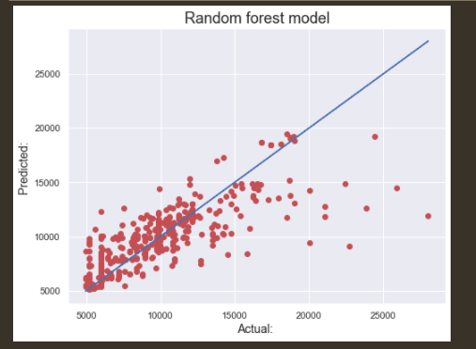
Finalized model
We have finalized the best model to be Ridge Regression

Slide 9
Conclusion
We’re getting a model with about 0.6604626379997061% accuracy post Cross Validation and Grid Search CV with all listed parameters.
Both Lasso and Ridge models gave a good R2 Score in the preliminary run, but on further inspection, Ridge turned out to be the best working model. On further running with the Cross validation, we were able to find that the difference between R2 Score and CV score were less for all the models, however, I went with ridge taking into consideration the low difference in values for all the models and the comparatively higher score for the Ridge Model.
I have created a model which gives me a good accuracy in terms of predicting the prospect price of a house with the parameters listed.

