Slide 1

University Of Dar es Salaam
College Of Information And Communication Technologies
IS 335 Progress Report
Title: ENVIRONMENTAL INFORMATION SYSTEM(EIS)
Members
ISSA, Miraji (2014-04-02829)
SLEYUM, Masoud (2014-04-02823)
ALLY, Azizi (2014-04-02778)
Supervisor: Mr. Benard Mussa

Slide 2
Abstract
Environment is very important as every living organism interact with it, It is faced by several activities in which some of them are Conservative and others are Destructive.
The destruction and Conservation of environment are both outcome of human activities and advancement in technology which is applied in our daily life, For example Energy Crisis
which result in use Firewood, Nuclear Energy production...etc.
On approach to the solution of this problem the government of Tanzania established National Environmental Management Council (NEMC) in 1983.

Slide 3
Abstract (Cont…..)
As the part of the community we proposed the solution that will organize, Store and disseminate environmental information. The Solution which will be introduced in details as follows….

Slide 4
Introduction To The Project
On dealing with environment issues, the government of Tanzania established special organization called National Environmental Management Council (NEMC) in 1983 when the Government of Tanzania enacted the National Environment Management Act No. 19 of 1983, The aim was to oversee environmental management issues and also implement the resolutions of the Stockholm conference (1972) which called upon all nations to establish and strengthen national environmental Councils to advise governments and the international community on environmental issues.

Slide 5

Introduction To The Project
Here by introducing to you the Environmental Information System( EIS ), the environmental management project which will result to a web based system which is expected to do the following:-
Functional requirements the System will do
The system will register environmental experts
The System will register environmental Project
It will also register the Firm(NGO`s), that will coordinate with NEMC in managing environment.
The system will also provide the mechanism for users to read, access information, publish report document based on the research done on the field.

Slide 6

Usefulness Of The Project
The project will be useful in providing solution on the following aspects:-
To increase the modern technologies of acquisition, processing, storage, retrieval and dissemination of environmental information.
To support and promote research, development and innovation in environmental information technology.
To provide national environmental information service relevant to present needs and capable of development to meet the future needs of the users, originators, processors and discriminators of information.
To promote, national cooperation for exchange of environment related information.
To promote, support and assist education and personnel training programmes designed to enhance environmental information processing and utilization capabilities.

Slide 7
Statement of the Problem
The Organizations dealing with environmental Management experiences the difficulties in not only obtaining the correct information on what is going on in the environment but also sending those information to the centralized authorities. This result to the late submission of information concerning those events and even failure, simply because the events occurs in areas which are not penetrative hence delay of information and result to the following shortcomings:-

Slide 8

Statement of the Problem(Cont...)
The approach done by NEMC has the following shortcomings
Use of file based System instead of using the automated system.
Reporting costs since the communication is by Mobile phones which is costful compared to the solution suggested here.
It is difficult to manage environment in large country like Tanzania using non automated systems.
The difficulties that occur during evaluation using the file based system become the bottleneck for the report generated and hence may reduce the performance of an organization.

Slide 9
Statement of the Problem(Cont...)
Rationality to The community
This project would be beneficial to the Government and Organizations which deals with environmental issues on how to manage the environmental information system similarly in handling and maintaining environmental project.
More information and data will enable the government to reach its plan as efficient as possible and at a perfect time, This can encourage development.
The system will be used in Environmental Management Organizations like (NEMC)

Slide 10
Objectives Of The Project
Main Objective
This project aimed at developing the Environmental Information System(EIS) That will help in management, Analysis and dissemination of environmental information.
In the process of accomplishing this main objective the system do the it will result to the following specific objective:-

Slide 11
Objectives Of The Project (Cont....)
Specific Objective
The project is expected to do the following related to environmental issues:-
Requirement Identification (User and System requirement).
Design and analysis for of data management modules.
Developing a prototype.
Testing and validating the collected data

Slide 12
Scope Of The Project.
The proposed system will operate in mode same as that of NEMC , It will act as a centralized point for environmental information collection, analysis, evaluation, and dissemination.

Slide 13
Literature Review.
National Environmental Management Council (NEMC).
NEMC was established by the government aimed to oversee environmental management issues and also implement the resolutions of the Stockholm conference (1972) which called upon all nations to establish and strengthen national environmental Councils to advise governments and the international community on environmental issues.
NEMC use the file based system to collect and record the information related to environments. It finally gives the evaluations.

Slide 14
Literature Review(cont….).
NEMC (cont………)
The File Based System has the following drawbacks
1. Data Redundancy (Repetition): It is possible that the same information may be duplicated in different files, this leads to data redundancy results in memory wastage.
2. Data Inconsistency: This is because of data redundancy, it is possible that data may not be in consistent state.
3. Difficulty in Accessing Data: Accessing data is not convenient and efficient in file processing system. Due to manipulation complexity
4. Security Concerns: We know how is important to secure the data, bu in file based system there is less security of data, data should be accessible to users in limited way.
Each user should be allowed to access data concerning his requirements only.

Slide 15
Literature Review(Cont...)
Literature Review(Cont...)
Literature Review(Cont...)
On Solving this problem, we have proposed to introduce to you Environmental Information System( EIS ), the software project which results to the development of software for automation of environmental information.
Advantage of the proposed Solution:
The proposed Solution ie, Development of Environmental Management System has the following advantages over the existing approach of solving this problem
Effective way of collecting the Information concerning environmental, This is achieved by having a user (reporter) who are responsible in collecting the information as soon as the occur.
. Correctness and enough description about the information collected.
Network mode of operation of the system provides the complete and accurate information.
Confidentiality.
Since the system allows experts to contribute their views, ideas and comments on the events that has occurred, this improve the decision making among the organization members using the system hence the easy in proposing the environment planning strategies.

Slide 16
Methodology.
This system used traditional System Development Life Cycle (SDLC) this means that the developers followed all development stages starting from requirement, analysis, implementation, testing and maintenance.
Based on the nature of our project, ie associated with requirements variability throughout the development the implementation of this process has followed AGILE Software Development methodology.
The methodology facilitates adaptive planning/designing, evolutionary development and dynamic improvement during development as it motivate rapid and flexible response to changes while the project in progress, this completely support our project.

Slide 17
System Analysis
Use case Diagram.
Below is the general use case diagram that shows the main users of the Environment Information System(EIS), That is the Manager who is responsible of managing the content of the system, Expert, Reporter and Proponent. Each category of actor can access the features associated with the system as shown below. The diagram also shows the main functionalities of the system.

Slide 18
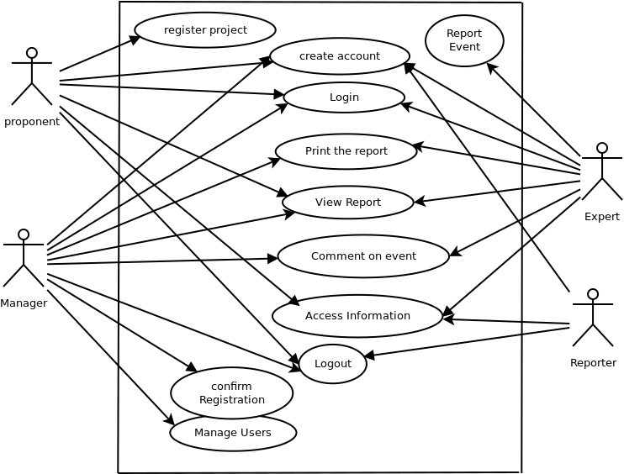
System Analysis(Cont...)
Use case Diagram.

Slide 19
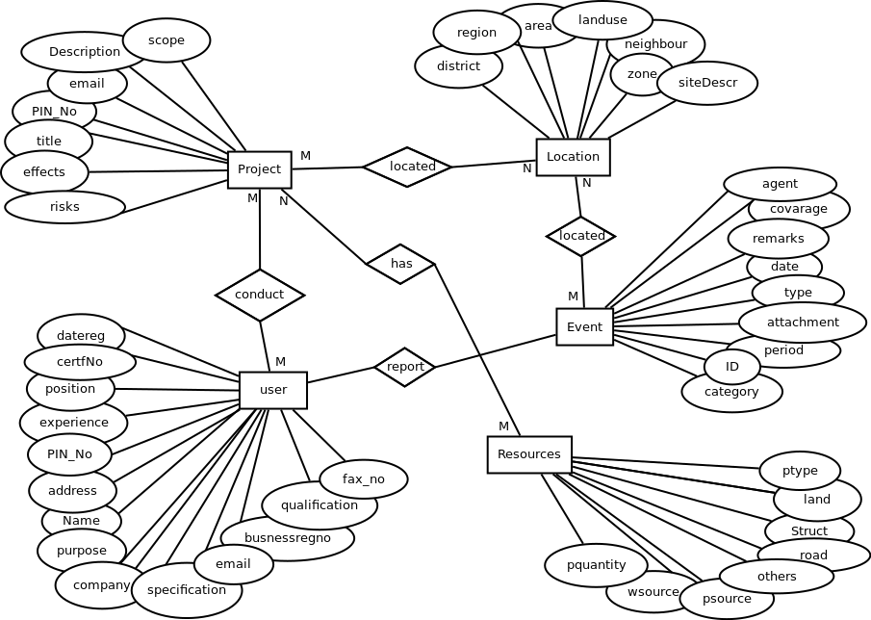
System Analysis(Cont...)
E.R Diagram

Slide 20
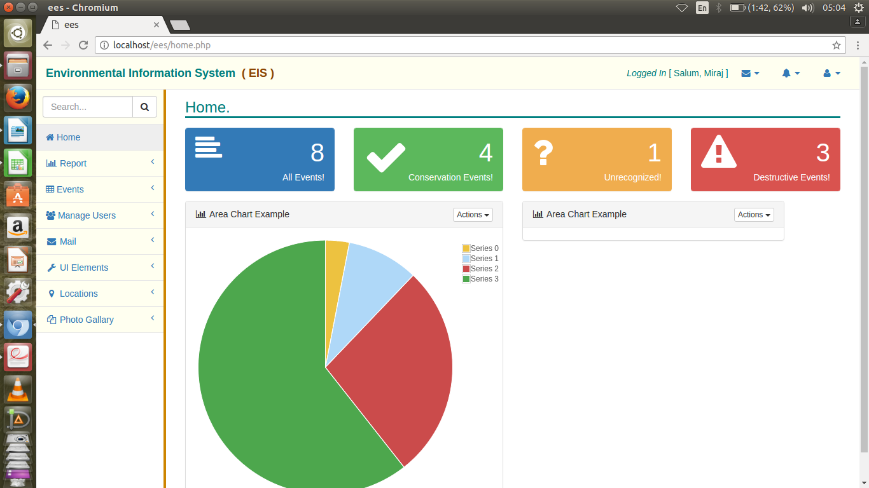
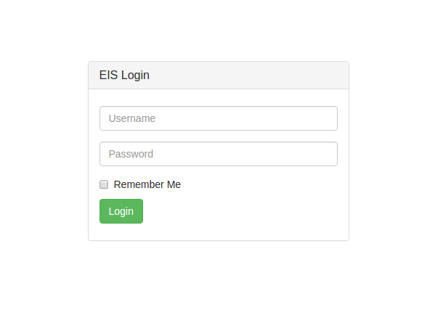

Work Done so Far
Requirement Collection
Requirement Analysis
System Design(On progress)

Slide 21
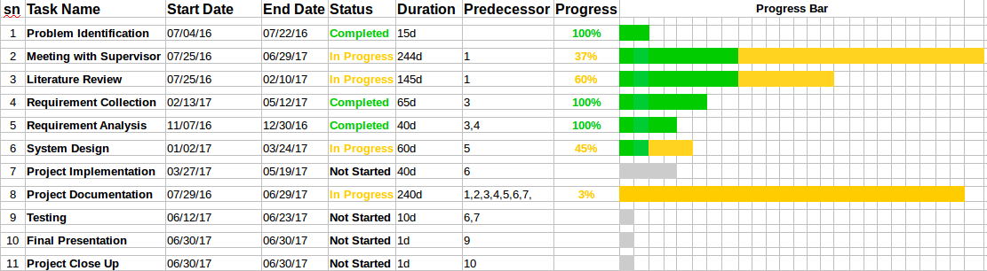
Schedule
Progresss chart Diagram

Slide 22
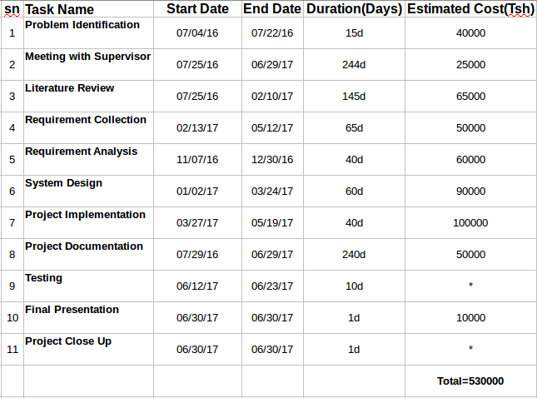
Budget

Slide 23
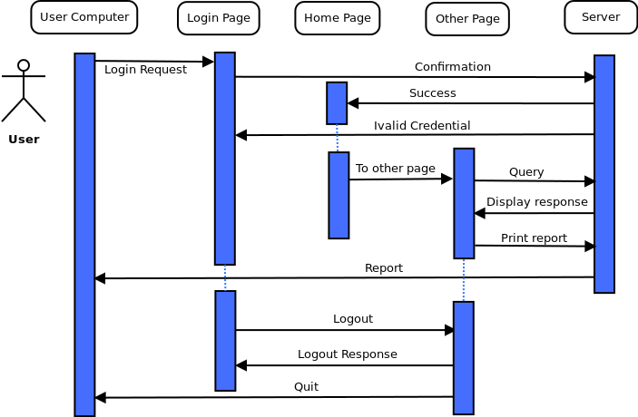
Appendix A1 (Sequence Diagram)

Slide 24
Reference
Ian Sommerville: Software Engineering, Eighth Edition (2001)
NEMC website, www.nemc.or.tz.

Slide 25


Reference (Document review)

Slide 26
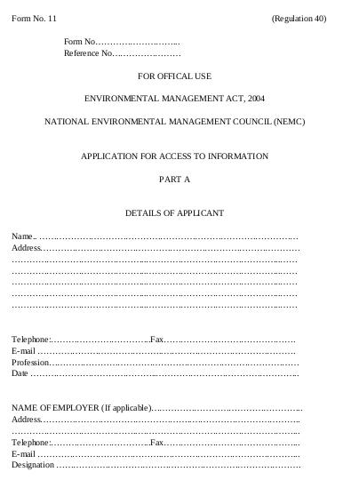
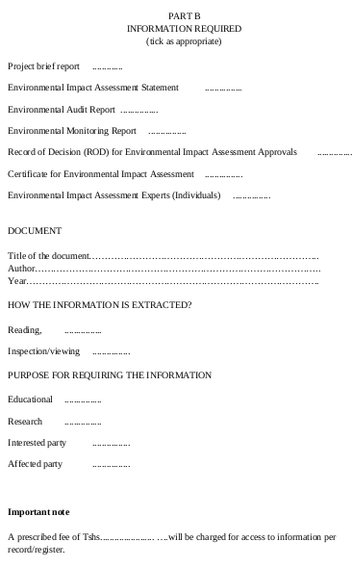
Reference (Document review)

