Slide 1

The intelligent buddy that accompanies you throughout your journey built upon AI and ML.
OutRun Hospitality

Slide 2

OutRun Hospitality
Provides Seamless Customer Experience with improve Productivity
The automation, machine learning, artificial intelligence, and incredible accuracy are the top flavors of technology that can enhance information processing and providing insights at speed.

Slide 3
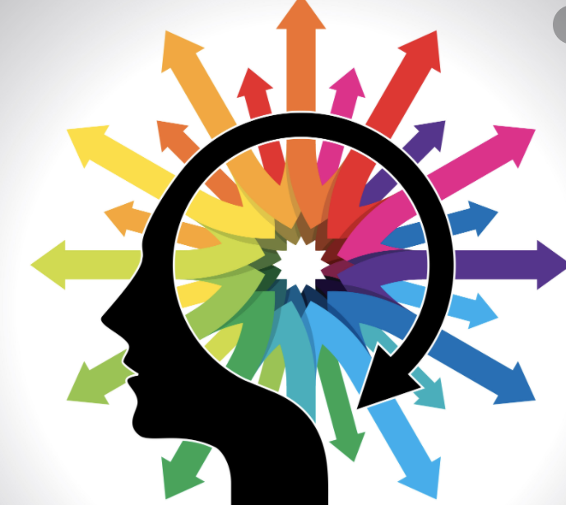
OutRun AI Insights
A Unique way of AI Insights

Slide 4

OutRun AI Insights
Powerful Analytics and Insights based on Machine Learning(ML) and Deep Learning(DL)
Customer Profiling
Sentiment Analysis
Pattern Recognition
Real-Time Dashboard

