Slide 1

PowerEnJoy RASD
Alessandro Caprarelli, Roberta Iero, Giorgio De Luca

Slide 2

Table of content
Introduction 3
Overall description 6
Specific requirements 19
Alloy 22
Notes:
This document describes:
◆ goals
◆ components of the system
◆ functional and non-functional requirements
◆ domain properties and assumptions
It Also provides a description of the system using UML diagrams.

Slide 3
Introduction
Introduction 3
Actors 4
Goals 5
Overall description 6
Specific requirements 19
Alloy 22

Slide 4

Introduction
Actors
Guest
Registered client
System administrators

Slide 5

Introduction
Goals (most relevant)
The Registered Client can hire a car through web/mobile application.
The Guest Client can register himself/herself into the system as Registered Client.
Ensure the Registered Client the possibility to receive a discount on his/her last ride.
Ensure a uniform distribution of cars in the city.
Ensure that a Registered Client's bad behaviour is punished with the application of some penalties.

Slide 6
Overall description
Introduction 3
Overall description 6
External services 7
Assumptions 8
Specific requirements 19
Alloy 22

Slide 7

Overall description
External services
Google Maps
Driving licences database
Payment interface service
SMS gateway provider
GPS system

Slide 8
Overall description
Assumptions (most relevant)
The Clients can leave the rented cars only in one of the safe areas.
There isn't an old system providing the same services.
The position of each car is known using the GPS signal. Each car is provided of an autonomous GPS system reachable from our service.
In the cars there are sensors that provides the system information about the current number of passengers.
A client can maintain his/her reservation of the car during a stop, parking the car temporary in a not safe area. This is allowed only if the client proclaim the intention to do that through the application. During this stop the client continues to pay with some reduction of the standard hiring cost.

Slide 9
Specific requirements
Introduction 3
Overall description 6
Specific requirements 9
Functional requirements 10
Use cases 12
Class diagram 14
Alloy 22

Slide 10

Specific requirements
Functional requirements (example)
G1 - The Registered Client can hire a car through web/mobile application
The system allows the Registered Client to choose the car to hire only between the available ones. Driving licences database
The system allows only one reservation per time for each Registered Client.
The system allows the Registered Client to cancel his/her request.
The system considers the reservation request as valid for at most one hour from the moment in which the request of hiring is accepted. If the Registered Clients doesn't reach the car before this time expires, the system gives him/her a penalty of one euro and mark the car as `available' again.
When a car is reserved the system marks it as ‘unavailable’.
The system unlock the chosen car only when the Registered Client is nearby and he/she communicates this to the system through the application.

Slide 11
Specific requirements
The system locks the car when the Registered Client parks it in a safe area or in a power grid station and he/she communicates the system the intention of ending the rent.
When the rent is finished the system marks the car as “available" again.
The system starts charging the Registered Client for a given amount of money per minute as soon as the engine ignites.
The system stops charging the user as soon as the car is parked in a safe area or in a power grid station and the Registered Client exits the car. Then the system starts the payment procedure.
The system allows the Registered Client to start driving if and only if he/she insert his/her personal code.
The system allows the Registered Client to choose an address in which he/she wants to hire a car or if he/she wants to be located through the GPS signal.
The system must supervise the charge of the car during all the rental period, showing the current charge on the GPS navigation device. It also has to show a warning notice if the charge is equal to the minimum possible charge admitted.
The system allows the Registered Client to find the location of an available car within a certain distance from his/her current location.

Slide 12
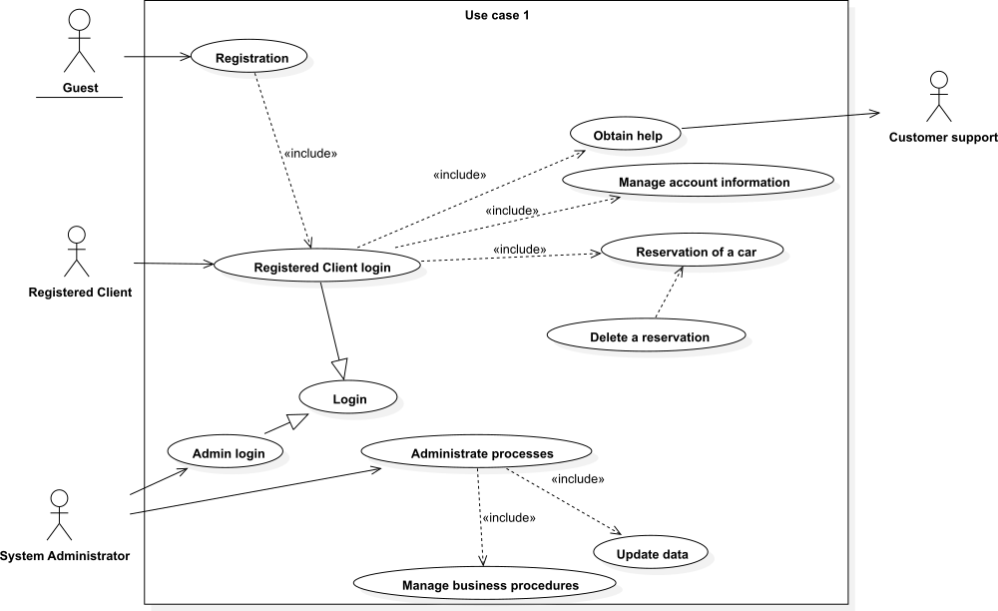
Specific requirements
Use Cases 1

Slide 13
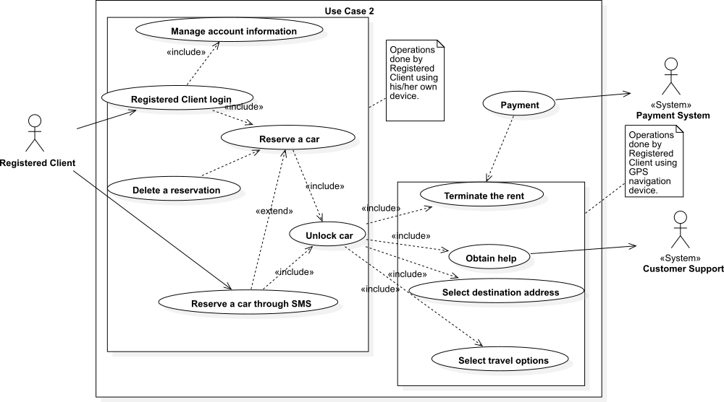
Specific requirements
Use Cases 2

Slide 14
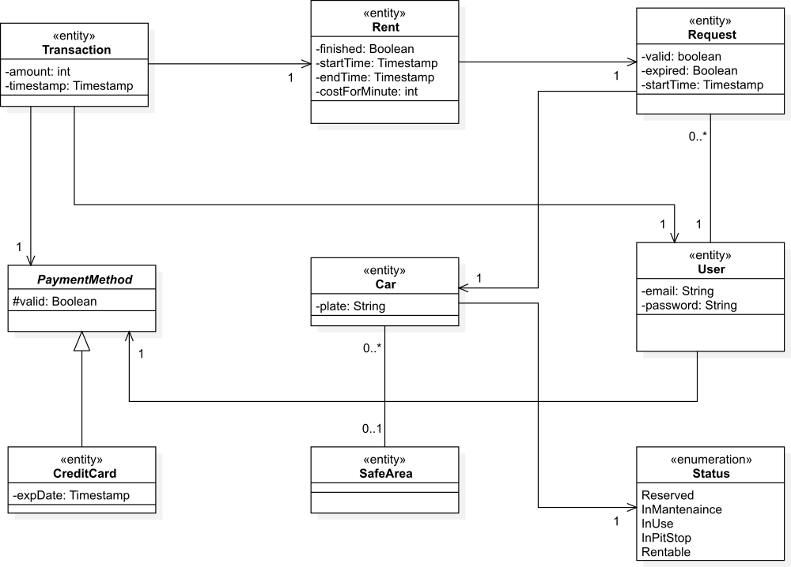
Specific requirements
Class Diagram

Slide 15
Alloy
Introduction 3
Overall description 6
Specific requirements 9
Alloy 15
Generated world 16

Slide 16
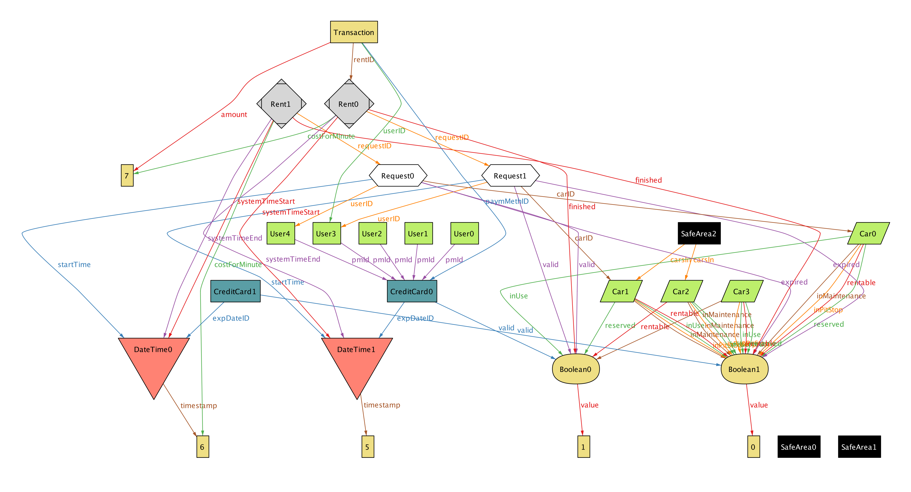
Alloy
Generated world

