Slide 1
Machine learning: car evaluation
By: Bryan alcazar
Tools:(python: Pandas / matplotlib)

Slide 2
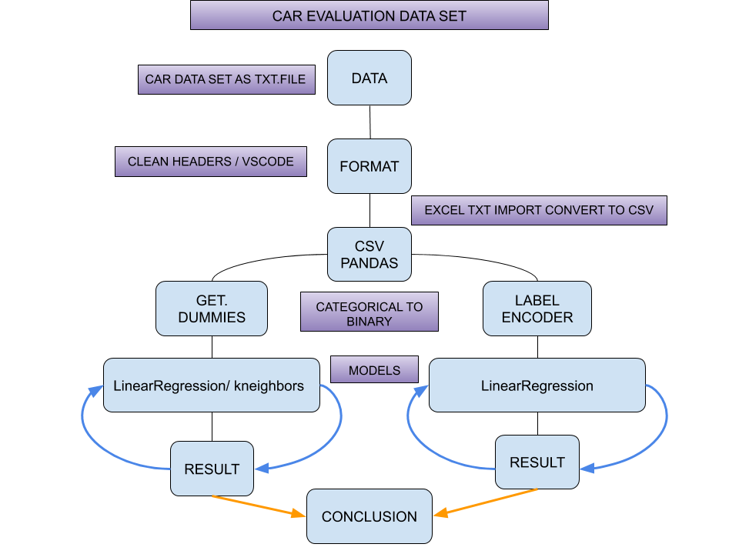
Project schema
DEPENDENCIES
import matplotlib.pyplot as plt
import numpy as np
import pandas as pd
import warnings
warnings.simplefilter('ignore’)
from sklearn.linear_model import LinearRegression
from sklearn.model_selection import train_test_split
from sklearn.preprocessing import StandardScaler
from sklearn.metrics import mean_squared_error
from sklearn.neighbors import KNeighborsClassifier
DATA SOURCE: UCI MACHINE LEARNING REPOSITORY

Slide 3
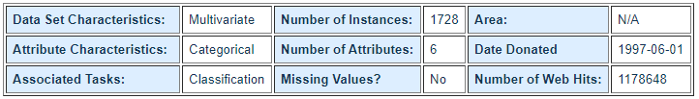
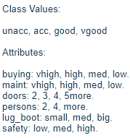
DATA SET INFORMATION
CLASS VALUES ARE ASSIGNED BASED ON THE CONDITION OF THE ATTRIBUTE
CATEGORIES INCLUDE BUYING, MAINTENANCE, NUMBER OF DOORS, NUMBER OF SEATS, SAFETY, AND CABINE SPACE

Slide 4
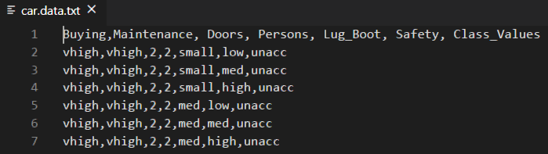
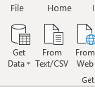
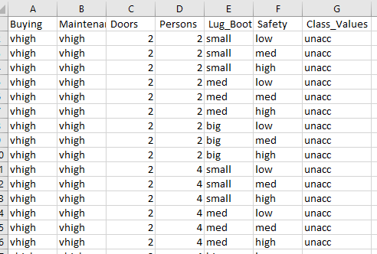
PREPARRING THE DATA
VSCODE : USED FOR POPULATING COLUMN HEADERS
EXCEL : IMPORT FROM TEXT TO CONVERT DATA SET TO CSV
READY FOR PANDAS….

Slide 5
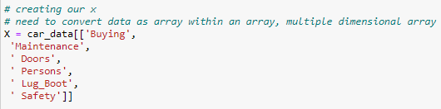
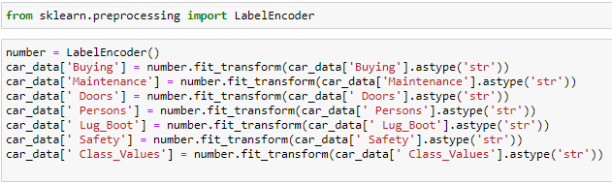
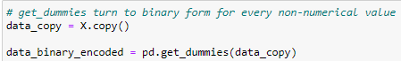
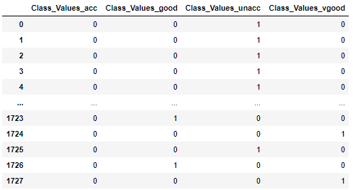
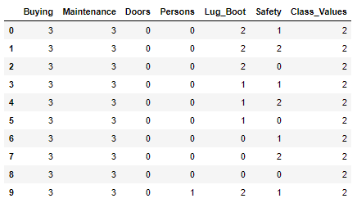
CATEGORICAL TO BINARY
PD.GET_DUMMIES
SKLEARN.PREPROCESSING IMPORT LABELENCODER
COLUMNS ARE CREATED FOR EACH UNIQUE VALUE. EACH VALUE IS ASSIGNED A 0 OR 1
CATEGORICAL DATA IS ASSIGNED A NUMERIC VALUE

Slide 6
CATEGORICAL TO BINARY
SKLEARN.PREPROCESSING IMPORT LABELENCODER
NO RANKING
NUMERIC VALUES ARE NOT SIGNIFICANT TO CATEGORY VALUE

Slide 7

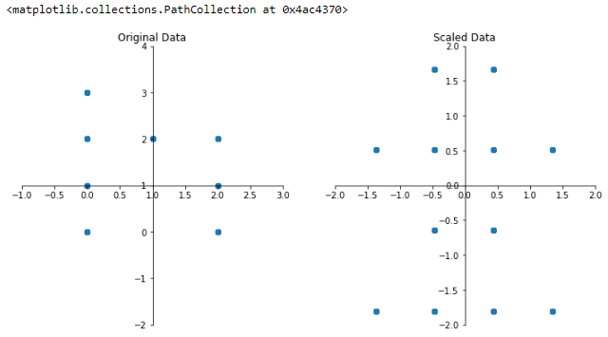

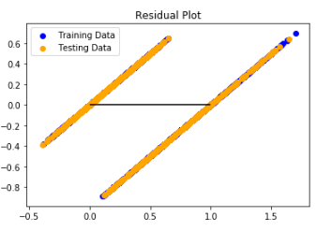
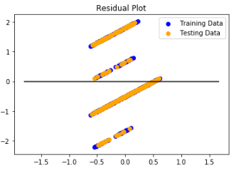
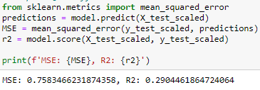
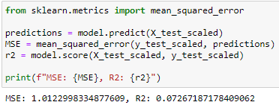
Linear regression – mean squared error (class value)
--- >
--- >

Slide 8
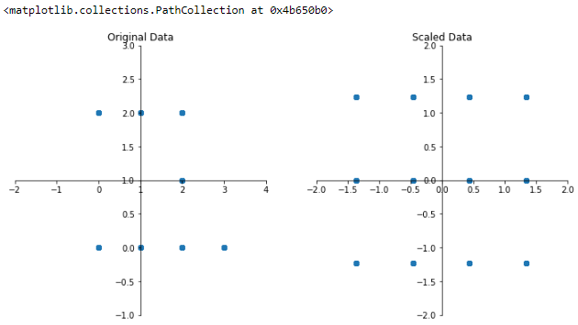
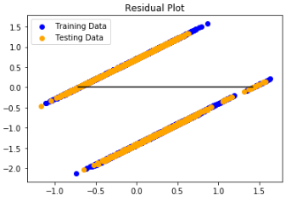
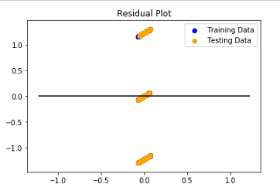
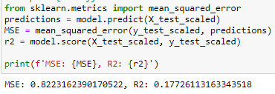
Linear regression – mean squared error (safety)
--- >
--- >

Slide 9
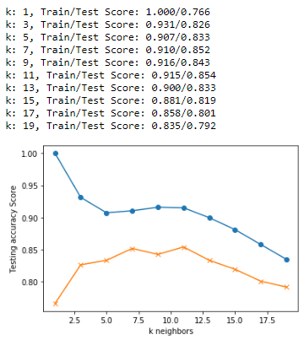
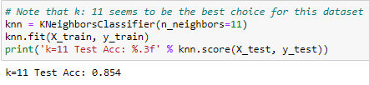
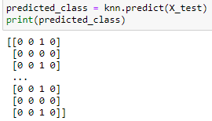
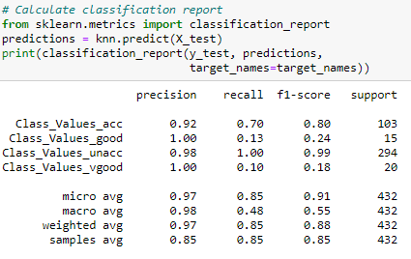
KNEIGHBORS CLASSIFIER – GET.DUMMIES

Slide 10
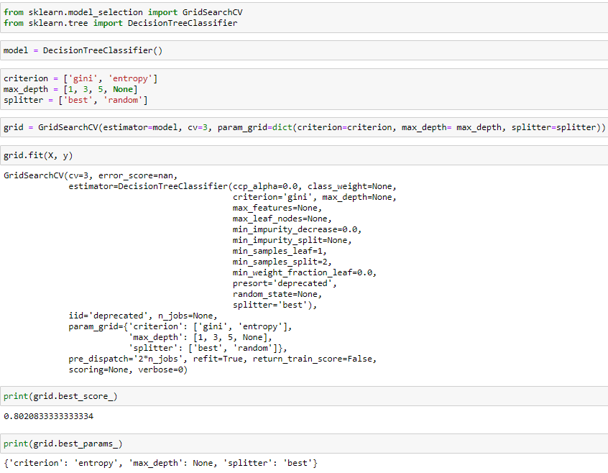
UNFINISHED MODEL – CLASS VALUE LABELENCODER

Slide 11
RESULTS -
PD.GET_DUMMIES
SKLEARN.PREPROCESSING IMPORT LABELENCODER
GROUPING OF DATA WORKED WELL
KNEIGHBORS WAS ABLE TO PREDICT WHAT CATEGORIES BELONG TO WHAT CLASS 85% ACCURACY (WORKED BEST WITH CATEGORICAL DATA)
LINEARREGRESSION MODEL PRODUCED BETTER RESULTS
LINEARREGRESSION MODEL DID NOT PERFORM AS WELL USING THIS MODEL
OVERALL
CATEGORICAL DATA DOES PLOT WELL
VALUES DON’T HAVE ACTUALL WEIGHT OR SIGNIFICANTS

Slide 12
CONCLUSION -
- AFTER RUNNING BOTH MODELS GET.DUMMIES PRODUCED BETTER RESULTS AND SEEMS TO WORK BEST WITH THIS DATASET
- CATEGORICAL DATA LIMITS THE USAGE OF SPECIFIC MODELS
- METHODS FOR TRANSOFRMING CATEGORICAL DATA TO BINARY CAN PRODUCED VARYING RESULTS
DATA DOES NOT HAVE SIGNIFICANT VALUES AFTER CONVERTING TO BINARY
DOES NOT PLOT WELL

Slide 13
ISSUES - BLOCKERS
- UNABLE TO INSTALL TENSORFLOW

