Slide 1
Maximizing the Spread of Influence through a Social Network
Authors: David Kempe, Jon Kleinberg, Éva Tardos
Presented by Rong Ge

Slide 2
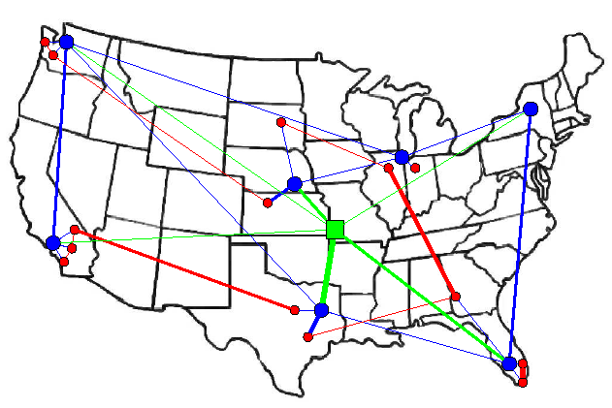


Introduction
What is a social network?
  The graph of relationships and interactions within a group of individuals.
Source: www.cs.washington.edu/

Slide 3
Outline
Social Network
Two basic diffusion models
  Linear Threshold Model
  Independent Cascade Model
An Approximation Algorithm
Conclusion

Slide 4
Social Network
A social network plays a fundamental role as a medium for the spread of information, ideas, and influence among its members.
Direct Marketing takes the “word-of-mouth” effects to significantly increase profits.
Examples:
  Hotmail grew from zero users to 12 million users in 18 months on a small advertising budget.
  A company selects a small number of customers and ask them to try a new product. The company wants to choose a small group with largest influence.

Slide 5
Construct a Social Network
A network value [DR01] is derived from a customer’s influence on other customers.
How to construct a social network?
  Use to be impossible since a customer’s network value depends not only on herself, but potentially on the configuration and state of the entire network.
  The growth of the Internet has led to the availability of a wealth of data from which the network can be built.
  Google’s Gmail service. A smart way to ask people from all over the world to construct this social network voluntarily.

Slide 6
The Models
A social network is represented as a directed graph. Each customer is considered as a node.
Each node can be either active ( buy a product) or inactive.
By the “word-of-mouth” effects, each node’s tendency to become active increases monotonically as more of its neighbors become active.
Assumption: node can switch to active from inactive, but does not switch in the other direction.

Slide 7


Two Basic Diffusion Models
Linear Threshold Model
  A node is influenced by each neighbor according to a weight such that
  Each node has a threshold which is chosen uniformly at random from the interval [0,1].
  A node becomes active if
Alice
Bob
0.7
0.2
You

Slide 8
Example
Inactive Node
0.6
Active Node
0.3
0.2
0.2
Threshold
0.1
Weight
0.4
U
0.5
0.3
Stop!
0.2
w
0.5
v
Source: David Kempe’s slides

Slide 9

Two Basic Diffusion Models (Contd.)
Independent Cascade Model
  Starts with an initial set of active nodes A₀
  The diffusion process unfolds in discrete steps
    When node You first becomes active in step t, it is given a single chance to activate each currently inactive neighbor Alice, it succeeds at probability p_{v,w} --- a parameter of the system.
Alice
Bob
0.7
0.2
You

Slide 10
Independent Cascade Model
If You succeed, then Alice becomes active in step t+1
Weather or not You succeeds, You cannot make any further attempts to activate Alice in subsequent rounds.
The process runs until no more activations are possible.

Slide 11
Example
0.6
Inactive Node
0.3
0.2
0.2
Active Node
U
Newly active
node
0.1
0.4
Successful
attempt
0.5
0.3
0.2
Unsuccessful
attempt
w
0.5
v
Stop!
Source: David Kempe’s slides

Slide 12
Influence Maximization Problem
Define the influence of a set of nodes A, denotes , to be the expected number of active nodes at the end of the process.
Problem Definition:
  Given a parameter k, find a k-node set A to maximize .
Hardness of this problem
  It is NP-hard to determine the optimum for influence maximization for both independent cascade model and linear threshold model.

Slide 13
Expected Results
Find an approximation algorithm for the influence maximization problem.
What we can use from the known results?
  The influence maximization problem is quite similar to the maximization problem of submodular function.
  There are some nice results from 1970’s on submodular function that will be helpful to figure out the influence maximization problem.

Slide 14
The Proof
Use independent cascade model.
Key part is to verify the diminishing returns property.
Difficulties:
  There are so many different outcomes from the coin flips.

Slide 15
Cope with the difficulties
Denote X to be the set of outcomes of all coin flips.
A non-negative linear combination of submodular functions is also submodular.

Slide 16
The Proof (Contd.)

Slide 17
Conclusion
This paper studies two influence diffusion models on a social network.
An approximation algorithm exists for both models.

Slide 18
Reference
David Kempe, Jon Kleinberg and Éva Tardos, Maximizing the Spread of Influence through a Social Network. SIGKDD’03
Pedro Domingos and Matt Richardson, Mining the Network Value of Customers. SIGKDD’01
Matthew Richardson and Pedro Domingos, Mining Knowledge-Sharing Sites for Viral Marketing. SIGKDD’02

Slide 19
Questions?

Slide 20

Submodular Function
A function f maps a finite ground set U to non-negative real numbers, and satisfies a natural “diminishing returns” property, then f is a submodular function.
Diminishing returns property:
  The marginal gain from adding an element to a set S is at least as high as the marginal gain from adding the same element to a superset of S.
  Formally, for S  T

Slide 21
Known Results
For a submodular function f, if f only takes non-negative value, and is monotone.
Finding a k-element set S for which f(S) is maximized is an NP-hard optimization problem[GFN77, NWF78].
There is a greedy hill-climbing algorithm for the maximization of submodular function.
This algorithm approximate the optimum within a factor of (1-1/e) ( where e is the base of the natural logarithm).

Slide 22
Similarity
The influence function maps a set of nodes to non-negative numbers.
The influence maximization problem is to maximize the function where A is an initial set of size k .
Now the problem becomes to prove that
is a submodular function.

Slide 23
Hill-Climbing Algorithm
Start with an empty set S
Choose an element that provides the largest marginal increase in the function value.
Until |S| = k

