Slide 1
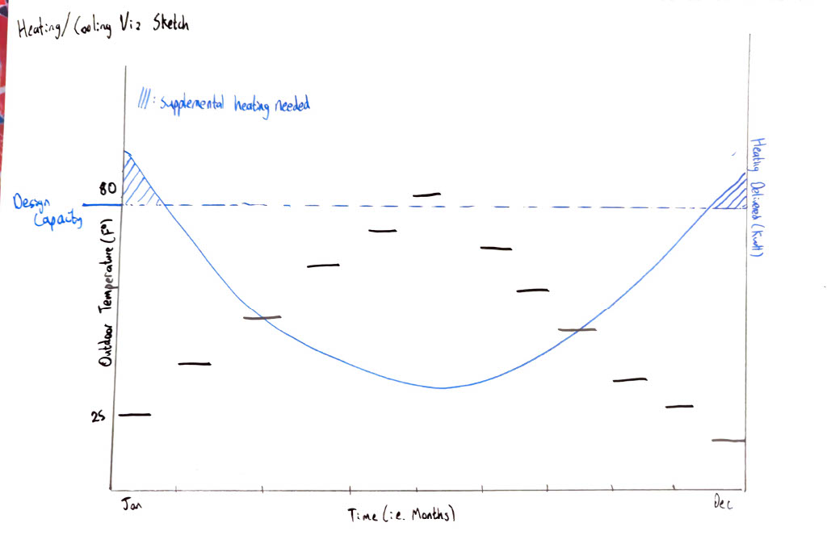
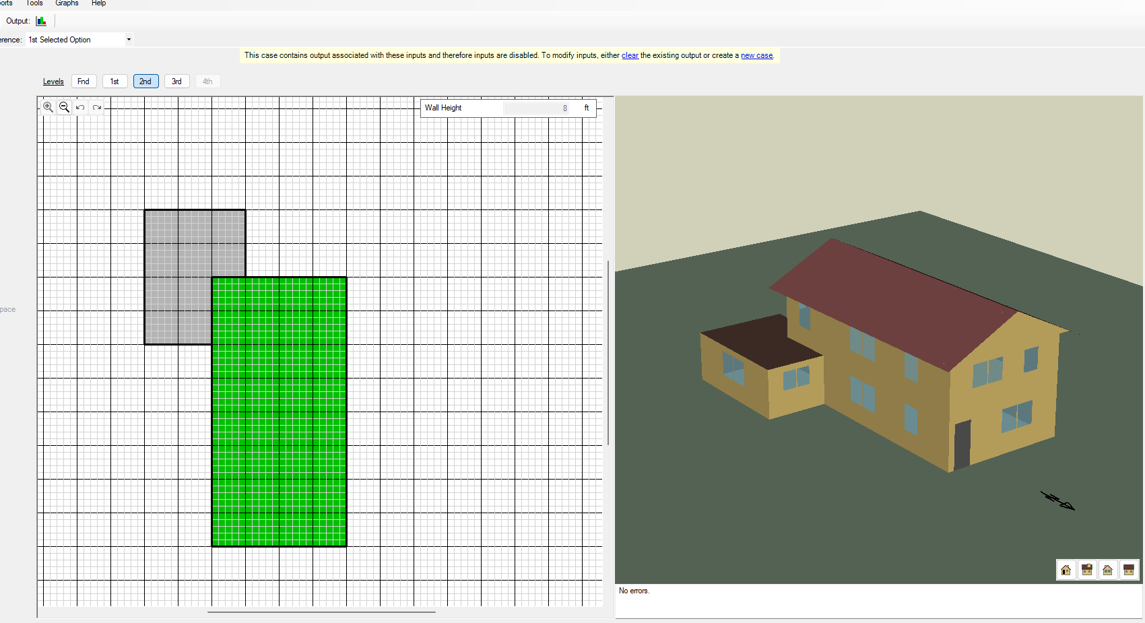
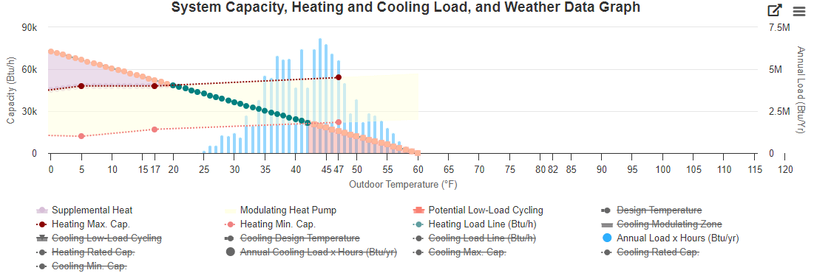
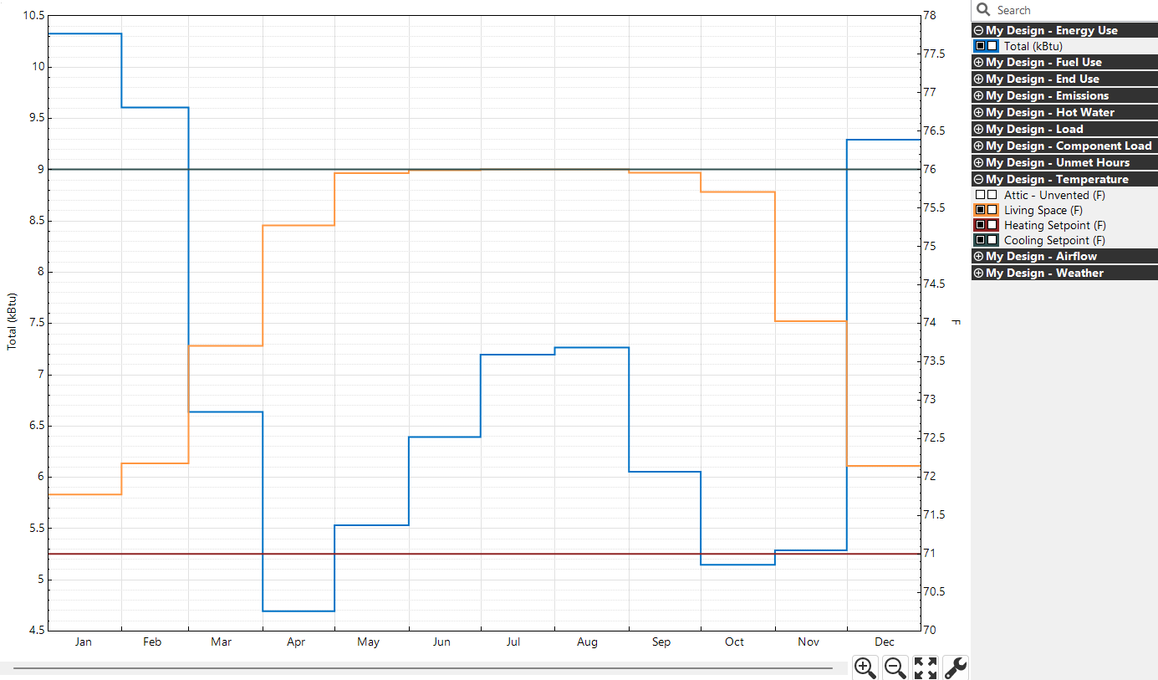
Michael Chen – Visualization of Heating/Cooling Demands Supervisor: Dr. James Howison
Motivation: properly sizing HVAC systems.
“homes are operating at (…) 50 % of maximum capacity during the coldest hours (…) considerable spare capacity a consequence of oversizing or years of adding insulation” (Meier Et Al., 2019)
Implications towards home sustainability, comfort, and energy usage.
Current visualizations are unintuitive:
Solution: re-design in time series
Next Steps:
Data wrangling and refinement
Model Generalization
Collaboration
Prototype → Simulation:
iSchool Course Relevance:
I320D Data Eng.
I310D HCDS
I310U UX
I305 Research

