Slide 1
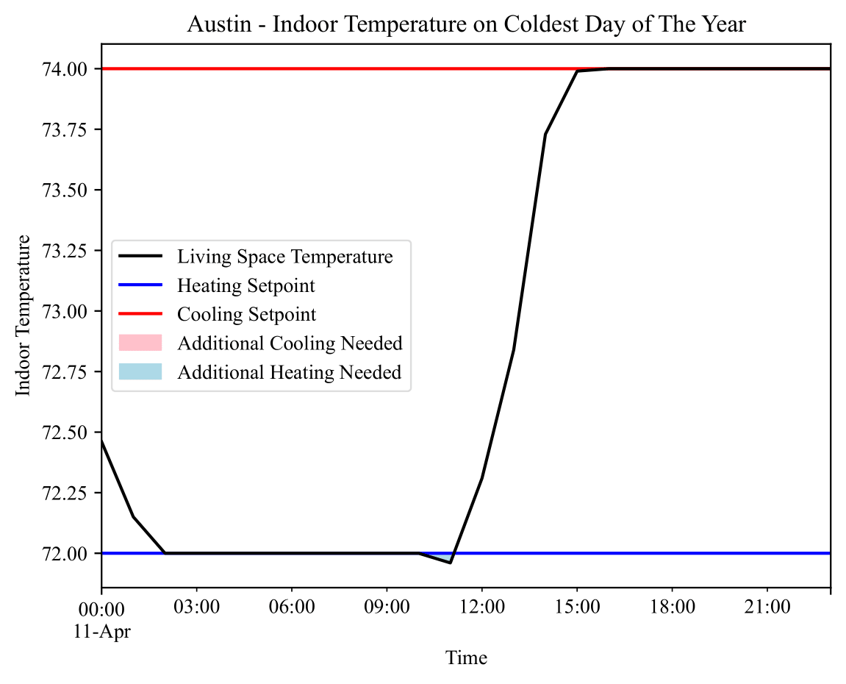
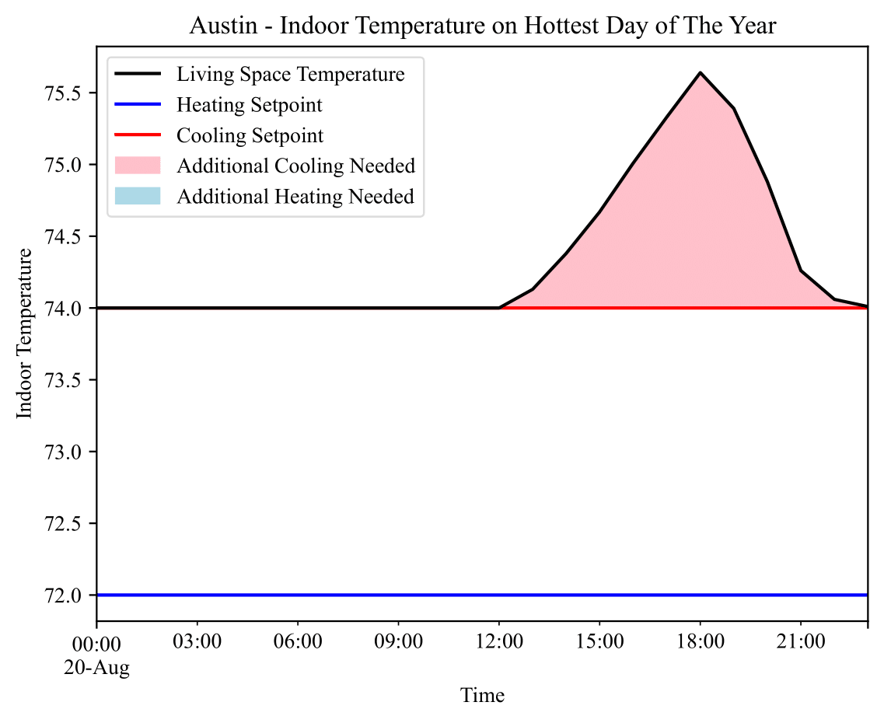

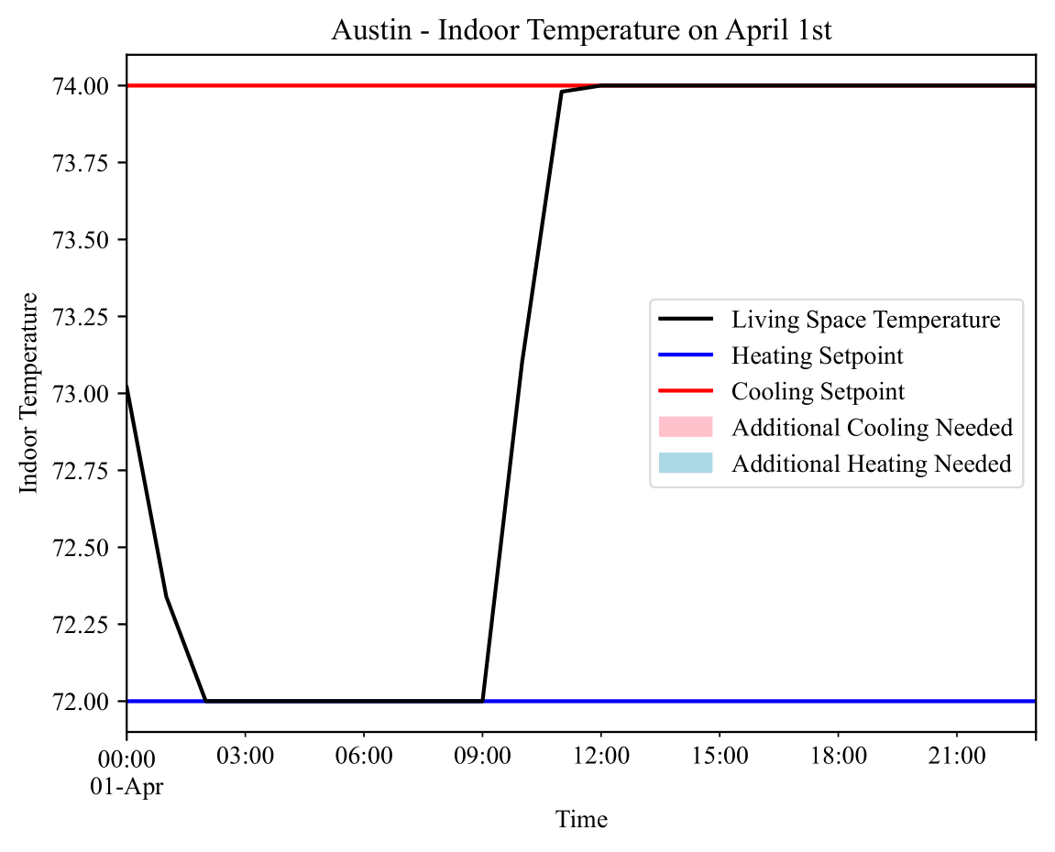
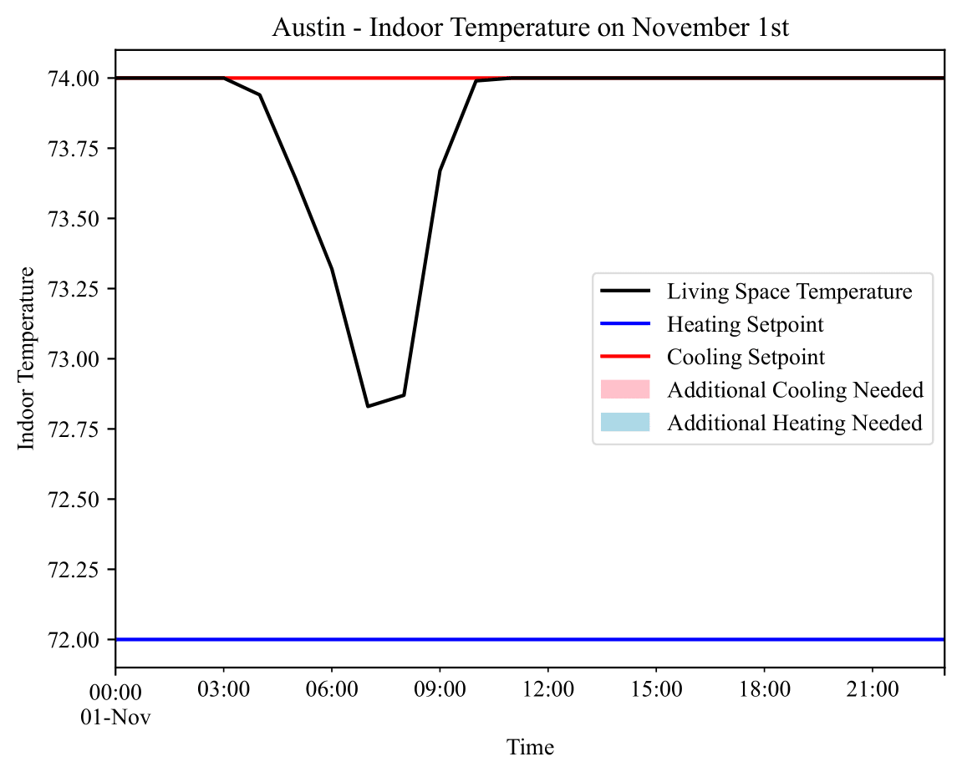
35
Design of Intuitive Visualization for Residential Heating and Cooling Demands
Michael Chen | Dr. James Howison
University of Texas School of Information

