Slide 1

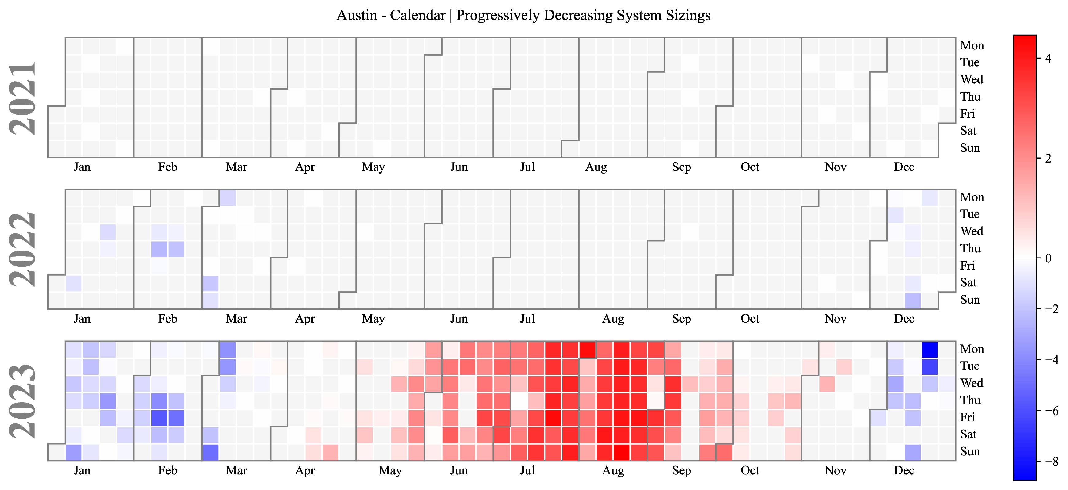
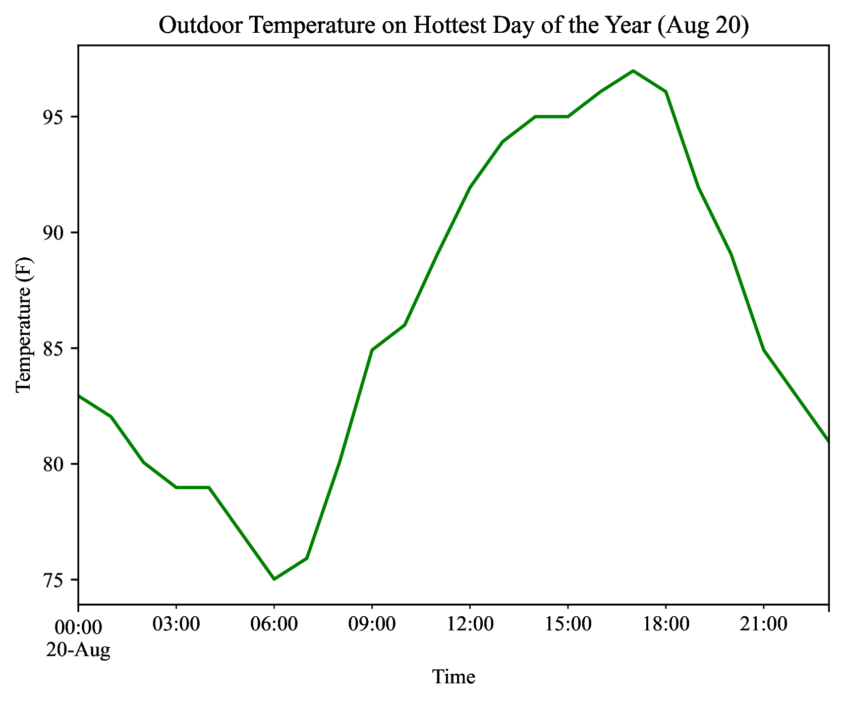
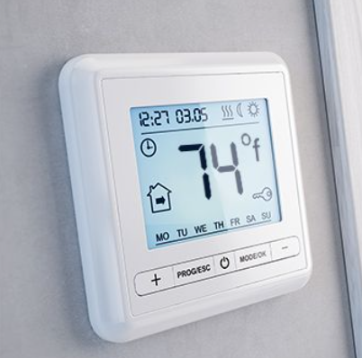
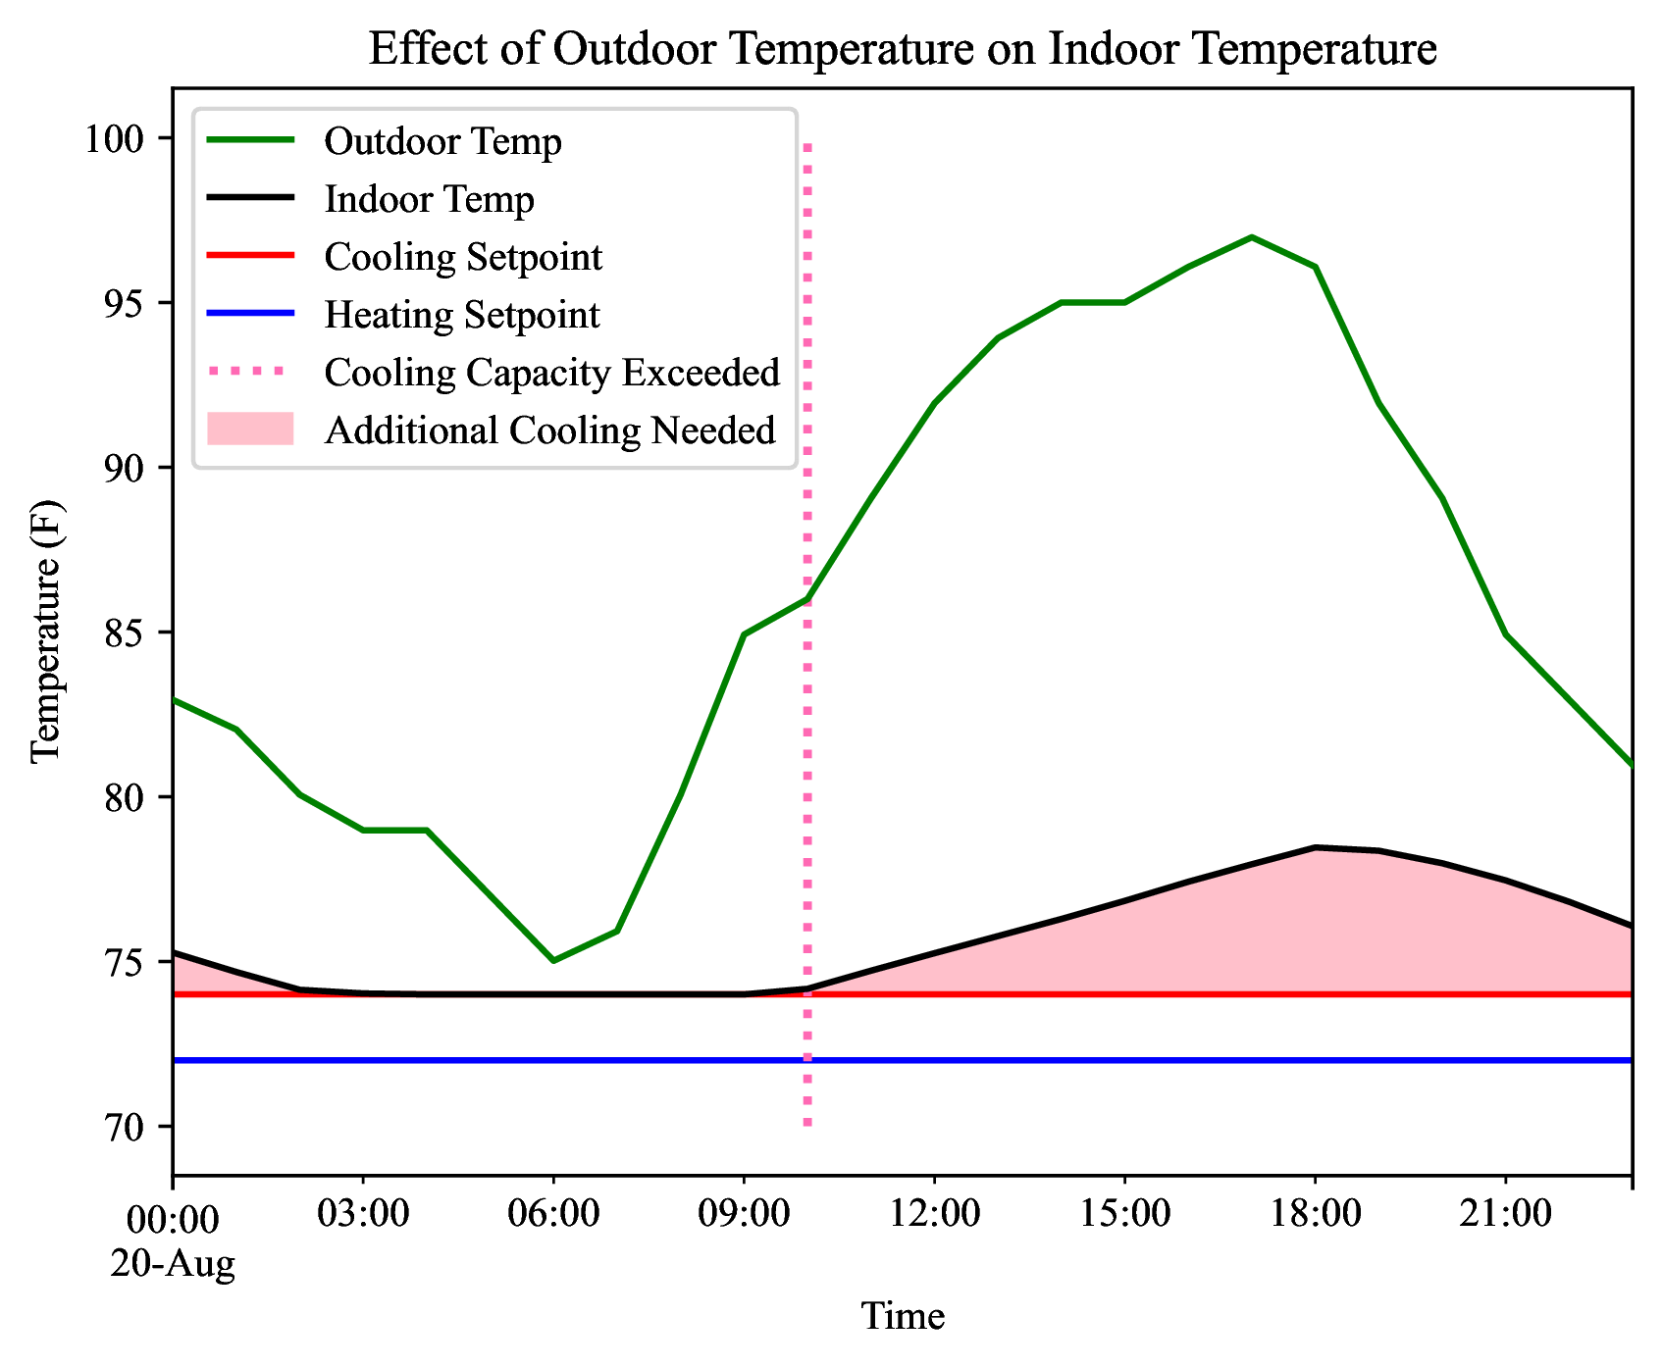



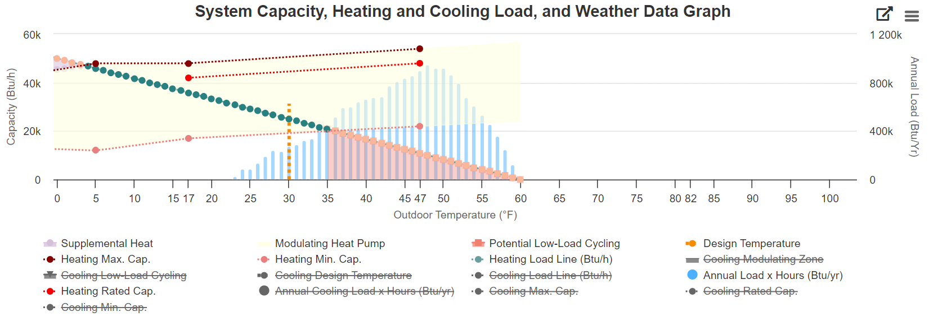
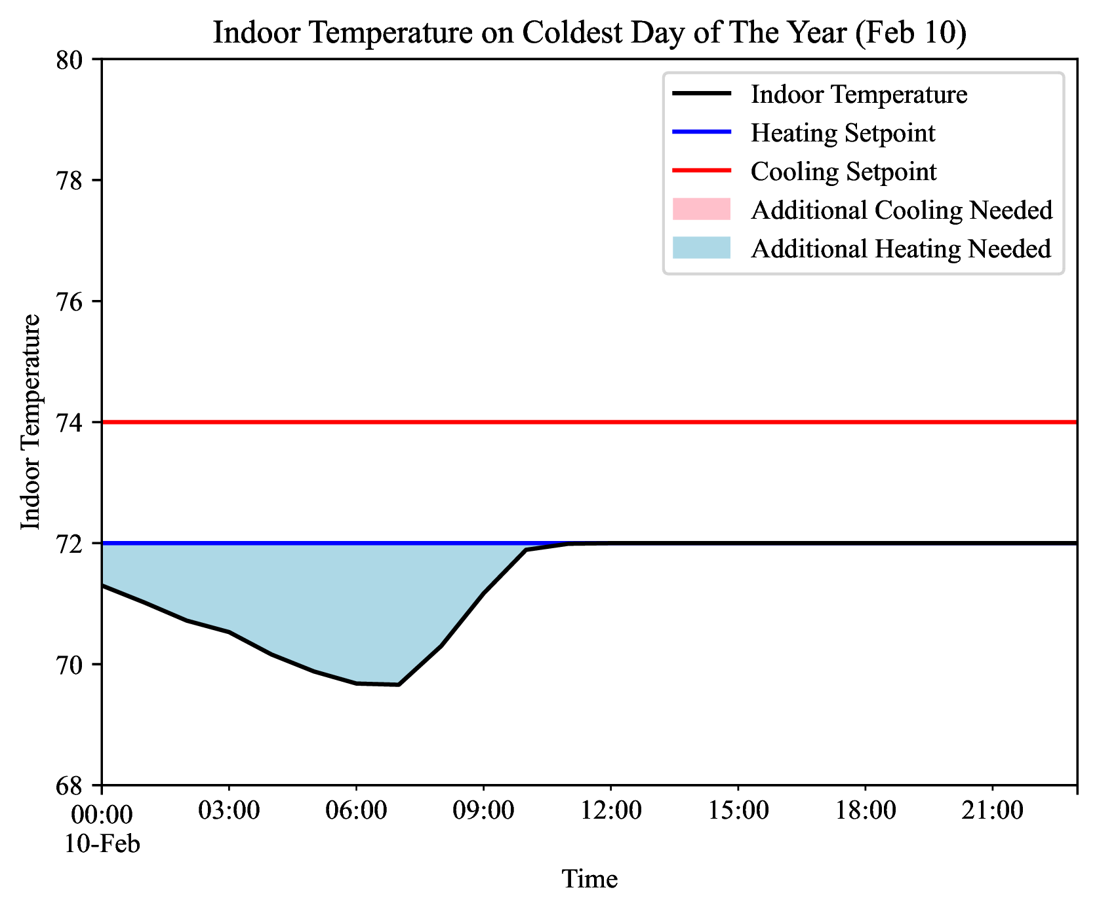
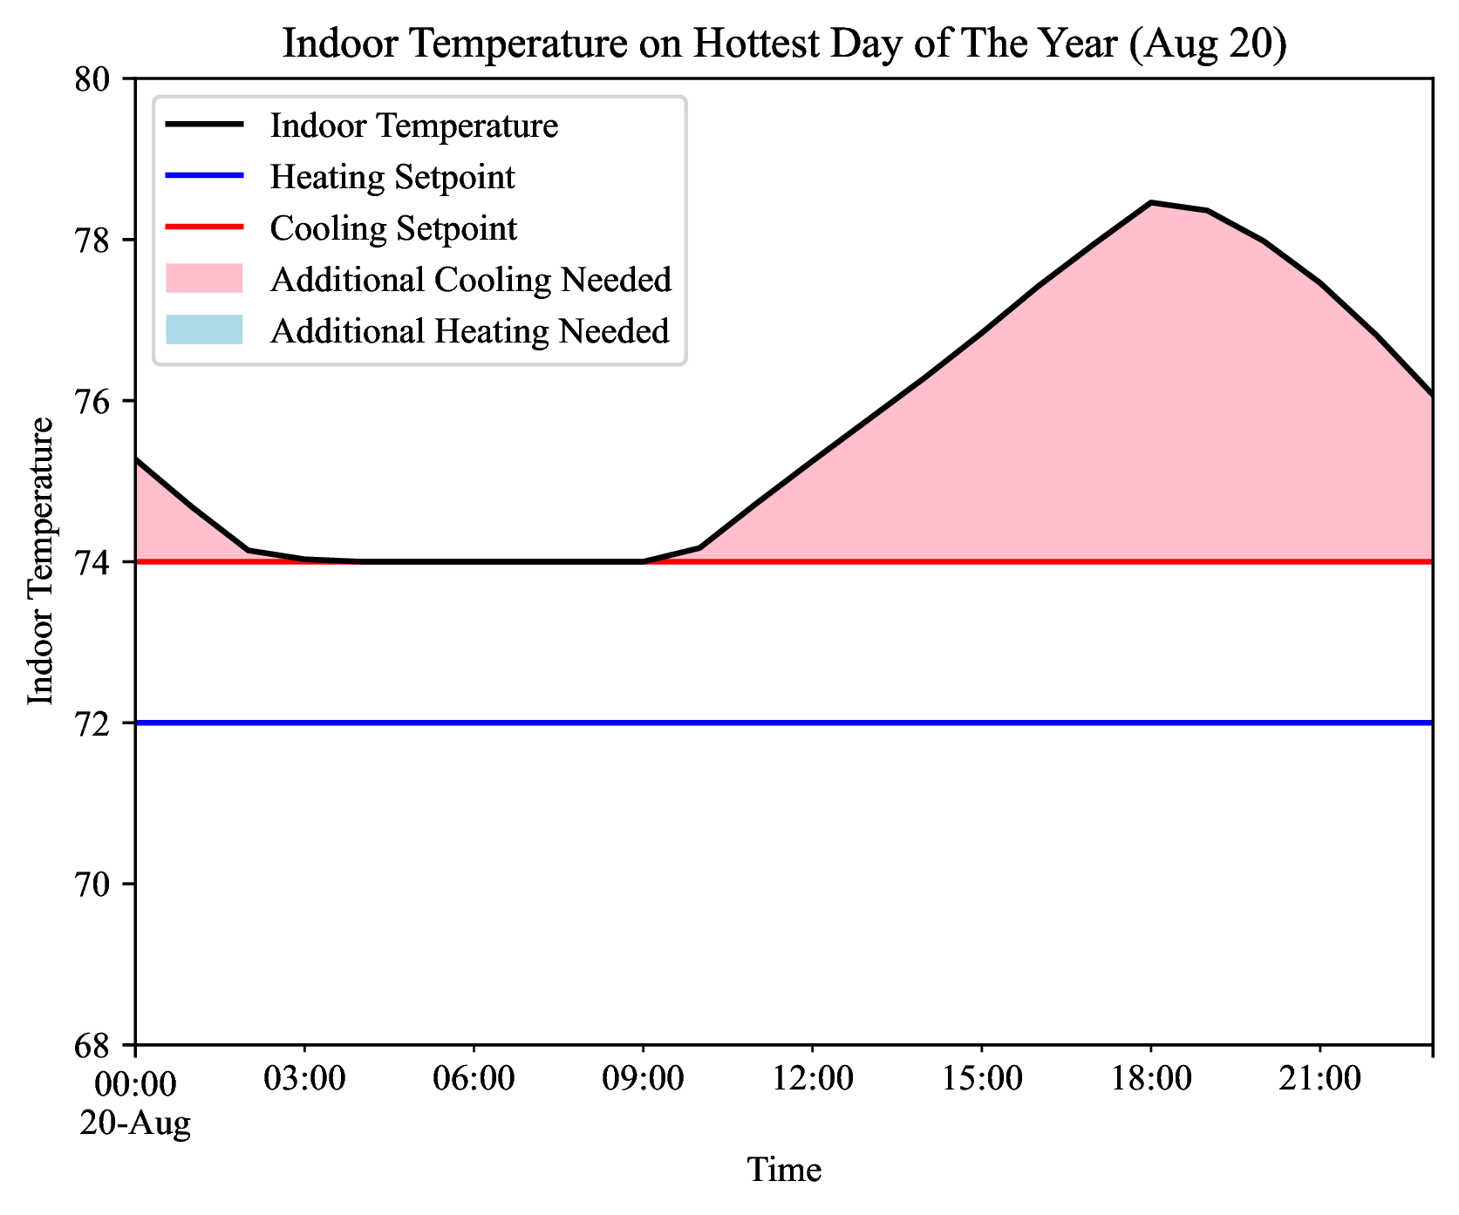
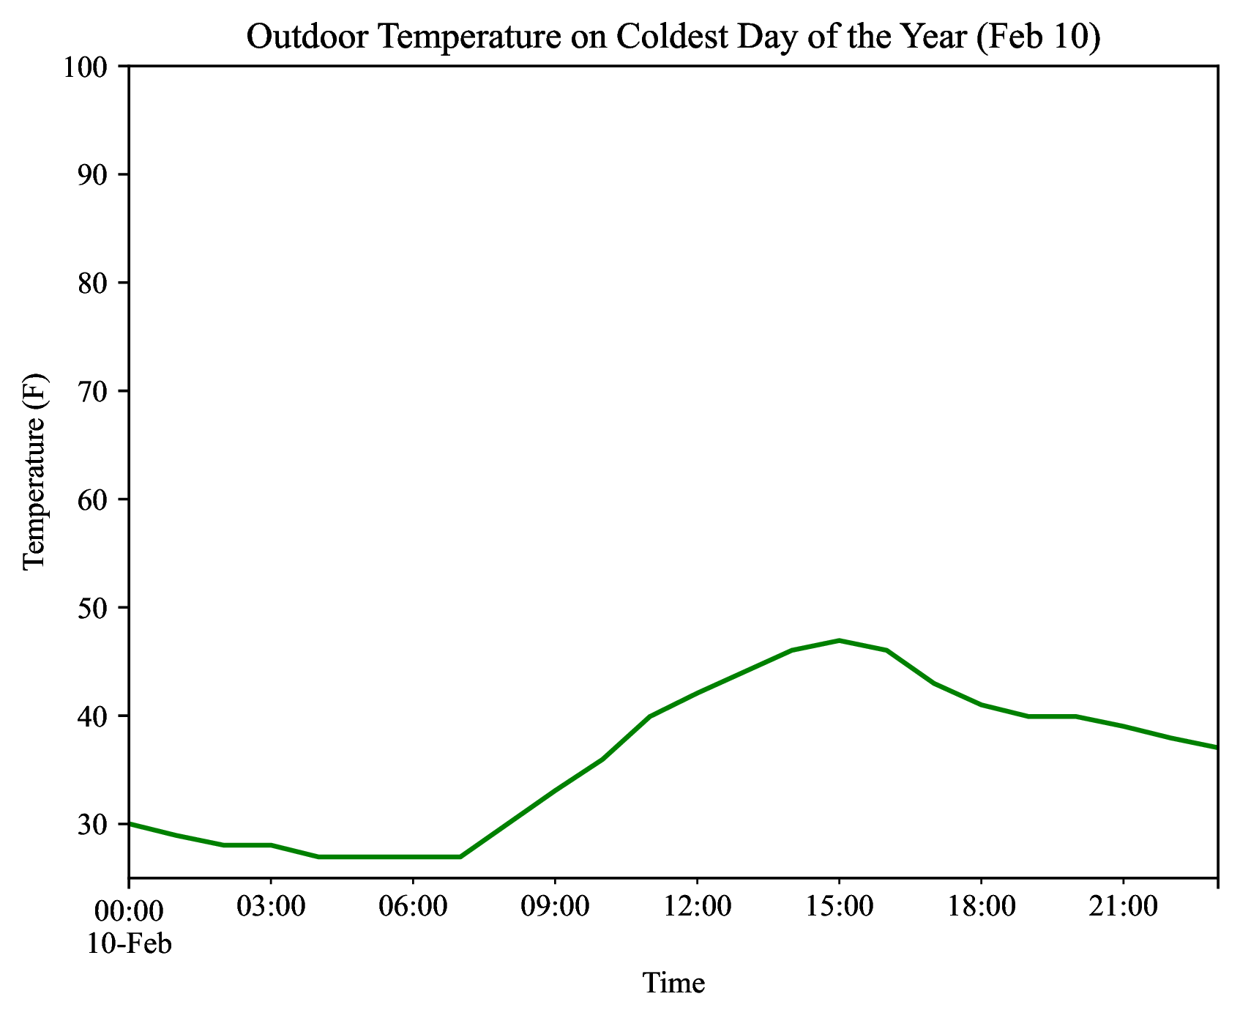
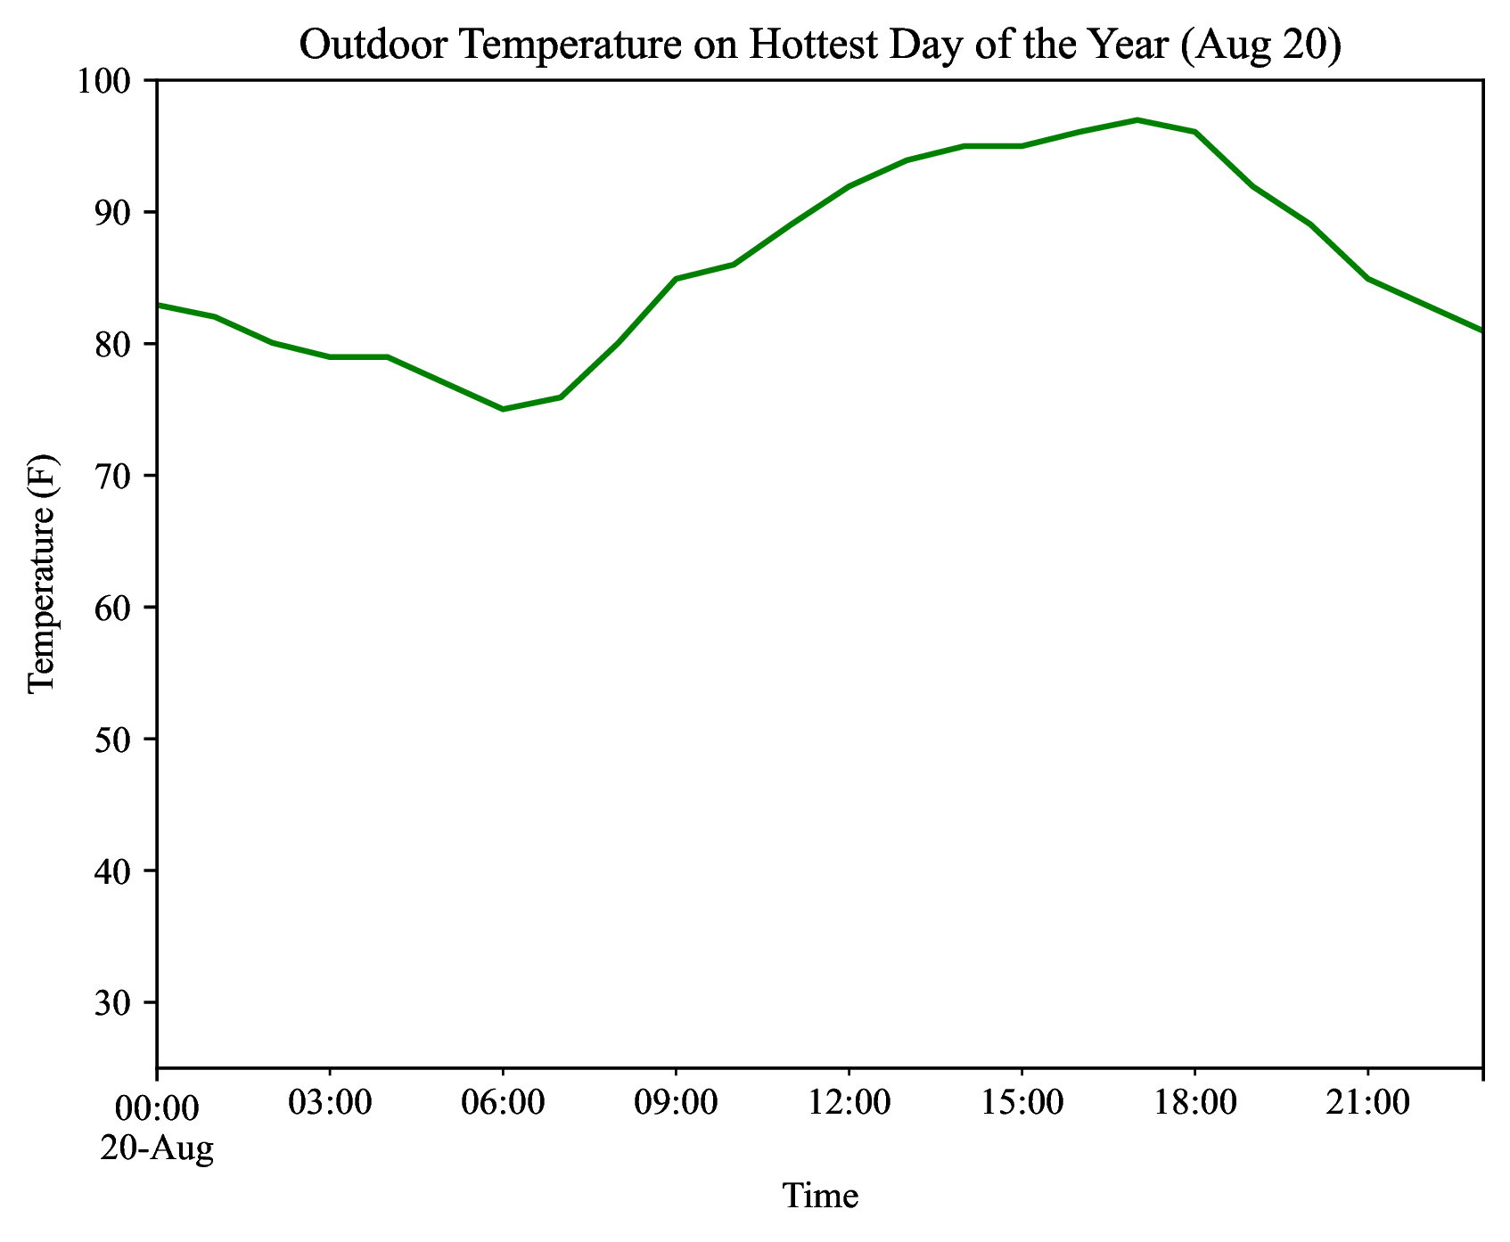
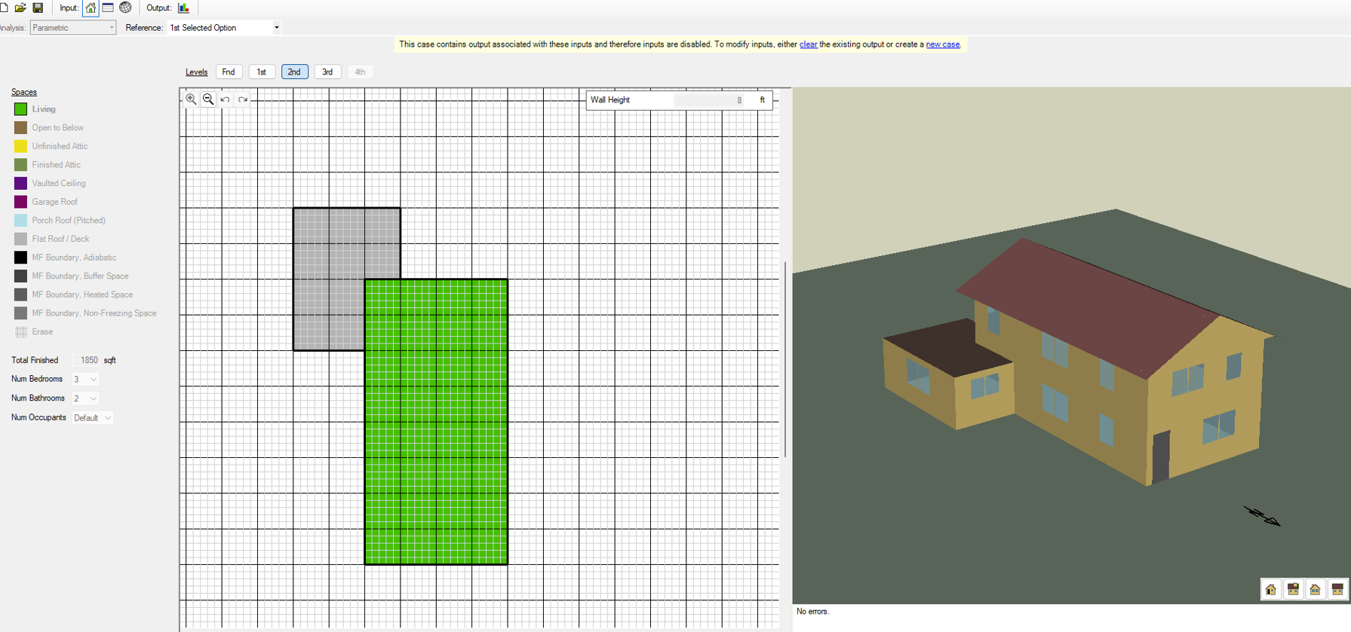
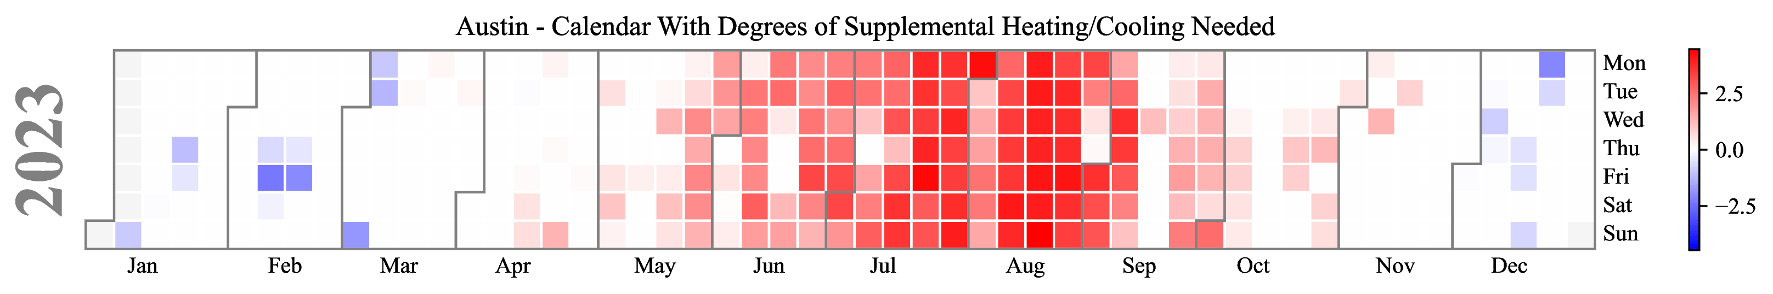
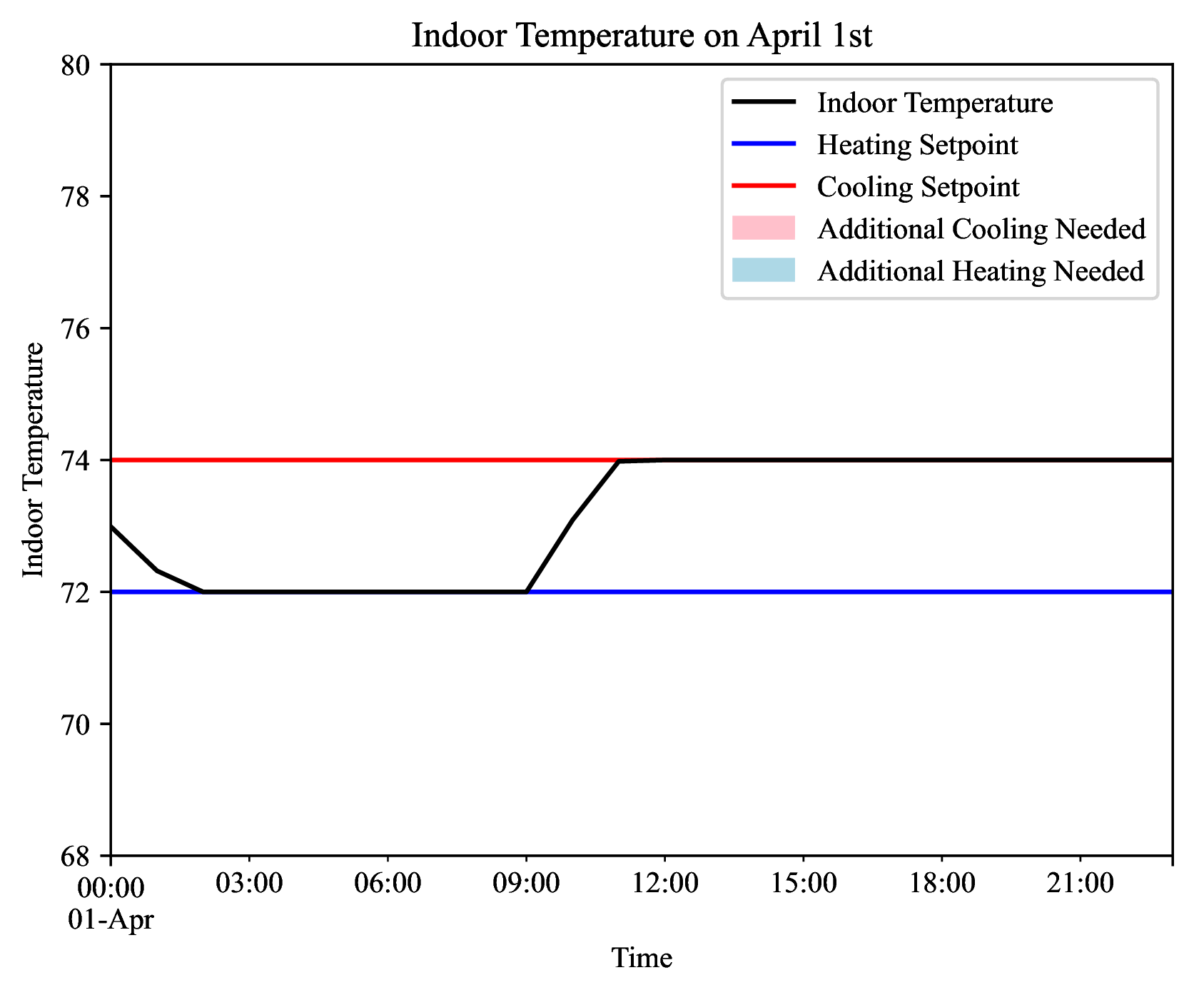
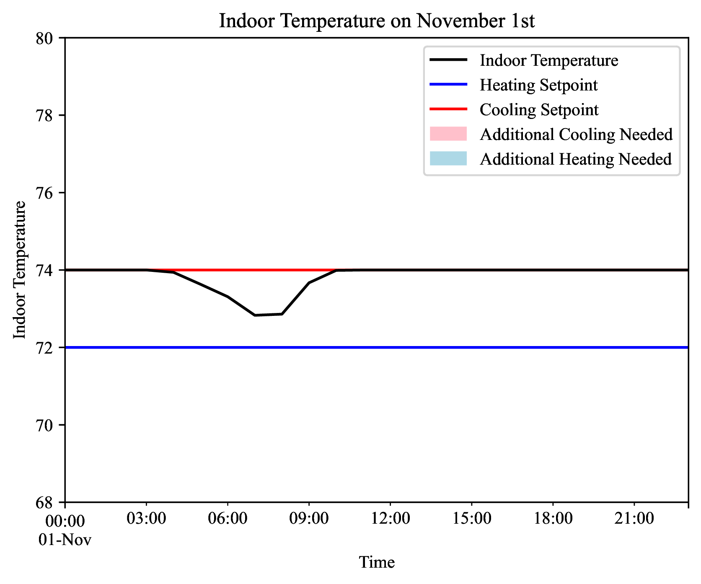
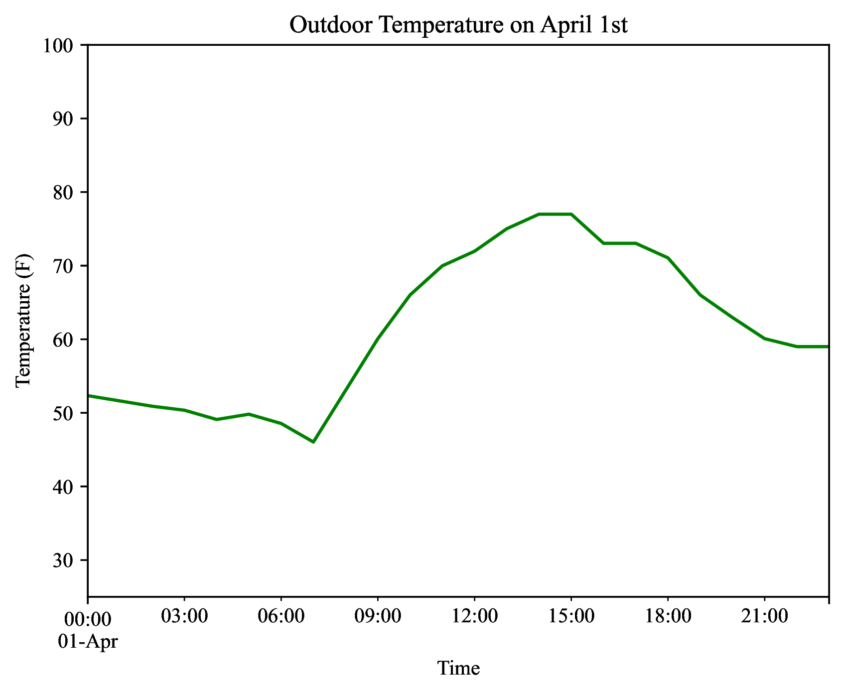
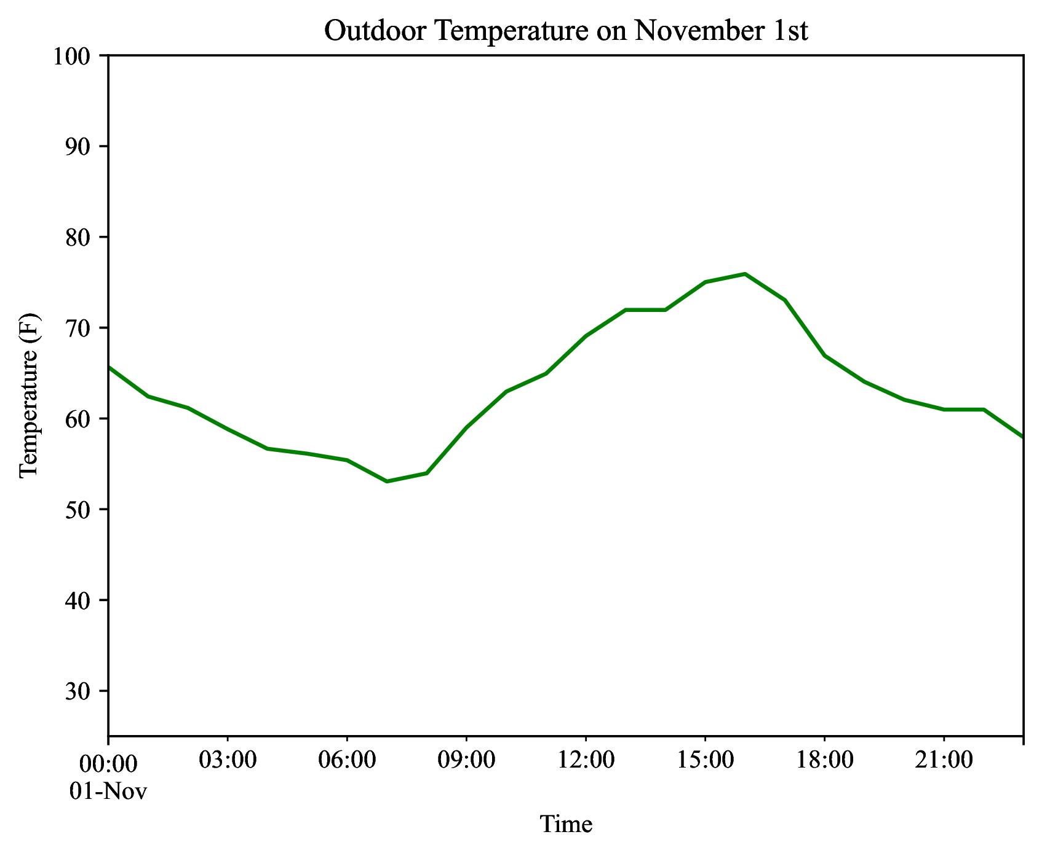
34
Design of Intuitive Visualizations for Residential Heating and Cooling Demands
Michael Chen | Dr. James Howison
University of Texas School of Information
Sizing Solutions:
Progressively Smaller Systems
Introduction
The majority of residential Heating, Vacuum and Air Conditioning (HVAC) systems in the United States are oversized, leading to increased upfront costs and long-term home and energy sustainability implications.¹
One potential factor preventing lay understanding of HVAC sizing is a lack of intuitive visualization systems: current systems are designed around contractor rather than consumer needs: ²
As such, our objective is to design more intuitive visualizations of the heating and cooling demands a residential home faces throughout a year to create a better understanding of the comfort implications of choosing differently sized systems.
Cooling Capacity: 4.5 Tons | Heating Capacity: 25k Btu/h
Comfort Implications: What Will a Hot Day Feel Like Indoors?
Cooling Capacity: 3 Tons | Heating Capacity: 15k Btu/h
95°
Cooling Capacity: 1.5 Tons | Heating Capacity: 10k Btu/h
Cooling Setpoint: 74 F
Cooling Capacity: 1.5 Tons
Heating Capacity: 15k Btu/hr.
Conclusions & Limitations
Putting residential heating and cooling loads onto a time-series level visualization can help laypersons more intuitively understand what differently sized HVAC systems would feel like throughout the course of a year. As such, these visualization methods can prove informative to both contractors and consumers when making HVAC sizing decisions.
The complexity of representing temperature and comfort provides a limitation to this system. A core role of air conditioning is to remove humidity from a system. However, these current visualizations do not adjust for the effects of humidity and latent heat. Furthermore, simulations on historical data do not account for rare unpredictable cases, such as the 2021 Texas Winter freeze. Finally, as homeowners change their systems, such as adding insulation or utilizing different materials, past simulations will no longer be representative.
Ultimately, these visualizations serve as an introduction to more intuitive understandings of heating and cooling demands while continued nuance is required to fully capture these systems.
Methodology
Large-scale time series data on residential loads is sparse. To represent the loads a home faces throughout a year, we simulate mock homes under a variety of conditions using the National Renewable Energy Laboratory (NREL) Building Energy Optimization Tool (BEOPT): ³
Through simulation, we collect hour-by-hour energy and load data throughout a year based on a variety of parameters including system sizing, weather, and home insulation properties. Of the various energy and HVAC related outputs, our most relevant variables are as follows:
We then develop a variety of time series visualizations on both a yearly and daily scale to best communicate the comfort implications.
Variable | Description
Outdoor Temperature | Outdoor temperature of the house.
Indoor Temperature | Indoor temperature of the house.
Heating Setpoint | Thermostat-set indoor minimum temperature.
Cooling Setpoint | Thermostat-set indoor maximum temperature.
Excess Degrees | Degrees by which the indoor temperature exceeded either setpoint – times when the home is too hot or too cold.
References
Djunaedy, E., van den Wymelenberg, K., Acker, B., & Thimmana, H. (2011). Oversizing of HVAC system: Signatures and penalties. Energy and Buildings, 43(2–3), 468–475. https://doi.org/10.1016/j.enbuild.2010.10.011
NEEP’s Cold Climate Air Source Heat Pump List. (2021). Cold Climate Heat Pump Sizing Support Tools. https://ashp-production.s3.amazonaws.com/NEEP_ccASHP+Heating+Visualization+User+Guide_v2.2_TRC_04.01.22.pdf
National Renewable Energy Laboratory. (2024). BEopt: Building Energy Optimization Tool. https://www.nrel.gov/buildings/beopt.html
Acknowledgements to Dr. James Howison and the University of Texas School of Information.

