Slide 1
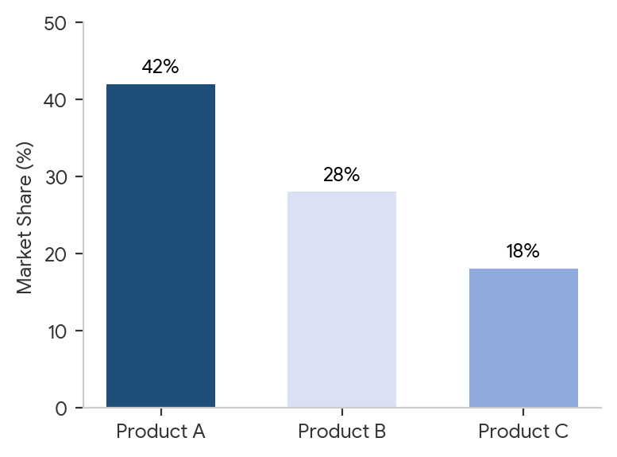
GLOBAL MARKET OVERVIEW
Product A
Market Share / Status
42%
Key Insight: Product A holds a dominant 42% share, driven by strong hospital channel adoption.
Product B
28%
Product C
18%

Slide 2
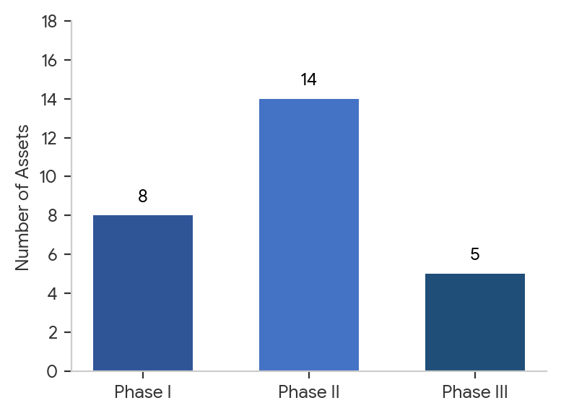
THERAPEUTIC AREA PIPELINE MATRIX
Phase II Candidates
Market Share / Status
14 Assets
Key Insight: Pipeline Velocity: Phase II assets expanded by 14% this quarter, signaling strong mid-stage clinical maturity.
Phase I Pipeline
8 Active
Phase III Registrations
5 Pending

Slide 3
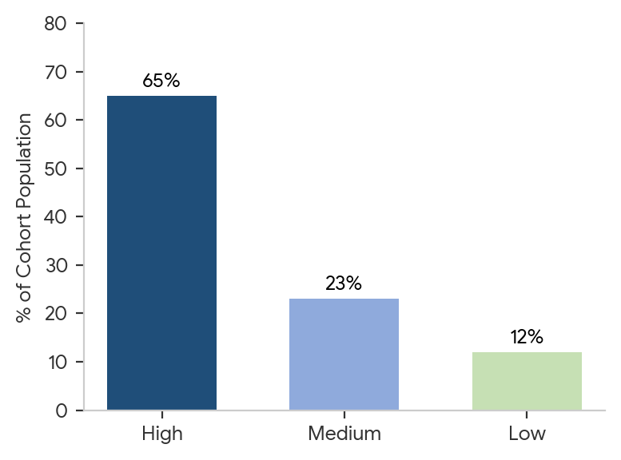
PATIENT ADHERENCE & LONGITUDINAL ENGAGEMENT
High Adherence Cohort
Market Share / Status
65%
Key Insight: Adherence Driver: Digital companion applications boosted High Adherence tiers by 12% longitudinally.
Medium Adherence
23%
Low Adherence / Dropouts
12%

