Slide 1


Slide 2
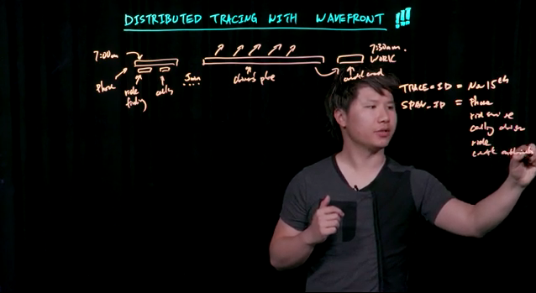
Distributed Tracing with Wavefront

Slide 3
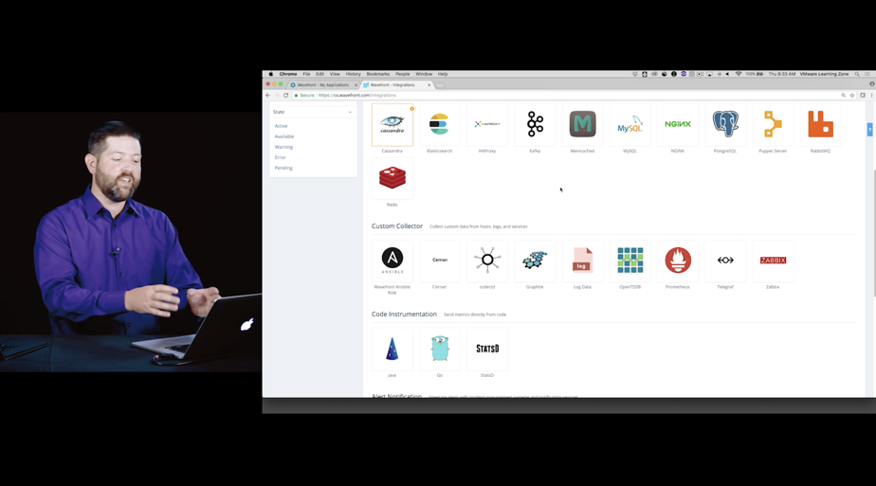
Integrations

Slide 4

Alert Severity Levels

Slide 5
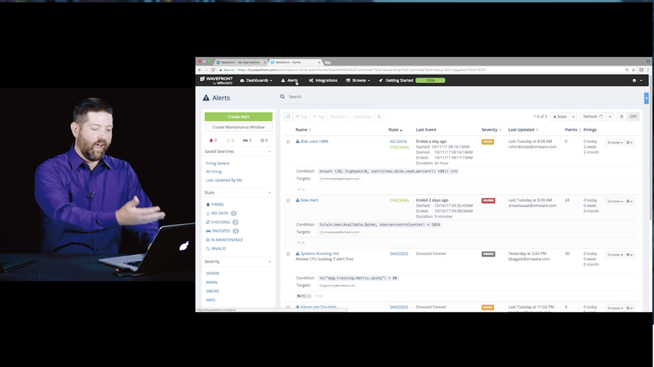
Monitoring with Alerts

