Slide 1
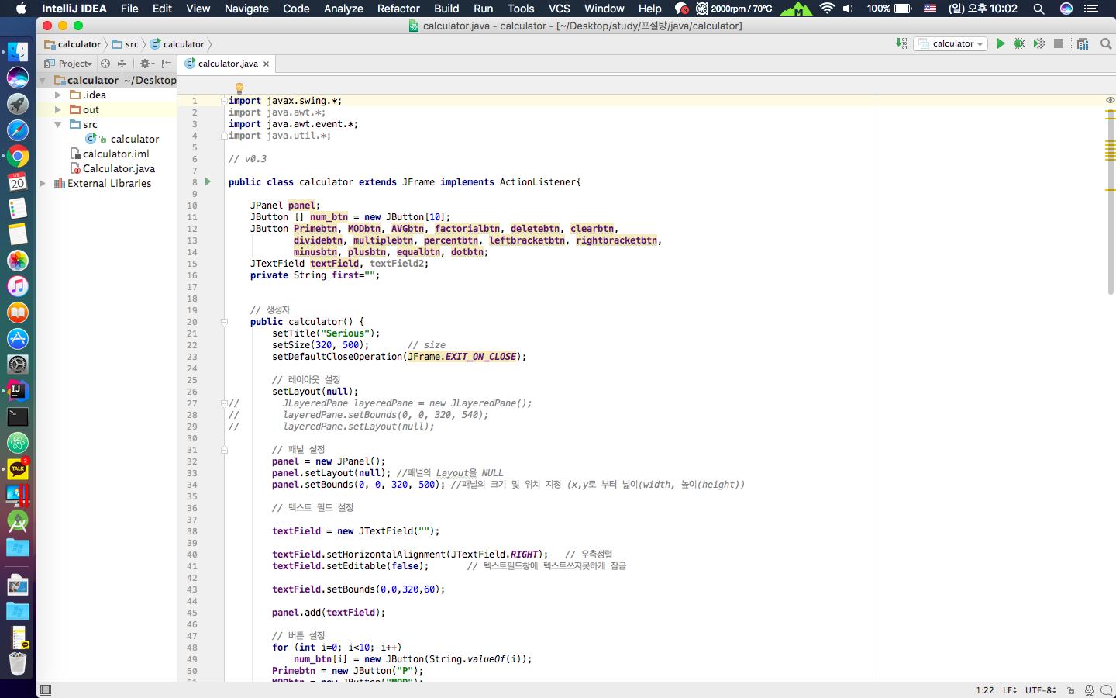
Open-Source SW
#28 - simpsons

Slide 2
Contents

Slide 3
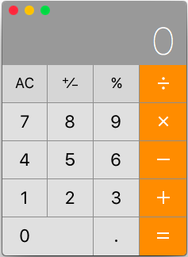
Project
?
Serious
Calculator
JAVA Desktop

Slide 4
Role
Development
Translation
Reading
Design
Maintain
Algorithm
Documentation
Management
Park
Collaboration
Seo

Slide 5
Calculator
Function
Plus
Minus
Multiply
Division
Percent

Slide 6

Serious
New Function
AVG
P
MOD
!
Distinction prime number
- True or False
Average
Factorial
Remainder

Slide 7
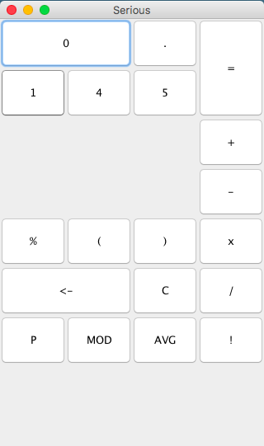
Serious v0.1
Make a Frame
Title
Button

Slide 8
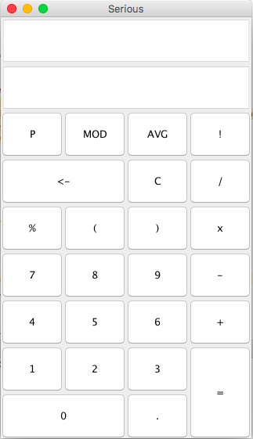
Serious v0.2
Add
TextField
Button
Set Location

Slide 9
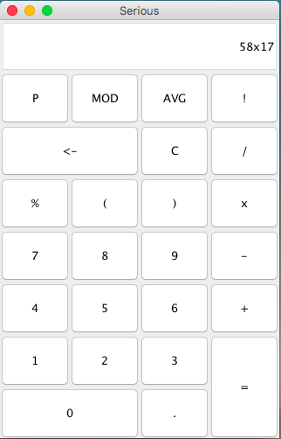
Serious v0.3
Add
Delete
Input Function
TextField

Slide 10
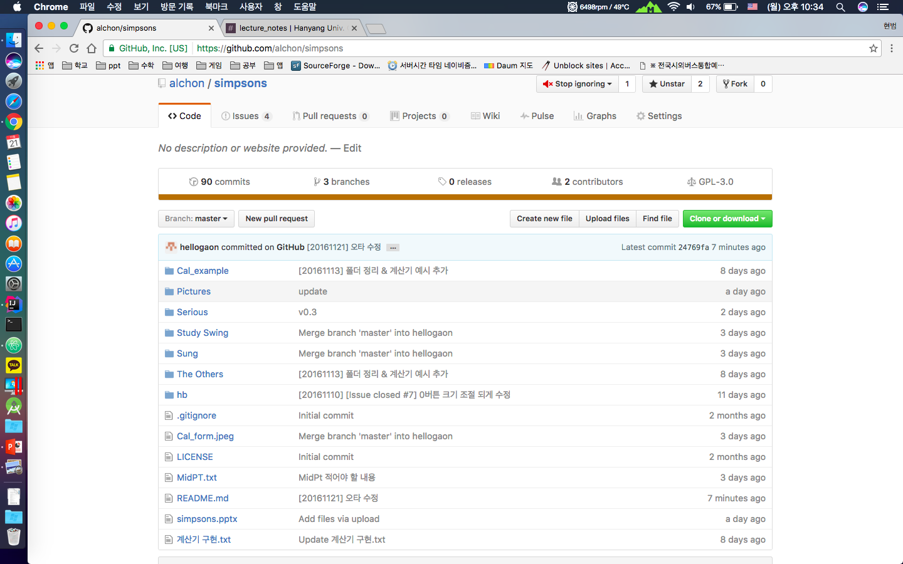
Github

Slide 11
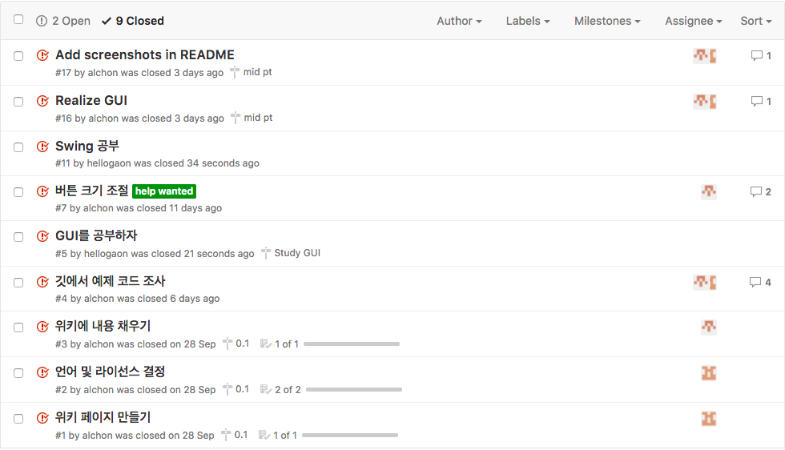
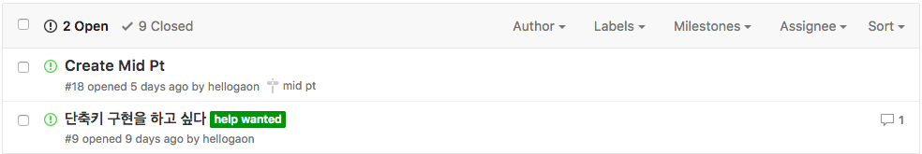
Github
Issue

Slide 12
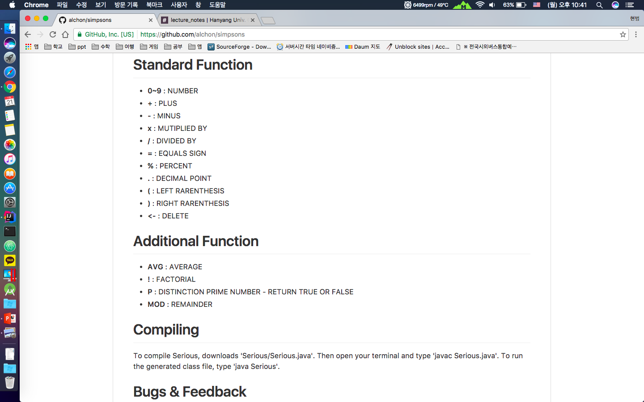
Github
README

Slide 13
Serious
Menu bar
Next Version
Hotkey
Design
Calculate
And so on …

Slide 14
THANK YOU !!

