Slide 1
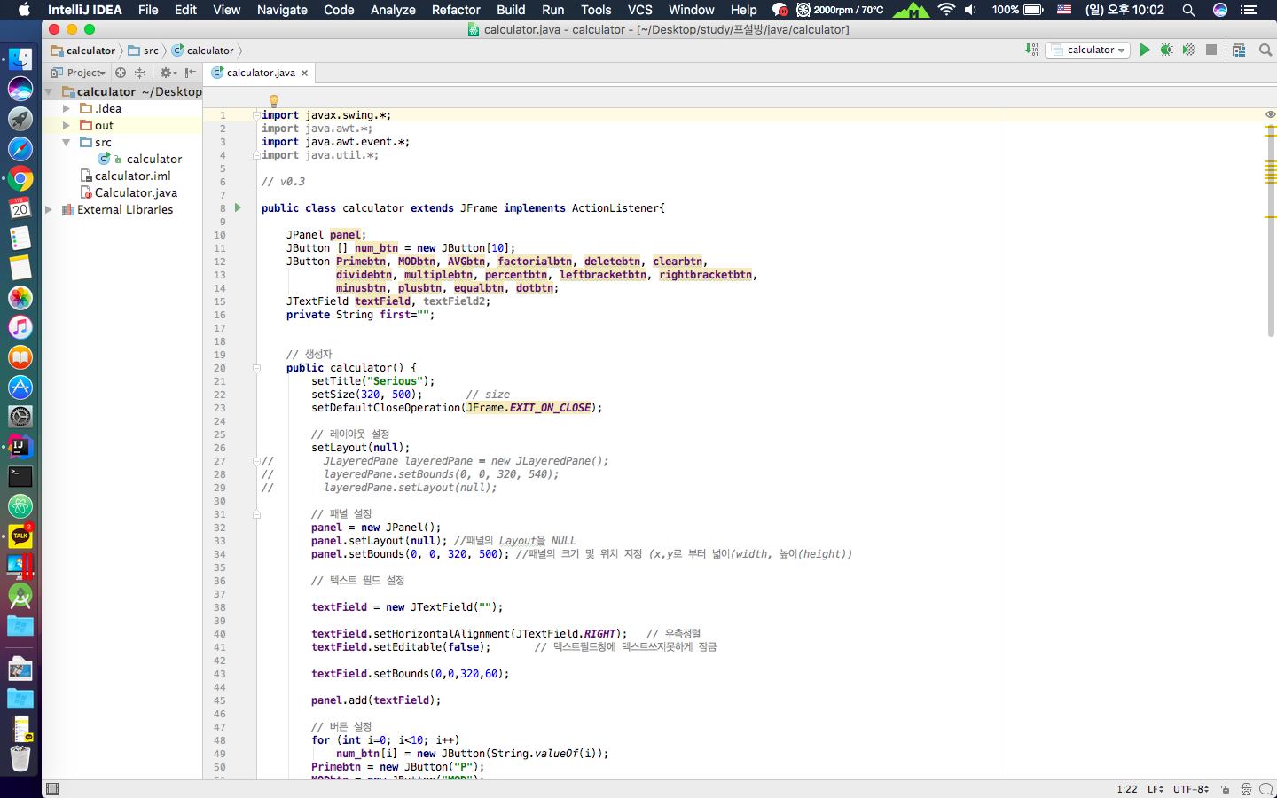
Open-Source SW
#28 - simpsons

