Slide 1
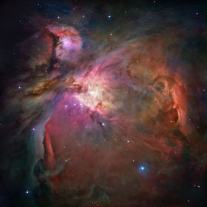
Stars
Formation and Evolution:
Interstellar Medium to Protostar
Protostars
Main Sequence Stars
Giants and Dwarfs
Supernova
The Cycle restarts
Notes:
The aim of this short presentation is to give an overview of the life cycle of Stars, how they form, evolve over billions of years and how their life might eventually end and the cycle begin again.
The background image for this first slide shows a photograph of the Orion Nebula taken from the Hubble space telescope. This is one example of a Nebula where examples of new stars evolving have been observed.
We cannot observe the evolution of a single star, the time scales are too large, and observations can only be made of different stars at different stages of evolution. The only event observed in any short space of time is the Supernova, which we will cover later in this presentation.
We will first cover the Interstellar Medium; find out what it consists of, and how regions can collapse to form Protostars and how these then become a Main Sequence Star.
We will then look at the beginning of a Main Sequence Star and how it takes billions of years to burn its main fuel supply.
Then we will look at the last stages of a stars life, the Giants and Dwarfs.
We will also cover another possible end for a star, in probably the most energetic event since the Big Bang – the spectacular death of a star in a supernova.
And finally we will see how this whole cycle can start again from the death of stars.
[
Template modification notes – template used is Quadrant.
Slide Master amended to change all text to Arial, added ‘IT for Astronomy Presentation 2007’ to Footer.
Title Master and sub-title colour, added ‘IT for Astronomy Presentation 2007’ to footer and changed colour to Yellow. All text changed to Arial, sub-title font size reduced to 18.
Background amended to show Orion Nebula
Formation and evolution sub title links to next slide.
Image source:NASA / ESA.
http://en.wikipedia.org/wiki/Image:Orion_Nebula_-_Hubble_2006_mosaic_18000.jpg
]

Slide 2
Interstellar Medium to Protostar
The ISM consists of gas and dust particles
Regions may be viewed as clouds
Some give off visible light, others weak radio waves
Dense molecular clouds collapse
Density is relative – virtual vacuum
Colliding clouds can start gravitational compression
Collapsing clouds fragment
Molecules speed up and heat up
Protostar starts to emit Infra Red radiation
Notes:
[Animate the points 1 – 9 one at a time and cover each section below as you do so]
1) The Interstellar Medium consists of low density gas ( a virtual vacuum!) and dust particles, and is estimated to consist of 70% hydrogen, 28% Helium, and 2% heavier elements.
2) Some regions are identifiable as clouds (Nebulae) because of their sheer size when viewed from light years away.
3) Some regions are hot and diffuse and give off electromagnetic radiation in the visible light range.
Other regions are cold and dense and only detectable from weak radiation in the radio range.
All are thin compared to our own Earth atmosphere.
The Orion region on the first slide gives an idea of the cloud types found in the ISM. The Horse Head nebula is another famous example in Orion.
4) To form a star a region of the ISM must collapse under its own gravity, so the most dense regions will have the greatest gravitational attraction. These are called molecular clouds, consisting of mostly molecular hydrogen (H2), and are cold at -250C or lower. In higher temperature clouds thermal pressure may overcome gravity.
5) The density is relative, being as thin as the best laboratory produced vacuums.
6) Stars can also form if clouds collide, as it helps the gas compress and start the gravitational attraction process.
7) In large clouds, as a cloud contracts it will split into fragments as denser regions contract individually.
8) As the gas in each cloud fragment falls towards its gravitational center the molecules speed up and release heat as they collide. This is the beginning of a Protostar.
9) It takes millions of years for a cloud to contract to form Protostars as the clouds may average 10 light years across (hence it appears dense viewed a long distance away).
After time a Protostar becomes hot enough to emit Infra Red radiation and this is how they can be detected amongst the clouds of gas and dust, using Infra Red telescopes.
[ Design template used - Quadrant
Slide design notes - Slide Master amended to change all text to Arial, added ‘IT for Astronomy Presentation 2007’ to Footer
Refs:- http://bcs.whfreeman.com/universe6e/ , Universe –Kaufmann & Freedman, How The Universe Works - Open University, Introduction to Astronomy - Open University, also see Refs. On slide 3 onwards.
]

Slide 3
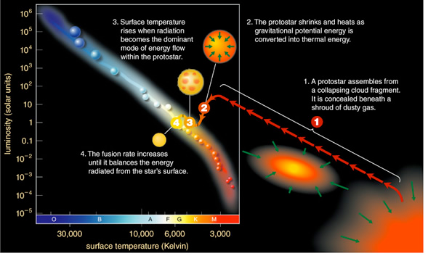
Protostars
Notes:
The image illustrates the formation of a Protostar and its evolution into a main sequence star.
As we saw on the previous slide, Stars form in the densest cold molecular clouds, when a cloud contracts under gravity.
About 1% of the mass of a molecular cloud is dust grains thought to be about 1 micron in size.
This scatters or absorbs visible nearly all visible light, so making clouds opaque, but the clouds transmits longer infrared wavelengths so protostars can be detected by infrared satellites such as the SPITZER space telescope.
Newly forming stars also heat the surrounding dust which then re-radiates at longer infrared wavelengths
In high mass clouds > 100 solar masses, where density is not even, fragmentation of clouds as they contract allows multiple Prototars to form.
Molecular clouds are not stationary. The molecules rotate around the core of the cloud. Thus when cloud cores collapse into protostars, the gas does not fall in a straight line onto the young star; instead it tends to collect in a rotating flat disk that slowly spirals into the star – a protostellar disc. The star builds up most of its mass on a time scale of a few million years (which is short compared to the lifetime of most stars which is many billions of years).
As the molecular cloud collapses gravitational energy converts to heat, this radiates away at infrared so the cloud stays cold and gravitational collapse continues, otherwise heat would result in pressure halting the collapse.
Once the central region of a fragment contracts to become dense enough for gravity to overcome pressure and to trap radiation it heats up enough to become a Protostar.
For nuclear fusion of hydrogen to start the temperature at the centre of the Protostar must reach more than 10 million K.
As a star gathers most of its gas, the gas and dust left over in the disk rotating around the core can begin to form planets – a protoplanetary disc.
[
Image source: http://www.roe.ac.uk/~wkmr/Teaching/DiscAstron/starbirth.pdf
Refs: http://csep10.phys.utk.edu/astr162/lect/birth/proto.html , http://genesismission.jpl.nasa.gov/educate/kitchen/resource/factsheets/Protostars.pdf
http://outreach.atnf.csiro.au/education/senior/astrophysics/stellarevolution_formation.html
http://www.roe.ac.uk/~wkmr/Teaching/DiscAstron/starbirth.pdf
http://nix.larc.nasa.gov/info;jsessionid=26y017a4yx233?id=PIA04939&orgid=10
]

Slide 4
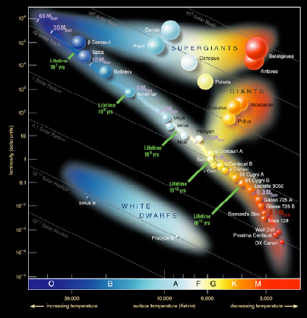
Main Sequence Stars
The Hertzsprung-Russell diagram is a way of categorising stars
It plots luminosity versus spectral colour which relates to temperature
Main sequence stars with a range of masses occupy a narrow band
Notes:
[Animate – click the 1, 2 & 3 points on the slide and describe the diagram, then go into the detail]
Hydrogen fusion starts when core temperatures reach > 10 million K and hydrogen fuses to form helium.
Fusion halts gravitational contraction because the outwards pressure from nuclear fusion counters the inwards gravitational force – equilibrium is reached – known a hydrostatic equilbrium.
The star is now a Main Sequence Star and will shine for millions or billions of years depending on its mass.
For a star like our Sun this process will last 10 billion years.
The Hertzsprung-Russell diagram shown is used by astronomers to plot the luminosity or brightness of stars against temperature which can be determined from spectral colour, and can be used to distinguish stars of different types, in different stages of evolution.
The diagonal line represents Main Sequence Stars with end stage stars represented by Red Giants and White Dwarfs.
New stars come in different sizes and colours from hot and blue to cool and red.
The greater a main sequence stars mass the greater the gravitational pressure in the center and the faster it burns hydrogen fuel in relative terms, and the hotter and brighter its outer layer - the photosphere.
Stars smaller than the Sun will burn longer. Star masses range from 0.08 to 150 solar masses. Hydrogen fusion cannot start in stars less than 0.08 solar masses- these are known as Brown Dwarfs, they can fuse deuterium but all shine dimly and cool over hundreds of millions of years.
Radiation pressure prevents stars becoming more massive than 150 solar masses.
The reason a star burns for so long is that hydrogen fusion is not that fast. It can take millions of years for two hydrogen atoms to be close enough to fuse even at the pressures in the core, i.e. to overcome the repulsion of their positively charged cores.
Because of a process called electron scattering it can take a million years for radiation (photons) released in the centre to reach the surface and radiate away. This is a subject for a particle physics presentation!
Again the larger the mass, the greater the pressure and temperature in the core, so the faster the fusion process (in relative terms). In a star cluster there are many more low mass stars than high mass stars.
The mass of the star determines what happens after the main sequence phase.
Eventually the hydrogen to helium fusion will reduce as hydrogen runs out in the stars centre and radiation pressure will reduce disturbing the equilibrium. The star will start to contract in the centre under gravity and the core become hot enough to fuse helium.
At this point the outer layers will expand to radiate away the extra energy and the Main Sequence Star becomes a Red Giant.
[
Image source:
http://www.roe.ac.uk/~wkmr/Teaching/DiscAstron/starbirth.pdf
Refs:
http://imagine.gsfc.nasa.gov/docs/science/know_l2/stars.html
http://bcs.whfreeman.com/universe6e/
Universe –Kaufmann & Freedman
How The Universe Works - Open University
http://imagine.gsfc.nasa.gov/docs/teachers/lifecycles/LC_main3.html
wikipedia.com
]

Slide 5
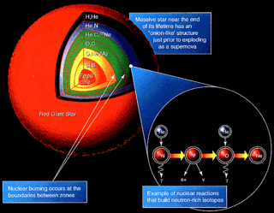
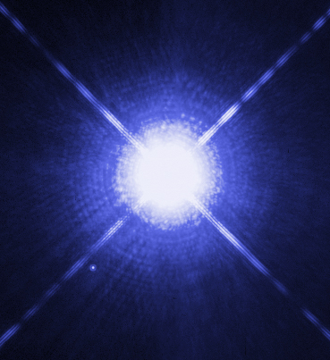
Giants and Dwarfs
Hydrogen fuel supply exhausted in center – outer parts expand to form a Red Giant
Eventually outer parts shed to form a planetary nebula and leave a remnant White Dwarf
Larger mass stars can come to a worse end..
Notes:
[Animate – click to show each section summary then go into detail]
1)A star such as our Sun will exhaust its hydrogen fuel supply in the core and then go through a few stage involving nuclear reactions of other substances. This should happen in another 5 billion years.
As stated in the previous slide, once the hydrogen is exhausted in the core, radiation pressure will reduce and gravity will contract the core till it is hot enough to fuse helium to carbon.
Hydrogen in the outer shell continues to burn to helium and the outer layers expand hugely making the star appear brighter but cooler (more red, temperature at the outer parts drops from 6000 to 3000C) – hence the Red Giant.
During this phase a lot of outer mass is blown away by radiation from below.
In stars with greater masses than our Sun (which burn more quickly) the carbon may fuse to heavier elements as shown in the diagram of a Red Giant.
2)Eventually even these reactions cease and the giant sheds a lot of material and becomes a White Dwarf.
The ejected outer parts form a planetary nebula - a shell of glowing material centred on the small white dwarf star.
Astronomers think these eventually cool to form a Black Dwarf.
3)If a star is more than 5 time the mass of our Sun it will become a Red Super Giant. In these stars the structure is thought to consist of layers, like an onion, with heavier elements found fusing in each layer moving inwards. It is these stars which eventually come to a bad end!
[ Image source: http://en.wikipedia.org/wiki/Image:Nucleosynthesis_in_a_star.gif and http://en.wikipedia.org/wiki/Image:Sirius_A_and_B_Hubble_photo.jpg
Refs: http://imagine.gsfc.nasa.gov/docs/science/know_l2/stars.html , http://bcs.whfreeman.com/universe6e/
Universe –Kaufmann & Freedman, How The Universe Works - Open University
http://imagine.gsfc.nasa.gov/docs/ask_astro/answers/971016.html
http://imagine.gsfc.nasa.gov/docs/teachers/lifecycles/LC_main3.html
http://en.wikipedia.org/wiki/Red_giant
http://en.wikipedia.org/wiki/White_dwarf
]

Slide 6
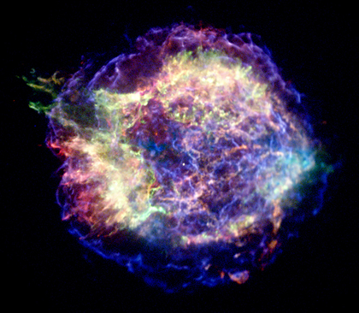
Supernova
Star explodes in minutes.
May be visible to naked eye.
Remanant shrinks under own gravity.
May form Pulsar or
Black Hole.
Notes:
The final stage of Supergiants life happens on a time scale we can observe! – in a matter of minutes the entire star rips apart in a massive explosion of light and other radiation. Supernovas can be thousands of ight years away and be seen with the naked eye.
This image from the Chandra X-Ray Observatory shows Cassiopeia A (Cas A, for short), the youngest supernova remnant in the Milky Way.
Where a star is more than 5 times the mass of our Sun and becomes a Super Giant, the contractions under gravity and nuclear reactions result in iron building up in the core.
Once the core is mostly iron fusion ceases, as iron cannot fuse further. Gravitational collapse then occurs and core temperatures rise to 100 billion degrees. The forces then overcome gravity and it explodes outwards. The shockwaves cause heating and fusing of elements in the outer layers and most of the mass is blown into space.
After the explosion a small remanant of the original star may remain in the center, it has no more nuclear fuel and shrinks under its own gravity.
It may become a Neutron star, and if, as the star shrinks it spins more rapidly and emits a radio pulse as it sweeps round, it is called a Pulsar. It is these ‘flashes’ which are detected by radio telescopes.
In some cases if the original star was massive enough the central remnant may collapse even further and its gravity is so strong that not even light can escape – it becomes a black hole.
It can then pull material towards itself with the huge gravitational pull, and if part of a binary star system pull in material from the other star.
The material swirls down into the black hole and becomes very hot – enough to emit radiation as X-rays. These can be detected by X-ray telescopes.
The ejected material from the Super Nova then becomes part of the ISM, which can allow the whole process to start again.
[Image source - NASA/CXC/MIT/UMass Amherst/M.D.Stage et al.
http://chandra.harvard.edu/about/index.html
http://chandra.harvard.edu/xray_sources/supernovas.html
Refs: - as previous slides.]

Slide 7
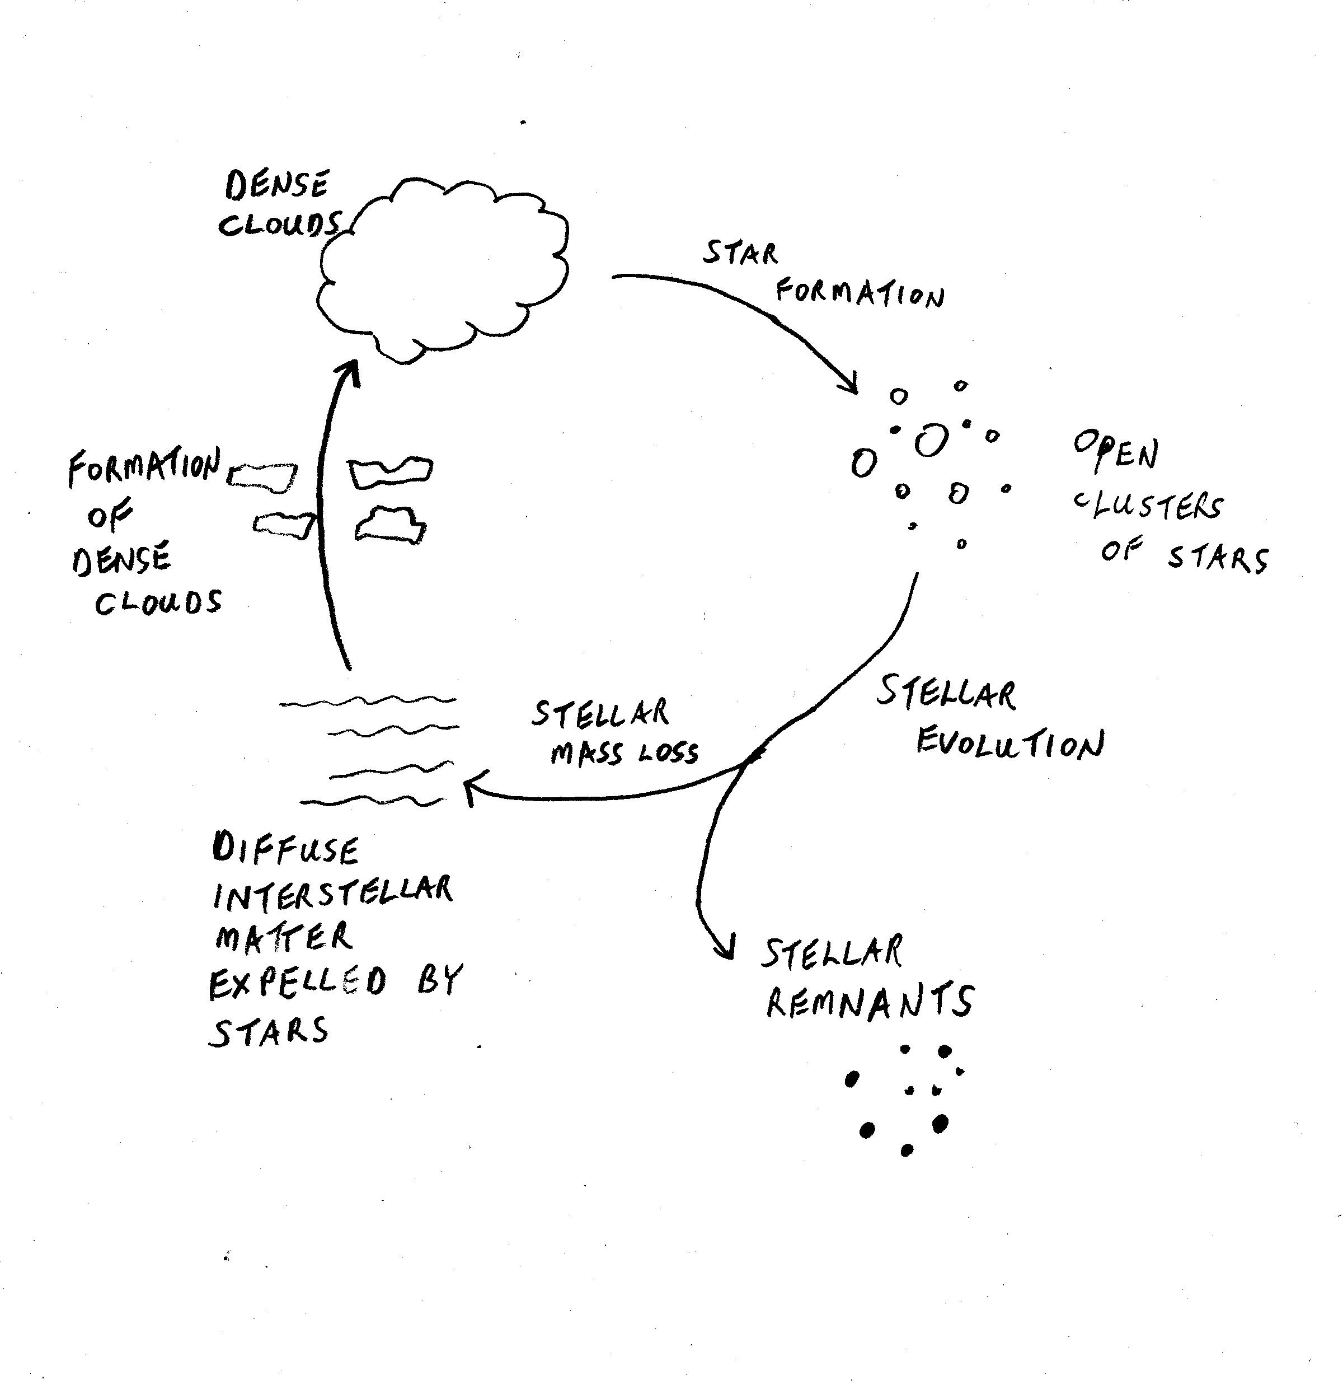
The Cycle Restarts
Notes:
On our final slide we have a diagram that shows the cycle of Star formation from Interstellar Medium to Stellar remnants and expelled matter which can form further clouds to start the cycle again.
So we can summarise the process:
The ISM consists of gas and dust particles
Regions may be viewed as clouds (nebula)
Some give off visible light, others weak radio waves
Star formation starts with contraction of a region of the ISM
Dense molecular clouds collapse
Density is relative – virtual vacuum
Colliding clouds can start gravitational compression
Collapsing clouds fragment
Molecues speed up and heat up
A fragment becomes a Protostar
Main sequence stars shine for billions of years consuming hydrogen in fusion reactions
Life span and eventual end depends on stars mass
Star swells to become a red giant or super giant
Red giant ejects a planetary nebula and ends as a white dwarf
Stars greater than 8x the Sun’s mass end in a supernova, leaving a cloud of matter and possibly a remnant pulsar or black hole
Material ejected by giants and supernova become part of the ISM and may contract to start the star formation process again
As we have seen on previous slides, heavier elements are all formed from the fusion of lighter elements in the center of stars in this cycle, so we are all made of ‘star stuff’. I hope you have enjoyed this short presentation. If you want more information please use the references and internet links in these notes – and the almost obligatory Google.
[
OU Introduction to Astronomy
http://www.enchantedlearning.com/subjects/astronomy/stars/lifecycle/
[http://www.ir.isas.jaxa.jp/ASTRO-F/Outreach/seika_e.html]
]

