Slide 1
CS50x final project
Falcao.js
By Alessio Ciregia
Pisa, Italy

Slide 2
Disclaimer
Sorry: no audio.
My spoken English sucks, and I have a bad microphone.

Slide 3
What is it
Falcao.js is a network tool
It is an IP Address and MAC address Tracker / Monitor
Useful to look at which IP addresses are currently in use on your network, which MAC addresses are associated with such IP addresses, and to have an history of such IP/MAC associations

Slide 4
What is it
In addition, you have a look to the IP addresses registered in the DNS that are not replying to ping for a long time.
In that way you can clean up your DNS entries and reassign unused IP addresses.

Slide 5
Programming languages
Node.js for the agent and the collector
PHP for the web interface
MySQL as the database

Slide 6
Components
An agent (or multiple agents)
A collector
A MySQL database (that is only one record)
A web interface

Slide 7
How it works
Broadcast domain (your LAN)
The agent scans the network
Agent
For each IP, the agent send
The data to the collector
Web interface
Collector
The collector writes the
data in the MySQL
database
DB
You can see the results
from your browser

Slide 8
How it works
If you have more than a LAN, for instance you manage many VLANs, you must place an agent in every broadcast domain.
Every agent will send collected data to a central collector.

Slide 9
How it works
Broadcast domain (VLAN2)
Broadcast domain (VLAN1)
Agent
Agent
Web interface
Collector
DB

Slide 10
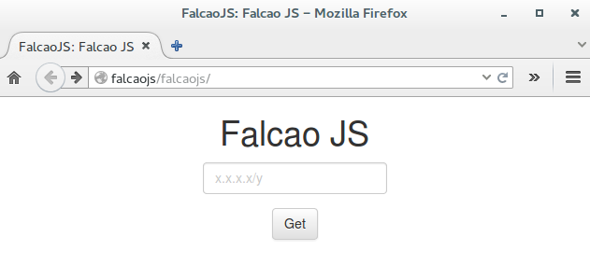
PHP interface
The web interface is similar to the one of the pset7 C$50 finance web pages. In fact I have reused the concepts, some line of code and the CSS.

Slide 11
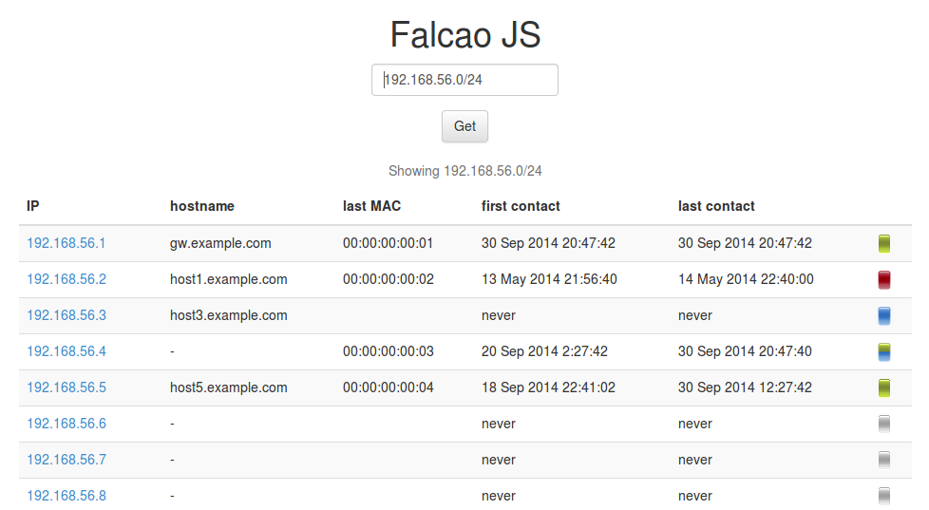

PHP interface
An icon useful to the identification of the anomalies
The most recent time when the IP/MAC pair
was seen on the network
The first time when the IP/MAC pair
was seen on the network
The hostname
(if present)
The list of scanned IP addresses (as by the query)
The last MAC address associated with the IP

Slide 12






PHP interface
Meaning of the icons
The IP is not registered in the DNS and it never replied to the ping
The IP is registered in the DNS and it did not reply to the ping for a long time
The IP is registered in the DNS and it replied to the ping in a reasonable time interval
Work in progress
The IP is registered in the DNS, but it never replied to the ping
The IP is registered in the DNS and it did not reply to the ping in the last times

Slide 13
The code
You can find the code and other information on GitHub
https://github.com/alcir/falcao.js

