Slide 1
Home made thermometer
Seis-785: Internet of things
Univ. of st. thomas

Slide 2
Why a thermometer
We have 2 little kids
Hard time trying to get the temperature when sick
Hard to visualize the temperature out of the houser

Slide 3
Components
Head Band
Lilypad temperature sensor.
Particle photon
Particle power shield (battery)
2 led
Conductive threads (not used).

Slide 4
How it works
Temperature Trigger
Below 28 C we considered as OFF (system measure house temperature).
Between 28 and 30 -> The system is ON
Between 30 and 32 -> Warning Zone
Above 32 -> Danger Zone
We set in the set up a max limit of 45 (volts get when not connected around 100 C).
Notifications:
Visual: D7 output (normal), yellow led (warning), red led (danger
PushBullet for Iphone notifications.

Slide 5
Website
Create using PHP, Javascript, Jquery, MySQL
Shows current measures
Shows last 20 records in the database
Notification are sent if there are not record with the same status within 1 hour.

Slide 6
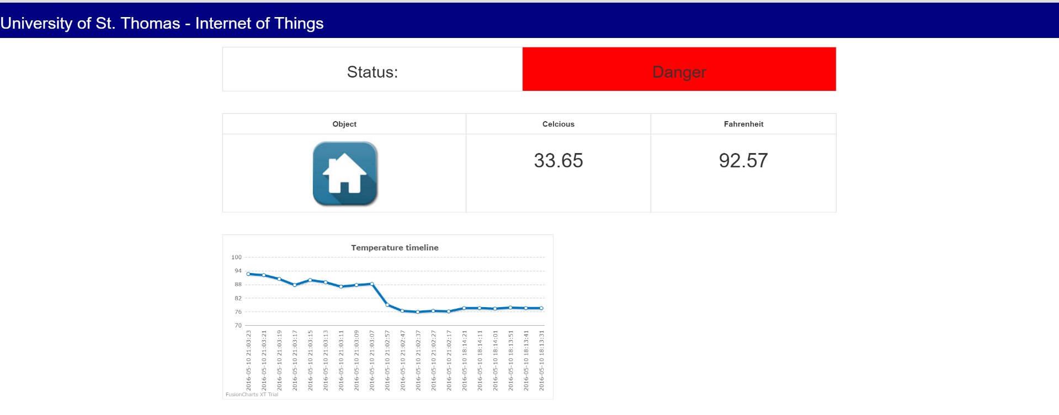
Website

Slide 7
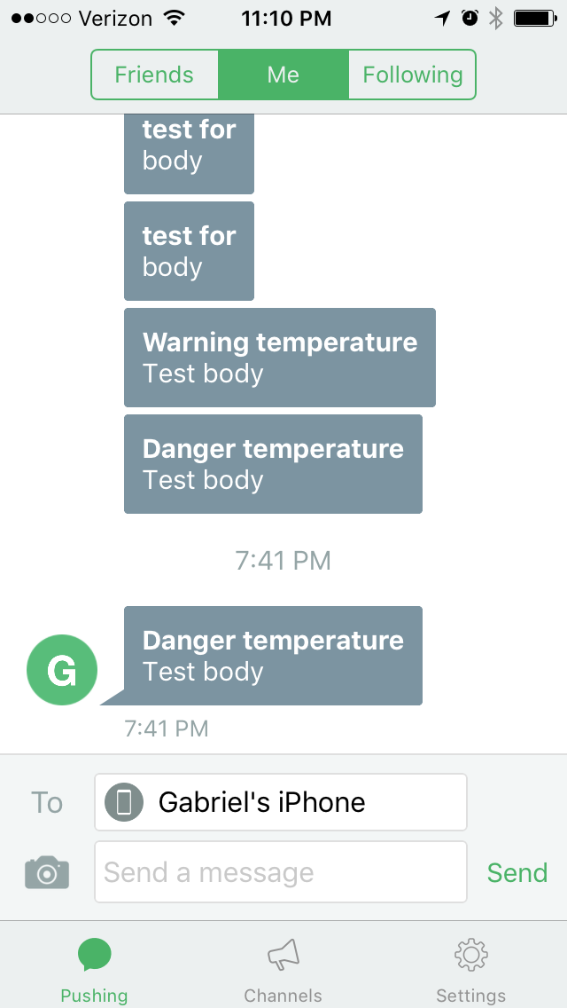
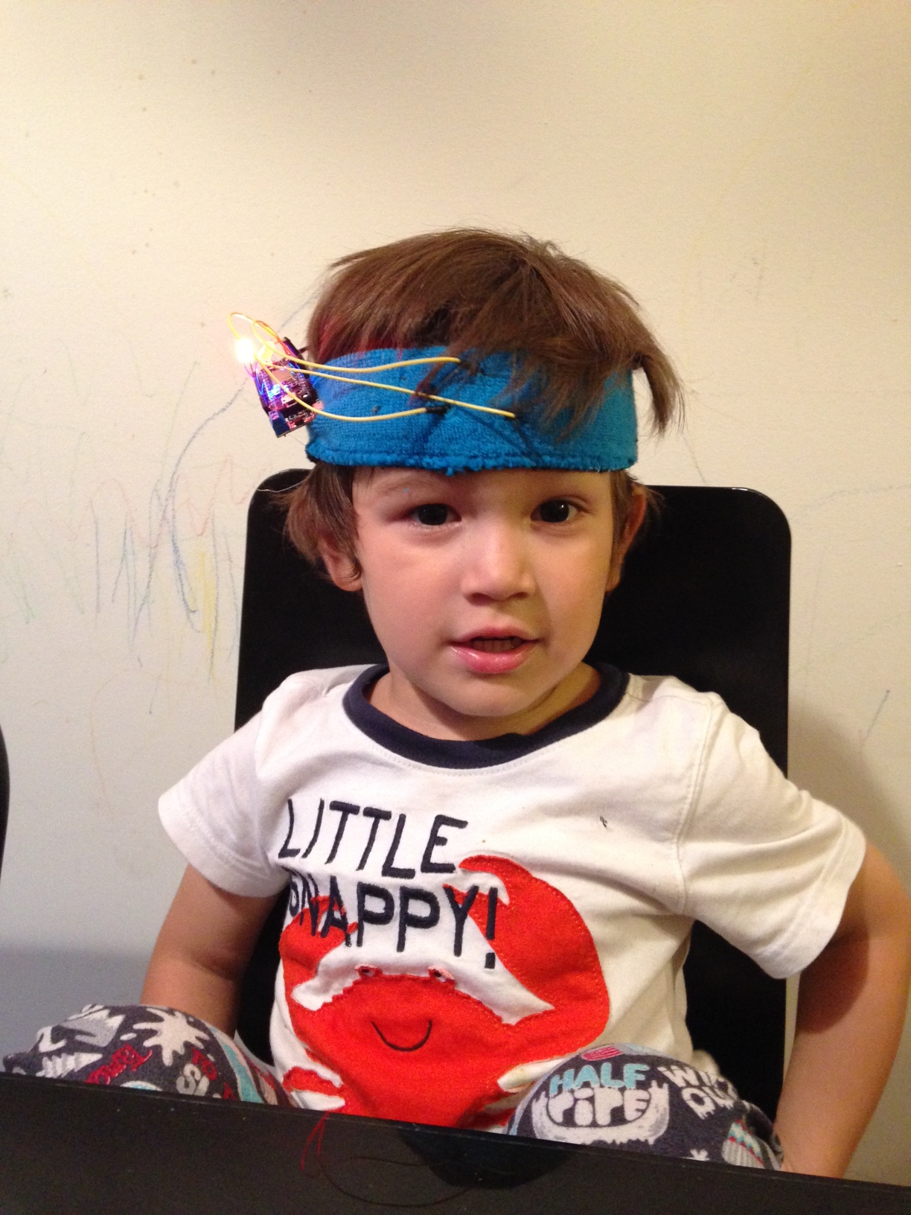
images

Slide 8
THANK YOU!

