Slide 1
Climate Negotiation Simulation
A multi-agent LLM framework for simulating UNFCCC bargaining
https://github.com/alcohol-freeWhisky/climate_negotiation_simulation
Project overview Background Goal Workflow Experiment Next steps
Current setup 8 bloc agents + Chair DeepSeek default backend Real draft/final text benchmark
Notes:
Today I will present my project, Climate Negotiation Simulation, a multi-agent LLM framework for simulating UNFCCC-style bargaining. The United Nations Framework Convention on Climate Change
The core idea is to move beyond single-agent text generation and instead model negotiation as a structured, multi-party process. In this system, different agents represent major negotiating blocs, interact over real draft text, and try to move toward a final decision through a chair-mediated workflow.
This project is designed as both a working software system and a research platform for studying how large language models behave in politically constrained, text-based negotiations.

Slide 2
Background
UNFCCC decisions are negotiated through text, not only through preferences.
The process is consensus-based, multi-party, and highly path-dependent.
Article 6 negotiations are especially difficult because legal drafting and political trade-offs interact.
This makes climate bargaining a useful testbed for multi-agent LLM systems.
Why simulation is hard Distinct bloc identities Iterative compromise text Chair-mediated convergence Adoption depends on political acceptability, not only textual quality
Notes:
UNFCCC negotiations are difficult to simulate because they are not just about preferences. They are fundamentally about text, procedure, and consensus.
Parties negotiate paragraph by paragraph, defend red lines, form coalitions, and react to chair proposals over multiple rounds. So the final outcome depends not only on what each actor wants, but also on how the drafting process unfolds.
This makes climate negotiations a strong test case for multi-agent LLM systems. A useful model here must do more than produce fluent language. It has to preserve distinct political identities, respond to evolving text, and distinguish between a document that looks realistic and one that is actually politically acceptable.

Slide 3
Goal
- Build an end-to-end system that can simulate bloc-level climate negotiations over real draft text.
- Preserve persistent agent identities, red lines, and coalition behavior across multiple rounds.
- Produce revisable decision text and compare it against a real negotiated outcome.
- Separate textual realism from political feasibility in the evaluation.
Notes:
The goal of this project is to build an end-to-end system that can simulate bloc-level climate negotiations over real draft text.
More specifically, I want the system to do four things.
First, represent major negotiating blocs with persistent identities, principles, and red lines. Second, follow a realistic workflow, rather than generating a final answer in one step. Third, produce revisable decision text that evolves over rounds. And fourth, evaluate the output against a real negotiated outcome, while also measuring whether the final package is politically passable.
So the project is not only about text generation quality. It is about process realism and political realism together.

Slide 4
Workflow
Opening Statements initial priorities
First Reading paragraph amendments
Informal Consultations multi-round bargaining
Final Plenary clean text and adoption
Chair synthesizes proposals into revised text after each consultation round.
Text Manager tracks brackets, amendments, and text evolution.
Notes:
The workflow has four phases.
The first phase is opening statements, where each bloc sets out its priorities and concerns. The second phase is first reading, where agents react to specific paragraphs and propose amendments. The third phase is informal consultations, which is the main bargaining stage. This is where agents negotiate contested language and the chair synthesizes proposals into revised text. The fourth phase is final plenary, where the system presents a clean text for adoption and each bloc decides whether to accept or block.
This phased design is important because it creates a negotiation trajectory. Agents do not just produce preferences. They respond to text, to prior moves, and to the evolving state of the package.

Slide 5
Workflow Implementation
Negotiation Engine Phase Manager Turn Manager Text Manager Amendment Processor
Agent Layer 8 negotiating blocs 1 Chair agent General charters Runtime agenda focus
Evaluation Layer ROUGE-L BERTScore Key clause matching Stance consistency Political acceptability
Notes:
At the implementation level, the repository has three main layers.
The first is the negotiation engine, which manages phases, turns, amendments, and text revision. The second is the agent layer, which includes eight negotiating blocs and a neutral chair. The third is the evaluation layer, which scores the results with both text-based and process-based metrics.
A key design choice is that each bloc has a general charter stored in configuration files. These profiles are not hardcoded for one specific agenda item. Instead, during runtime the system narrows each agent’s focus to the issues most relevant to the current scenario and paragraph.
That helps preserve generality while still allowing issue-specific behavior during the negotiation itself.

Slide 6
Experiment
- Case study: Article 6.8 - Framework for Non-Market -- Participants: 8 negotiating blocs plus a neutral Chair
- Default backend: DeepSeek chat
- Scenario disputes: scope, governance, relation to markets, institutional home, reporting
- Validation: pytest, unittest, compileall, and dry-run all pass
Repository snapshot 20 source files 8 bloc profiles 6 test modules Per-run output folders
Notes:
The current case study focuses on Article 6.8 of the Paris Agreement, which concerns the framework for non-market approaches.
The simulation includes eight major negotiating blocs: the EU, G77 and China, AOSIS, the Umbrella Group, the Least Developed Countries group, the African Group, the Like-Minded Developing Countries, and the Environmental Integrity Group. A chair agent manages the process.
The default backend currently uses DeepSeek, although the framework also supports OpenAI and Anthropic backends.
The main disputed issues in this scenario are scope, governance, the relationship to market mechanisms, institutional arrangements, and reporting requirements.
On the software side, the repository is fully executable. The tests pass, the dry-run works, and outputs are saved per run for later analysis.

Slide 7
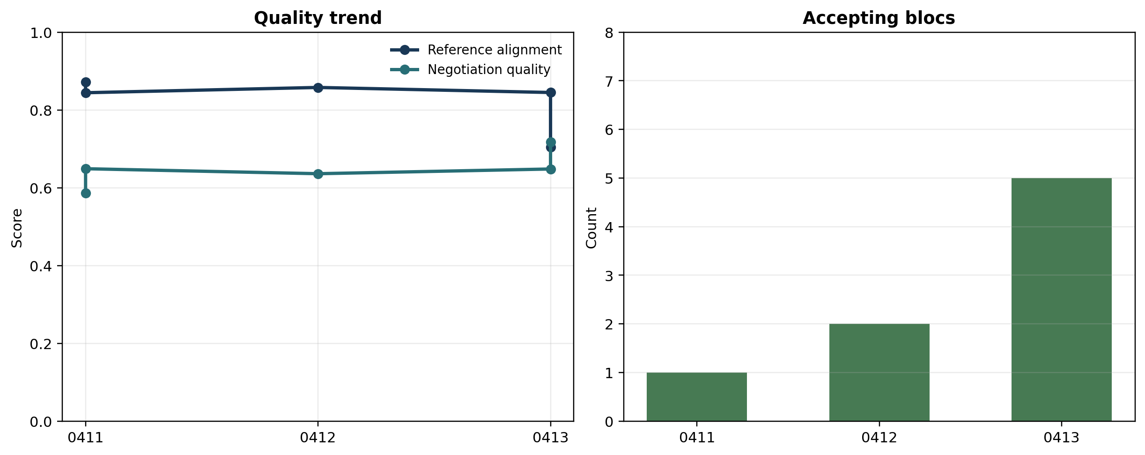
Experiment Results
Representative findings Best ROUGE-L: 0.856 Best BERTScore: 0.970 Latest accepting blocs: 5 / 8 Latest blocking blocs: 3 / 8 The system writes realistic text before it reliably reaches full consensus.
Observed pattern: textual alignment improved earlier than political acceptability, which makes endgame behavior the key bottleneck.
Notes:
The current results show a useful pattern.
On the one hand, the system is already quite strong at producing realistic decision text. In some runs, ROUGE-L and BERTScore are relatively high, and the generated structure is close to the reference decision. ROUGE-L measures how much the generated text overlaps with the reference text in wording and order.
BERTScore measures how similar the generated text is to the reference in meaning, using contextual word embeddings, so it can reward paraphrases even when the exact words differ.
On the other hand, political acceptability remains harder than textual similarity. In other words, the system can generate text that looks plausible before it can consistently generate a package that all blocs are willing to adopt.
This is actually an important finding. It shows that negotiation quality and reference alignment are not the same thing. A model can produce fluent, realistic text while still failing at the coalition balancing needed for consensus.
So the main challenge has shifted from basic generation to endgame convergence.
Show negotiation text and what group thinks what
Think about pros and cons, does country adopt llm negotiation model in the future?

Slide 8
Next Steps
- Expand from one scenario to a broader set of negotiation topics.
- Run controlled ablations on bloc composition and behavioral parameters.
- Compare model families under the same negotiation protocol.
- Improve endgame convergence without collapsing bloc distinctions.
Research contribution A reusable workflow for studying whether LLM agents can negotiate like structured political actors, not just generate fluent text. This is the bridge from a proof of concept to a paper-ready experimental platform.
Notes:
There are four main next steps.
First, expand beyond a single scenario and test the framework on a broader set of negotiation topics. Second, run more controlled experiments, including counterfactuals and parameter sensitivity tests. Third, compare different model families under the same negotiation protocol. And fourth, improve endgame behavior so that the system can better balance bloc-specific red lines without collapsing their identities into generic compromise language.
The larger contribution of this project is that it offers a reusable workflow for studying whether LLM agents can behave like structured political actors in a multilateral process.
So the project is already more than a proof of concept. It is becoming a research platform for computational studies of international climate governance.

