Slide 1
High-Level Plan with Solution Architecture and Milestones
Objective: To design and implement a scalable ETL solution that integrates event data from the Ticketmaster API with weather data from the OpenWeatherMap API. The solution will provide valuable insights and visualizations, allowing users to understand historical weather patterns during past events and predict weather conditions for upcoming events.

Slide 2
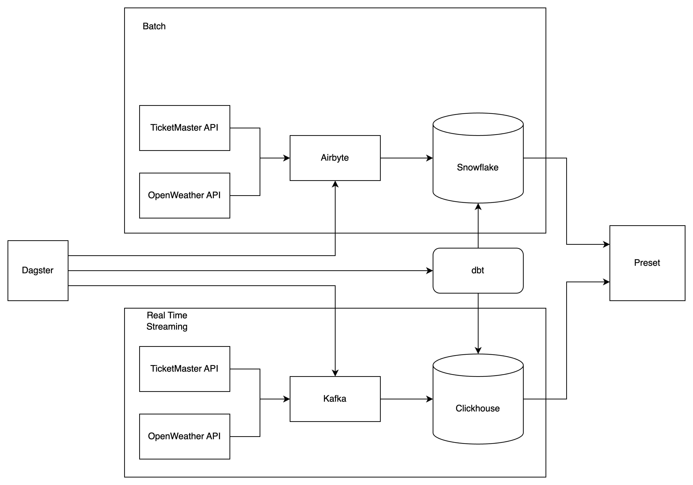
Proposed Solution Architecture

