Slide 1
Sketch applications of semi-supervised self-learning
Alessandro Dal Corso, Andrea Luongo, Jonathan Scharff Nielsen
Technical University of Denmark
Notes:
Hi Alessandro
Technical university of Denmark

Slide 2
Introduction – self learning
Applying semi-supervised learning to our research
Applications of semi supervised learning to:
Computer graphics
CT projections views
Inspired by the lecture on self learning on Tuesday

Slide 3
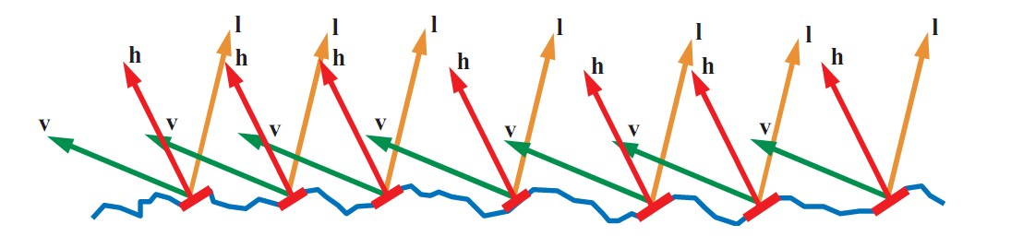
Problem Statement
Microfacets modeling, widely used technique in CG to render rough surfaces
Avoids using a highly resolution mesh to render
Problem: What is the best microfacet model that best approximates the normals of a given mesh?
Solution: Use machine learning to classify the distributions of normals!
Notes:
Difficult to find applications in graphics
Part of the model is the normal distribution

Slide 4
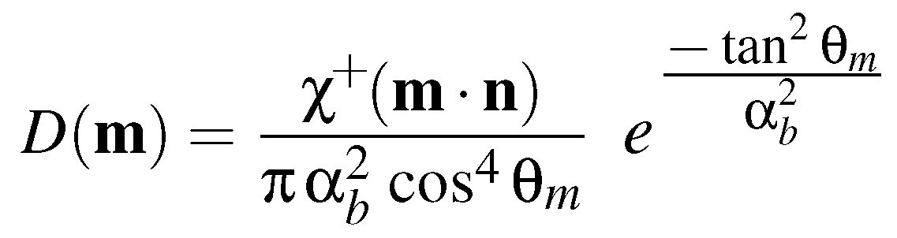
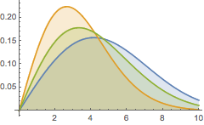

Beckmann distribution
For our proof of concept, we use the Beckmann distribution with three different values of a parameter $α_{b}$
$θ_{m}$ is the azimuthal angle
Notes:
Beckmann distribution (2)
- Something about the beckmann (equation)
- For our test case, we use only this
- It has one parameter
- Roughness according to parameter
- What is the best parameter to approximate a given distribution of normals

Slide 5
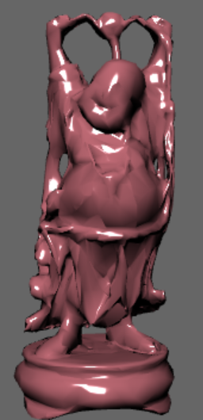
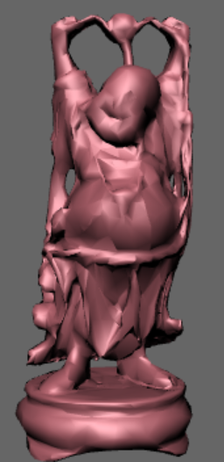
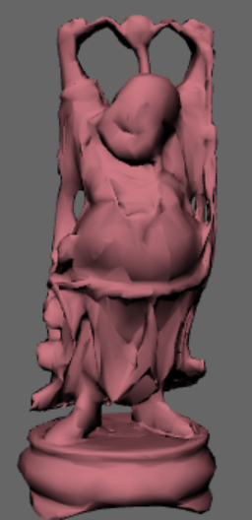



Beckmann distribution
$$α=0.1$$
$$α=0.5$$
$$α=0.9$$

Slide 6
Training data
We train our model using randomly generated Beckmann distributions in three classes
A few distributions per class are used for the initial supervised learning
The rest (100 distribution per class) is used for self-learning to improve the classifier
We use a centroid k-means classifier with a specific metric

Slide 7

Distance metric – Bhattacharyya distance
We use the Bhattacharyya distance as a distance metric between distributions
In practice, we use the histograms of the two distributions $p$ and $q$ to estimate their pdf

Slide 8
Results
Supervised prediction

Slide 9
Results
Semi-supervised prediction

Slide 10
Results
Validation

Slide 11
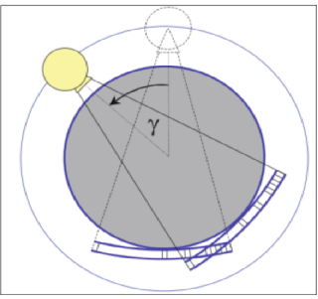
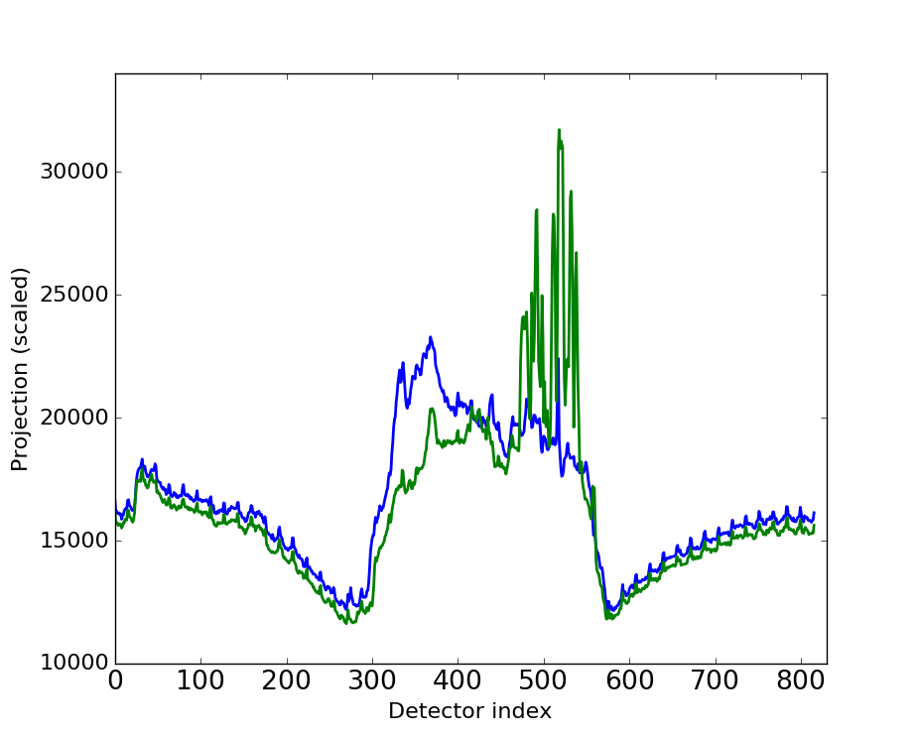
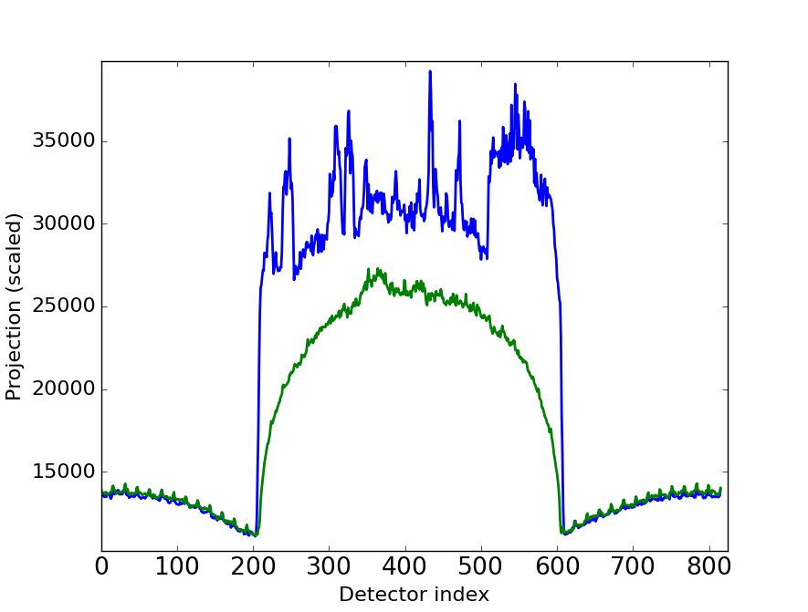
CT projection data
Green:
Slice with dental implant
Blue:
One slice down
816 detectors -> 816 input features
Blue:
Phantom with metal
Cylinders
Green:
Plain phantom
Idea: If we can classify the views using the raw data, we can choose how to handle them individually.

Slide 12
Labelling
Unlabelled
Metal (+1)
No metal (-1)
Metal (+1)
Index

Slide 13
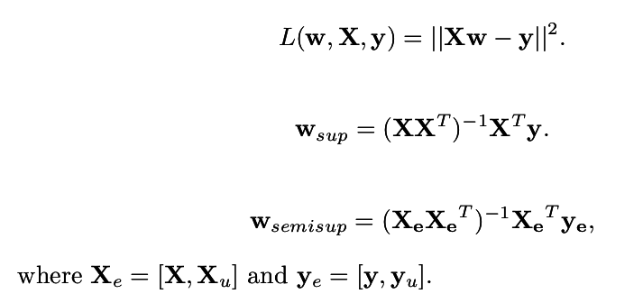
Least squares linear classifier
1. Teach a linear classifier on the labeled data
2. Label the unlabeled data by applying the model
3. Reiterate

Slide 14
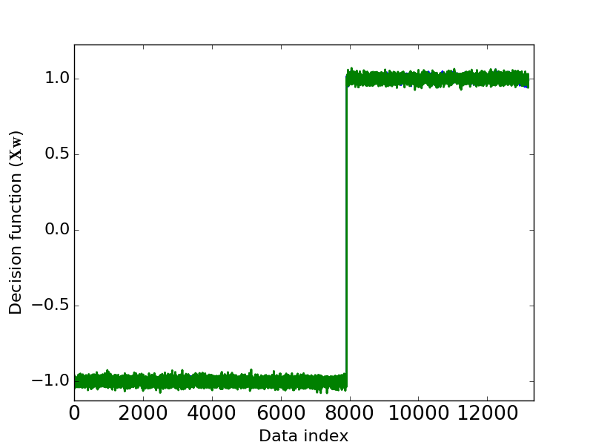
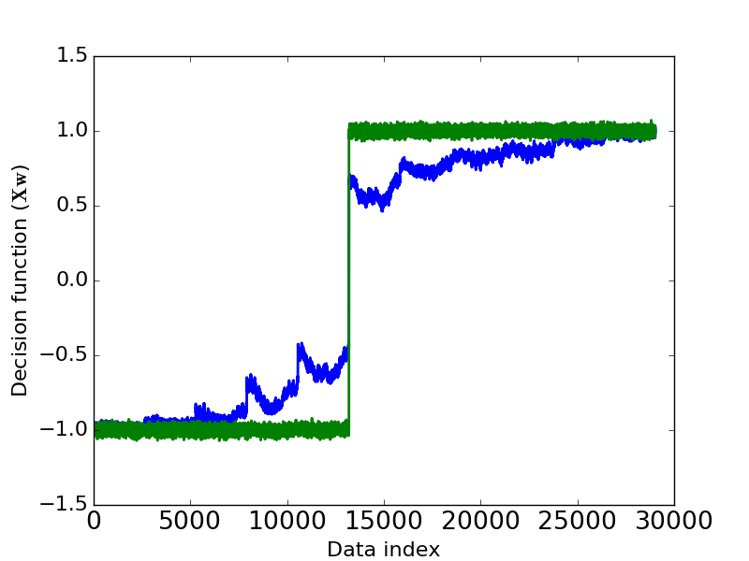
Decision functions
Supervised w_sup (blue) and unsupervised w_semi (green) classifiers on labeled data:
(1 is “metal” and -1 is “no metal”)
Supervised (blue) and unsupervised (green) classifiers on unlabeled data
The classifier finds a threshold that approximately coincides with where metal enters the image (but not quite)
Unsupervised learning reinforces the boundary

Slide 15
Conclusion
Classifier useless for general data since the features are poorly chosen
Deep learning could possibly be used to find better features, or one could handcraft
The classifier should probably be non-linear

