Slide 1
Sketchy applications of semi-supervised learning
Alessandro Dal Corso, Andrea Luongo, Jonathan Scharff Nielsen
Technical University of Denmark
Notes:
Hi Alessandro
Technical university of Denmark

Slide 2
Introduction – self learning
Applying semi-supervised learning to our research
Applications of semi supervised learning to:
Computer graphics
CT projections views
Inspired by the lecture on self learning on Tuesday

Slide 3
Computer Graphics - Normal classification
Problem of data in rendering
Microfacets modeling, widely used technique in CG to render rough surfaces
Avoids using a highly resolution mesh to render
Problem: What is the best microfacet model that best approximates the normals of a given mesh?
Solution: Use machine learning to classify the distributions of normals!

Slide 4
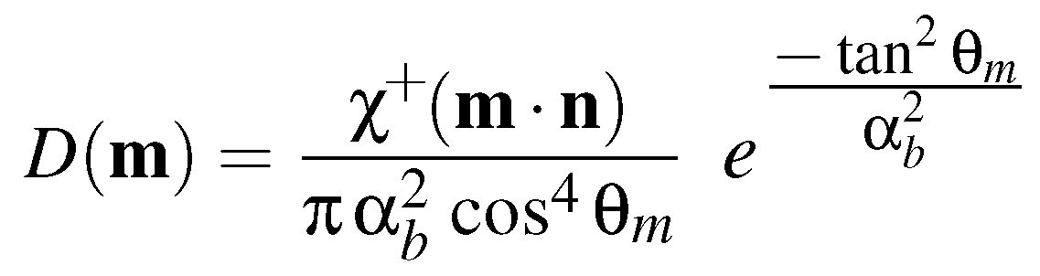
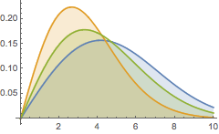

Beckmann distribution
For our proof of concept, we use the Beckmann distribution with three different values of $α_{b}$
Notes:
Beckmann distribution (2)
- Something about the beckmann (equation)
- For our test case, we use only this
- It has one parameter
- Roughness according to parameter
- What is the best parameter to approximate a given distribution of normals

Slide 5
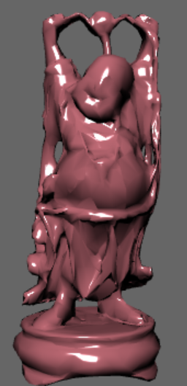
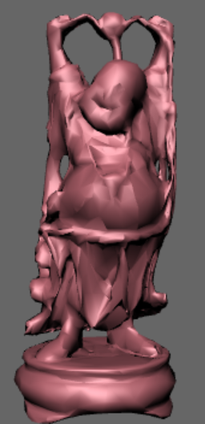
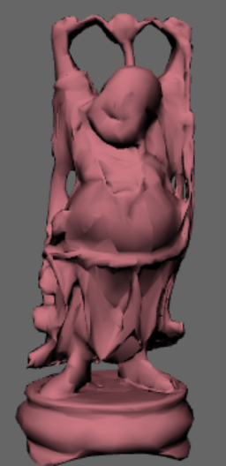



Beckmann distribution
$$α=0.1$$
$$α=0.5$$
$$α=0.9$$

Slide 6
Training data
Training data generation (2)
- 1 per parameter
- k mean classifier,
- Prediction of labels and self training until stabilization
- Finished classifier to classify distributions
- prediction of unsupervised

Slide 7
Distance metric – Bhattacharyya distance
We use the Bhattacharyya distance as a distance metric between distributions
Good distance metric to approximate distance between distributions

Slide 8
Results
Supervised prediction

Slide 9
Results
Semi-supervised prediction

Slide 10
Results
Validation

