Slide 1
Inchiriere biciclete
Ristoiu Aurel
342A3

Slide 2
Cuprins
Documentul XML
Documentul DTD
XSD Schema
Document XSL
Aplicatia
Bibliografie

Slide 3
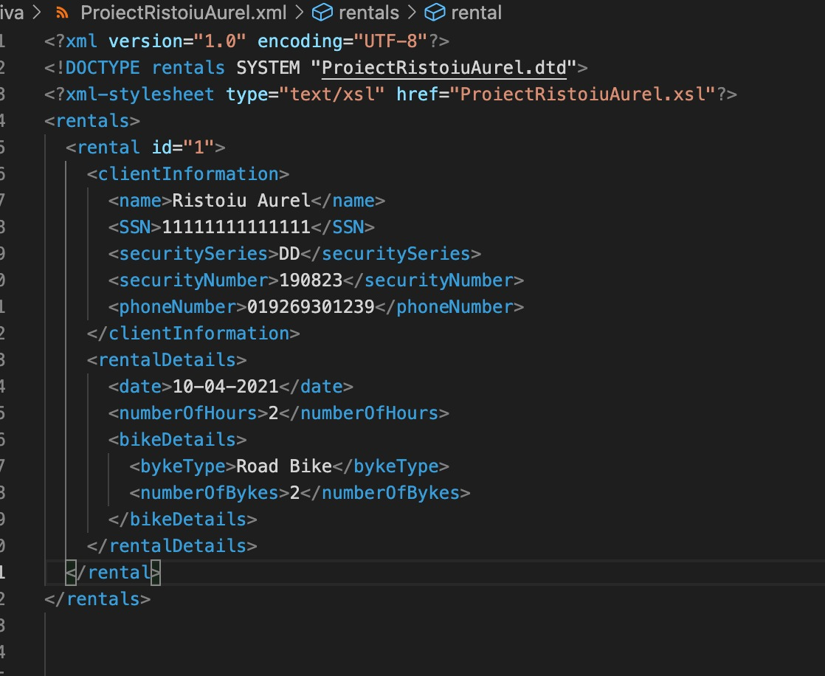
Documentul XML

Slide 4
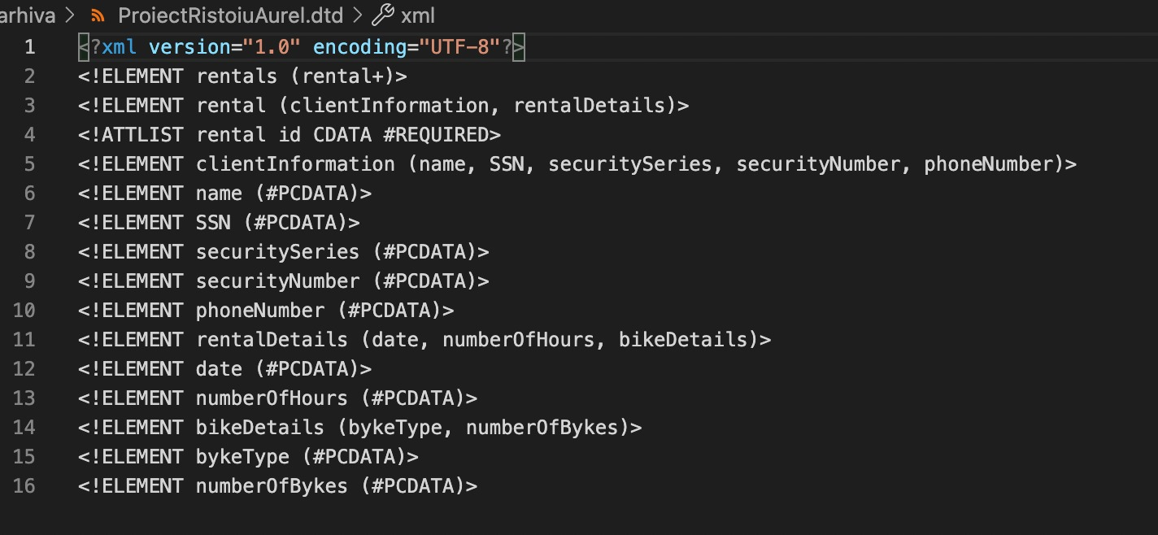
Documentul DTD

Slide 5
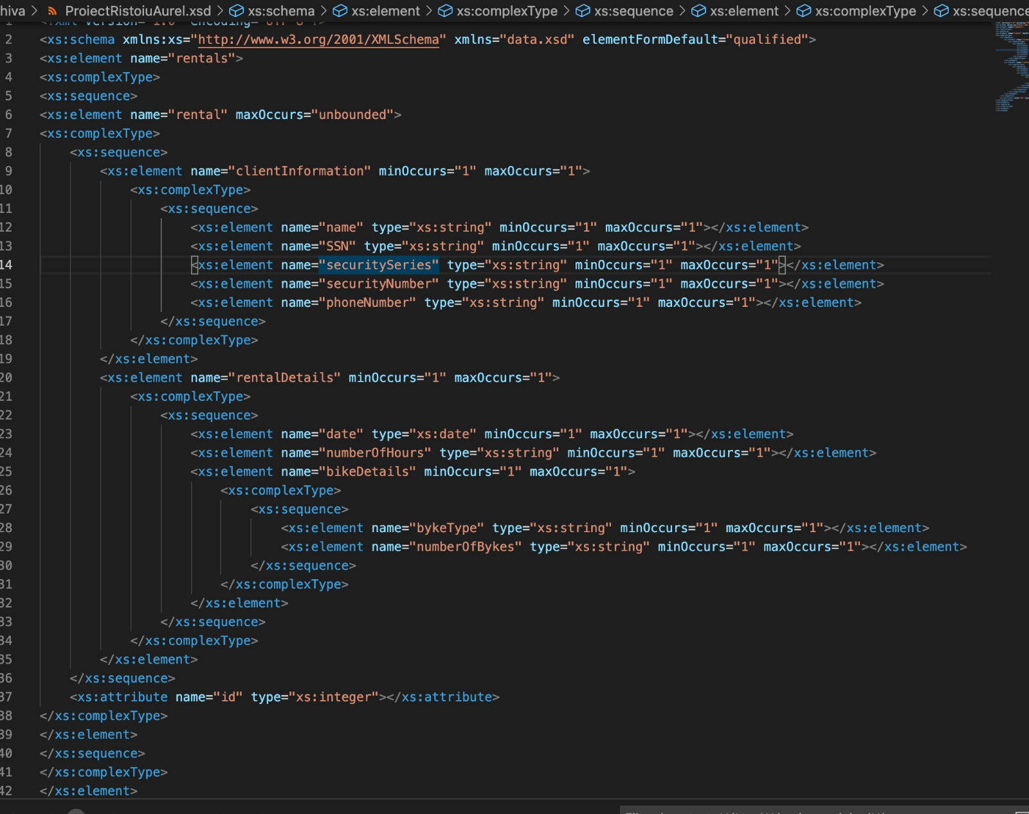
XSD Schema

Slide 6
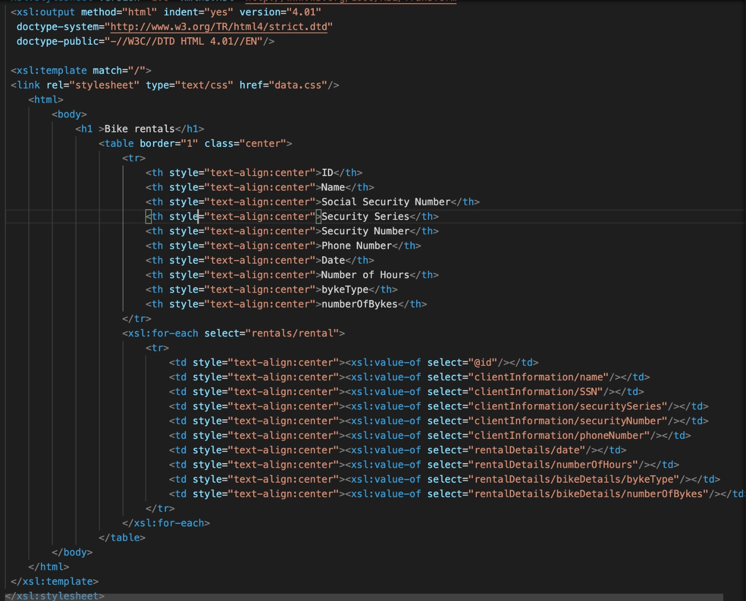
Document XSL

Slide 7
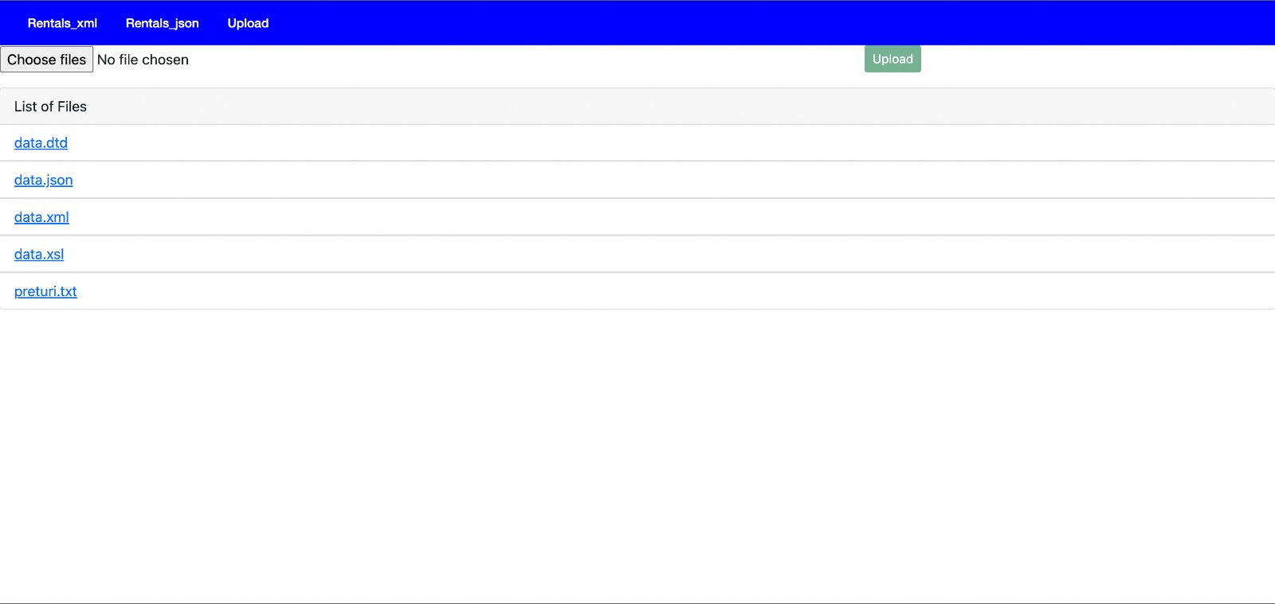
Aplicatia

Slide 8
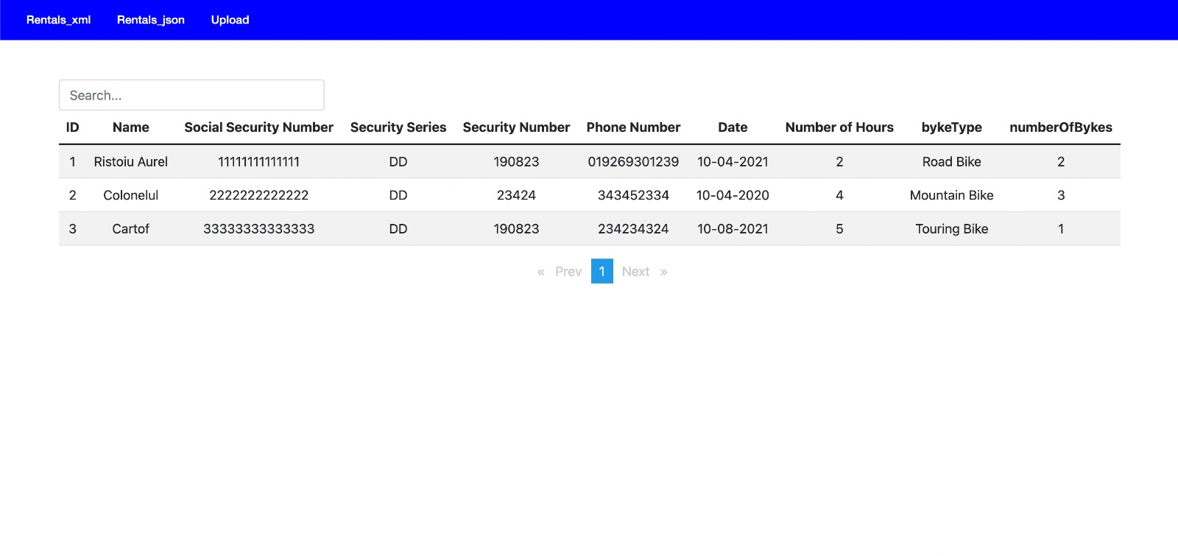

Slide 9
Bibliografie
https://stackoverflow.com/questions/10904448/node-to-parse-xml-using-xml2js
https://nodejs.dev/learn/reading-files-with-nodejs
https://www.geeksforgeeks.org/file-uploading-in-node-js/

