Slide 1



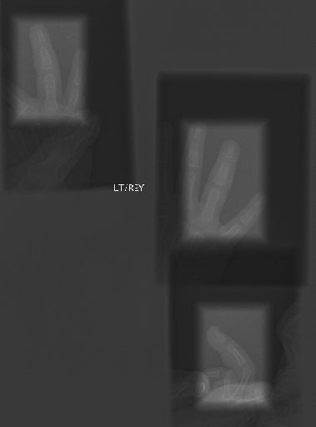
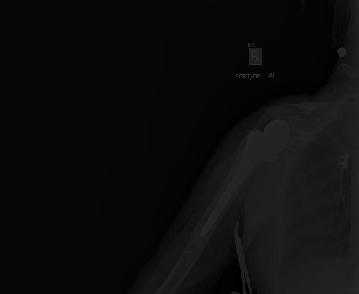
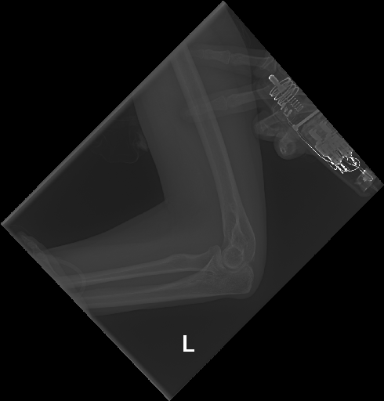
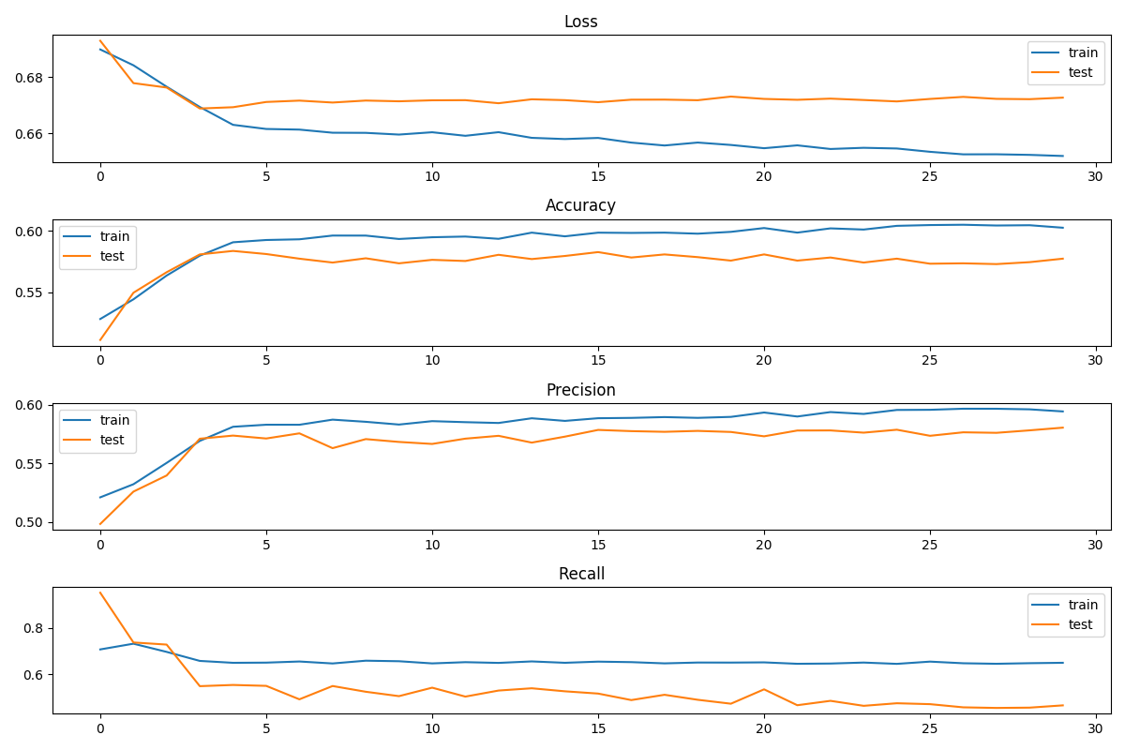
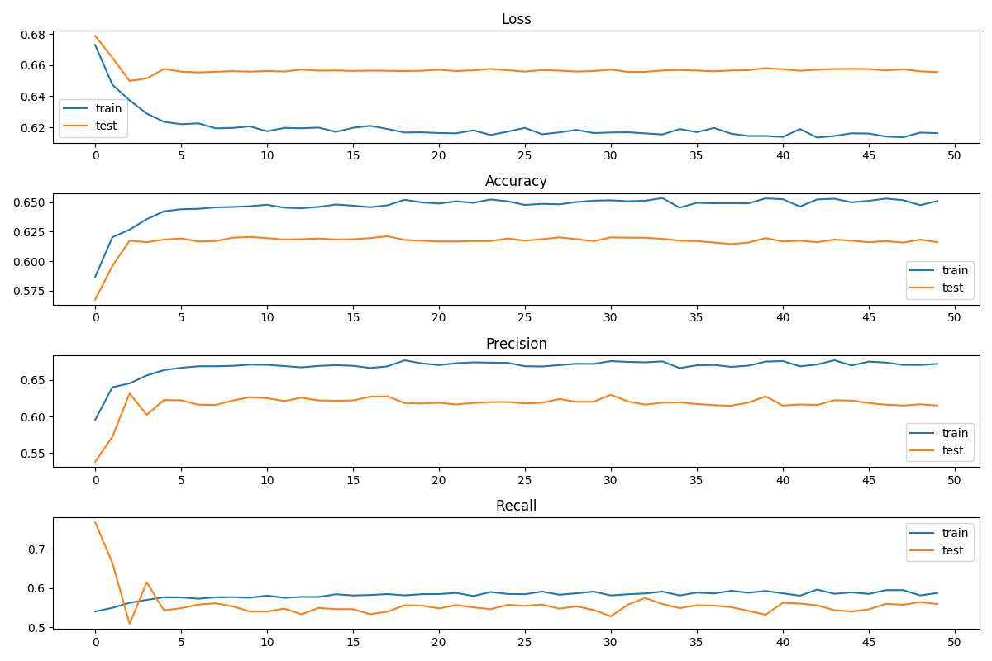
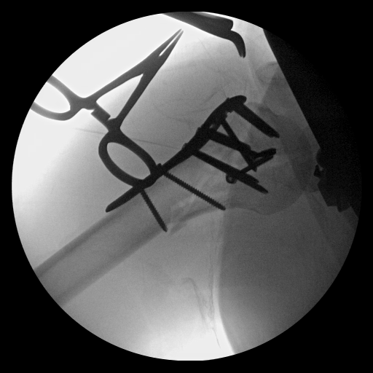
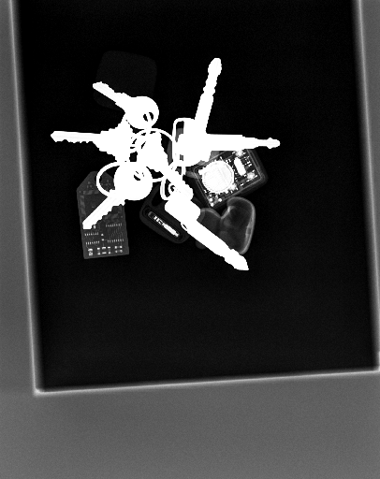
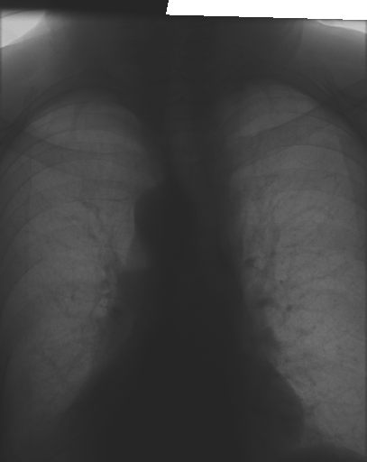
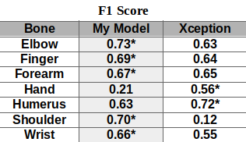
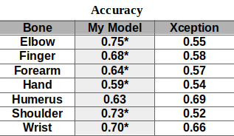
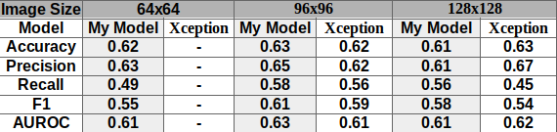
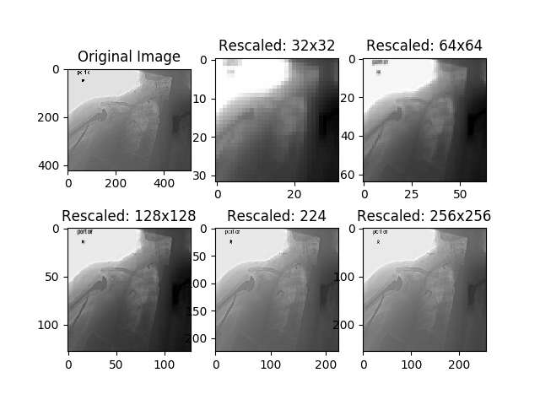
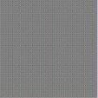
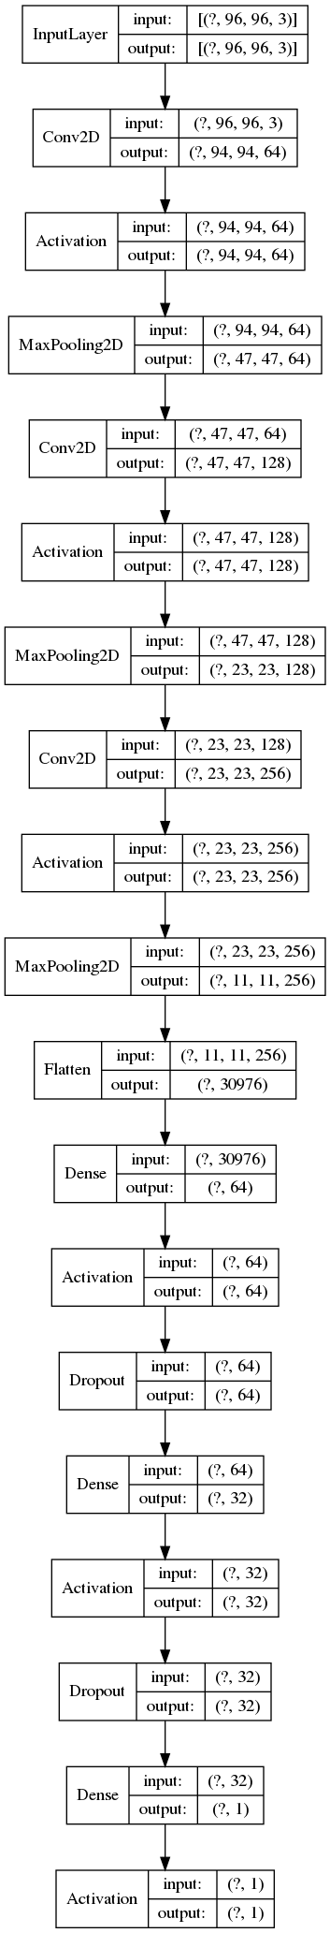
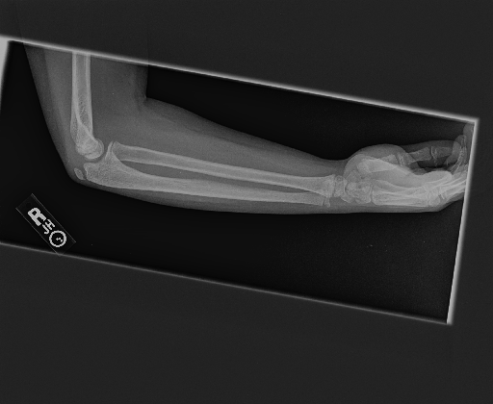
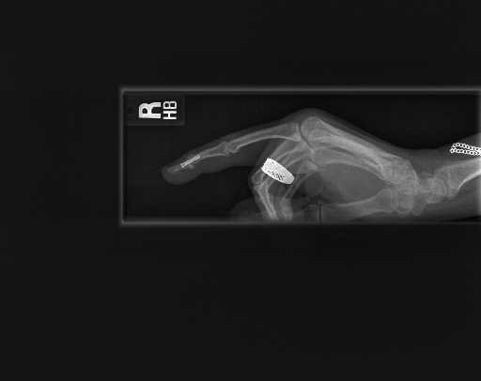
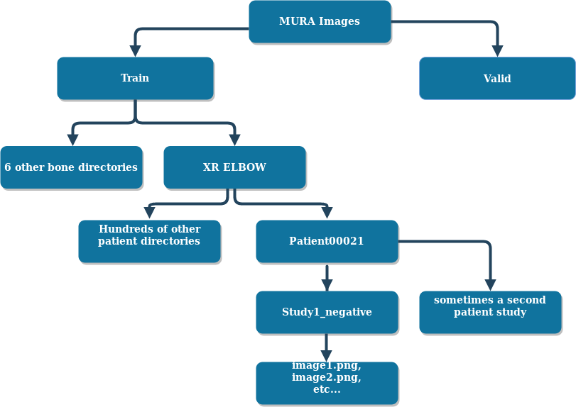

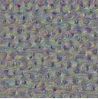
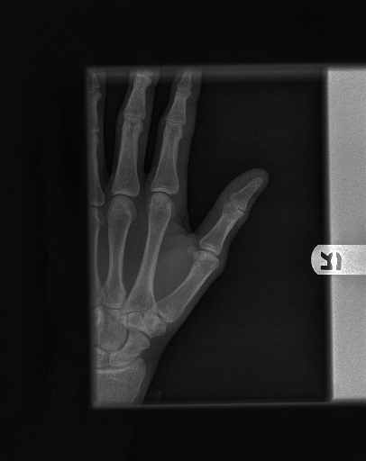
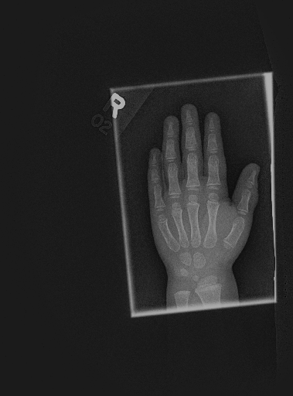
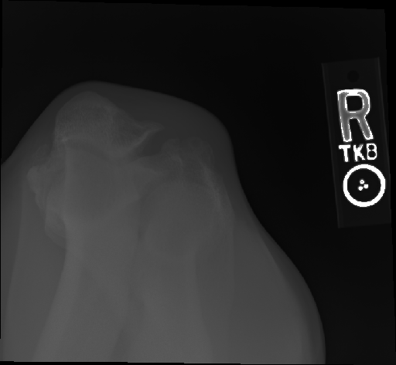
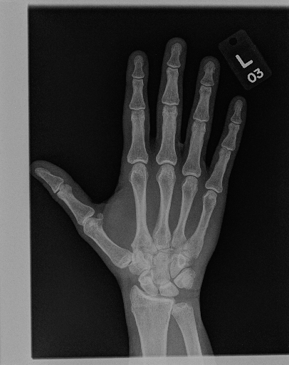
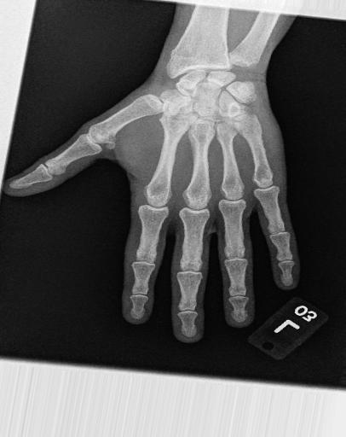
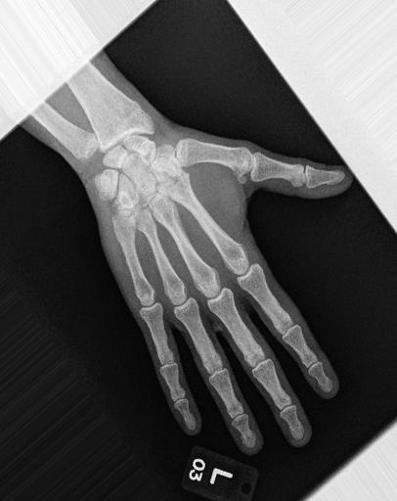
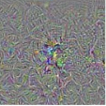
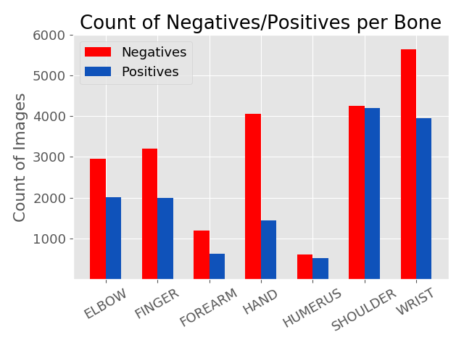




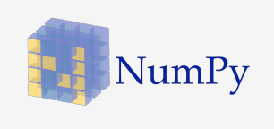

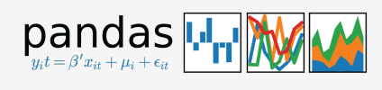
X-Ray Classifier
Alex Cross
/github.com/alcr0996
in
/in/alcr0996
alexfourdata@gmail.com
Background
Difficult data:
Results
This dataset was obtained from the Stanford ML group, which worked with a group of board certified radiologists to prepare and label the data.
Creating a ML model that could assist in the identification of x-ray studies would be a major contribution to the healthcare industry.
My Model
Xception
Objectives
Misclassified data:
  Test models to make a diagnosis of normal vs abnormal on X-Rays of the arm
            Simple C – basic cnn
            CP – convolution-pool
            CCP - convolution-convolution-pool
  Test best performing model on each set of X-Rays (finger, hand, wrist, forearm, elbow, humerus, shoulder)
  Compare best model performance vs pre-trained model: Xception
Total dataset after cleaning and balancing: 44k train, 3.2 test
* - indicates better performing model
Data
Image Size/Augmentation
Final Model Architecture
Misclassified Results
  40k images: 36.5k training images, 3.2k testing images.
Class: 1 Model: 0.39
Class: 0 Model: 0.99
Class: 1 Model: 0.08
Class 0 Model: 0.76
Class: 0 Model: 0.82
Future Steps
Separate images
Visualize layers of CNN
Class activation map
Prediction per study
Adult/youth study
Transfer Learning
Unsupervised Learning
VGG19
Example of Gradient Ascent
Image size: 96x96
Tech Stack
References
Rajpurkar P, Irvin J, Bagu Al, Ding D, Duan T, Mehta H, Yang B, Zhu K, Laird D, Ball RL, et al. 2017. MURA: Large Dataset for Abnormality Detection in Musculoskeletal Radiographs. 1st Conference on Medical Imaging with Deep Learning.

