Slide 1



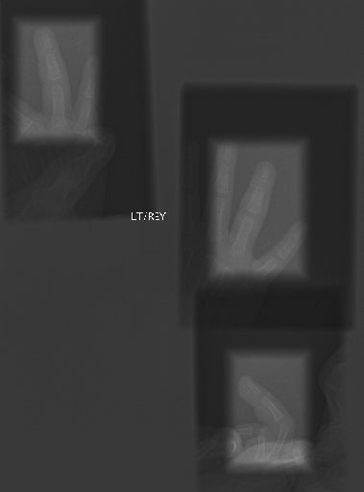
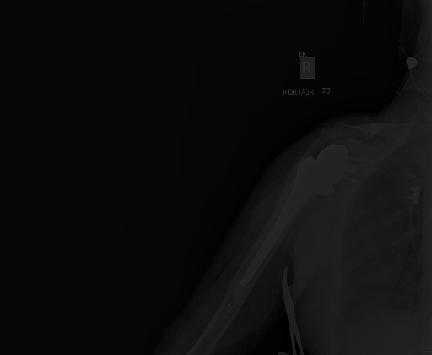
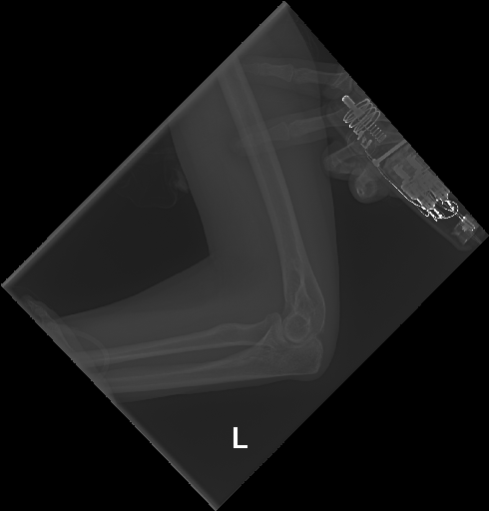
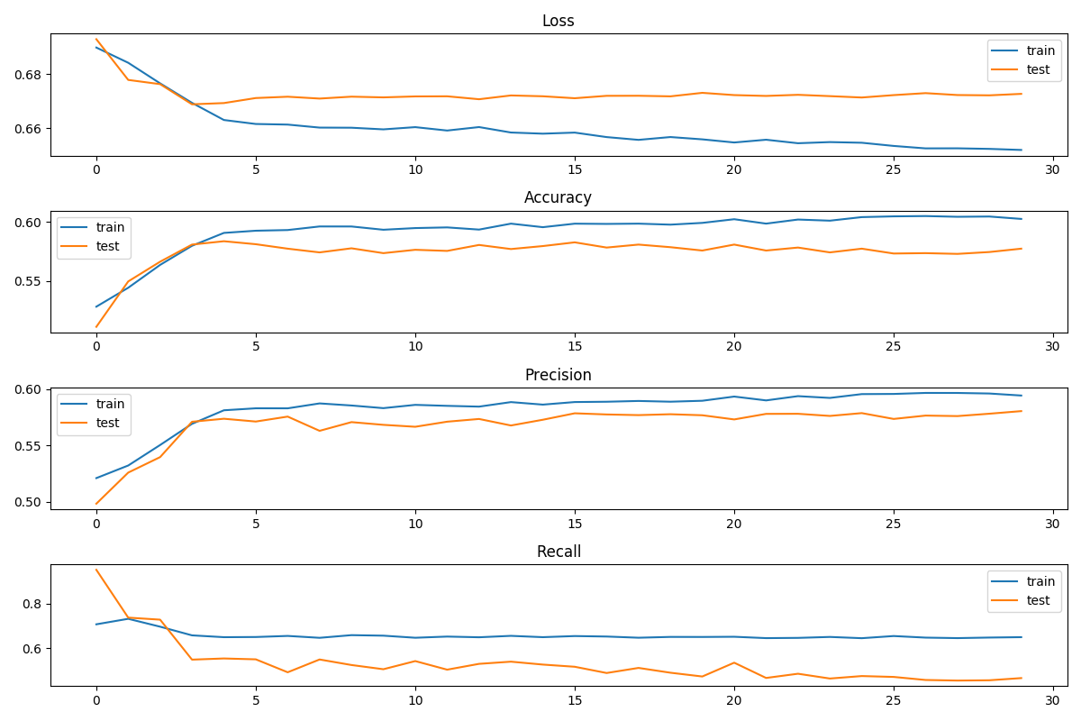
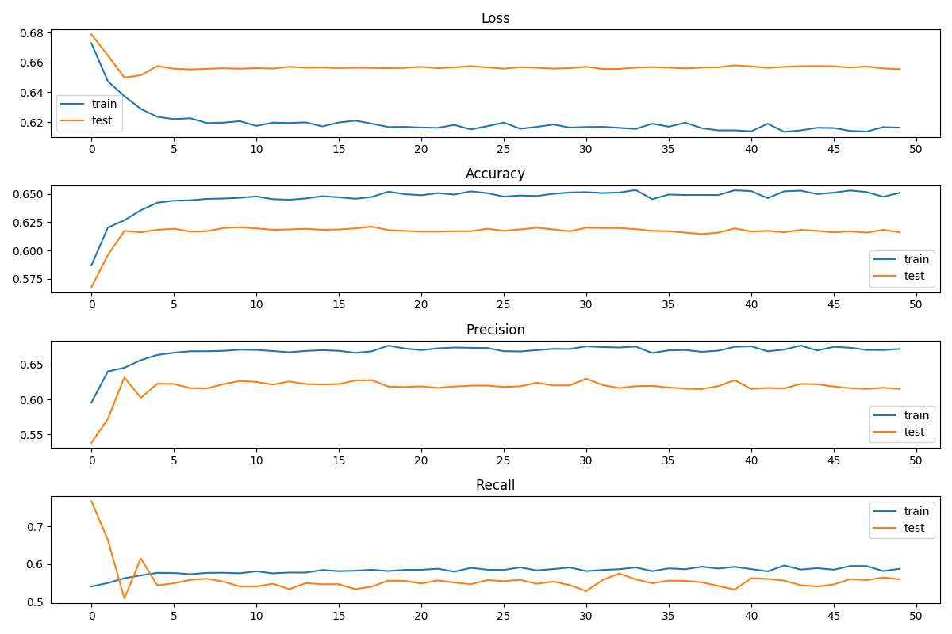
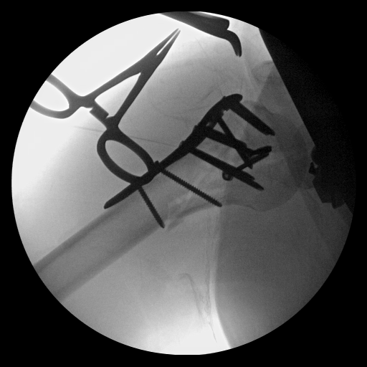
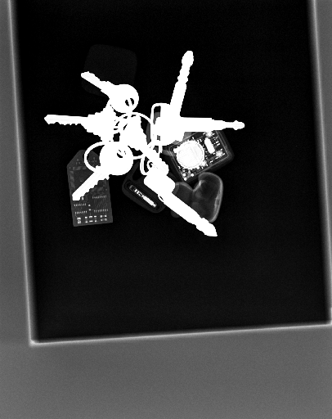
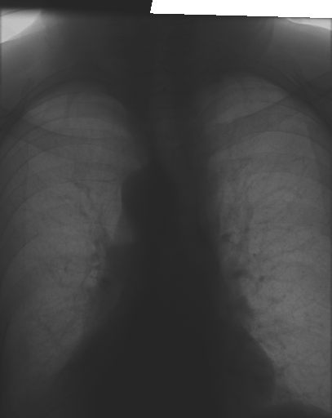
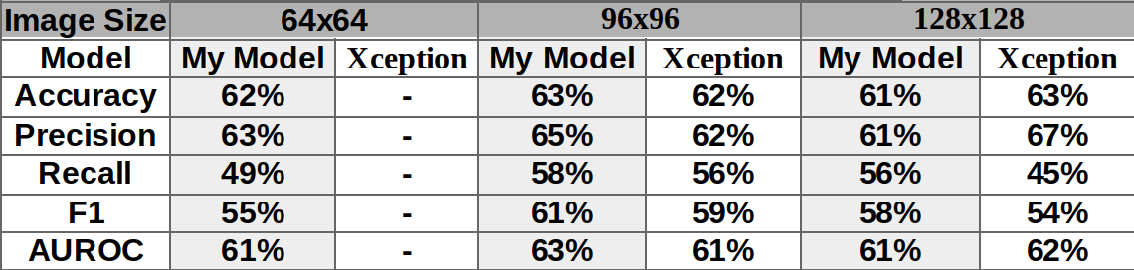
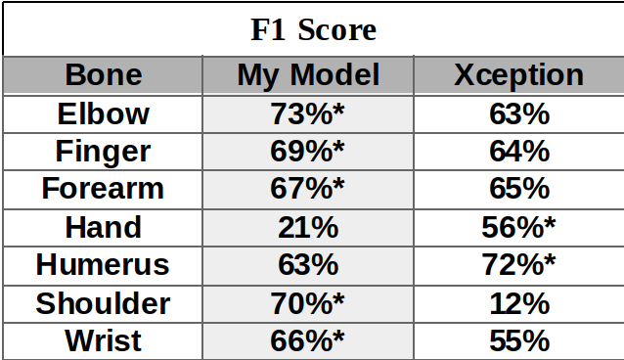
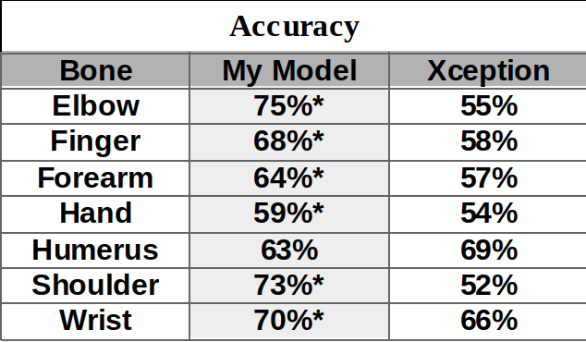
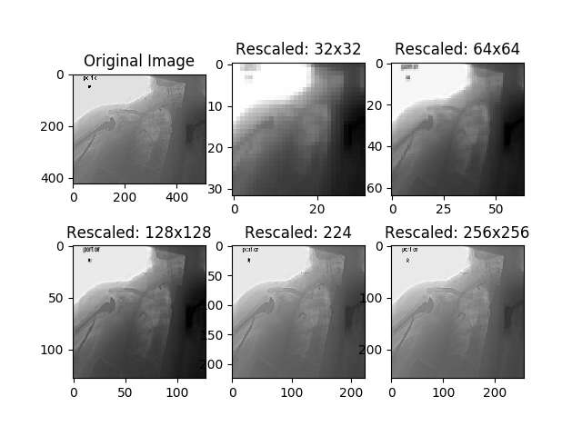
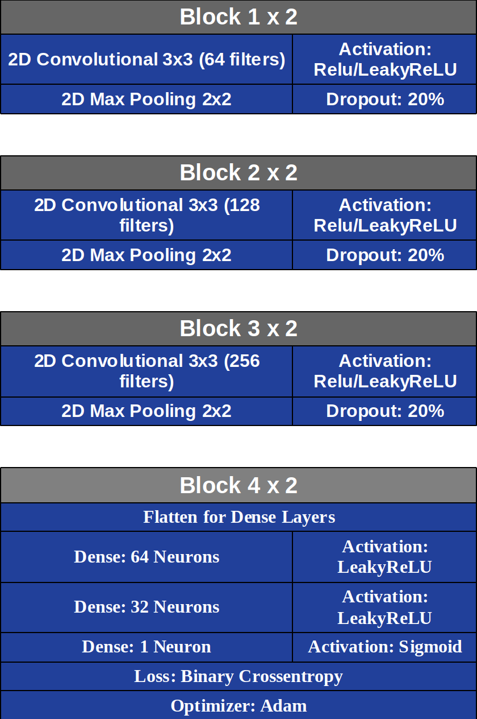
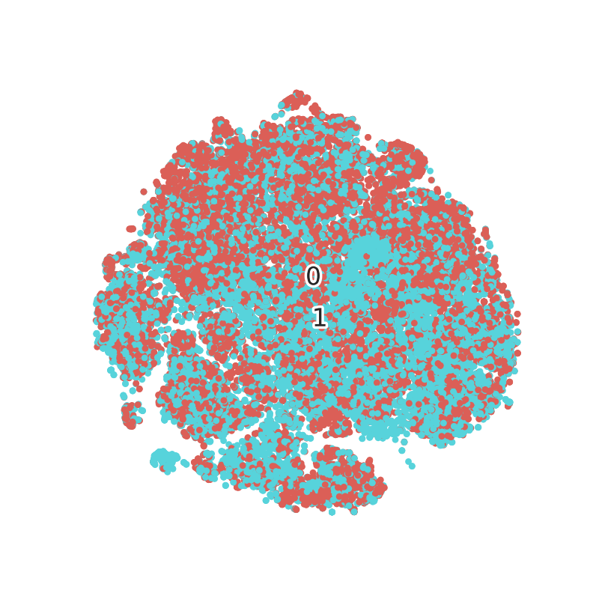
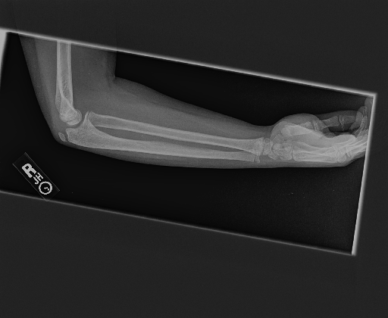
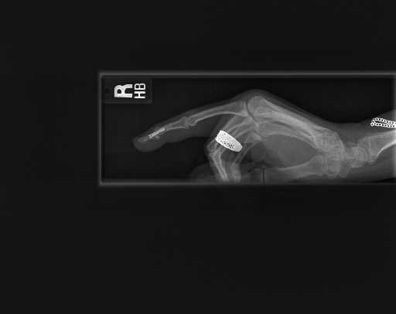
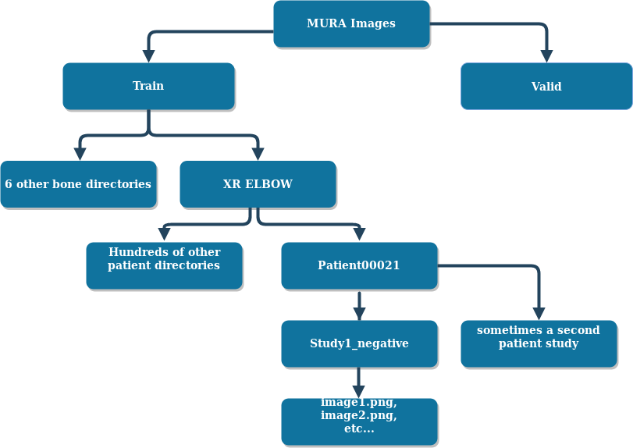
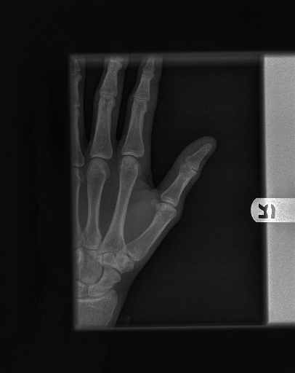
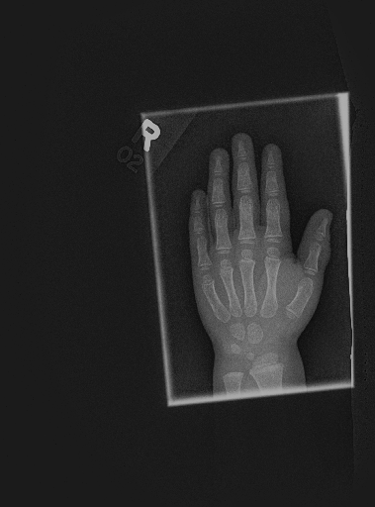
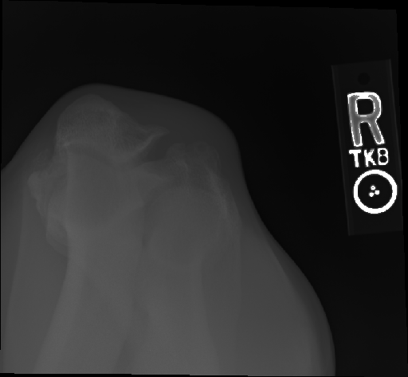
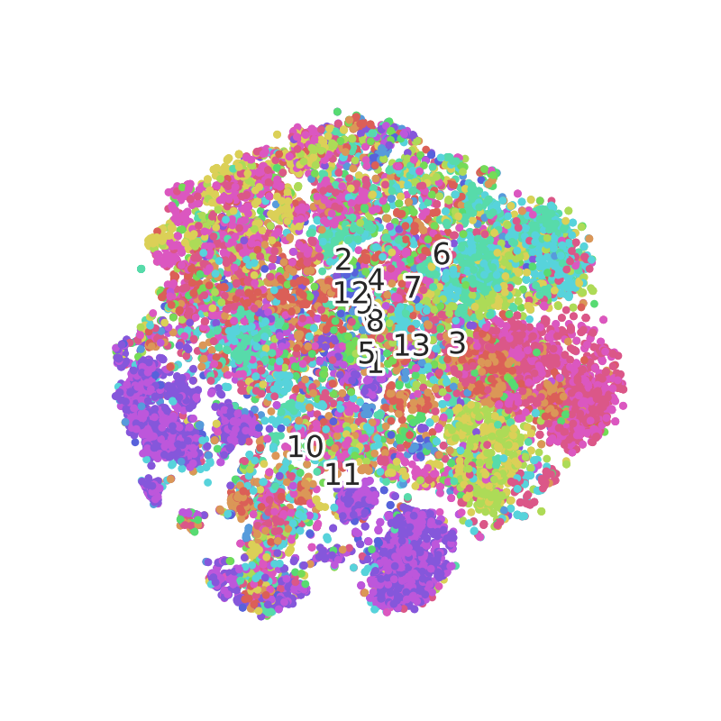
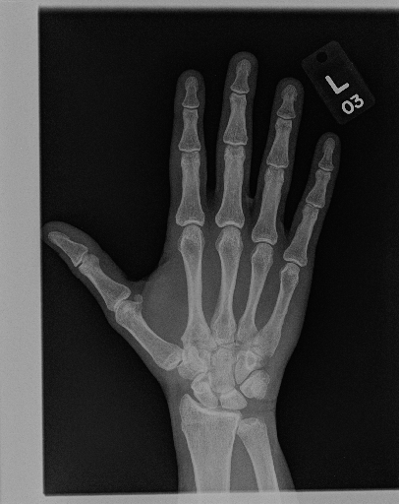
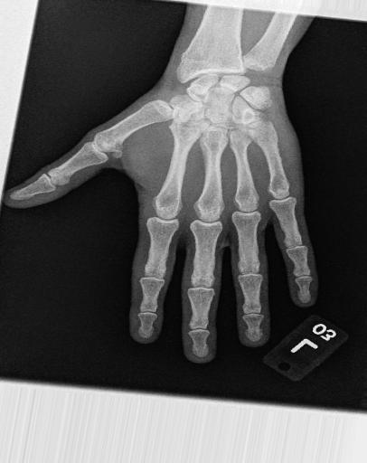
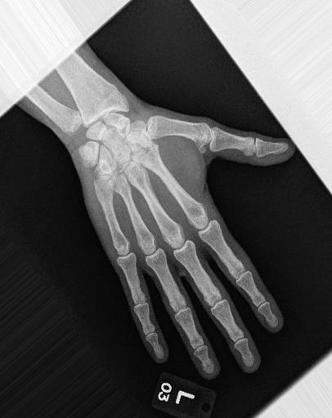
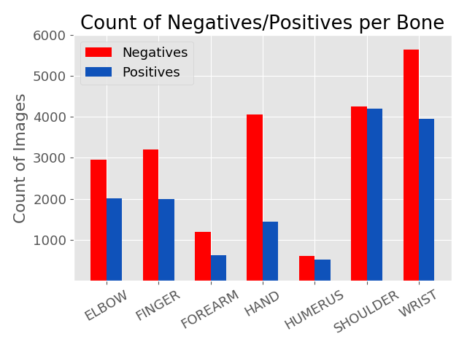




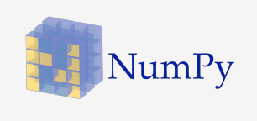

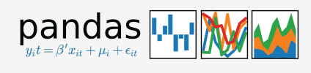
X-Ray Classifier
Alex Cross
/github.com/alcr0996
in
/in/alcr0996
alexfourdata@gmail.com
Background
Difficult data:
Results
This dataset was obtained from the Stanford ML group, which worked with a group of board certified radiologists to prepare and label the data.
Creating a ML model that could assist in the identification of x-ray studies would be a major contribution to the healthcare industry.
My Model
Xception
Objectives
Misclassified data:
  Test models to make a diagnosis of normal vs abnormal on X-Rays of the arm
            Simple C – basic CNN
            CP – convolution-pool
            CCP - convolution-convolution-pool
  Test best performing model on each set of X-Rays (finger, hand, wrist, forearm, elbow, humerus, shoulder)
  Compare best model performance vs pre-trained model: Xception
Total dataset after cleaning and balancing: 44k train, 3.2k test
* - indicates better performing model
Data
Image Size/Augmentation
Model Arch.
Unsupervised
Misclassified Results
  40k images: 36.5k training images, 3.2k testing images.
Class: 1 Model: 0.39
Class: 0 Model: 0.99
PCA-TSNE: All Neg. vs Pos.
Negative
Positive
Class: 1 Model: 0.08
Class 0 Model: 0.76
Class: 0 Model: 0.82
PCA-TSNE: All Classes
0 Elb/Neg
1 Elb/Pos
2 Fin/Neg
3 Fin/Pos
4 For/Neg
5 For/Pos
6 Hnd/Neg
7 Hnd/Pos
8 Hum/Neg
9 Hum/Pos
10 Shd/Neg
11 Shd/Pos
12 Wrt/Neg
13 Wrt/Pos
Future Steps
Separate images
Visualize layers of CNN
Class activation map
Prediction per study
Adult/youth study
Transfer Learning
Unsupervised Learning
VGG19
Tech Stack
References
Rajpurkar P, Irvin J, Bagu Al, Ding D, Duan T, Mehta H, Yang B, Zhu K, Laird D, Ball RL, et al. 2017. MURA: Large Dataset for Abnormality Detection in Musculoskeletal Radiographs. 1st Conference on Medical Imaging with Deep Learning.

