Slide 2





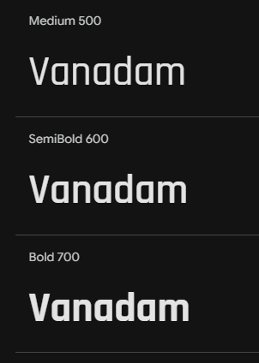
Colour Swatches
#2B2E2E
#96989E
https://fonts.google.com/specimen/Rajdhani?query=Rajdhani&preview.text=Halo%20Infinite

Slide 3
Navigation
Current Season / Counter
Esports News
Article Carousel (featured blog)
Map 1
Map 2
Map 3
Map 4
Map 5
Map 6
Map 7
Map 8
Blog

Slide 4
Navigation
Current Season / Counter
Map
Article Carousel (featured blog)
Map
Map
Map
Map
Map
Map
News
Map
?

Slide 5
LFG
Username (FK)
Rank (FK)
Playlist
Playlist
Group Size
Time posted
Users can see posts not logged in
Users can only post if they have CSR, Xboxname (discord opt)
TABLE ‘lfg’ ??
Users will submit a (form?) with info on (playlist) (group size dropdown) (group info) (time)

Slide 6
Admin Control
Manual add/ edit/ remove records (videos / articles)
(functions exist for videos)
Manage users
Add remove maps
Change info such as HALO_INFINITE_DATA for ranked = true / false

Slide 7
Articles.db
Load in a txt file containing a string that can contain html, the user will also need to be able to add in any images required (?)
ADMIN

Slide 8
