Slide 1

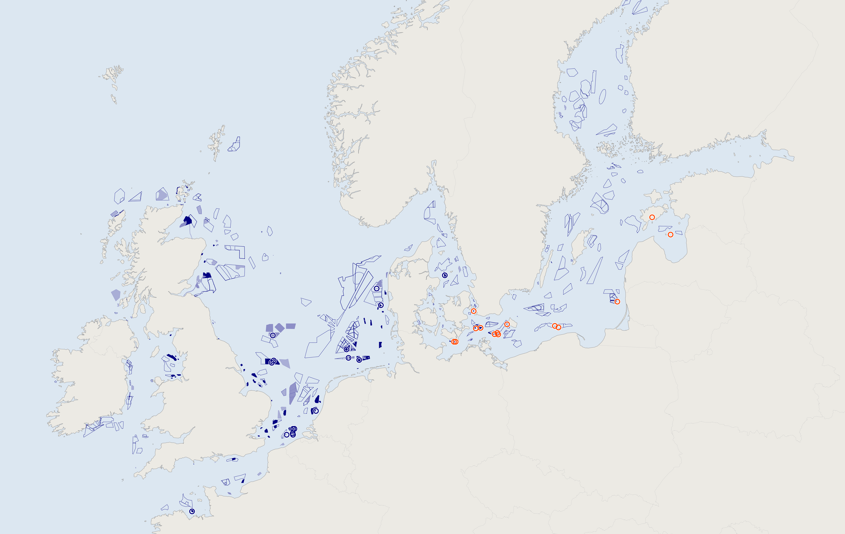
Background › Question and method › Results › Conclusion
Europe's offshore wind sits in a crowded North Sea and an almost empty Baltic
operating
approved or building
planned
one of the 31 study farms
BALTIC SEA
NORTH SEA
Farms in one sea generate in the same hours, so the price falls for all of them. Capture value is the share of the average market price a farm receives.
Source: EMODnet wind-farm dataset, 2026 update. ENTSO-E. Own analysis.
Faisal Bindakhil | MSc Thesis | Offshore wind cannibalisation in the Baltic and North Sea
1 / 8
Notes:
Europe's offshore wind sits in two seas. Every filled shape is an operating wind farm and every dashed outline is a planned one. The mechanism behind my work is simple. Farms in one sea generate in the same hours, so when they produce the price falls for all of them. The share of the average market price a farm receives is its capture value.

Slide 2
Background › Question and method › Results › Conclusion
North Sea farms are being pushed offshore and capture a falling share of the price
New farms sit 45 km offshore on average. Farms from before 2012 sat 13 km out. Farms captured 0.87 of the average price in 2024, down from 0.95 in 2017.
130 farms and 36 GW
operate here today.
Source: EMODnet wind-farm dataset, 2026 update, operating farms with a known commissioning year. ENTSO-E. Own analysis.
Faisal Bindakhil | MSc Thesis | Offshore wind cannibalisation in the Baltic and North Sea
2 / 8
Notes:
The North Sea first. One hundred and thirty operating farms, thirty-six gigawatts. The near-shore sites are taken: farms built since 2019 sit forty-five kilometres from shore on average, against thirteen for farms built before 2012. And the share of the price they capture keeps falling, from 0.95 in 2017 to 0.87 in 2024.

Slide 3
Background › Question and method › Results › Conclusion
The Baltic has the space, the shallow water and a market where cannibalisation has barely begun
18 farms and 6 GW
operate here today.
Another 99 GW is approved or planned. The technical potential is 93 GW, in shallow water with strong winds. Baltic farms capture 0.88 of the average price today, the same share as North Sea farms.
Source: EMODnet wind-farm dataset, 2026 update. BEMIP 2024 for technical potential. ENTSO-E. Own analysis.
Faisal Bindakhil | MSc Thesis | Offshore wind cannibalisation in the Baltic and North Sea
3 / 8
Notes:
Now the Baltic. Eighteen operating farms, six gigawatts, a sixth of the North Sea, but ninety-nine gigawatts approved or planned and ninety-three gigawatts of technical potential in shallow water with strong winds. Today its farms capture the same share of the market price as North Sea farms, at a tenth of the buildout.

Slide 4
Background › Question and method › Results › Conclusion
The question needs a record of the past and a model of a grid that does not yet exist
Will the Baltic lose value the way the North Sea did once its planned fleet is built, and how much of that loss can be avoided by building the surrounding system differently?
ENTSO-E hourly prices, 31 farms, 2017 to 2024
ERA5 hourly weather
Plants, grid, demand and 2040 scenarios
Statistical model
for today
Both reproduce 2023 within 0.5 percentage points.
Power-system model, PyPSA-Eur
for 2040 under two grids
Capture value, both seas, today and 2040
Source: ENTSO-E Transparency Platform. ERA5 reanalysis. PyPSA-Eur. ENTSO-E TYNDP 2030 and 2040 scenarios.
Faisal Bindakhil | MSc Thesis | Offshore wind cannibalisation in the Baltic and North Sea
4 / 8
Notes:
The question splits in two: how do the two seas compare today and once the fleet is built, and what causes the loss and how much can be avoided. The first needs the observed record, the second needs a market I can rebuild under a grid that does not yet exist. So there are two models. Both take ERA5 weather. The statistical model learns from eight years of ENTSO-E prices at 31 farms and is the right tool for today. The power-system model, PyPSA-Eur, rebuilds the market from plants, grid and demand under the official scenarios and is the right tool for 2040, because I can run it under two grids. Both reproduce 2023 within half a percentage point, and both produce the same output, capture value.

Slide 5
Background › Question and method › Results › Conclusion
The Baltic loses almost half its value by 2040 under today's grid and recovers it when the grid is expanded
North Sea
Baltic
0.88
0.88
today's share, 0.88
−35%
−47%
0.64
0.66
0.57
0.47
+0.19
Today, observed
2040, today's grid
2040, grid expanded
About half of the Baltic loss under today's grid comes from congestion in the grid. With the grid expanded the Baltic share recovers to 0.66, level with the North Sea.
Source: PyPSA-Eur under ENTSO-E TYNDP scenarios. Observed 2023 to 2024 from ENTSO-E. Own analysis.
Faisal Bindakhil | MSc Thesis | Offshore wind cannibalisation in the Baltic and North Sea
5 / 8
Notes:
First result. Today both seas capture 0.88 of the average price. By 2040 with the planned fleet and today's grid the North Sea falls to 0.57 and the Baltic to 0.47, almost half its value. About half of the Baltic loss is congestion in the grid. Expand the grid and the Baltic recovers to 0.66, level with the North Sea.

Slide 6
Background › Question and method › Results › Conclusion
Dividing LCOE by capture value gives the market price a farm needs to break even
LCOE
÷
capture value
=
value-adjusted LCOE
what it costs to produce one MWh
the share of the market price a farm receives
the market price a farm needs to break even
By 2040 the median site costs 66 EUR/MWh to build, less than in 2025. Its break-even price rises to 121 EUR/MWh, because capture value falls faster than cost.
Source: PyPSA-Eur 2040, grid frozen at today's network. Medians across the seabed studied.
Faisal Bindakhil | MSc Thesis | Offshore wind cannibalisation in the Baltic and North Sea
6 / 8
Notes:
Before the maps, one idea. LCOE is what it costs to produce a megawatt hour. Capture value is the share of the market price you receive for it. Divide one by the other and you get the price a farm must earn on average to break even, the value-adjusted LCOE. By 2040 the median site is cheaper to build, 66 euros, down from 74, yet its break-even price rises to 121, up from 87, because capture value falls faster than cost.

Slide 7
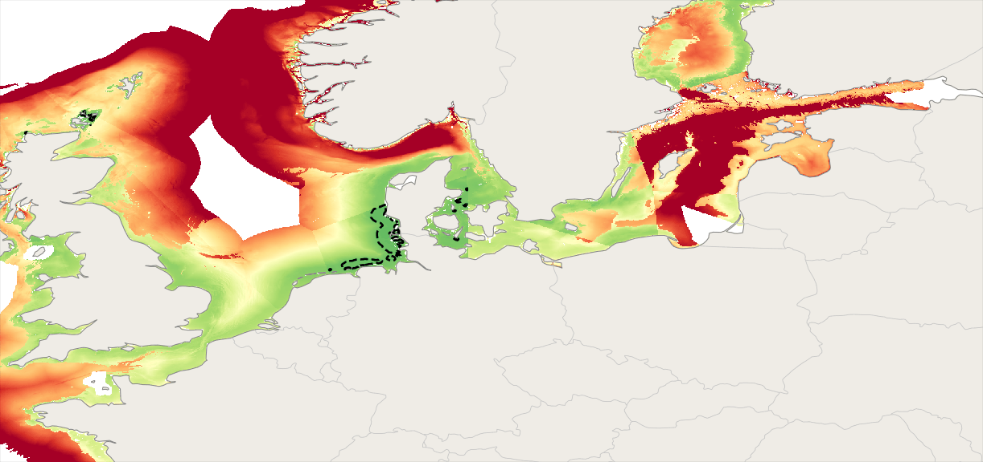
Background › Question and method › Results › Conclusion
Under today's grid most of the seabed studied cannot pay back by 2040
In 2040 the median site needs 121 EUR/MWh to break even under today's grid. Less than 1 per cent of the seabed clears 70 EUR/MWh.
60
80
100
120
140
160
value-adjusted LCOE, EUR per MWh
Source: PyPSA-Eur 2040, grid frozen at today's network. LCOE from the model's cost assumptions. Own analysis.
Faisal Bindakhil | MSc Thesis | Offshore wind cannibalisation in the Baltic and North Sea
7 / 8
Notes:
This is the break-even price across the sea in 2040 with today's grid. In 2040 the median site needs 121 euros per megawatt hour to break even, and less than one per cent of the seabed clears seventy. The central Baltic is the most exposed part of the region.

Slide 8
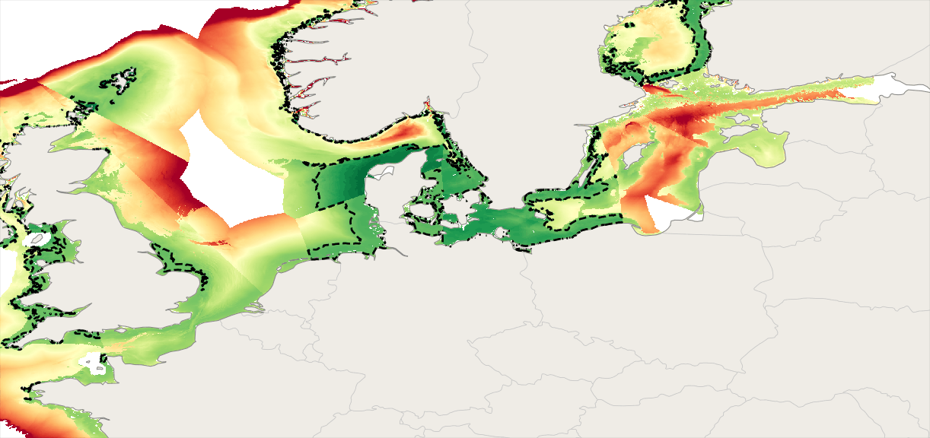
Background › Question and method › Results › Conclusion
Expanding the grid lets most of the Baltic seabed pay back by 2040
With the grid expanded the Baltic break-even price falls by 33 EUR/MWh and Polish and Danish waters drop below 70.
60
80
100
120
140
160
value-adjusted LCOE, EUR per MWh
The extra Baltic loss is congestion, and transmission removes it. Next, Markos takes this price risk into the contracting decision. Ask me about who pays under CfDs, congestion rent and the DK2 dispatch puzzle.
Source: PyPSA-Eur 2040, transmission expanded at least cost. Own analysis.
Faisal Bindakhil | MSc Thesis | Offshore wind cannibalisation in the Baltic and North Sea
8 / 8
Notes:
Now expand the transmission. Same wind, same farms, same year. The Baltic break-even price falls by 33 euros per megawatt hour, and Polish and Danish waters drop below seventy. The extra loss the Baltic suffers comes from congestion in the grid, and transmission removes it. Cannibalisation is a design outcome.
Handover: my work tells you what price the market will pay a developer and how uncertain that price is. Markos takes that price risk into the contracting decision: how much of a farm's output to sell forward under a PPA and how much to leave to the market.
Ask me about: who pays for the lost value under CfDs (the grid moves the exposure onto investors, from 18.5 to 33 per cent of hours); whether congestion rent of 4 to 12 billion euros a year can fund a 2.7 billion a year grid; why the dispatch model overshoots in DK2 while the regression does not.

