Slide 1
The Market Value of Offshore Wind:
The North Sea and the Baltic to 2040
Faisal Bindakhil · MSc Thesis · Supervisor presentation
Keep work focused
Notes:
• Thesis: market value of offshore wind, open North Sea vs enclosed Baltic, out to 2040
• Order: three research questions, then method from first principles, then results
• About 20 minutes; please interrupt at any point

Slide 2
Research questions
• RQ1. How does Baltic offshore value compare with the North Sea today, and how does it evolve under the buildout to 2030 and 2040?
• RQ2. Which market mechanisms set how fast value erodes, and do they differ between an enclosed and an open basin?
• RQ3. Can a model trained on history project these futures, or is a system model needed, and how should the two combine?
Notes:
• RQ1: how does Baltic value compare with the North Sea today, and under the 2030/2040 buildout
• RQ2: which mechanisms set the erosion, and do they differ enclosed vs open
• RQ3: can a history-trained model project the future, or is a system model needed
• All on open data; both predecessor theses relied on confidential Aurora data

Slide 3
The puzzle: theory expects the Baltic to be favourable
• A wind farm earns the price in the hours it generates, not the average
• When wind blows, all farms flood the market together and depress that price
• Capture value = the fraction of the average price a farm actually earns
• Theory (hydro premium, low buildout) says the Baltic should hold value better
Notes:
• A farm earns the price in its windy hours, not the average
• Correlated wind means all farms flood the market together and push that price down (cannibalisation)
• Capture value = fraction of the average price actually earned; below 1 = self-depressing
• Textbook (Hirth) expects the Baltic to hold value better (Nordic hydro, little built); we test it

Slide 4
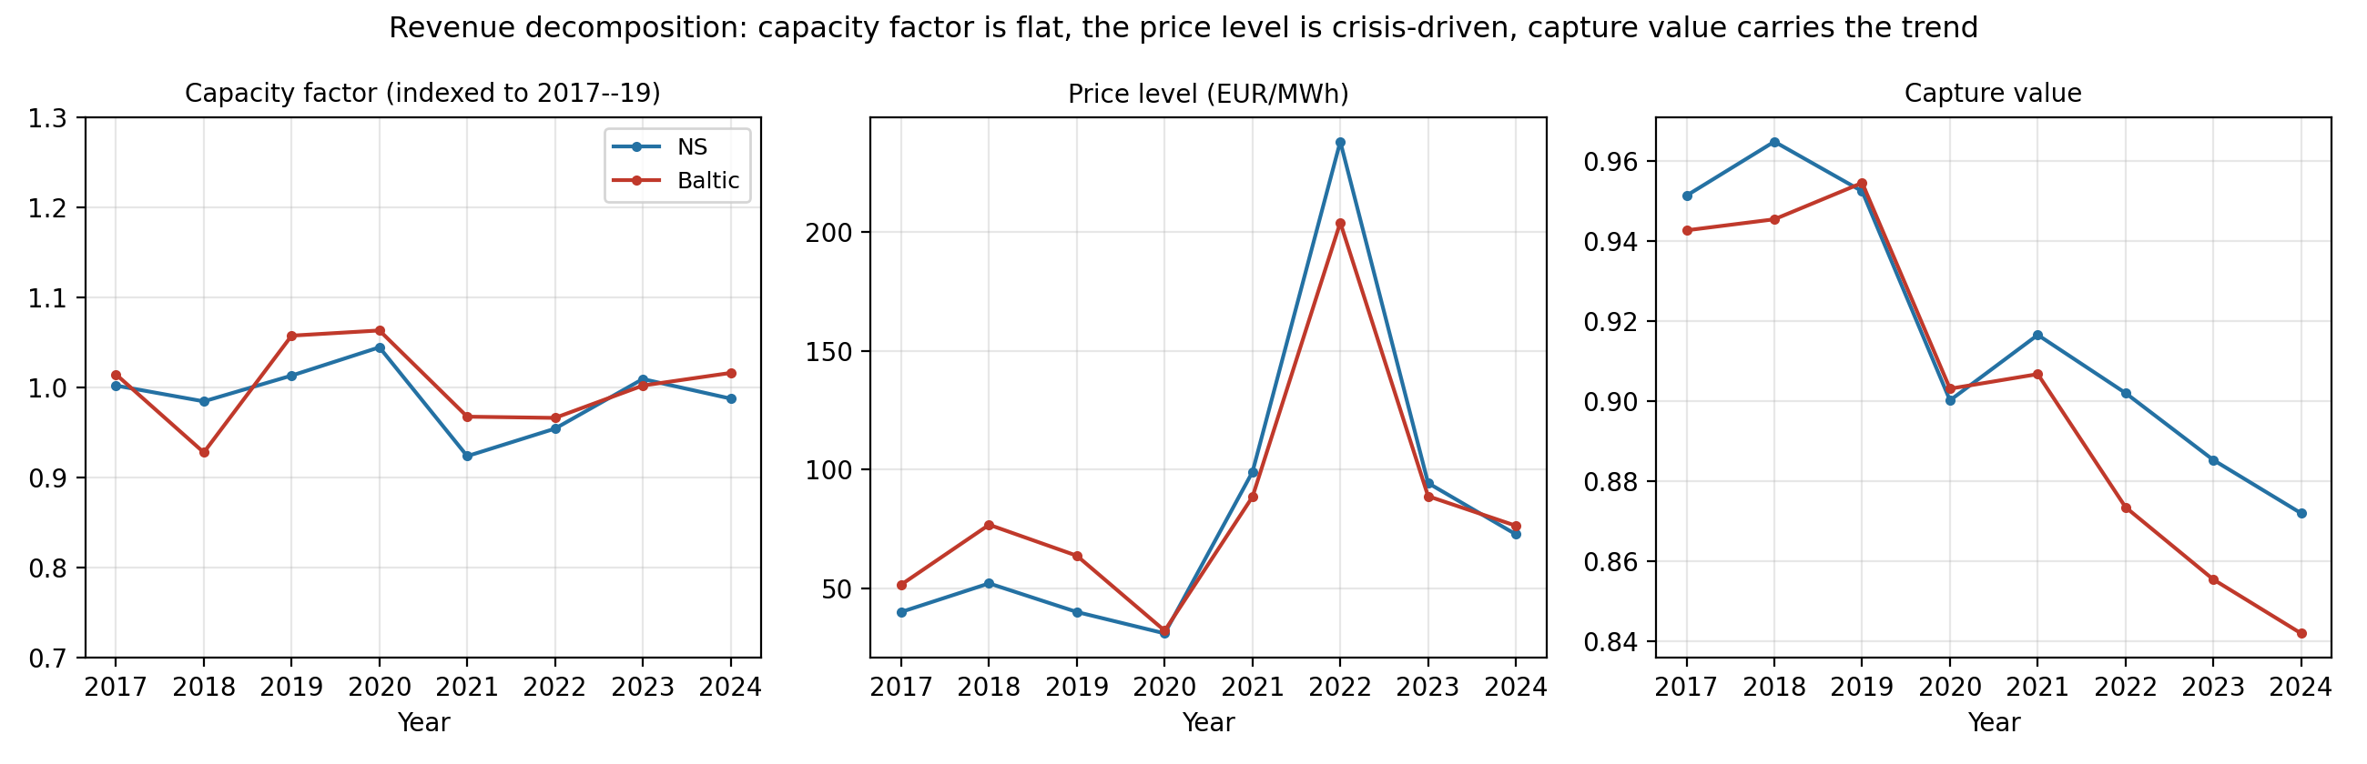
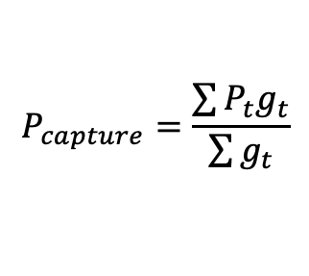

Capture value is the number that matters
• Lets decompose, Revenue per MW = capacity factor × price level × capture value
• Capacity factor flat over time; price level shared; only capture value diverges
$$P_{capture}=\frac{\sum{P_{t}g_{t}}}{\sum{g_{t}}}$$
Capture Value = $\frac{P_{capture}}{P_{average}}$
Notes:
• Revenue/MW = capacity factor x price level x capture value
• CF is flat, price level is shared (gas spike); only capture value diverges, Baltic further
• So the whole revenue story lives in capture value: our common currency across both models
• Measured monthly for 31 study farms (16 North Sea, 15 Baltic)

Slide 5
Scope: three groups of bidding zones
• Unit = the bidding zone (the area where one price is set)
• North Sea (open): DE, NL, BE, Danish DK1, FR
• Baltic under-built: Poland, Estonia, Latvia, Lithuania
• Baltic built-out (the preview): Danish DK2, Swedish SE4
• Excluded: Finland (nuclear collapse), GB (Brexit), Norway (hydro)
Notes:
• Unit of analysis = the bidding zone (one price per area per hour)
• North Sea (open): DE, NL, BE, DK1, FR
• Baltic under-built: PL, EE, LV, LT; built-out preview: DK2, SE4
• Excluded: Finland (nuclear), GB (Brexit), Norway (hydro)
• Space-for-time: the built-out zones are the future of the under-built ones

Slide 6
The design: two instruments, one validation
• Regression: measures the past, where data is dense
• PyPSA system model: projects the future, where there is no data
• The validation triangle: checks both agree where reality can be observed
• A deliberate division of labour (this is RQ3)
Notes:
• Need to MEASURE the past (data-rich) and PROJECT the future (no data); no single method does both
• Regression measures the past and explains the mechanism
• PyPSA carries the future; the validation triangle checks they agree where reality is observable
• Deliberate division of labour; the regression provably cannot extrapolate

Slide 7
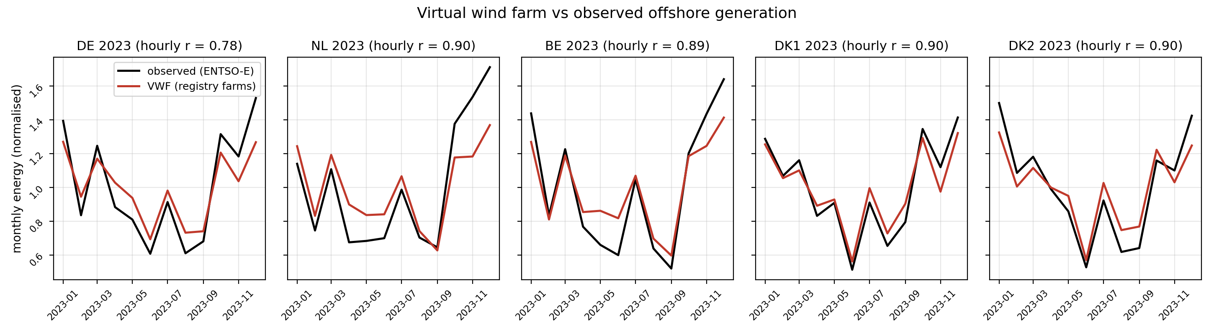
The data: a virtual wind farm from weather
• ERA5 wind → hub height → power curve → hourly output, for every zone
• Validated against metered generation: r = 0.88 hourly, 0.95 monthly
Notes:
• Need a consistent hourly profile for every zone, including zones with no farm yet, from open data
• Built from weather: ERA5 wind, lifted to 150 m hub height, through a 15 MW turbine power curve
• Validated vs metered output: r = 0.88 hourly, 0.95 monthly
• Neither predecessor validated this; it lets us price farms in zones with prices but no turbines

Slide 8
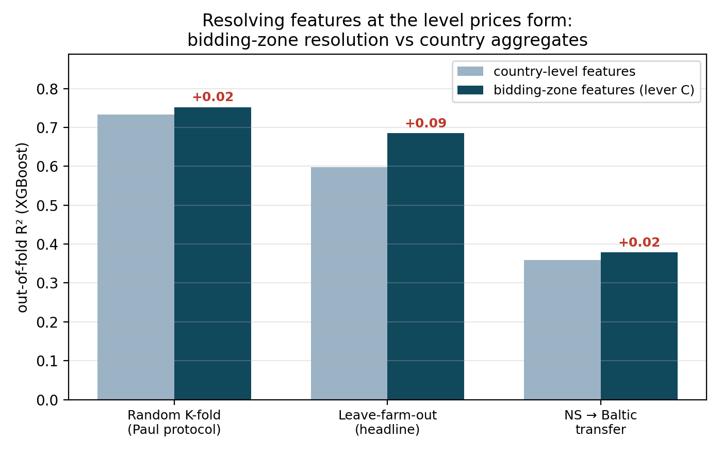
Instrument 1: the regression, trained and tested blind
• Input: the 7 market features for one farm-month → output: that farm-month's capture value
• Scored leave-farm-out: every prediction is for a farm the model never trained on (R² 0.69; every enclosed Baltic zone predicted blind)
Notes:
• Unit = one farm-month; 7 features in, that month's capture value out
• Scored leave-farm-out (blind): R2 = 0.69
• Capture value is a property of prices, so I price the validated farm in all 7 enclosed Baltic zones
• Predicts the enclosed Baltic zones blind within 0.07 (general, not memorising one zone)
• A North-Sea-only model still transfers to the Baltic (R2 ~0.38): general, not memorising

Slide 9
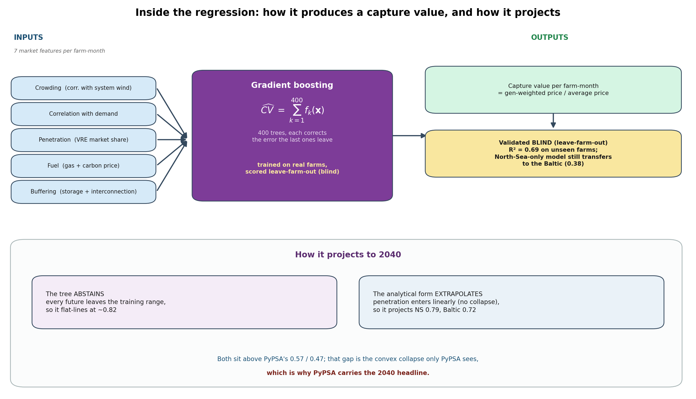
Inside the regression: inputs, the model, and how it projects
Notes:
• The empirical instrument opened up (the mirror of the PyPSA box)
• Inputs: 7 market features per farm-month (crowding, demand, penetration, fuel, buffering) from the VWF + ENTSO-E
• Model: gradient boosting, 400 shallow trees summed; trained operational, scored leave-farm-out (R2 0.69)
• How it projects: the tree ABSTAINS (flat ~0.82); the analytical form extrapolates gently (0.79, 0.72) but linearly
• That sits above PyPSA's 0.57/0.47 (the convex collapse it cannot see), so PyPSA carries 2040
it is like predicting a house's price (CV) from its size, location, and age (the 7 features). You train on past (attributes, price) pairs; at prediction you supply only the attributes and the model returns a price. The price is the target, never an input

Slide 10
Instrument 2: PyPSA, the power-system model
• Open model: grid, generators, storage, demand, solved hourly
• 14 countries, ~30 nodes, frozen 2020 grid, year-correct fleets
• Wholesale price = the hourly shadow price at each node
• Future built from official TYNDP 2030/2040 scenarios
Notes:
• Open model: grid, generators, storage, demand, solved least-cost every hour
• Wholesale price = hourly shadow price at each node, then capture value by the same formula
• 14 countries, ~30 nodes, grid FROZEN at 2020 (today's grid under tomorrow's fleet, on purpose)
• Future built from official TYNDP 2030/2040 scenarios; the frozen grid is bracketed later

Slide 11
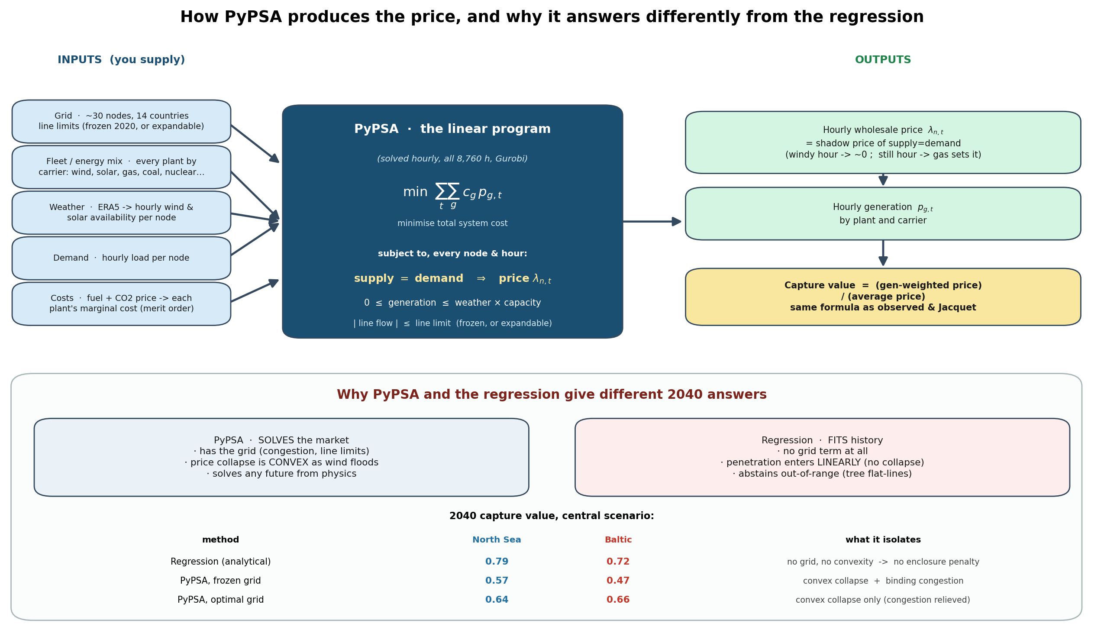
Inside PyPSA: inputs, the dispatch it solves, and the outputs
Notes:
• Inputs: grid nodes, full fleet, ERA5 weather, hourly demand, fuel and carbon prices
• Solves: minimise system cost over 8,760 hours; the supply=demand shadow price is the wholesale price
• Windy hour: wind is marginal, price falls toward zero; still hour: gas sets it
• Supervisor's question: same capture-value formula as the regression, but price from a grid the regression cannot see

Slide 12
Model Assumptions:
  Perfect competition / marginal-cost pricing. Price = marginal unit's cost, no market power, no scarcity bidding. Real prices carry mark-ups and scarcity rents the model omits, so modelled prices are smoother.
  Linear program, NO unit commitment (extendable_carriers empty; no integer variables). No start-up costs, no minimum load, no minimum up/down times, no ramp limits. Consequence: essentially no negative prices. Real negative prices come from must-run inflexible plants and subsidies bidding below zero; an LP floors at ~0. This understates the cannibalisation tail.
  Perfect foresight. The solver sees the entire year's weather and demand at once, so storage, especially Norwegian hydro, is dispatched perfectly (config flatten_dispatch: false, hydro_max_hours from national reservoir totals = ~151 TWh). This over-smooths Nordic prices and is the specific reason your DK2 capture value is too high. Real operators have imperfect, rolling foresight.
  30-cluster spatial aggregation, copper-plate within a cluster (config clusters: [30]). Each cluster is one node with no internal congestion; cross-border lines are finite but use thermal ratings, which exceed real market NTCs. Small, well-connected zones (DK2) get their price pinned to large neighbours, hiding local cannibalisation.
  Inelastic demand. Load is a fixed ENTSO-E time series; there is no demand response. Scarcity is absorbed only by load-shedding at VOLL = 100,000
Notes:
Assumptions 2, 3 and 4 compound in small, hydro-coupled, well-interconnected zones. That is exactly why your DK2 capture value comes out at 0.93-0.97 versus an observed 0.78: perfect-foresight hydro floors the Nordic price, the copper-plate tie to Sweden prevents the local price from collapsing, and the LP cannot produce the negative-price tail.

Slide 13
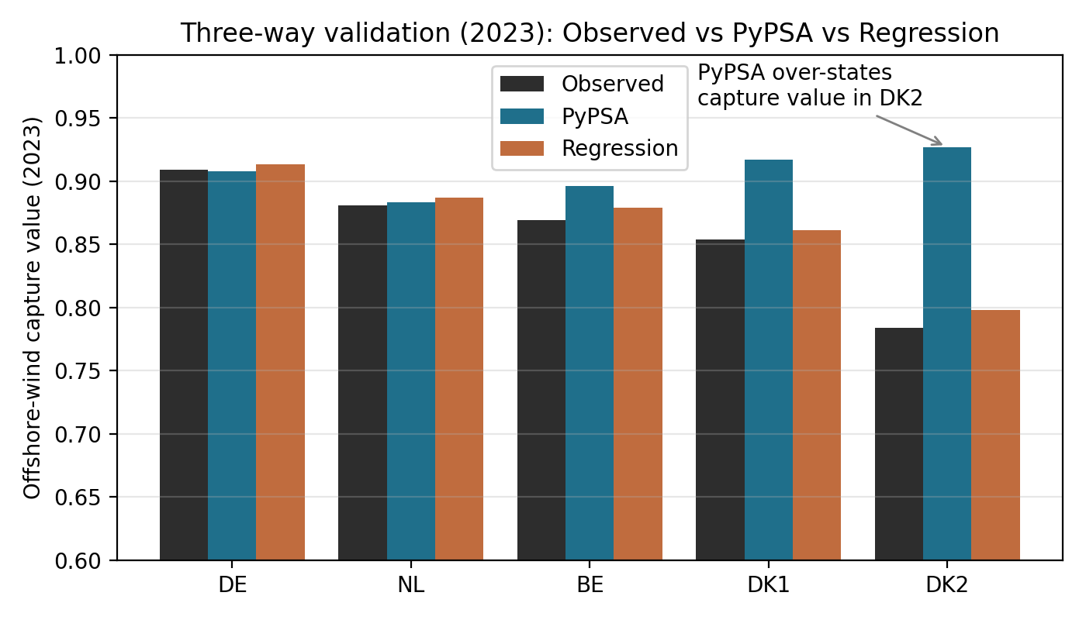
The validation triangle
• Three independent estimates: observed, PyPSA, regression (blind)
• The blind regression lands within 0.014 of observed; PyPSA's congestion bias shows in DK1 and DK2
Try sector coupled
balmoral
Test model more
Find out how model Is performing
Not a data dump
Pypsa perfect foresight
Go heavy on method
How to test to disruption
Notes:
• Three independent estimates per zone: observed, PyPSA, regression (blind)
• Blind regression within 0.014 of observed (2023), 0.025 across 3 years, by a route independent of PyPSA
• PyPSA exact on open zones, carries its congestion bias on DK1 and DK2
• No predecessor confronted a statistical model, a physical model, and observation like this

Slide 14
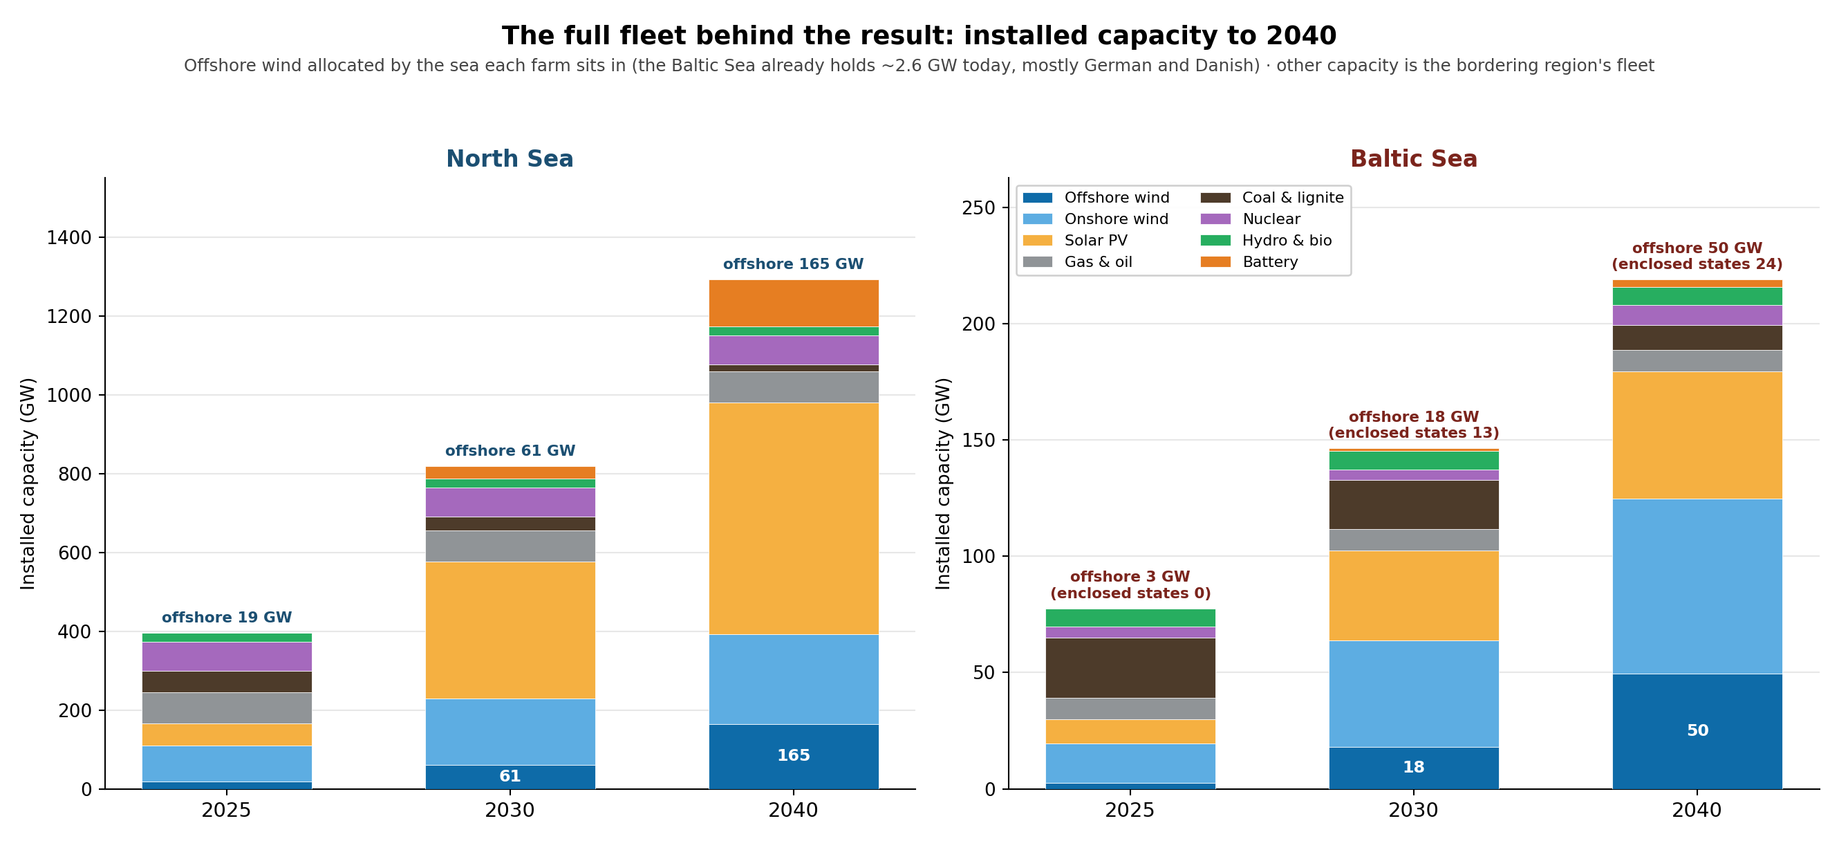
The build-out behind the result: the full energy mix
Notes:
• The buildout behind the result; the natural question is whether it is realistic
• North Sea offshore ~19 to 165 GW; Baltic Sea ~3 to 50 GW (of which the enclosed states 0 to ~25, a quarter of regional demand)
• Full mix: gas and oil persist (~80 and 9 GW) through 2040, nuclear and hydro stay, only DE/PL coal winds down
• The fossil backbone still sets the low-wind price, which is exactly what erodes capture value

Slide 15
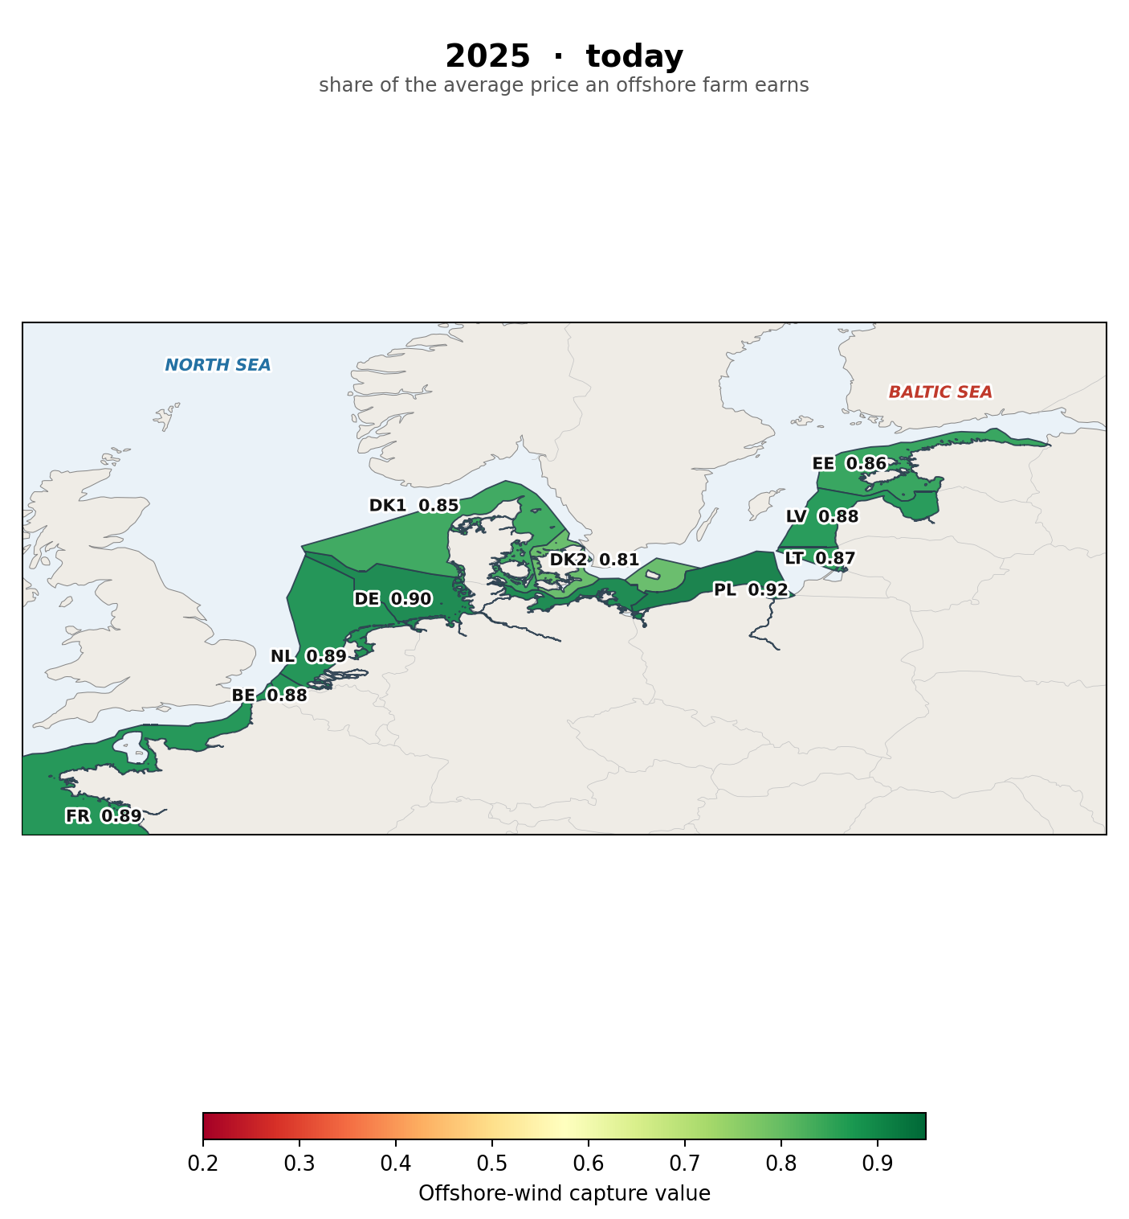
RQ1: the market value of offshore wind today
Notes:
• Direct answer to RQ1, as a map; shading = capture value
• Today the map is all green: under-built Baltic 0.85 to 0.92, level with the North Sea 0.85 to 0.90
• So the Baltic does NOT start behind

Slide 16
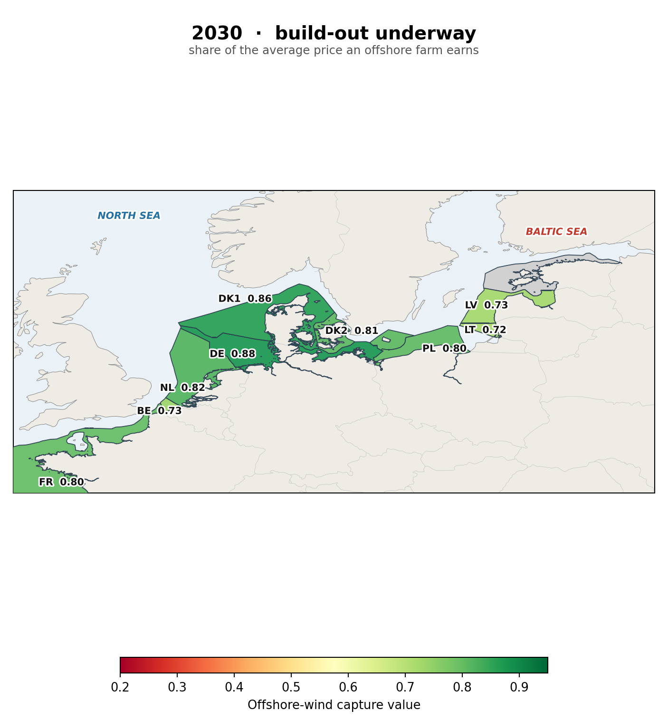
RQ1: by 2030 the Baltic begins to fade
Notes:
• First buildout has landed; North Sea and under-built Baltic still mostly green (high 0.7s to 0.8s)
• Baltic starting to fade as its own correlated wind begins to crowd its price
• Estonia grey: no offshore in the water yet at this horizon

Slide 17
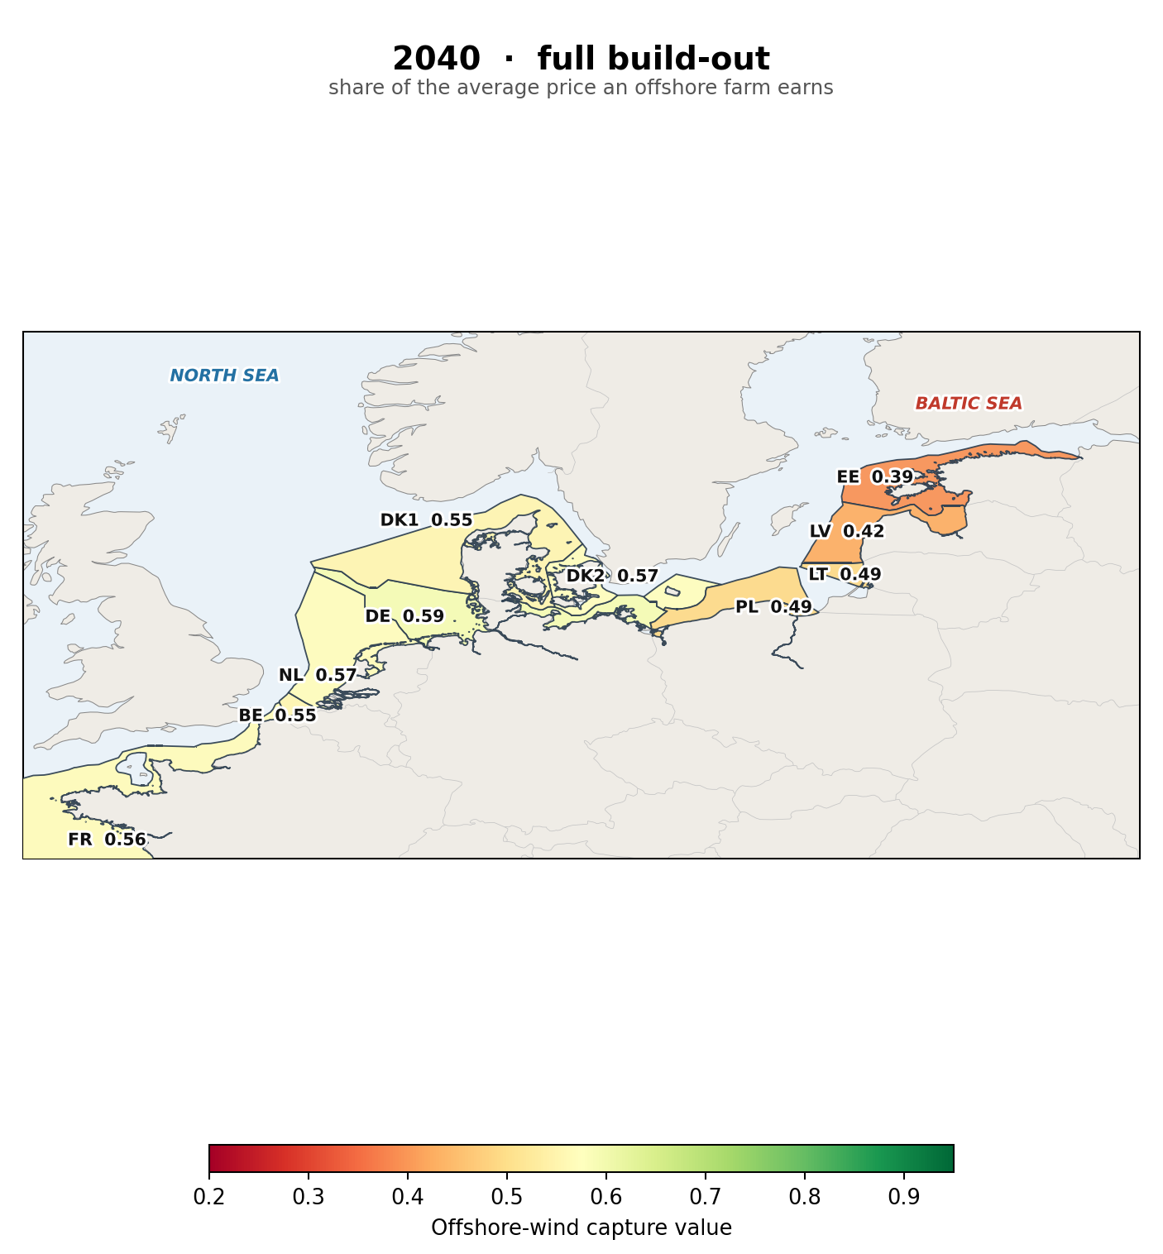
RQ1: by 2040 the Baltic erodes well past the North Sea
See whn issue is trans and when issue si oversupply
Apply policy angle?
• At parity today (~0.89); by 2040 the Baltic falls to about 0.47, the North Sea holds about 0.57
Gb market data
It Is public avail
In the case of transmission
Const cfd winning not in the case of overprod
Notes:
• Map splits: Baltic red-orange (PL 0.49, LV 0.42, EE 0.39); North Sea holds about 0.57
• Parity today (~0.89) to Baltic ~0.47 vs North Sea ~0.57; Baltic loses ~47%, North Sea ~35%
• The buildout, not the starting point, is what does it
• Why it falls faster, and whether the grid changes it, are the next sections

Slide 18
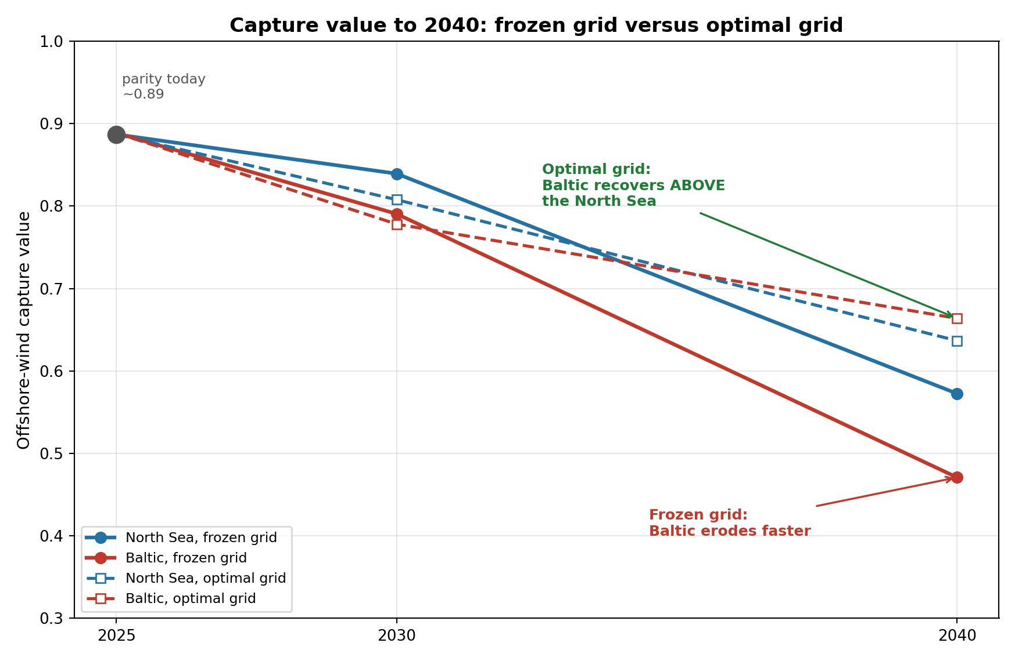
Does the Baltic still erode faster if we build the grid? No, it reverses
• Frozen grid (today's): the Baltic erodes faster, 2040 Baltic 0.47 vs North Sea 0.57
• Cost-optimal grid: the ordering REVERSES, Baltic 0.66, above the North Sea 0.64
• So the Baltic's faster erosion is a grid story: open the export valve and its advantage returns
• Interconnection is the single highest-leverage lever on Baltic value
Notes:
• The reframe: I removed the grid limit, let the model build the cost-optimal transmission and pay for it
• Frozen (solid): Baltic erodes faster, 0.47 vs North Sea 0.57
• Optimal (dashed) CROSSES: Baltic recovers to 0.66, above the North Sea 0.64 (PL 0.49 to 0.74)
• So the faster Baltic erosion is a frozen-grid effect; open the export valve and its advantage returns
• Policy headline: interconnection is the highest-leverage lever
• Honest detail: at 2030 (low penetration) optimal is marginally below frozen; it only helps once congestion binds

Slide 19
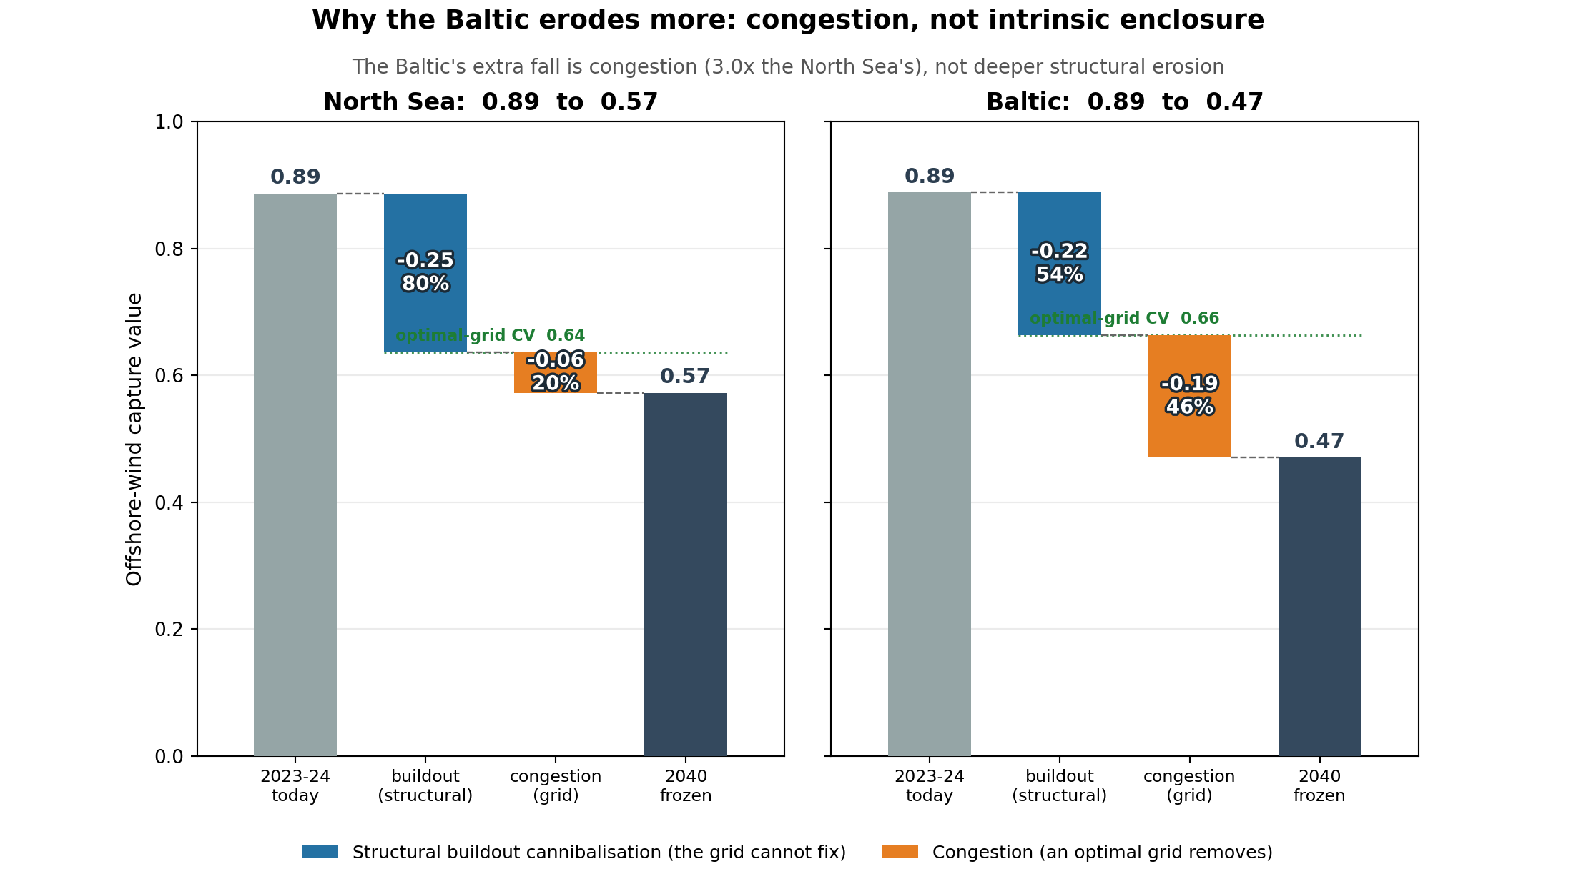
Congestion or enclosure? Decomposing the Baltic's fall
• Each basin's 2040 fall split in two: structural buildout (the grid cannot fix) and congestion (an optimal grid removes)
• Both start at parity ~0.89; on the frozen grid the Baltic falls to 0.47, the North Sea to 0.57
• The Baltic's congestion penalty (0.19) is 3x the North Sea's (0.06); its structural fall is SMALLER (0.22 vs 0.25)
• So the enclosure shows up as congestion the grid removes, not a permanent penalty: build it and the Baltic ends ABOVE the North Sea
Notes:
• Answers his question directly: of the CV fall, how much is congestion (grid-fixable) vs structural enclosure
• Both basins start at parity ~0.89; frozen 2040: Baltic 0.47, North Sea 0.57
• North Sea fall = 80% structural, 20% congestion; Baltic = 54% structural, 46% congestion
• Baltic congestion penalty (0.19) is 3x the North Sea's (0.06); its STRUCTURAL fall is smaller (0.22 vs 0.25)
• So the enclosure is really congestion: build the grid and the Baltic ends ABOVE the North Sea (0.66 vs 0.64)

Slide 20
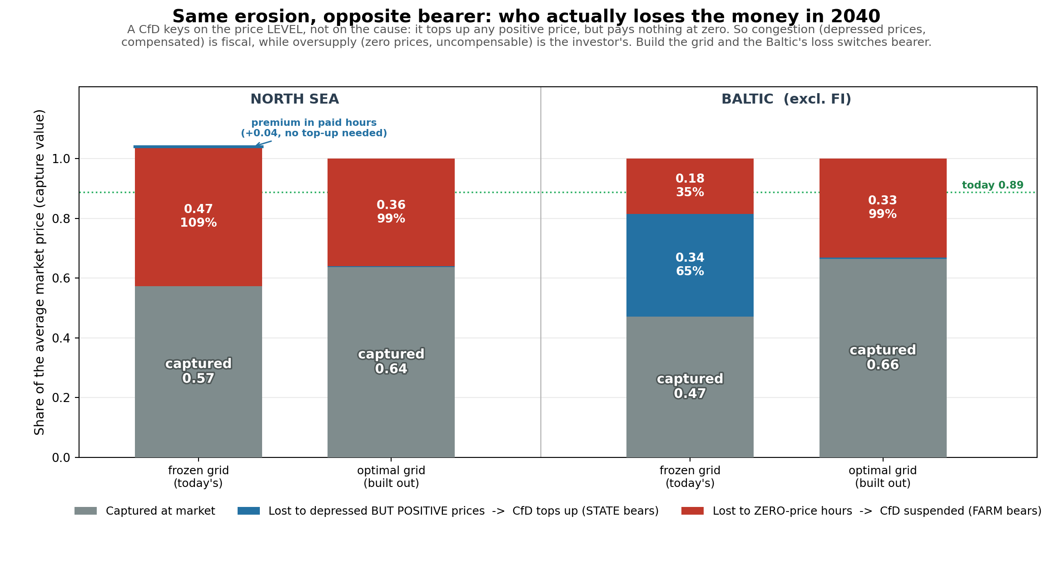
Who bears the loss? Congestion is compensated, oversupply is not
• A CfD tops up any positive price but pays nothing at zero, so the money turns on the price LEVEL, not the cause of the loss
• Frozen grid: 65% of the Baltic's fall is depressed-but-paid (state carries it); the North Sea's is all zero-price (farm does)
• Same-looking erosion, opposite bearer: the Baltic's is fiscal, the North Sea's is investor-borne
• Build the grid and both converge to ~99% farm-borne: it removes the depression but hands the rest to the investor
Notes:
• This answers his CfD question directly: of the capture-value fall, how much can a CfD actually cover
• A CfD keys on the price level, not the cause: it tops up any positive price, and constrained-off volume is compensated (EU 2019/943 Art. 13), but at zero price the payment is SUSPENDED (GB AR4+, EU market reform) and no compliant scheme may cover it
• Capture value factorises exactly: CV = (share of energy still earning a positive price) x (how depressed that price is). Baltic frozen 0.47 = 0.82 x 0.58; North Sea frozen 0.57 = 0.53 x 1.07
• So on the frozen grid the Baltic's loss is 35% farm / 65% state, the North Sea's is ~109% farm (its paid-hour price sits ABOVE the annual mean, so nothing to top up)
• Under the optimal grid the depression factor snaps to ~0.99 in BOTH basins: the grid removes price depression entirely, and what is left is purely the uncompensable zero-price channel
• Policy: interconnection cuts the CfD bill but raises investor risk; ranking projects on capture value alone misranks them for a CfD-backed investor
• Caveat: the LP floors prices at zero, so the farm-borne slice is a conservative floor; Poland's frozen-grid depression is partly scarcity pricing (1.17: PL CV 0.49 full vs 0.74 ex-scarcity)

Slide 21
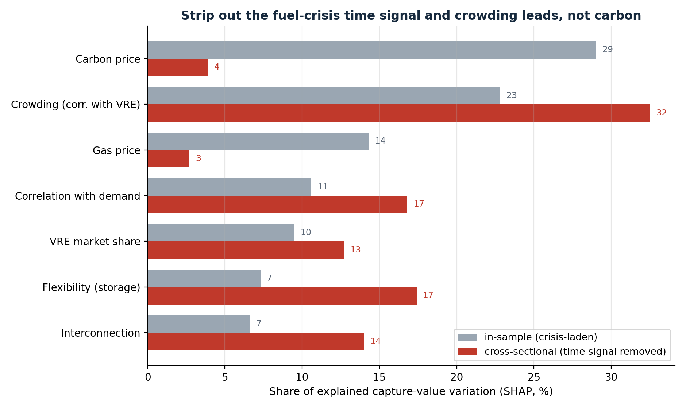
RQ2: what sets the severity, and it is steeper in the Baltic
• Strip out the 2022 fuel-crisis signal and crowding leads (32%); carbon and gas are a time artefact, not a farm-to-farm driver
• Same mechanisms in both basins, but steeper in the enclosed Baltic: the same buildout cannibalises about twice as hard
Notes:
• Cross-sectional question: why does one farm earn less than another in the same month
• Strip the shared 2022 fuel-crisis time signal: carbon collapses from 29% to 4%
• Crowding (correlation with system wind) leads at 32%; buffering (interconnection, flexibility) close behind
• Basins differ: the same buildout cannibalises about twice as steeply in the enclosed Baltic (analytical penalty 0.74 vs 0.37)

Slide 22
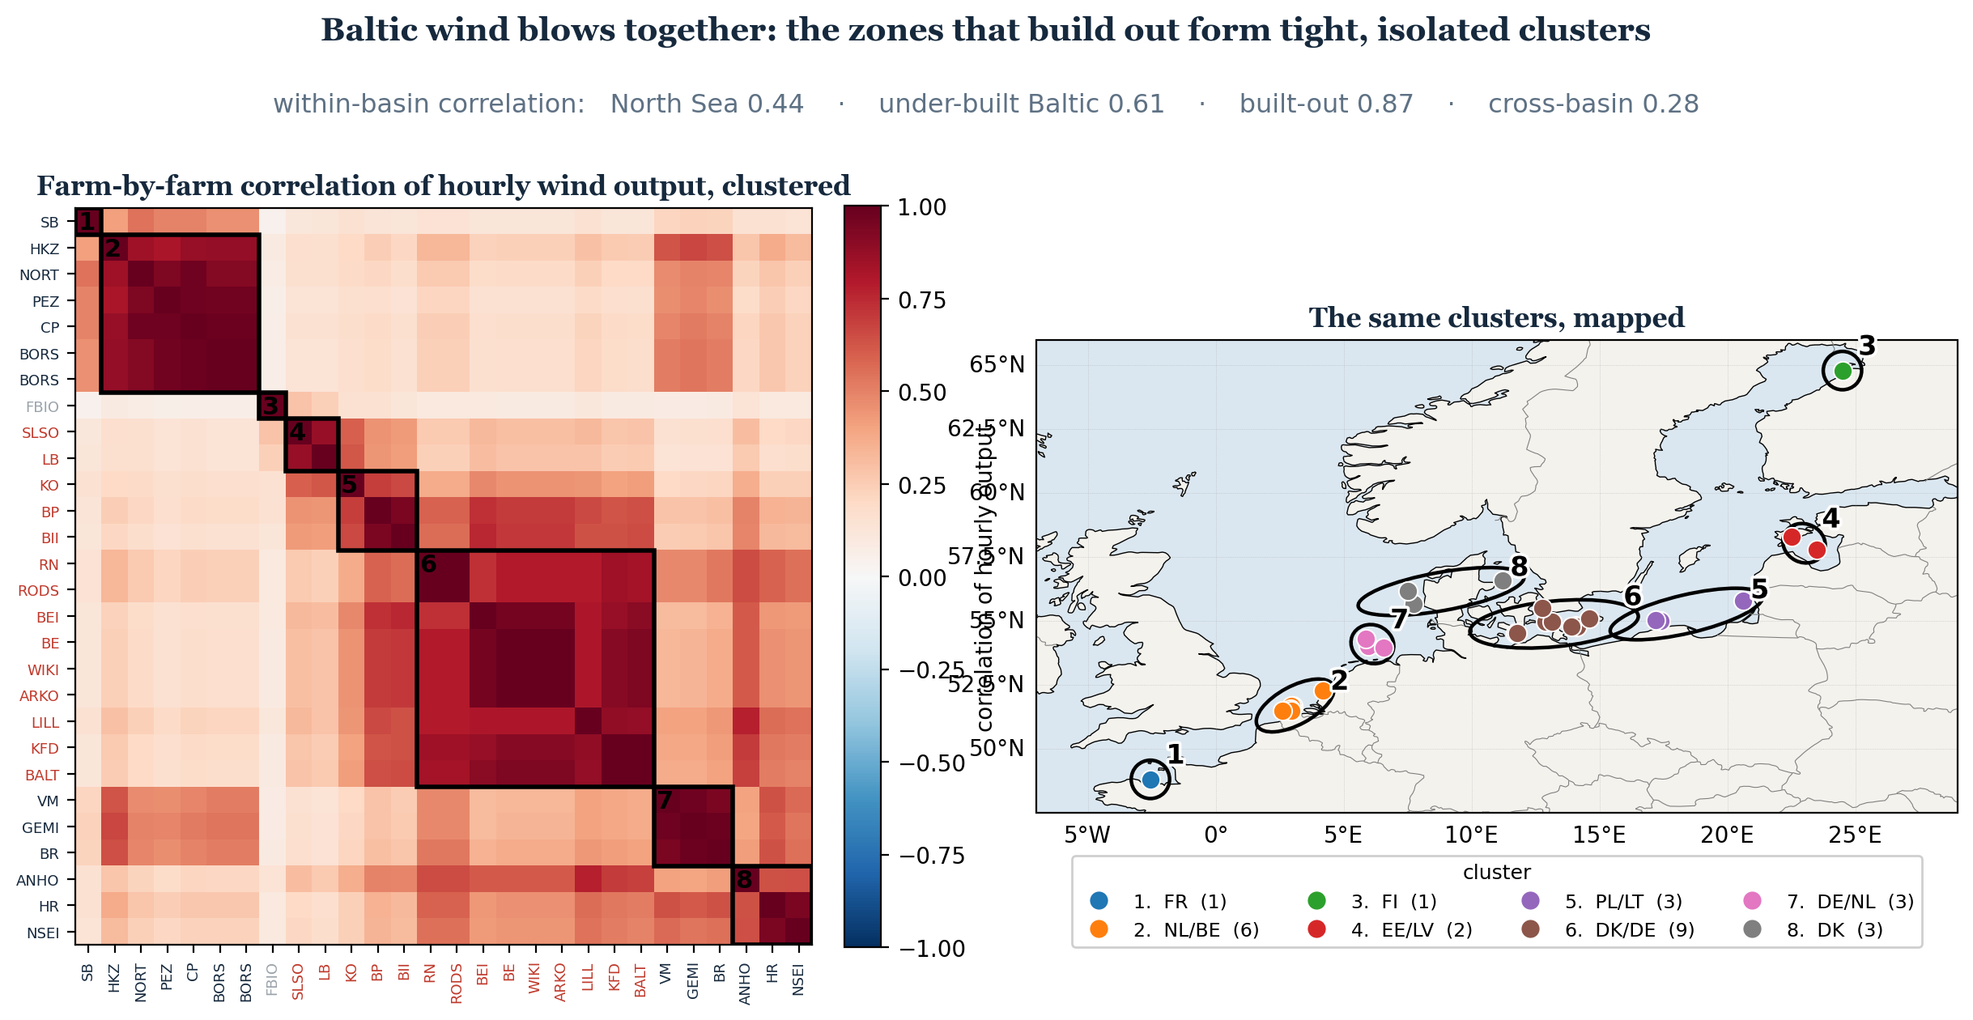
RQ2: the enclosed basin blows together
• Under-built Baltic states correlate at 0.61; the North Sea at 0.44; the two basins decouple (0.28)
• As those zones build out, their correlated wind floods the enclosed market together, the congestion the grid relieves
Notes:
• Geographic root of why the Baltic is steeper (built like Jacquet: cluster the farms, circle them on the map)
• Under-built Baltic correlate at 0.61 vs North Sea 0.44; built-out DK2/SE4 tightest at 0.87
• Those under-built zones are exactly the ones about to build out
• The two basins are decoupled (0.28), so the Baltic cannot lean on the North Sea to absorb its surplus

Slide 23
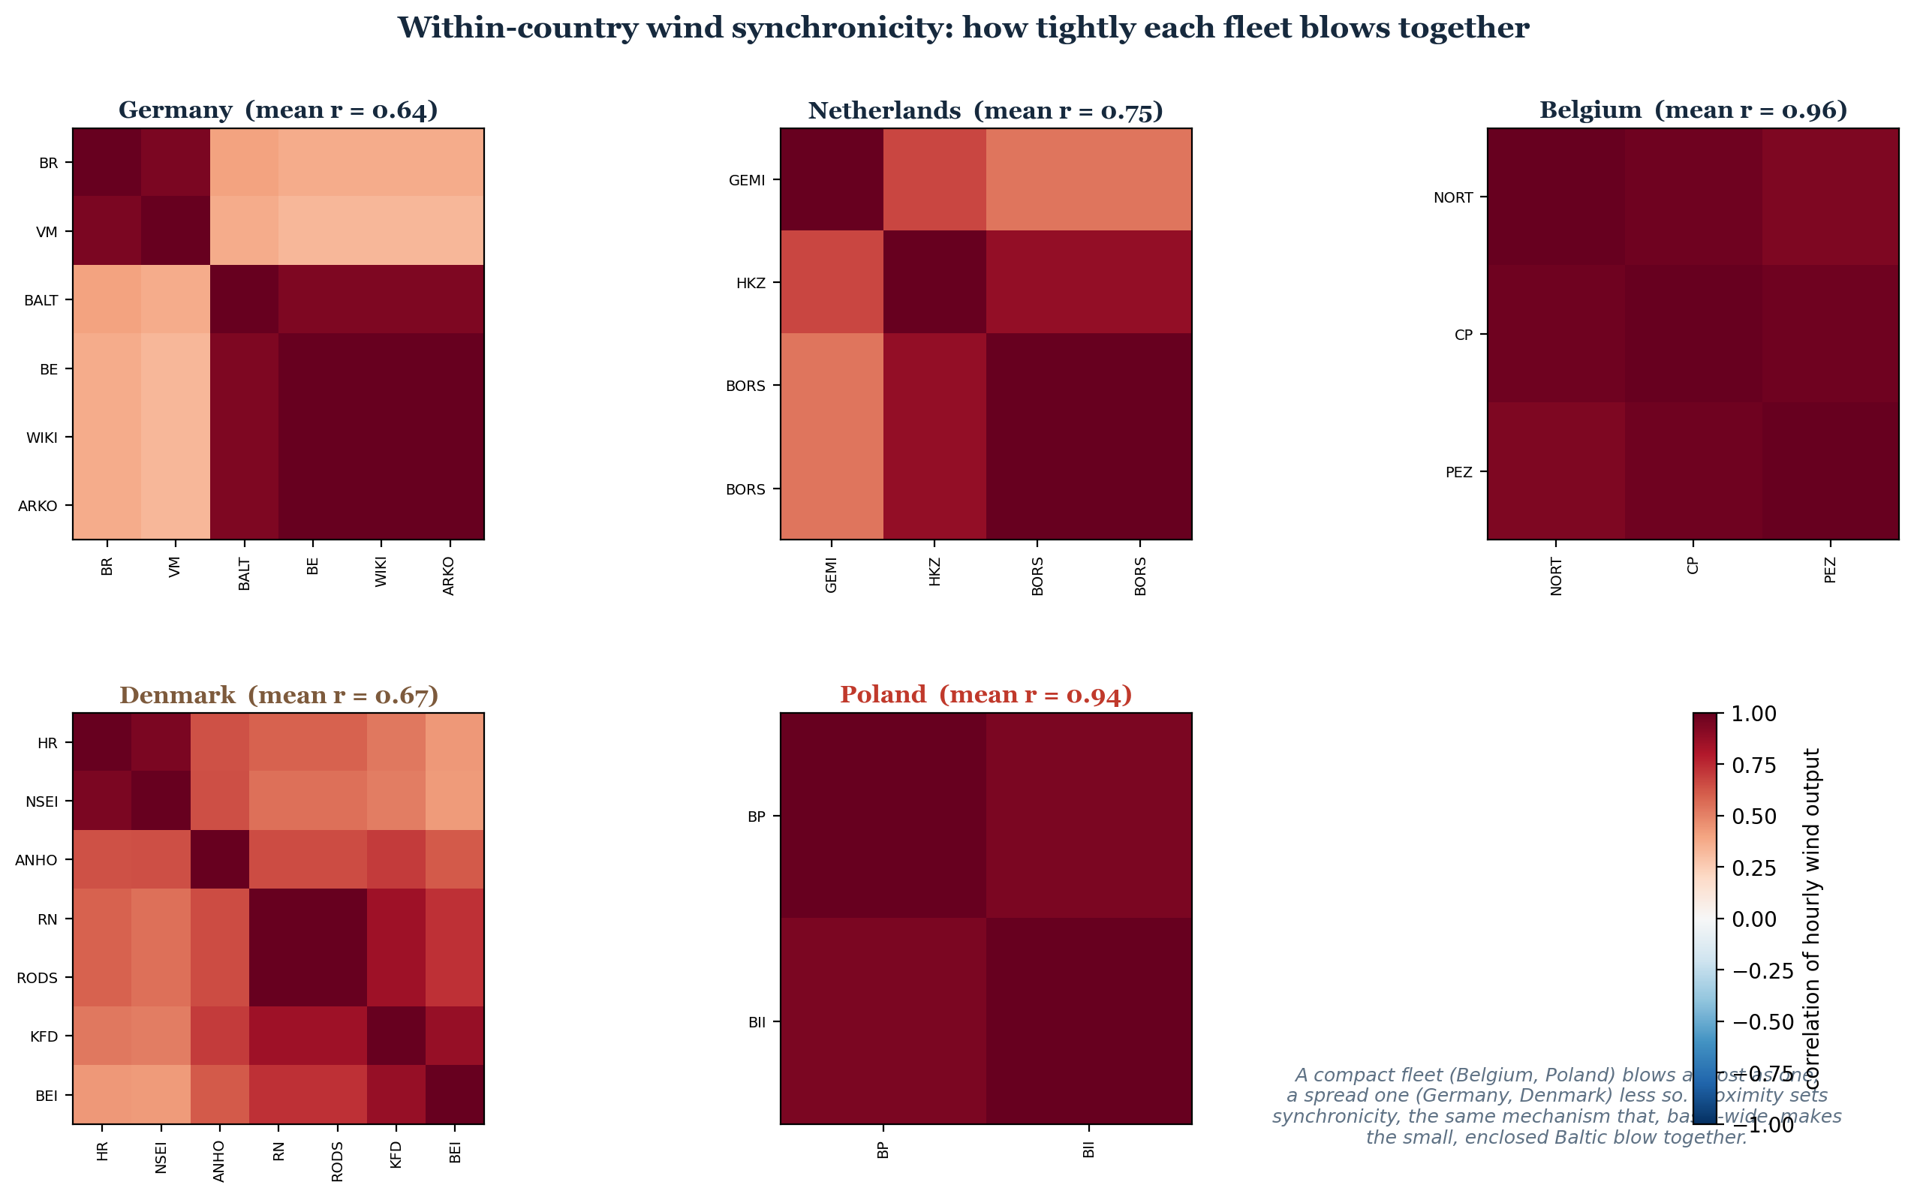
RQ2: within-country synchronicity, farm by farm
• A compact fleet blows almost as one (Belgium 0.96, Poland 0.94); a spread one less so (Germany 0.64, Denmark 0.67)
• Even Germany splits in two: its North Sea and its Baltic farms decouple, so the basin boundary beats the national one
Check data?
HKZ GEMI
Notes:
This is the granular, farm-by-farm version of the previous slide, one correlation matrix per country that has more than one study farm, the idiom Jacquet uses. The point is that within-country synchronicity is really about geographic spread, not which basin you are in: a compact fleet like Belgium's three farms or Poland's two blows almost as one, near 0.95, while a spread fleet like Germany's six or Denmark's seven is looser, around 0.65. The most telling panel is Germany, which splits into two clear blocks, its North Sea farms in one and its Baltic farms in the other, the two barely correlated. So even inside a single country the basin boundary beats the national one: it is proximity and the sea you sit in, not the flag, that set how tightly wind blows together. That same proximity, concentrated in the small enclosed Baltic, is what aggregates up to the basin pattern on the previous slide.

Slide 24
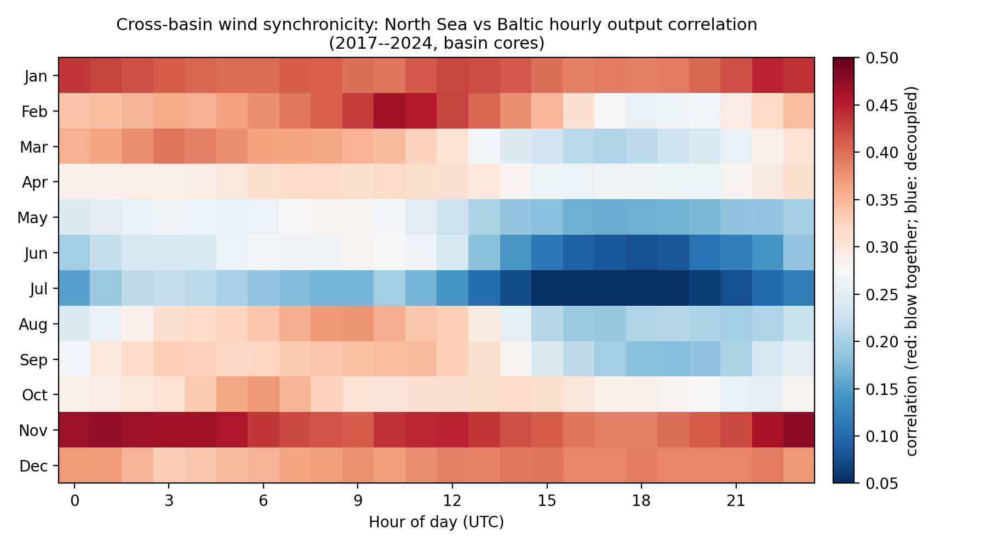
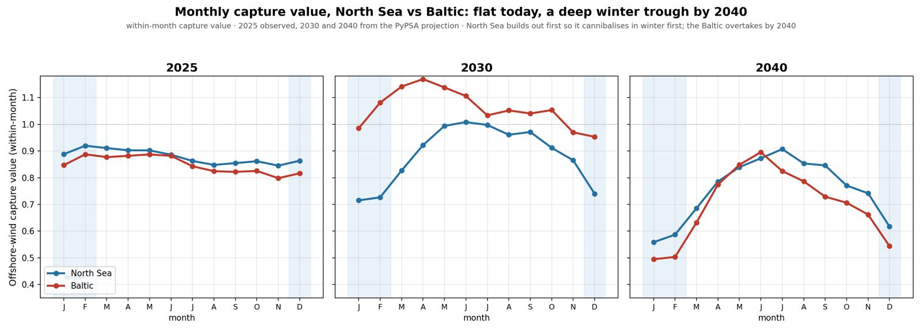
RQ2: when they blow together, a seasonal pattern
• Winter (red): the basins synchronise, exactly when output is highest
• Summer (blue): they decouple. This matches Jacquet's winter-cannibalisation finding
Notes:
This deepens the mechanism and ties it to the literature. The figure is the correlation between the North Sea and the Baltic, broken down by month, down the side, and hour of day, along the bottom. Red means the two basins blow together; blue means they are decoupled. Look at the seasonal banding. In winter, November to February, the band is red: the basins synchronise. In summer, especially June and July afternoons, it turns deep blue: they decouple, because summer wind is driven by local daytime sea breezes that differ between the basins. Why this matters: winter is when offshore output is highest. So in exactly the season the Baltic generates most, it blows together with the North Sea, which means its export valve to the rest of Europe shuts precisely when its surplus peaks. That deepens winter cannibalisation. This is the same winter signature Jacquet found in the French case, and here it is explained by basin synchronicity: the enclosure bites hardest in winter.

Slide 25
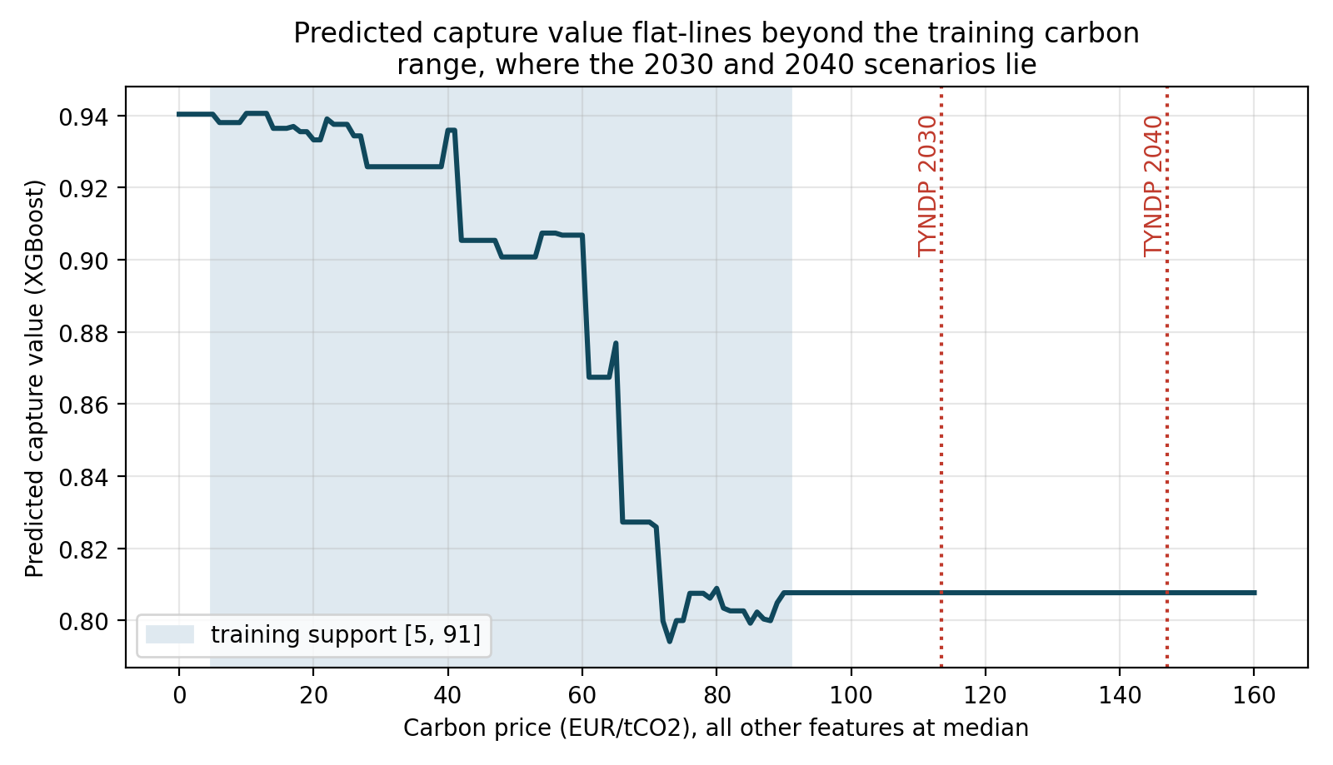
RQ3: the regression abstains, so PyPSA carries the future
• Every future scenario leaves the model's training range (carbon)
• The tree model flat-lines out of support, by proof; a time-split test fails
Notes:
• Can an empirical model project these futures? Provably no, and that is by design
• Every future scenario sits beyond the training range (carbon); the tree flat-lines out of support
• Time-split test (train through 2022, predict 2023 to 2024) fails: R2 about minus 0.03
• So the regression abstains and PyPSA carries it; the triangle proves the hand-off (a methodological contribution)

Slide 26
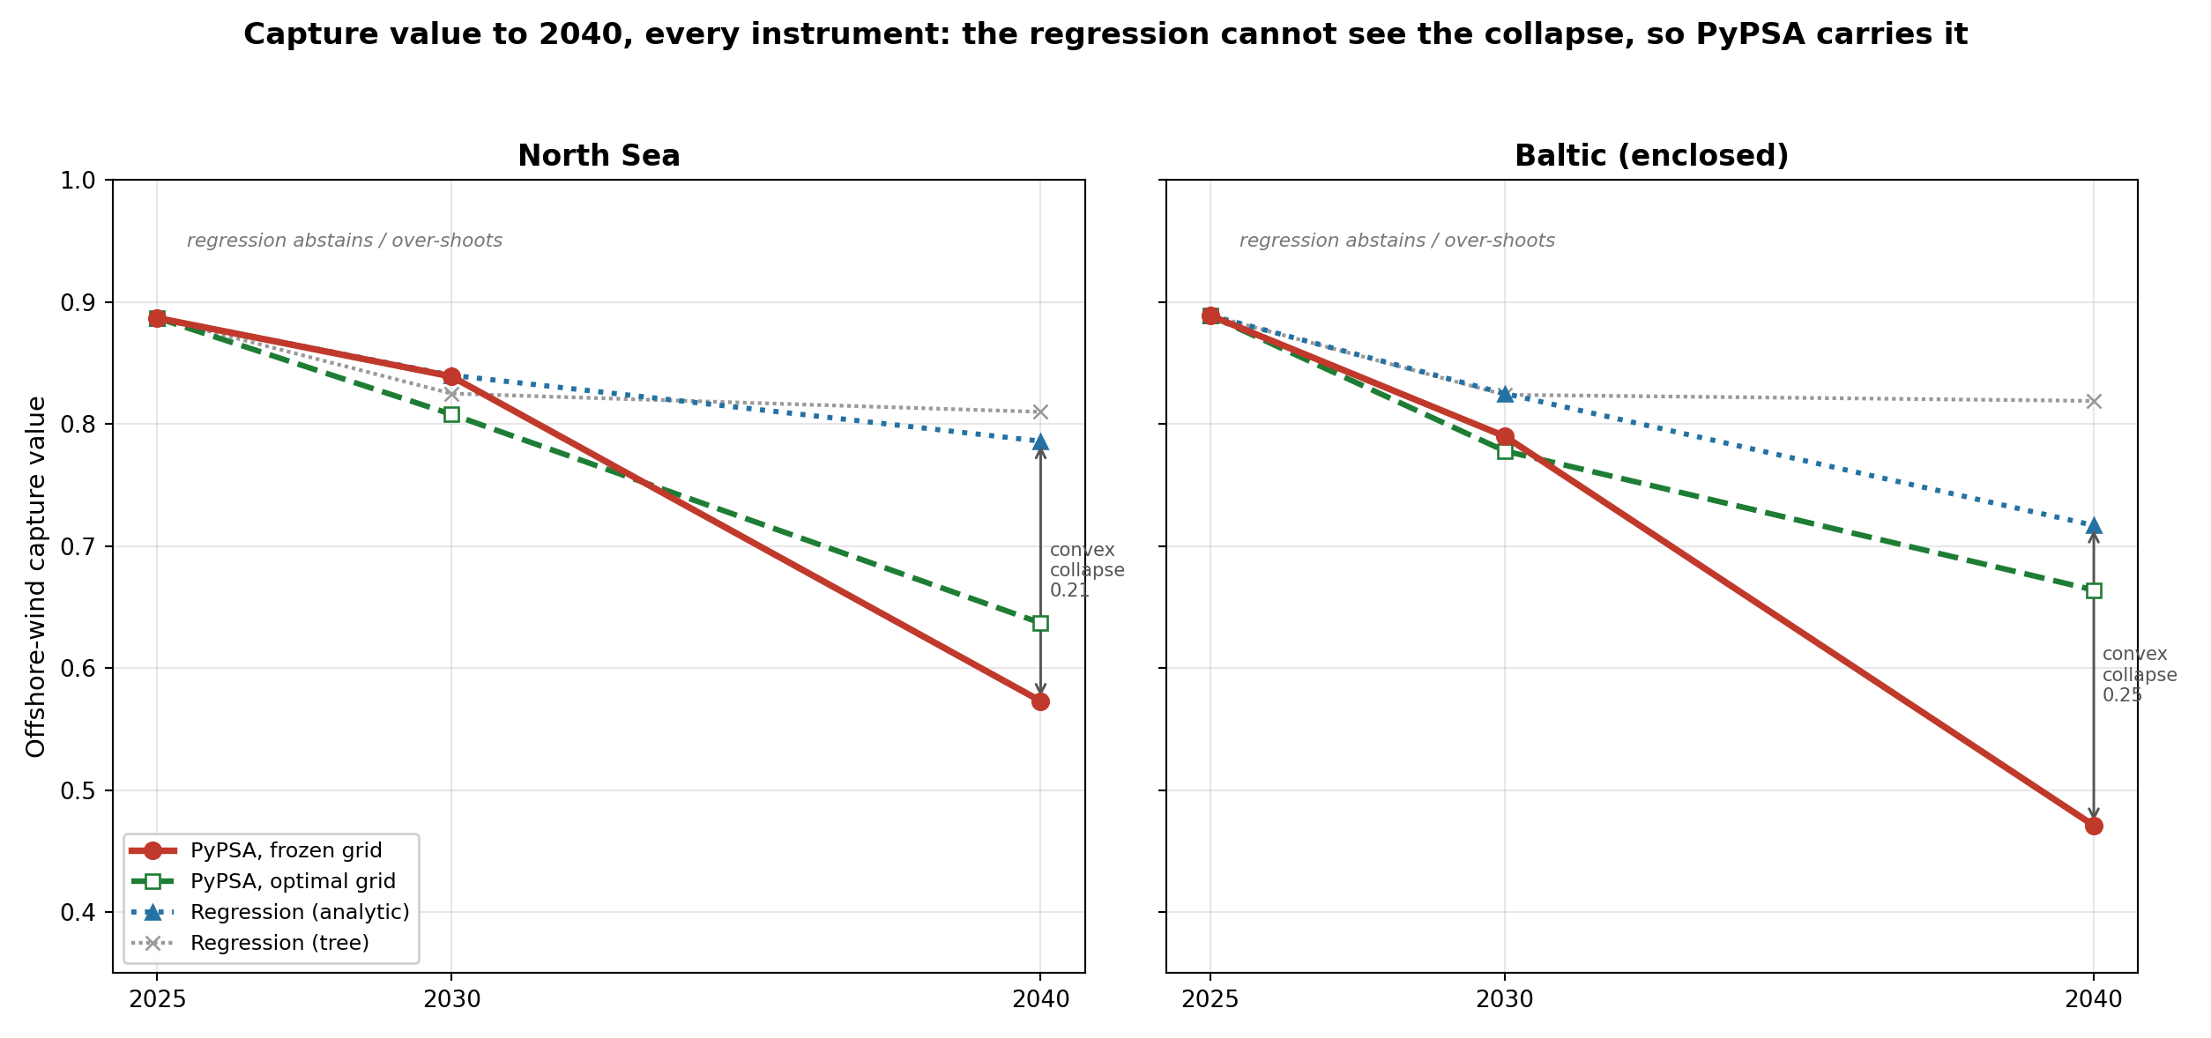
Capture value to 2040: every instrument on one chart
• PyPSA frozen finds the convex collapse (North Sea 0.57, Baltic 0.47); the optimal grid recovers it (0.64, 0.66)
• The regression cannot see it: the tree abstains (flat ~0.82), the analytical form projects only gently (0.79, 0.72)
• That 2040 gap IS the convex cannibalisation the linear empirical form misses, so PyPSA carries the headline
• Agree to 2030 (trust either); part at 2040 (only the market-clearing model is right)
Effort of what
Model is better
Notes:
• Every instrument on one chart (North Sea left, Baltic right), 2025 to 2040
• PyPSA frozen finds the collapse (NS 0.57, Baltic 0.47); the optimal grid recovers it (0.64, 0.66)
• Regression stays high: tree abstains (flat ~0.82), analytical projects gently (0.79, 0.72)
• The 2040 gap (~0.22 NS, 0.25 Baltic) IS the convex collapse the linear form misses, so PyPSA carries it
• Agree to 2030 (trust either); part at 2040 (only the market-clearing model is right)

Slide 27
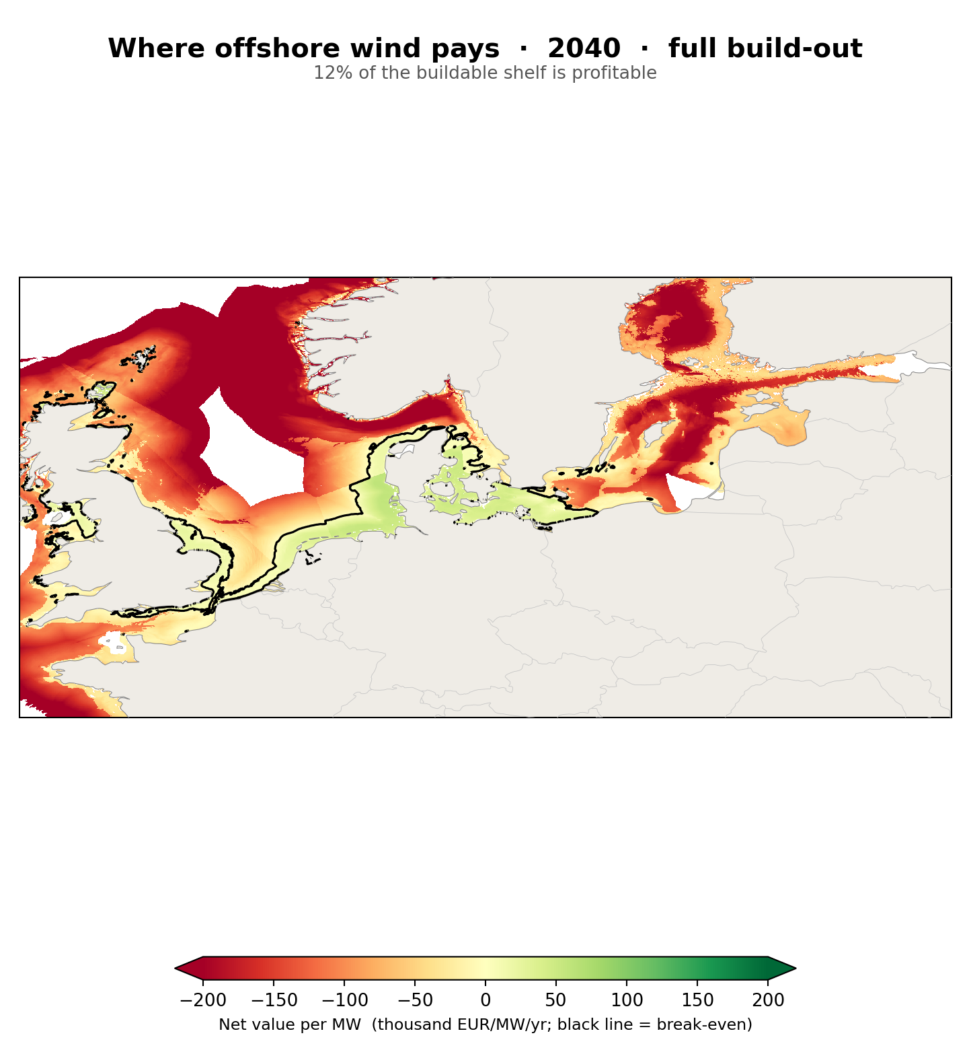
Does offshore wind pay? From capture value to net value
• Net value per MW = revenue (resource x capture value x price) minus depth- and distance-driven cost
• 2025: ~48% of the shelf is merchant-profitable (green); by 2040 cannibalisation shrinks it to ~12% even as turbines get cheaper
• WHY it shrinks: cannibalisation erodes the captured price faster than cheaper turbines cut cost
• WHY the green is the shallow North Sea: best wind + shallow + near-shore stack the most cost margin; deep water never clears the floating-foundation cost
Notes:
• Does it PAY? Net value/MW = resource (CF) x capture value x price, minus depth/distance cost (GWA + GEBCO)
• 2025: ~48% of the shelf profitable (green); 2040: ~12% - the profitable area collapses
• WHY it shrinks: cannibalisation erodes capture value, so revenue drops below cost across more of the sea; cheaper turbines (~12%) cannot keep up with the value lost
• WHY the shallow North Sea stays green: it stacks all three - best wind (CF ~0.5), shallow water, near shore - so the most cost margin to absorb the erosion
• WHY the deep water (Norwegian trench) is always red: floating foundations add ~EUR 1m/MW, so even strong wind cannot break even there
• WHY it still beats the Baltic despite the capture-value reversal: net value is set by resource + cost, and the North Sea's ~20% CF edge outweighs the Baltic's higher capture value
• Takeaway: build EARLY (value highest before cannibalisation) and SHALLOW (cost margin); late and deep both lose

Slide 28
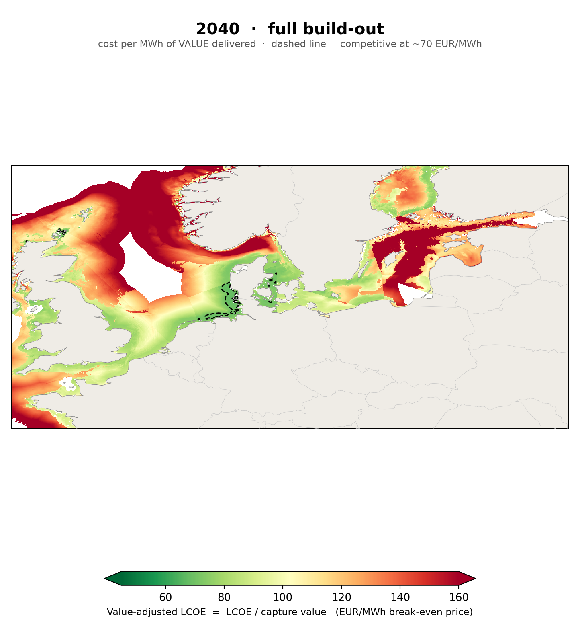
Value-adjusted LCOE (cannibalisation undoes the learning)
• Value-adjusted LCOE = LCOE / capture value = the wholesale price a site needs to break even
• Raw LCOE FALLS with technology (74 to 66 EUR/MWh); the value-adjusted LCOE RISES (87 to 121), because cannibalisation overruns learning
• Robust: costs would have to fall 36% by 2040 (3x the DEA's 12%) just to hold it flat, in all 27 cases tested
Notes:
• The contribution: value-adjusted LCOE = LCOE / capture value = the price a site needs to break even
• Raw LCOE FALLS with technology (74 to 66 EUR/MWh); the value-adjusted LCOE RISES (87 to 121)
• Cannibalisation undoes the learning; the competitive area (under ~70) collapses from 35% to under 1%
• Robust: costs must fall 36% by 2040 (3x the DEA's 12%) just to hold it flat, in all 27 cases
• No one has mapped this spatially before

Slide 29
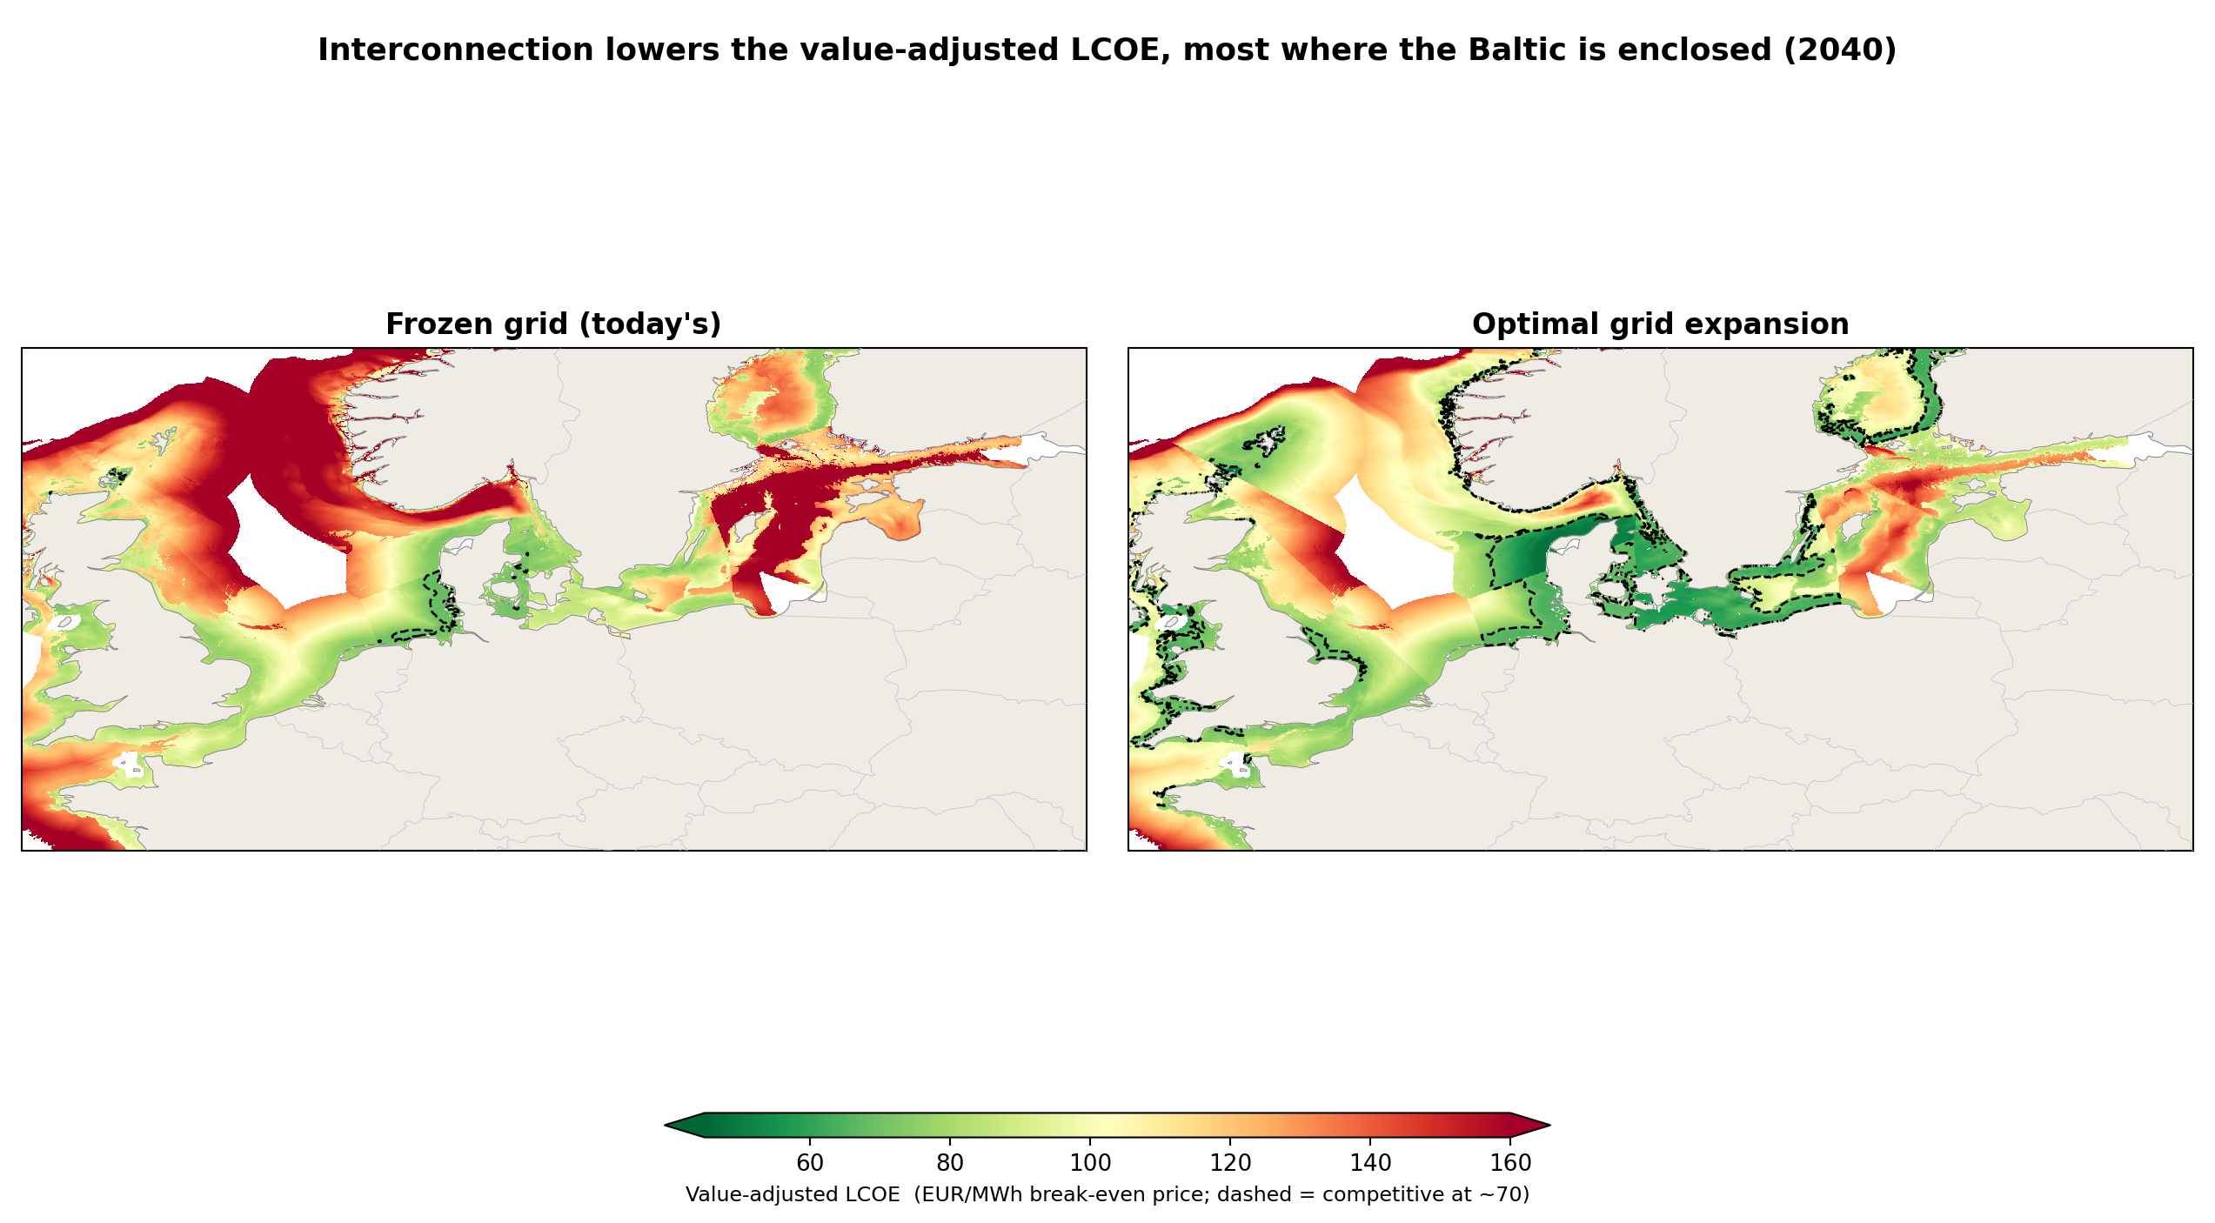
Interconnection is the lever, in money
• Interconnection lowers the enclosed Baltic's value-adjusted LCOE by EUR 33/MWh, 4x the core North Sea's EUR 8
• Worth ~EUR 1.2 bn/yr in captured revenue to Baltic offshore alone, about 55% of the cost of ALL the new lines
• The recommendation: the cost-optimal grid makes Baltic offshore viable; without it, it needs subsidy
Value being captured by cfd?
Winners and losers.
Notes:
• Value-adjusted LCOE = LCOE/CV, and interconnection raises CV, so it lowers the break-even price
• Enclosed Baltic falls EUR 33/MWh, four times the core North Sea's EUR 8 (Danish transit EUR 48)
• Worth about EUR 1.2 bn/yr to Baltic offshore alone, roughly 55% of the cost of ALL the new lines
• Not an open cost problem: the model builds a specific 133 GW at EUR 2.2 bn/yr and stops
• Recommendation: build the grid; it is a break-even cut aimed exactly at the basin with the problem

Slide 30
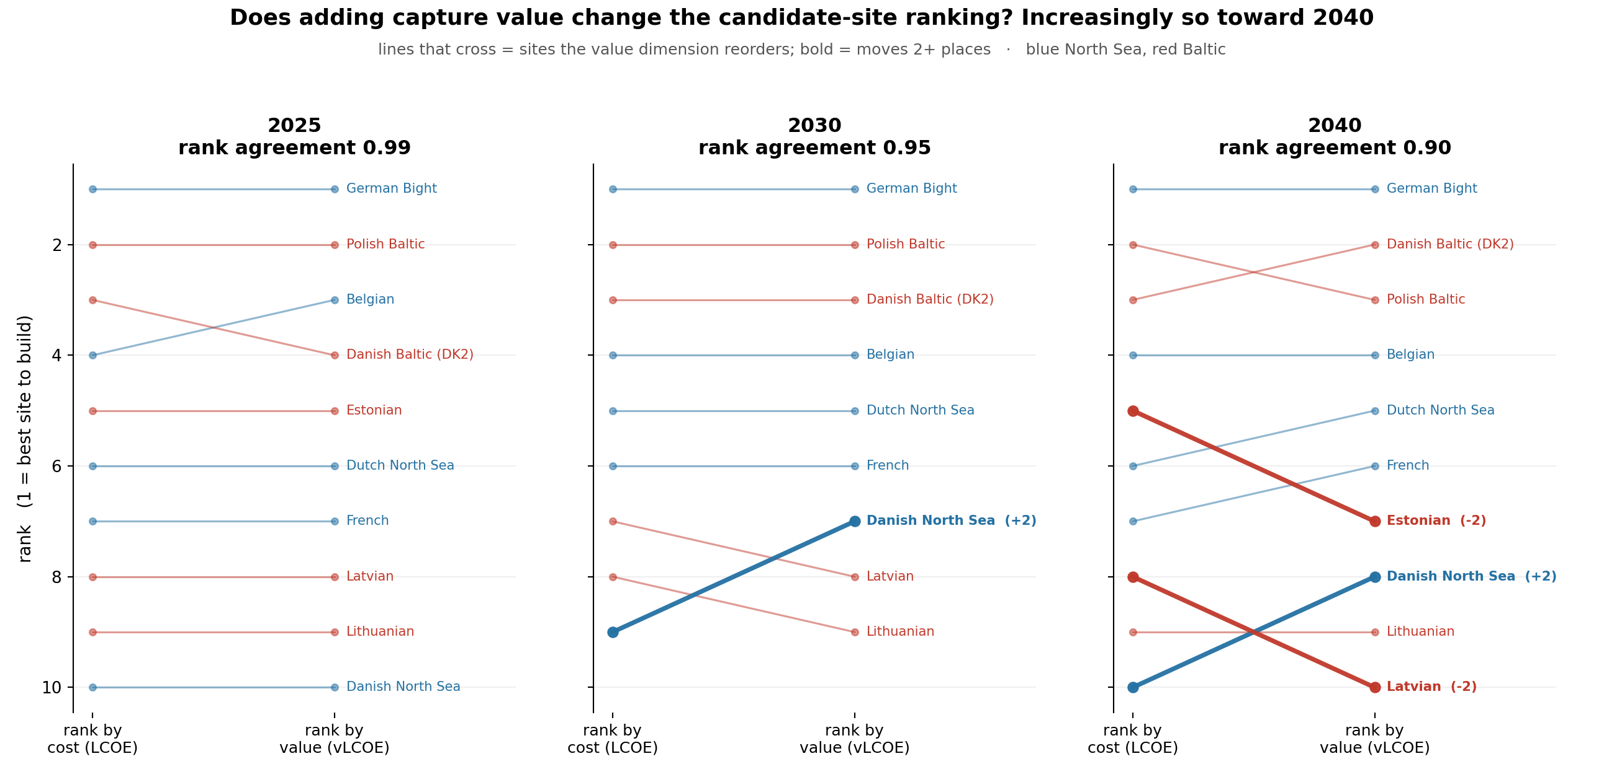
Does capture value change where to build?
• Rank candidate areas by cost alone (LCOE) versus with capture value added (value-adjusted LCOE)
• 2025 the two rankings agree (0.99); by 2040 they diverge (0.90), so the value dimension increasingly reorders site choice
• The cheap-but-cannibalised eastern Baltic (Estonia, Latvia) drops; the value-resilient Danish North Sea rises; the German Bight stays number one
• So ranking on cost alone is fine today but increasingly misleads toward 2040
Notes:
• Objective 4: does adding capture value change which sites to build?
• Rank candidate areas by cost (LCOE) vs value-adjusted (vLCOE): 2025 agree (0.99), 2040 diverge (0.90)
• Movers: cheap-but-cannibalised Estonia + Latvia DROP; value-resilient Danish North Sea RISES; German Bight stays #1
• So cost-only ranking is fine today but increasingly misleads toward 2040: the value dimension matters

Slide 31
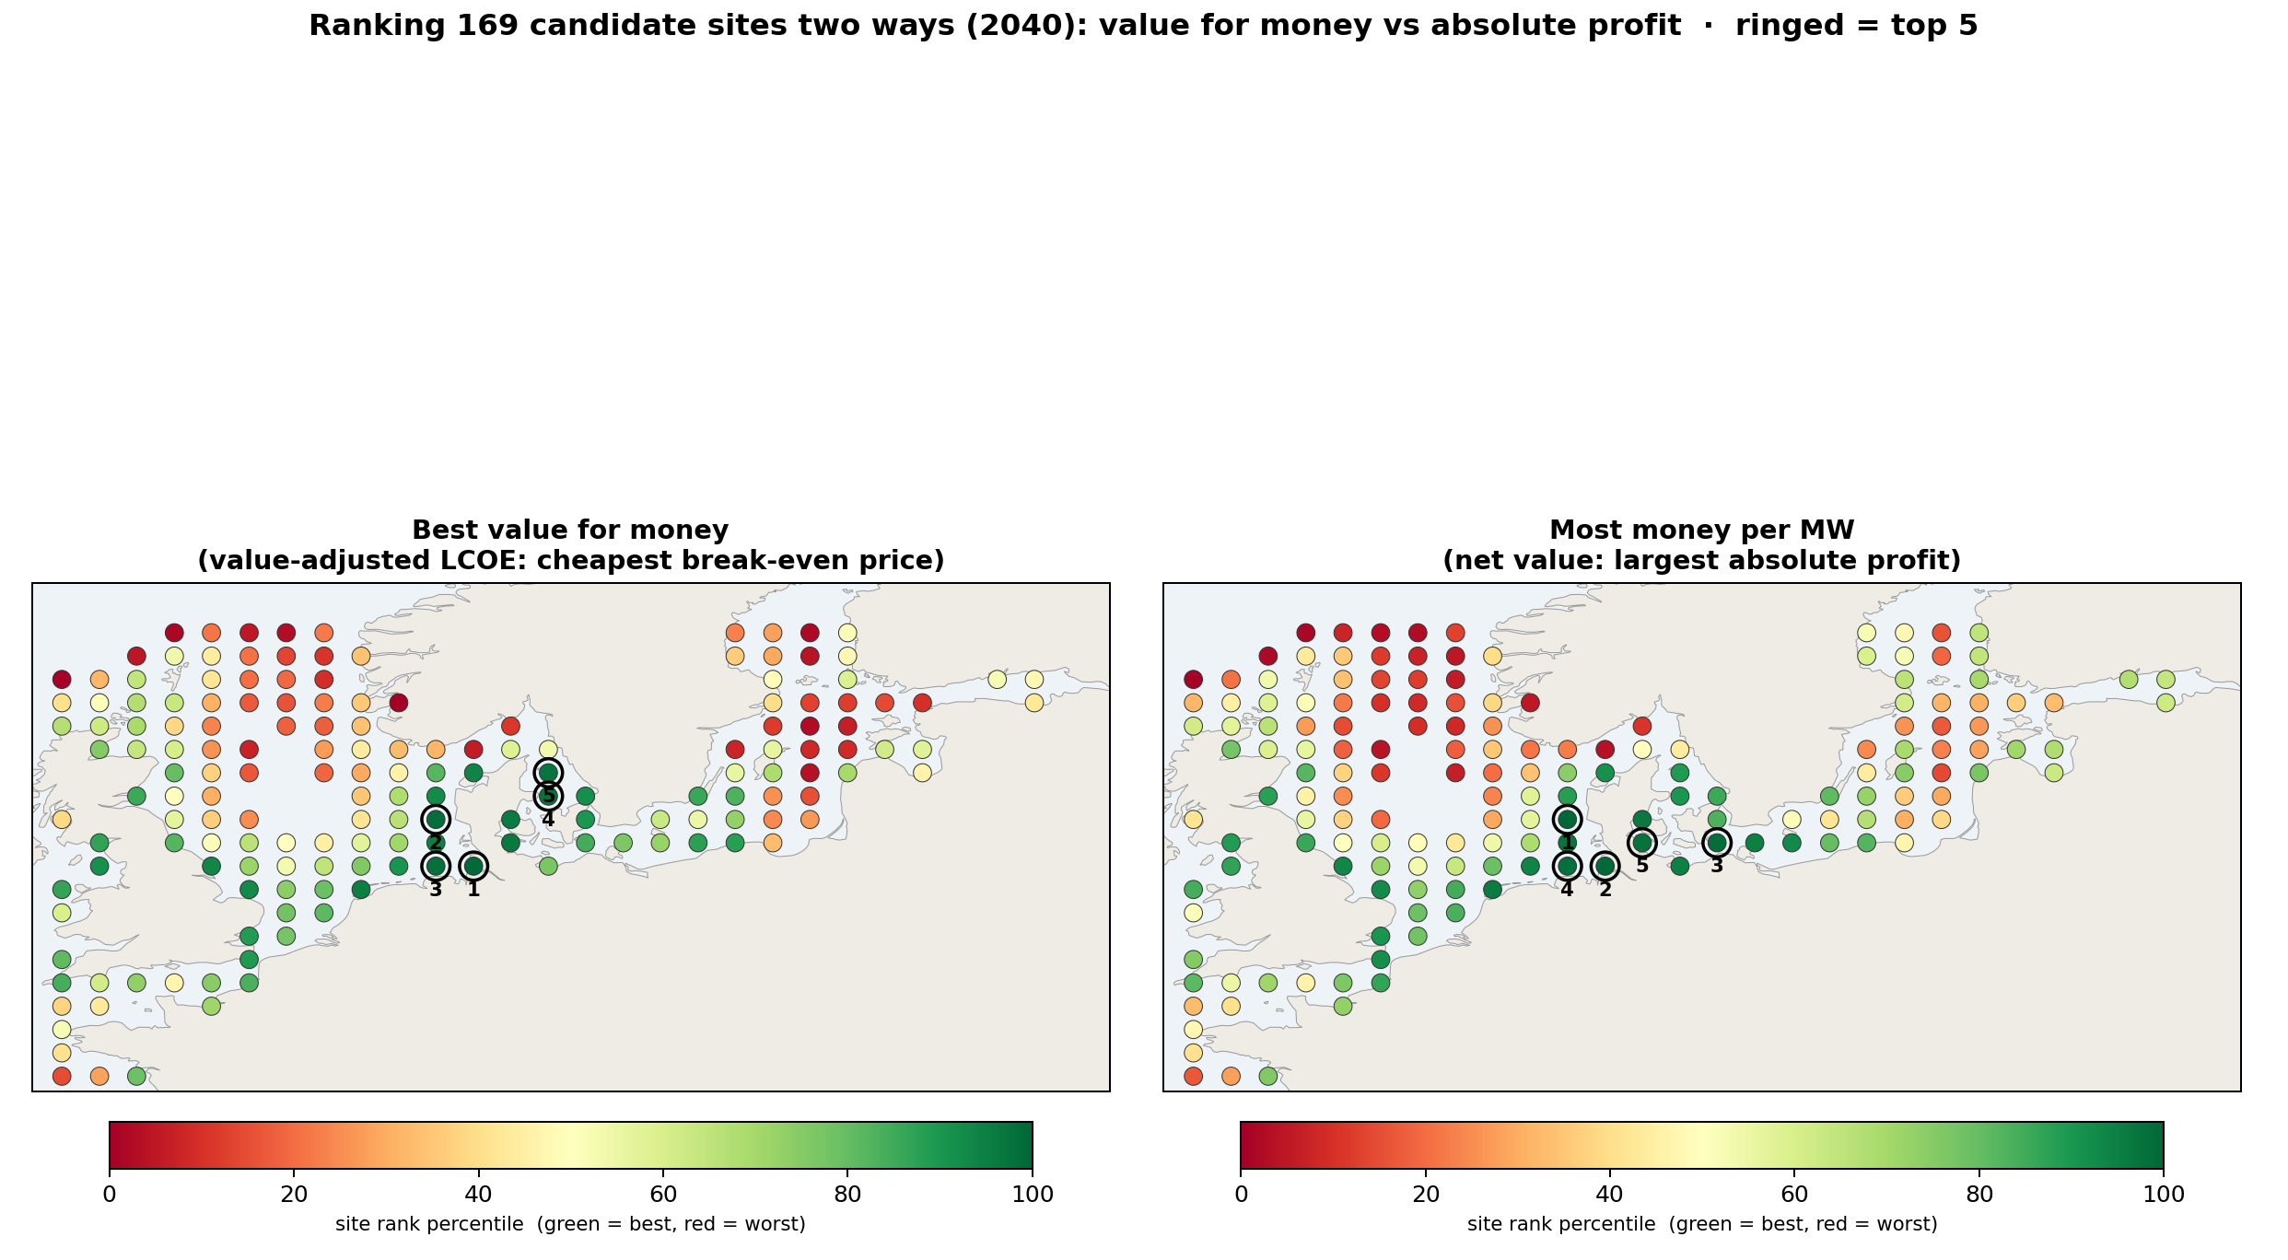
Where to build: many sites, two lenses
• 169 candidate sites across both shelves, ranked two ways: cheapest break-even (value for money) and largest profit per MW (net value)
• Both reward the shallow, windy, value-resilient shelf; the German Bight tops both lenses
• Value-for-money tilts to the cheap shallow western Baltic (Poland, DK2); absolute money tilts to the high-resource open North Sea
• Recommendation: German Bight and the shallow western Baltic first; the cheap eastern-Baltic sites are a value trap by 2040
Notes:
• 169 candidate sites, two lenses: cheapest break-even (value for money) vs largest profit/MW (net value)
• Both reward the shallow windy value-resilient shelf; German Bight tops both
• Value-for-money tilts to the cheap shallow western Baltic (PL, DK2); absolute money tilts to the high-resource North Sea
• Recommendation: German Bight + shallow western Baltic first; cheap eastern Baltic (EE, LV) is a value trap by 2040

Slide 32
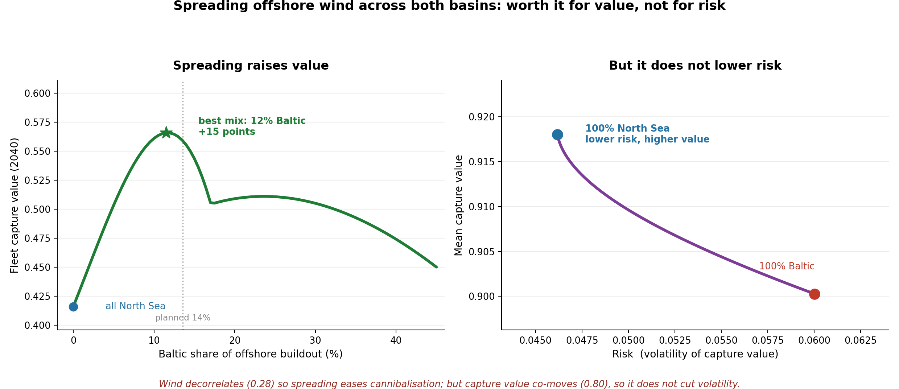
Is it worth spreading across both basins?
• Cannibalisation hedge (YES): all-North-Sea craters; spreading the optimal ~12% to the Baltic lifts aggregate 2040 capture value about a third (planned split near-optimal)
• Risk hedge (NO): the wind decorrelates (0.28) but capture value co-moves (0.80) on shared European prices, so no volatility cut
• So the portfolio payoff is on the MEAN (less cannibalisation), not the variance
• The low correlation that motivates diversification lives in the wind, not the value
Notes:
• Objective 5: portfolio value of spreading across both basins vs concentrating in the North Sea
• Cannibalisation hedge YES: all-NS craters; spreading ~12% to the Baltic lifts aggregate 2040 CV about a third; planned split near-optimal
• Risk hedge NO: wind decorrelates (0.28) but capture value co-moves (0.80), so no volatility cut; NS is lower-risk AND higher-value
• Payoff is on the MEAN (less cannibalisation), not the variance; the low correlation lives in the wind, not the value

Slide 33
What it means, against the three questions
• RQ1: at parity today; the Baltic falls to about 0.47 by 2040 vs the North Sea's 0.57, but with grid expansion it recovers to 0.66, above the North Sea
• RQ2: same mechanisms, steeper in the enclosed Baltic (weak export valve, correlated wind)
• RQ3: regression measures and explains; PyPSA carries the far future; the triangle validates the hand-off
• Economics: the value-adjusted LCOE RISES despite cheaper turbines; interconnection lowers the Baltic's by EUR 33/MWh, worth ~EUR 1.2 bn/yr
• Policy: interconnection is THE lever, it decides whether the Baltic erodes or thrives; subsidy design must price the structural fall
Notes:
• RQ1: parity today, Baltic about 0.47 by 2040 vs North Sea 0.57; with grid it recovers to 0.66 (above)
• RQ2: same mechanisms, steeper in the enclosed Baltic (correlated wind, weak export valve)
• RQ3: regression measures and explains; PyPSA carries the future; the triangle validates the hand-off
• Economics: value-adjusted LCOE rises despite cheaper turbines; interconnection lowers the Baltic's EUR 33/MWh (~EUR 1.2 bn/yr)
• Policy: interconnection is THE lever; subsidy and CfD design must price the structural fall

Slide 34
Conclusion
• The enclosed Baltic does not start behind, but on today's grid the buildout cannibalises it faster
• Build the grid and it reverses: the Baltic recovers above the North Sea, and the erosion is a policy choice, not fate
• New metric, the value-adjusted LCOE, rises despite cheaper turbines; interconnection lowers the Baltic's most (EUR 33/MWh, ~EUR 1.2 bn/yr)
• Contribution: two validated instruments, a proven hand-off, a value-adjusted cost map, on open data · Thank you · questions
Notes:
• The Baltic does not start behind, but on today's grid the buildout cannibalises it faster
• Build the grid and it reverses: the Baltic recovers above the North Sea; the erosion is a policy choice, not fate
• Novel metric: value-adjusted LCOE rises despite cheaper turbines; interconnection lowers the Baltic's most (EUR 33/MWh, ~EUR 1.2 bn/yr)
• Contribution: two validated instruments, a proven hand-off, a value-adjusted cost map, all on open data
• Thank you; happy to take questions

