Slide 1
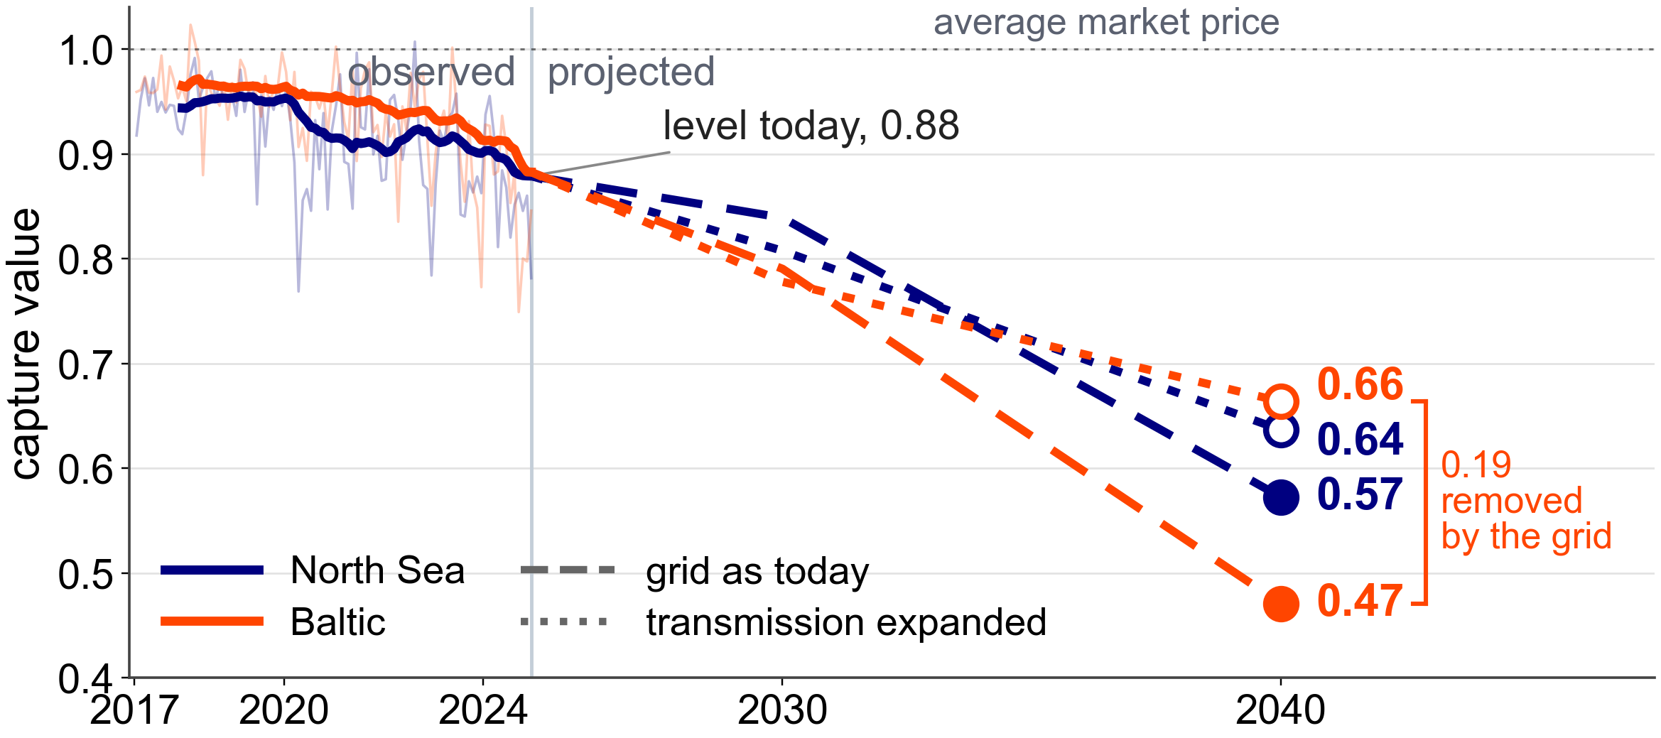
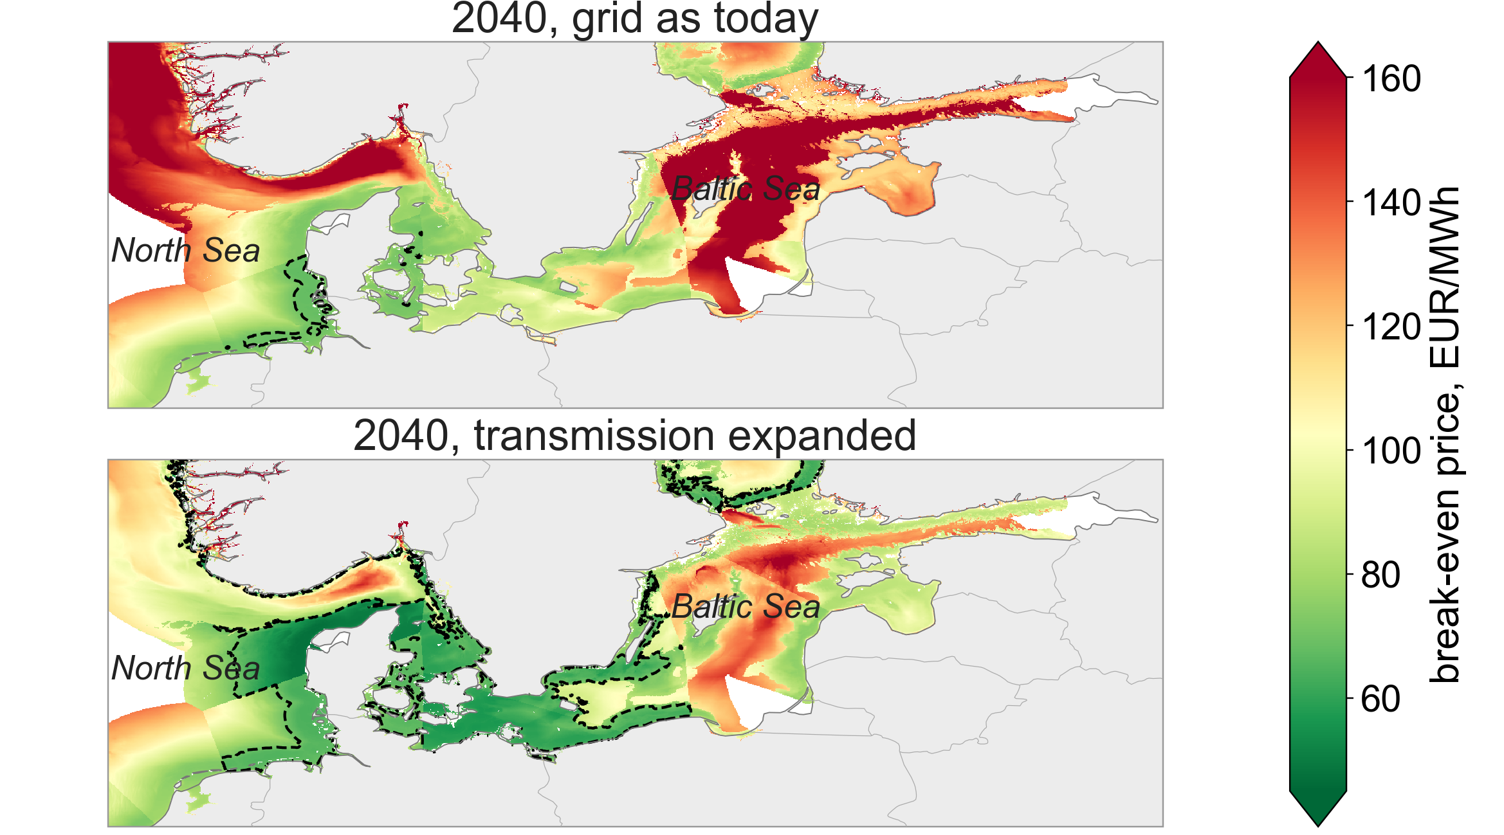
58
Offshore wind cannibalisation in the Baltic and North Sea: how much value is lost depends on the grid built alongside the farms
Faisal Bindakhil
MSc Sustainable Energy Futures
Imperial College London
Supervisor: Dr Ruslan Galimov, RWE
Background
Results
Europe's next wave of offshore wind moves from the mature North Sea into the enclosed Baltic Sea. Wind farms in one sea generate in the same hours, so when they all produce the price falls. The share of the average market price a farm actually receives is its capture value [1], and it falls as more wind is built. The Baltic fleet grows nineteenfold by 2040, the North Sea's ninefold, and the Baltic grid is weakly connected to its neighbours.
Objective
Measure how much value offshore wind loses as the planned fleets are built, and answer:
How do the two seas compare, today and once the planned farms are built?
What causes the loss of value, and how much of it can the grid avoid?
Can a model trained on the past project this future, or must the market be rebuilt?
Figure 2: Capture value observed to 2024 and projected to 2040, with the grid as today and with transmission expanded.
Both seas are level today. With the planned buildout and today's grid the Baltic falls to 0.47 by 2040 and the North Sea to 0.57. Expanding the grid lifts the Baltic to 0.66: half of its extra loss is congestion that transmission removes.
Methodology
Statistical model
Power‑system model
Two models estimate capture value from different inputs. The statistical model is a regression fitted to eight years of prices at 31 farms [5], with wind output from ERA5 weather [2]. The power‑system model, PyPSA‑Eur [3], rebuilds every hour's price from Europe's plants, grid and demand under the 2030 and 2040 plans [4]. Both are checked against 2023 and 2024 prices.
Today's prices
closer, error 0.01
error 0.05
Any future
one answer for all
responds to the grid
Congestion
an input only
priced at every node
Table 1: The regression is better for today, the power‑system model for the long term, so the 2040 numbers come from it.
ERA5 weather, turned into the hourly output of every wind farm [2]
Observed prices, 2017 to 2024 [5]
Plants, grid and demand, with the 2030 and 2040 plans [3, 4]
Statistical model
Power‑system model
Capture value = a farm's average price ÷ the market's average price. Both models agree on 2023 and 2024 within 0.5 points.
Figure 1: The two models, their inputs and their common output.
Figure 3: Break‑even price of a new farm in 2040, cost ÷ capture value. Below 70 EUR/MWh a farm pays back.
Limitations
With today's grid the Baltic break‑even price rises from 87 to 121 EUR/MWh by 2040. Expanding the grid lowers it by 33, and Polish and Danish waters pay back.
The power‑system model has no negative prices and a simplified grid, so the DK2 zone is set aside. All 2040 figures use the National Trends scenario. Flexible demand recovers more value than transmission, 0.28 against 0.19, and costing it is the next step.
Conclusions
Today the seas are equal at 0.88. Once the planned farms are built, with today's grid, the Baltic falls to 0.47 and the North Sea to 0.57.
The buildout costs both seas about the same. The Baltic's extra loss is grid congestion, and transmission removes it: the Baltic recovers to 0.66.
The market must be rebuilt: the model trained on the past gives one answer for every future, so the 2040 numbers come from the power‑system model.
With thanks to Dr Ruslan Galimov, RWE, who guided this project.
References
[1] L. Hirth. The market value of variable renewables. Energy Economics, 38:218–236, 2013.
[2] L. Hayes, M. Stocks and A. Blakers. Accurate long‑term power generation model for offshore wind farms in Europe using ERA5 reanalysis. Energy, 229:120603, 2021.
[3] J. Hörsch, F. Hofmann, D. Schlachtberger and T. Brown. PyPSA‑Eur: an open optimisation model of the European transmission system. Energy Strategy Reviews, 22:207–215, 2018.
[4] ENTSO‑E and ENTSOG. TYNDP 2024 Scenarios Report, final version, January 2025.
[5] ENTSO‑E Transparency Platform. Day‑ahead prices and generation data, 2017 to 2024.

