Slide 1
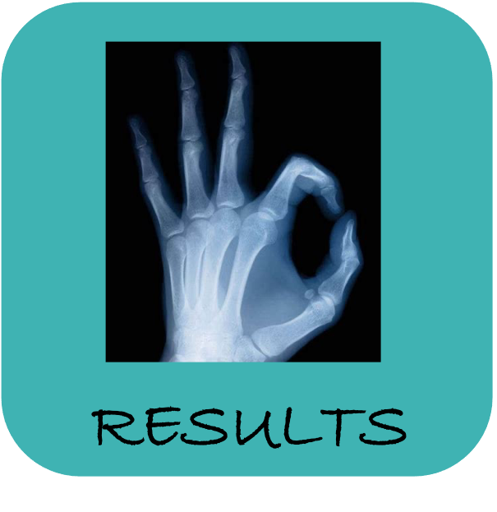
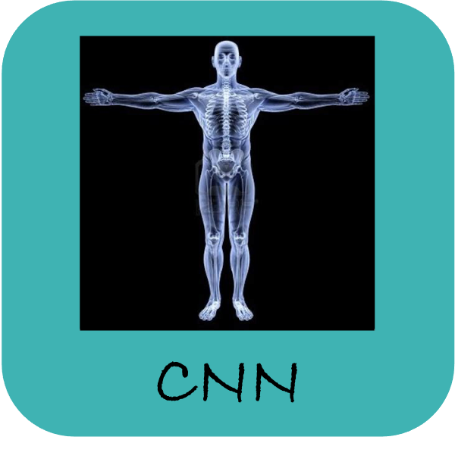
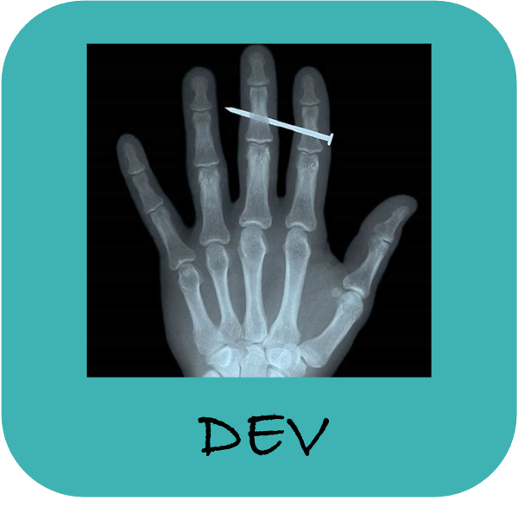
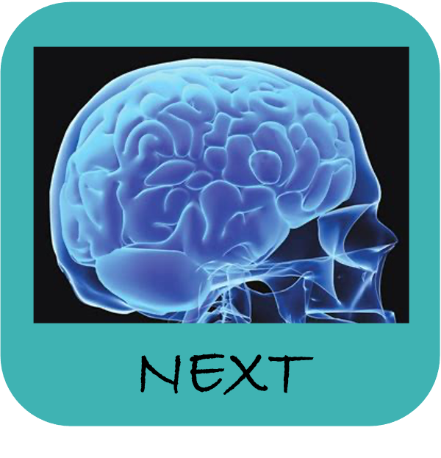
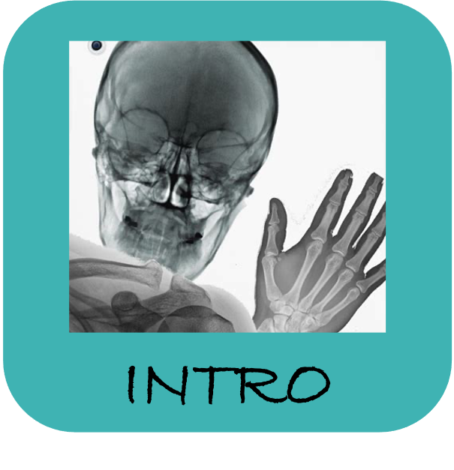
X-Ray Classification
A development approach to Convolutional Neural Networks
By Alberto Mengual to github to linkedIn

Slide 2
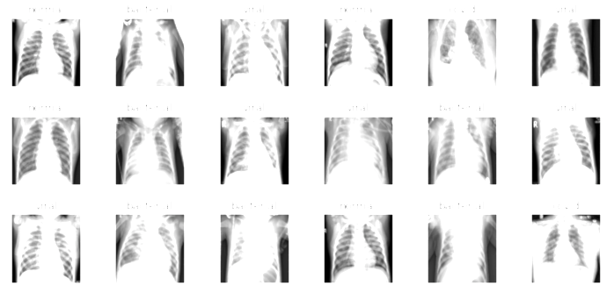
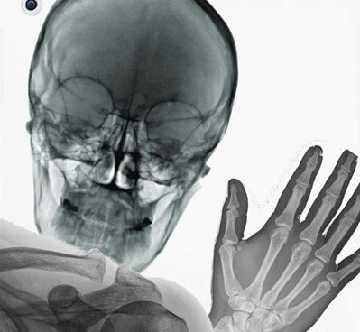
Case Study
Classify chest illnesses and Identify COVID by x-Ray images
Project Objectives
Increase survival rate
Have a pre-diagnosis in minutes
Reduce costs and detection time
INTRO
Dataset description
Training set : 530 images
Test set: 40 images
Categories:
0 - Covid-19
1 - Healthy
2 - Viral Pneumonia
3 - Bacterial Pneumonia

Slide 3
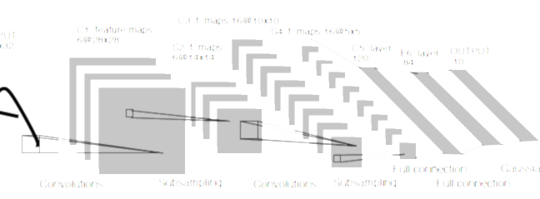
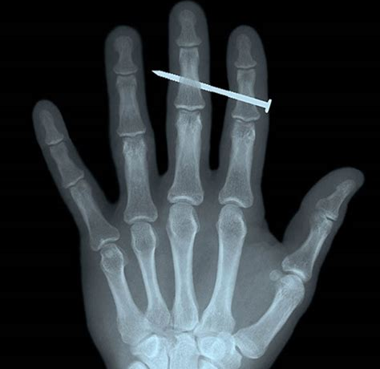


Load the images
First Convolutional Neural Network
Feature engineering – Image Augmentation
Improve Architecture
Callbacks: cp, estopping, itd
Learning Rate - Tunning and Scheduling
Overfitting: Regularizers and Dropout layers
Transfer Learning: ResNet50 - ImageNet
DEVELOPMENT

Slide 4
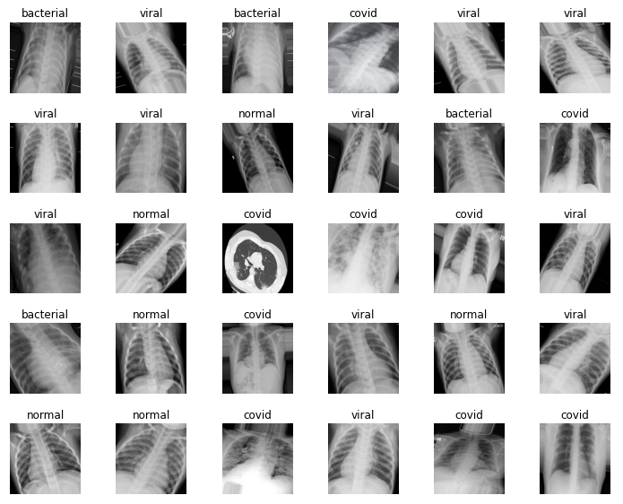

Slide 5
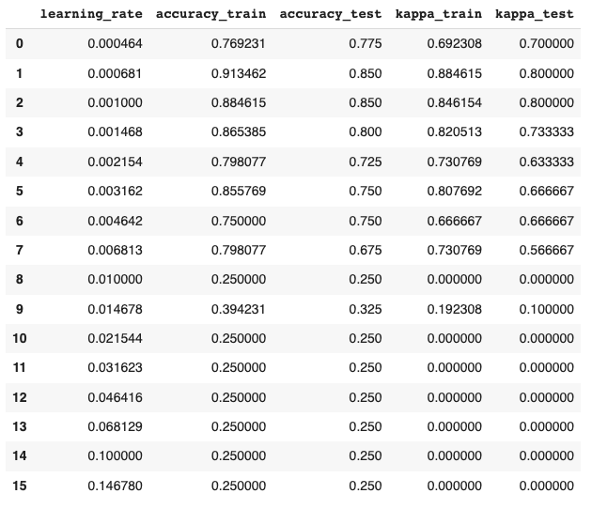
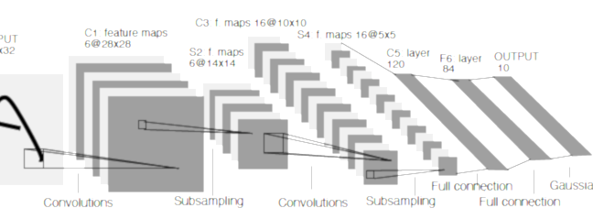
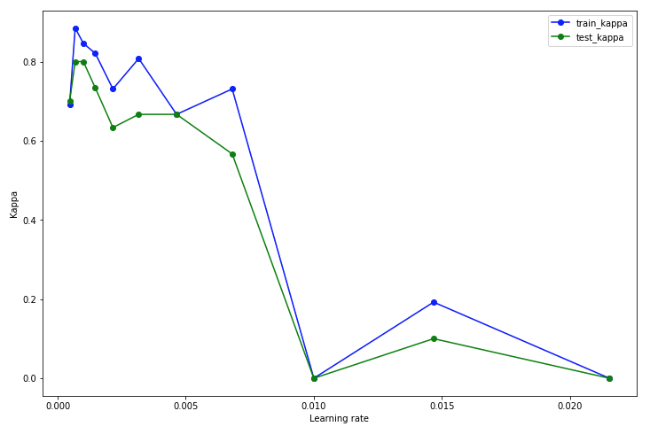
Learning Rate Tuning

Slide 6
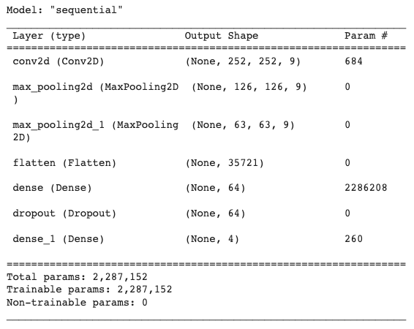
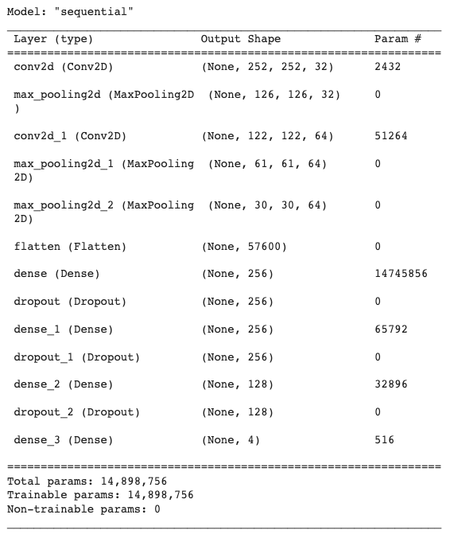
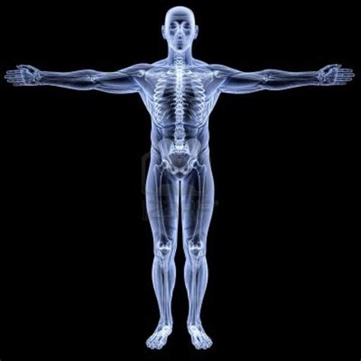
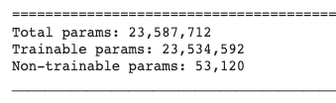
Initial Architecture
Increased Architecture
CNN
ResNet 50 - parameters

Slide 7
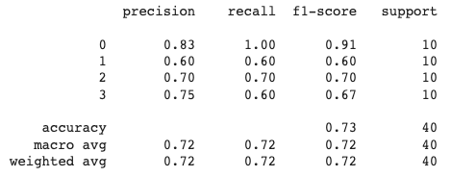
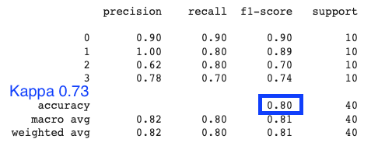
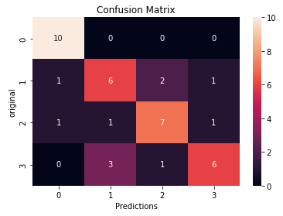
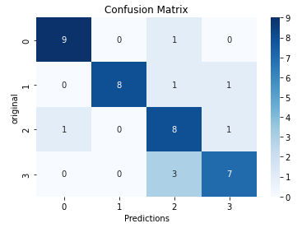
First Model
Best Model

Slide 8
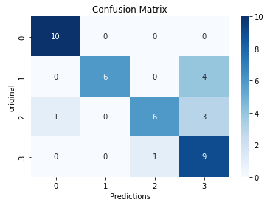
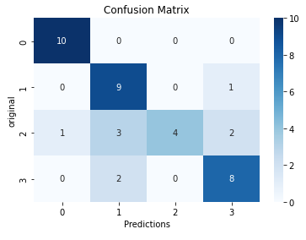
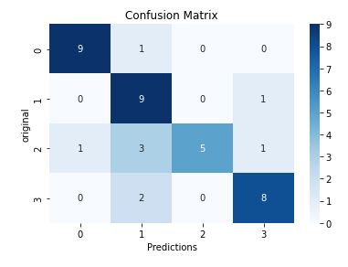
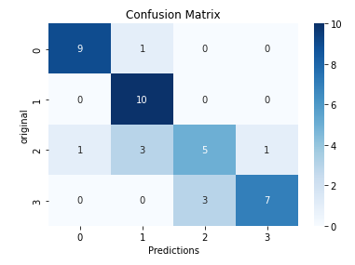
Increased Architecture
Image Augmentation
Monitoring Precision
Monitoring Recall

Slide 9
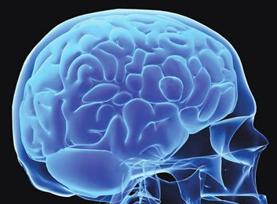
Enhance a wider Data Set
Define a transferable CNN
Identify other illnesses
Detect the location of illnesses
NEXT STEPS
Thank you very much.
Enjoy Life !!

