Slide 1
Dependency Injection
Liam Whitelaw
Notes:
It honestly sounds fancier than it is. It is still very useful though.
https://martinfowler.com/articles/injection.html – the original
https://blog.thecodewhisperer.com/permalink/refactor-your-way-to-a-dependency-injection-container – how to refactor to use DI
https://en.wikipedia.org/wiki/Dependency_injection – the summary version
https://freecontent.manning.com/understanding-method-injection/ - method injection

Slide 2
What is Dependency Injection?
A form of inversion of control (specifically dependency inversion)
A way to decouple object dependencies from how they are created
A way to pass an object the dependencies it needs without the object itself having to be concerned with how to acquire them
Replace “I am acquiring ingredients to make dinner” with “I’ll make dinner knowing someone will make sure I have what I need when I need it”
Notes:
In a normal program, you call other (generic) code. Under inversion of control, you arrange to let a framework call your custom code. In the case of dependency injection, the “framework” is the client, and the service is the “custom code”. Specifically, this is dependency inversion. Instead of high-level code calling into low-level code directly, the low-level code is being provided to the high-level code through an interface. The high-level code need not concern itself with the lower-level implementation as long as it is provided with what it needs.
In dependency injection, the object is not acquiring its dependencies directly or indirectly through a factory. It only asks for some higher code to provide exactly the object it asks for.

Slide 3
Why Use Dependency Injection?
Explicit Declaration of Dependencies
Dependencies become a part of the API
No hidden service acquisitions in the implementation
Configurability
Change it at runtime!
Centralise all system configuration
Easier to Test
Configure a stub as a service
Notes:
Testing is easier when you know you can just pass in a stub or mock as an object dependency, knowing the object in question will not bring in unexpected objects from elsewhere.
With dependencies as part of the API, it also means that adding a dependency will properly break your tests so you can know to go back and fix them.

Slide 4
Roles
Service
An object that provides functionality
Client
Consumes a service
Can itself be a service, but that is not important right now
Interface
A protocol both client and service agree to use
Injector
Something that provides clients with the services they request
Notes:
An interface (abstract class, etc.) is not strictly required for dependency injection- though there is not much point using DI without one unless the dependency has the rare property of having different implementations under the same concrete class.
Injectors are often themselves objects, but they need not be formal entities. They can just be a series of object constructions and parameter passes.

Slide 5
Setting the Stage

Slide 6
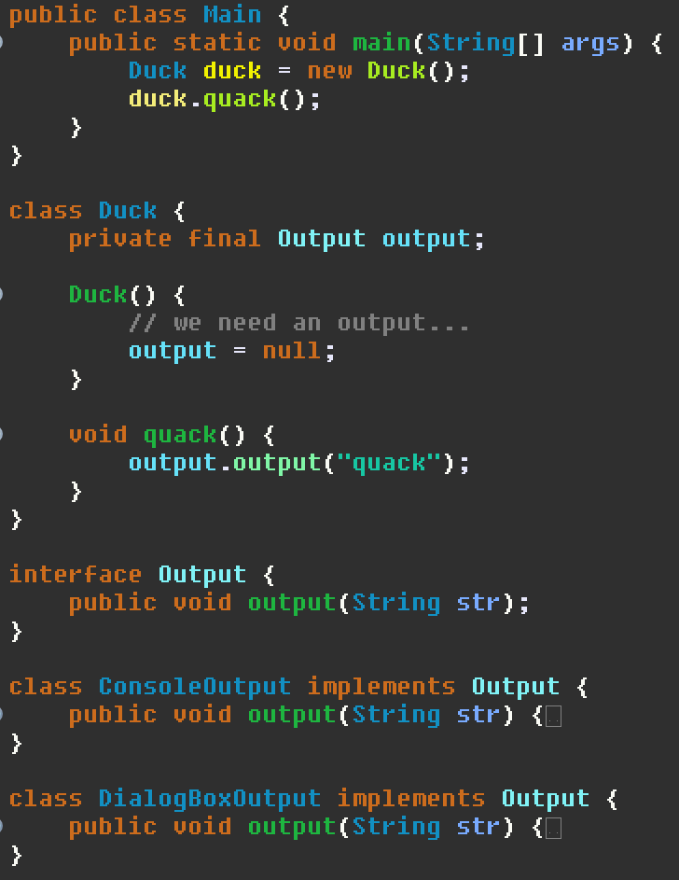
Setting the Stage
We want the duck to quack through an output
Multiple kinds of outputs
Console…
Dialog box…
The details are not important
We want to handle multiple output types- ducks are Agile
Watch the Duck class
Watch main

Slide 7
Without Injection

Slide 8
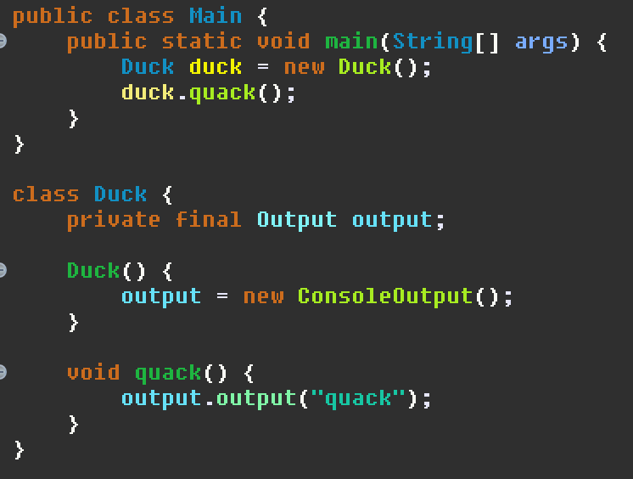
Direct Instantiation
Notes:
The dependency is hardcoded into the Duck class. No changing here.

Slide 9
Direct Instantiation
Hardcoded dependency
Directly coupled to the type we depend on
The dependency is directly created
What if we need to change it?
What if there are multiple constructors?

Slide 10
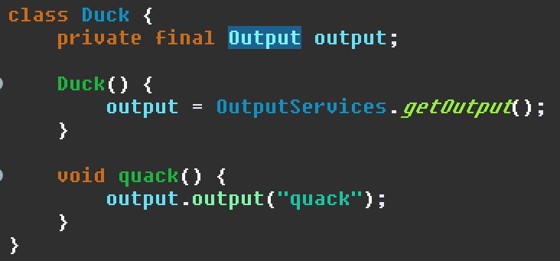
Factory Method
Notes:
We gain the dependency through a hardcoded call to a method. A layer of abstraction has been introduced; this is better, but Duck is still concerned with how to acquire the dependency. Arguably, in my opinion, this is enough for most situations. However, it still isn’t what we are here for.

Slide 11
Factory Method
Now the Duck class is not concerned with directly constructing an output
We can change the implementation by changing the factory method
Testing with a stub object now possible without changing Duck
We are still tightly coupled but to the factory class instead
Related: Service Locator pattern

Slide 12
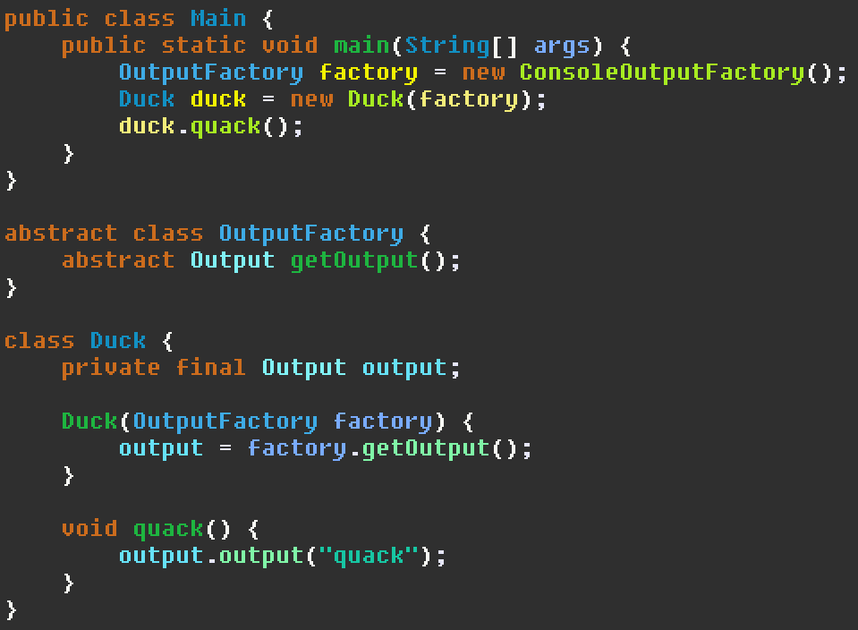
Factory Object
Notes:
Here we construct a factory object in main then pass it into the Duck via constructor. This is almost close to dependency injection proper, but the duck still has to construct the object it wanted to begin with via the factory.

Slide 13
Factory Object
The factory is now factored out
No longer dependent on a hardcoded reference to a factory method
We pass a factory to the constructor to change implementations
The dependence on the factory is now public API
Who creates the factory?
It is in main here, but it could be anywhere else
Duck still has a role in constructing the object
Why do not we just ask for the Output we originally wanted in the first place?
Notes:
Technically speaking, if it was the factory we wanted in the first place, this would be an example of dependency injection. However, that we only use it for constructing the object we really want disqualifies it.

Slide 14
Dependency Injection

Slide 15
Dependency Injection
Constructor Injection
Setter Injection
Derivative types
Method Injection
Interface Injection
Notes:
The most important types of dependency injection are constructor and setter injection. Method injection is a variation of constructor injection, and interface injection is a variation of setter injection. That does not mean they are any less important, even though for the most part they are not too different from the forms they are based on.

Slide 16
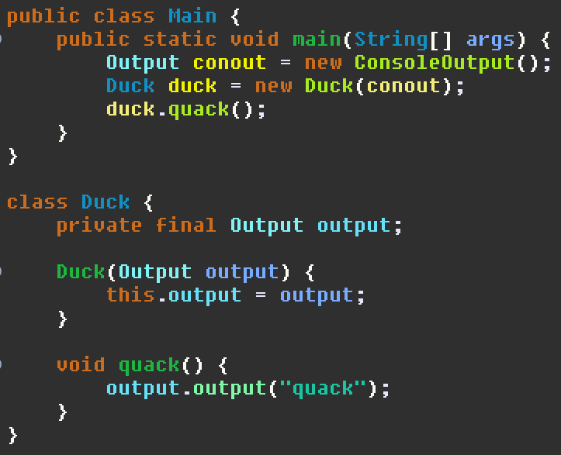
Constructor Injection
Notes:
Here we construct our output at the start, then pass it into the Duck object. The duck gets an output without having to care about how it acquired it. Users of the duck also know they need to supply that dependency.

Slide 17
Constructor Injection
Receive the dependency directly through the constructor
Yes, it really is that simple.
Who makes it? The duck class does not need to know
Ensures dependency is present before object is used
No longer coupled to an output implementation nor a way of acquiring that implementation
Notice that the client did not invoke any construction or acquisition code
This is what differentiates injection from the Factory Object example
Notes:
Like before, if we really wanted to inject a factory, then the factory object example would have counted as constructor injection.

Slide 18
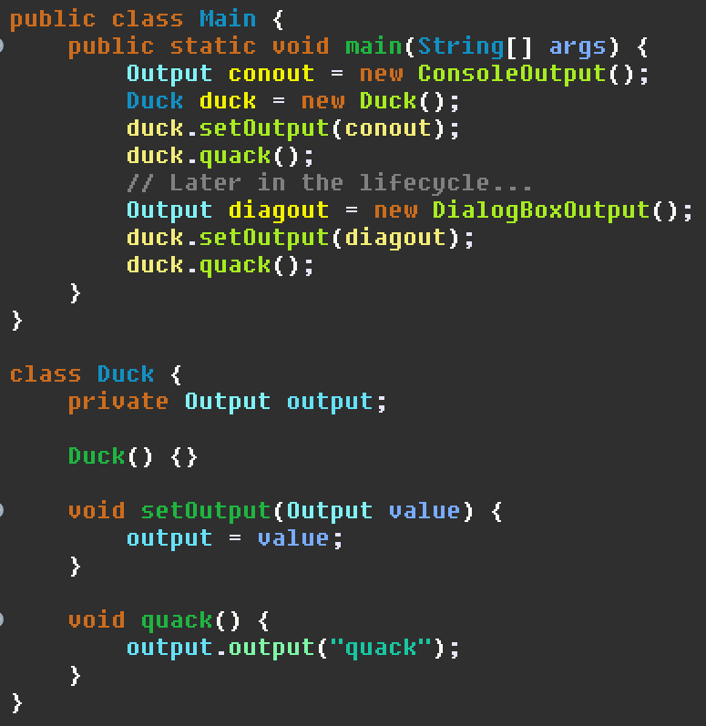
Setter Injection
Notes:
In setter injection, the dependency is injected by invoking a setter method. It could also be a field, but that is not important right now.

Slide 19
Setter Injection
Have the dependency passed into the class via a dedicated setter
Yes, it really is that simple.
Dependencies can be switched out any time
Sophisticated systems could switch functionality off by passing a stub object
Better able to handle optional dependencies
As in “you must handle that case”
What happens if nothing injects the dependency?

Slide 20
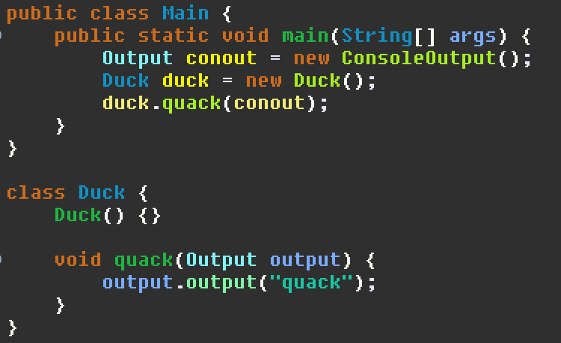
Method Injection
Notes:
In method injection, the dependency is passed as a method argument to only the methods that need it. Yes, really.

Slide 21
Method Injection
Pass the dependency to method calls that use it
In other words, passing an object as an argument
Useful for transient uses of dependencies
Can be seen as a one-shot variation of constructor injection
Opinion: This is not dependency injection, but it sometimes is referred to anyway since semantically it might as well be the case
Notes:
I do not personally count this as a type of dependency injection, but it does sometimes show up. Granted, it still fulfils the spirit of dependency injection, but it’s just a method call. I doubt anyone would notice it as a DI pattern as opposed to just calling a method with object parameters that just happen to be so-called dependencies. Are not software patterns wonderful?

Slide 22
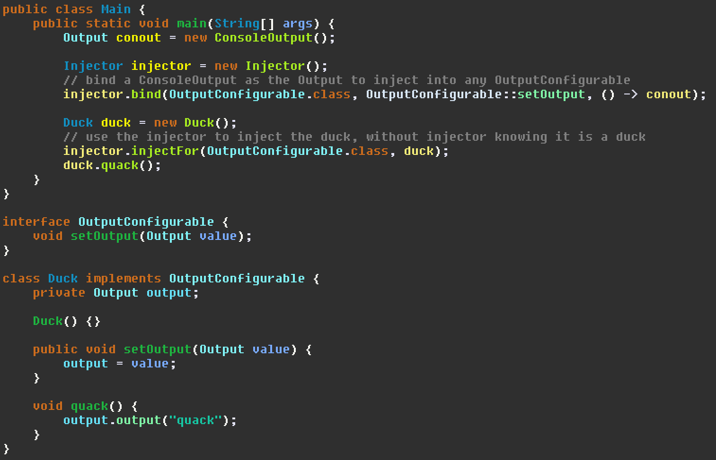
Interface Injection
Notes:
The most complicated but also the most potentially useful, interface injection puts the setter methods on an interface. Injectors do not have to know their clients anymore to inject services into them. Do not worry about the injector.bind syntax- usually there’s a framework and it’s much less syntactically intimidating. (That’s what I get for making the injector myself as an example)

Slide 23
Interface Injection
Clients implement an interface that declares the setter method used to inject into itself
An abstraction over setter injection, inheriting its benefits and drawbacks
Injectors no longer need to know the type of the client they inject into
Functionality for injecting types can be factored out
Mass injection for switching services
Accounting
Injection frameworks!
In practice, the interface might be metadata or a convention
Notes:
The Spring Framework uses interface injection. The items to inject are given metadata known as Java annotations. It helps that there is a convention of Java objects called beans where setters have standard names making it easier for frameworks to introspect objects.

Slide 24
Comparison
Constructor
Ensures dependencies are provided before use
Possible to fix dependencies to not be modifiable
Setter
Allows changing dependencies at runtime
Must ensure dependencies present before use or handle if missing
Method
Per-invocation configuration
Interface
Abstracts clients and injectors
Allows extra logic in the injection process
Extra injector functionality needed to be worthwhile over setter
Notes:
I like the idea of interface injection, but it is the most complex to use. If the logic for injection can be factored out and it is worthwhile to do so, it is probably the best technique here. Otherwise, I would probably prefer constructor injection if writing by hand.

Slide 25
Details

Slide 26
Determining What To Inject
Known as assembly
Objects are known as assemblers or injectors
In the preceding examples it was done by hand in main
This is perfectly acceptable for smaller systems
In practice, a framework will be used to automate it
Spring Framework
Guice
Configuration of injected objects is often external, such as XML
The framework handles construction of objects and injecting with no user injection code
Notes:
The interface interjection example is most similar to how frameworks handle it, but more automated and less hacked together.

Slide 27
Refactoring Code To Use Dependency Injection
Replace each new or service acquisition with a setter/constructor argument, moving the new up the chain
Repeat until the services are constructed/acquired in the main or entry point
At this point the entire service-client object graph is being constructed here
Make sure services are only instantiated once
Consider mapping service interfaces to implementations
Consider externalising the configuration at this point
Notes:
As dependency constructions are moved out of classes and up to the classes that instantiate them, eventually they all have to come from somewhere- the entry point. Once DI is successfully applied, the entry point will be responsible for constructing the entire object graph of services and clients. Once that is done, you could leave it as is or turn it into a kind of framework. With that, you could load/save the configuration to a file if you wanted.

Slide 28
Disadvantages
Complex object graphs have to be constructed at startup
Larger abstraction overhead in smaller projects
“Where did my dependency come from?”
Large distance between time of creation and use = potential bugs
Classes cannot self-configure with default dependencies
Self-configuration is what DI is intended to avoid!
Especially an issue when reasonable defaults exist
Can potentially hurt readability
In some languages, hinders compiler optimisations
Compiler might not know if the implementation is fixed since there is an abstraction in the way
Notes:
Do not blindly dependency inject everything just because you can. For every class using DI, some of the construction cost of a class is passed up to whatever instantiates it. At some point, someone must just construct something. That will all go to your application entry point or it’ll be hidden in whatever framework you use. Simplicity, the art of maximising the amount of work not done, is essential. If you do not need DI, you do not need it. If a factory would work better (in my opinion a factory is good enough most of the time), use that.

Slide 29
Conclusion
Dependency injection decouples object dependencies from how they are created
Dependency injection permits objects to not be concerned with how to acquire their dependencies
Multiple methods to perform dependency injection: constructor, setter, method, interface
Classes are easier to test
Dependencies are made explicit in API
Classes can support multiple configurations
Configuration can be kept in a single place

